Slide 1
FINAL PROJECT COMPUTER VISION
Content based image retrieval citra daun
Kelompok 6
Devira wiena p | Hariyanto | Gian sebastian a
Nanang taufan | Syah dia Putri

Slide 2
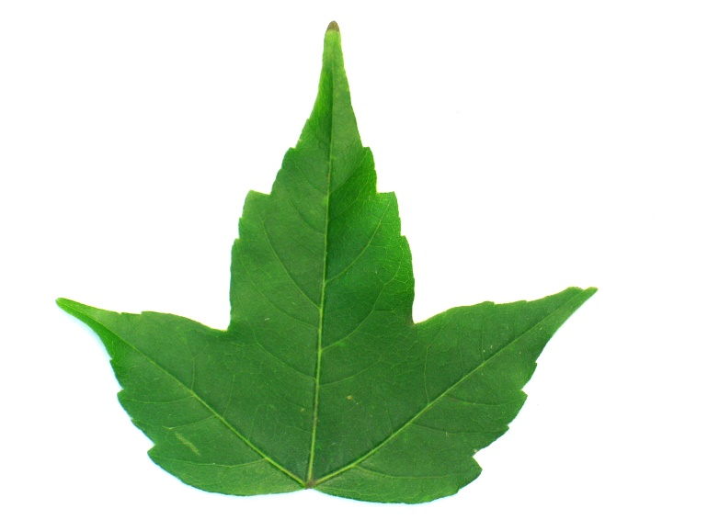
DataSET
1. Data gambar daun sebanyak 300 citra daun
2. Terdiri atas 10 kelas → Jenis Daun {1,2,...,10}
3. Ukuran gambar 1600 x 1200
CONTOH DATA GAMBAR
Notes:
NANANG

Slide 3

Data Training & Testing
Data Flavia
Sumber : http://flavia.sourceforge.net
Data Corpus
Data Query (30 data)
Dissimilarity Measurement

Slide 4
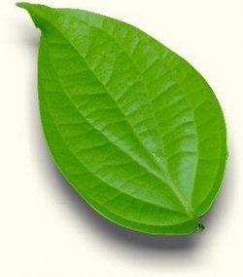

Alur sistem
SYSTEM
USER
INPUT
Feature Extraction
Feature Extraction
Feature Selection
Dissimilarity Measurement
Feature Selection
Evaluation
Notes:
DHEA

Slide 5


Skema Pre-processing
Memisahkan foreground dan background
Ekstraksi Fitur Warna
Ekstraksi Fitur Bentuk
Seleksi Fitur
Feature vector
Ekstraksi Fitur Tekstur

Slide 6
Pre-processing
Inisialisasi array untuk menampung background pixel, lalu digunakan metode thresholding dengan threshold nilai Blue > 60 untuk mengambil background pixel
v=zeros(1200,1600);
for i=1:1200
for j=1:1600
if B(i,j) > 60
v(i,j)=1;
end
end
end
Membaca data training, kemudian di ekstrasi nilai RGB-nya
source =
strcat('.\Leaves\', num2str(k), '.jpg' );
img = imread(source);
R = img(:,:,1);
G = img(:,:,2);
B = img(:,:,3);

Slide 7
Membuat Binary Image
b = logical(not(v));
Mengisi lubang (holes) pada Binary Image dengan nilai dari foreground pixel
b = imfill(b, 'holes');

Slide 8
Ekstraksi Fitur
EKSTRAKSI FITUR
Ekstraksi fitur bentuk
slimness, form factor/roundness, rectangularity, narrow factor, rasio antara keliling dan diameter, dan rasio antara keliling dan panjang serta lebar daun
Ekstraksi fitur warna
menggunakan model warna RGB yang akan didapatkan nilai mean, skewness dan kurtosis dari masing-masing channel R, G dan B
Ekstraksi fitur tekstur
menggunakan gliding box lacunarity
Notes:
NANANG

Slide 9
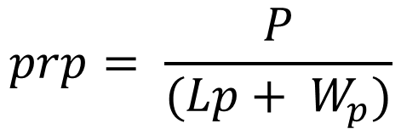

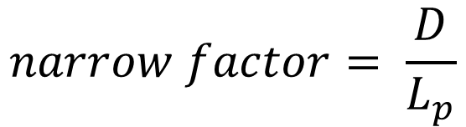
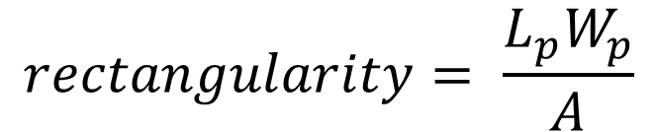

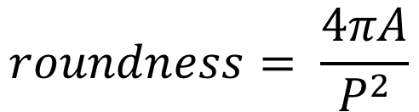
EKSTRAKSI FITUR BENTUK
$$slimness= \frac{Lp}{Wp}$$
$$roundness= \frac{4πA}{P^{2}}$$
$$narrow factor= \frac{D}{L_{p}}$$
$$prp= \frac{P}{(Lp+ W_{p})}$$
Keterangan
Lp = panjang daun
Wp = lebar daun
A = luas area daun
P = keliling daun
D = diameter daun
$$rectangularity= \frac{L_{p}W_{p}}{A}$$
$$rpd= \frac{P}{D}$$
Notes:
GIAN

Slide 10
EKSTRAKSI FITUR BENTUK (code)
Menghitung parameter seperti Area, Perimeter, Diameter, Panjang dan Lebar dari Objek pada Binary Image
results=regionprops(b,'Area','Perimeter','EquivDiameter','MajorAxisLength','MinorAxisLength');
Ekstraksi fitur bentuk
arrPanjang = arrayfun(@(struct)max(struct.MajorAxisLength(:)),results);
panjang = max(arrPanjang(:));
arrLebar = arrayfun(@(struct)max(struct.MinorAxisLength(:)),results);
lebar = max(arrLebar(:));
arrDiameter = arrayfun(@(struct)max(struct.EquivDiameter(:)),results);
diameter = max(arrDiameter(:));
arrArea = arrayfun(@(struct)max(struct.Area(:)),results);
area = max(arrArea(:));
arrPerimeter = arrayfun(@(struct)max(struct.Perimeter(:)),results);
perimeter = max(arrPerimeter(:));

Slide 11


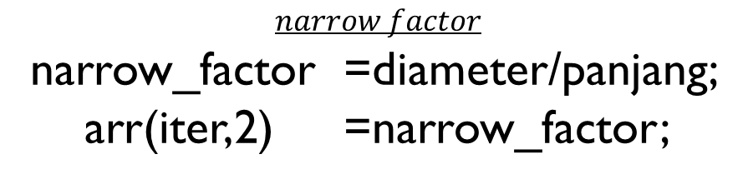

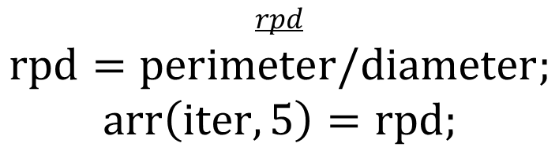

EKSTRAKSI FITUR BENTUK (code)
$$slimness$$
slimness = panjang/lebar;
arr(iter,1) =slimness;
$$roundness$$
roundness =(4*pi*area)/perimeter^2;
arr(iter,4) =roundness;
$$narrow factor$$
narrow_factor =diameter/panjang;
arr(iter,2) =narrow_factor;
$$prp$$
prp =perimeter/(panjang+lebar);
arr(iter,6)=prp;
$$rectangularity$$
rectangularity = (panjang*lebar)/area;
arr(iter,3) = rectangularity;
$$rpd$$
$$rpd=perimeter/diameter;$$
$$arr\left(iter,5\right)=rpd;$$
Notes:
GIAN

Slide 12

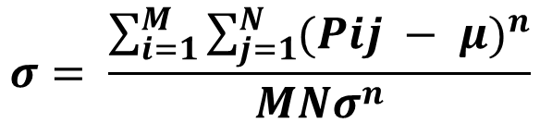
EKSTRAKSI FITUR WARNA
Mean
Skewness dan Kurtosis
$$μ= \frac{1}{MN} \sum_{i=1}^{M}{\sum_{j=1}^{N}{Pij}}$$
Keterangan
Pij = nilai piksel
M = panjang piksel
N = lebar piksel
σ = standar deviasi
Rata-rata nilai piksel pada masing-masing channel R, G dan B
$$σ= \frac{\sum_{i=1}^{M}{\sum_{j=1}^{N}{{(Pij − μ)}^{n}}}}{MNσ^{n}}$$
Skewness adalah derajat ketidaksimetrisan suatu distribusi (n = 3) Kurtosis adalah derajat keruncingan suatu distribusi (n = 4)
Dilakukan pada masing-masing channel warna
Notes:
GIAN

Slide 13
EKSTRAKSI FITUR warna - MEAN (code)
Merubah nilai background image menjadi black (0) menggunakan filter mask
mask = uint8(not(v));
im_new = img .* repmat(mask, [1,1,3]);
Mengambil nilai masing masing chanel Red Green dan Blue dari citra
red=im_new(:,:,1);
green=im_new(:,:,2);
blue=im_new(:,:,3);

Slide 14
EKSTRAKSI FITUR warna - MEAN (code)
Menentukan mean dari channel red, green dan blue citra input
iter_red = 0;
sum_red = 0.0;
iter_green = 0;
sum_green = 0.0;
iter_blue = 0;
sum_blue = 0.0;
for i=1:1200
for j=1:1600
if red(i,j) > 0
sum_red = sum_red + double(red(i,j));
iter_red = iter_red + 1;
end
if green(i,j) > 0
sum_green = sum_green + double(green(i,j));
iter_green = iter_green + 1;
end
if blue(i,j) > 0
sum_blue = sum_blue + double(blue(i,j));
iter_blue = iter_blue + 1;
end
end
end
2
1

Slide 15
EKSTRAKSI FITUR warna - MEAN (code)
Mean dari channel red, green dan blue
mean_red = sum_red/iter_red;
arr(iter,7)=mean_red;
mean_green = sum_green/iter_green;
arr(iter,8)=mean_green;
mean_blue = sum_blue/iter_blue;
arr(iter,9)=mean_blue;

Slide 16
EKSTRAKSI FITUR warna – SKEWNESS & KURTOSIS (code)
Menentukan skewness dan kurtosis dari channel red, green dan blue citra input
pangkat2_red = 0; pangkat3_red = 0; pangkat4_red = 0;
pangkat2_green = 0; pangkat3_green = 0; pangkat4_green = 0;
pangkat2_blue = 0; pangkat3_blue = 0; pangkat4_blue = 0;
for i=1:1200
for j=1:1600
if red(i,j) > 0
temp_red = double(red(i,j)) - mean_red;
pangkat2_red = pangkat2_red + (temp_red^2);
pangkat3_red = pangkat3_red + (temp_red^3);
pangkat4_red = pangkat4_red + (temp_red^4);
end
if green(i,j) > 0
temp_green = double(green(i,j)) - mean_green;
pangkat2_green = pangkat2_green + (temp_green^2);
pangkat3_green = pangkat3_green + (temp_green^3);
pangkat4_green = pangkat4_green + (temp_green^4);
end
if blue(i,j) > 0
temp_blue = double(blue(i,j)) - mean_blue;
pangkat2_blue = pangkat2_blue + (temp_blue^2);
pangkat3_blue = pangkat3_blue + (temp_blue^3);
pangkat4_blue = pangkat4_blue + (temp_blue^4);
end
end
end
2
1

Slide 17
EKSTRAKSI FITUR warna – SKEWNESS & KURTOSIS (code)
Skewness dan kurtosis dari channel red, green dan blue
skewness_red = (pangkat3_red / iter_red) / (S_red^3);
kurtosis_red = (pangkat4_red / iter_red) / (S_red^4);
arr(iter,10)=skewness_red;
arr(iter,13)=kurtosis_red;
skewness_green = (pangkat3_green / iter_green) / (S_green^3);
kurtosis_green = (pangkat4_green / iter_green) / (S_green^4);
arr(iter,11)=skewness_green;
arr(iter,14)=kurtosis_green;
skewness_blue = (pangkat3_blue / iter_blue) / (S_blue^3);
kurtosis_blue = (pangkat4_blue / iter_blue) / (S_blue^4);
arr(iter,12)=skewness_blue;
arr(iter,15)=kurtosis_blue;
Standar deviasi dari channel red, green dan blue
S_red = sqrt(double(pangkat2_red / iter_red));
S_green = sqrt(double(pangkat2_green / iter_green));
S_blue = sqrt(double(pangkat2_blue / iter_blue));

Slide 18
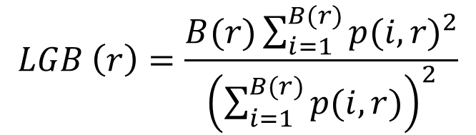
Gliding Box Lacunarity
Penghitungan dimensi fraktal (berapa banyak ruang yang terisi data) dari area-area berbentuk kotak yang merupakan bagian dari gambar
Ket :
B(r) = kotak berukuran r, dimana r = 2
p = banyak titik pada kotak tersebut
$$LGB \left(r\right)=\frac{B(r)\sum_{i=1}^{B(r)}{{p(i,r)}^{2}}}{{\left(\sum_{i=1}^{B(r)}{p(i,r)}\right)}^{2}}$$
Notes:
GIAN

Slide 19
EKSTRAKSI FITUR tekstur – gliding box lacunarity (code)
[rows, cols] = size(b);
r = 2; edge = 1; finish = rows - edge;
jumlah_kotak = power(finish,2); sigma_fraktal = 0.0; sigma2_fraktal = 0.0;
for i=1:finish
for j=1:finish
sums = sum(sum(b(i:i+edge,j:j+edge)));
sigma_fraktal = sigma_fraktal + sums;
sigma2_fraktal = sigma2_fraktal + power(sums,2);
end
end
GBL = (jumlah_kotak*sigma2_fraktal)/(power(sigma_fraktal,2));
arr(iter,16)=GBL;
iter = iter + 1;
%dlmwrite('test4.csv', arr(2:end,:), '-append') ;

Slide 20
Feature selection
Correlation based Feature Selection (CFS)
Notes:
HARI

Slide 21
Correlation based Feature Selection (CFS)
[Feature vector]
Kombinasi fitur
Korelasi dalam kombinasi dengan RELIEF
Perhitungan Merits per fitur
Merits > Threshold
[Feature vector]

Slide 22
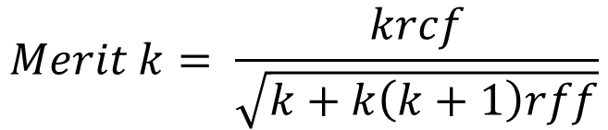
Correlation based Feature Selection (CFS)
Menentukan pasangan fitur
Menentukan bobot fitur dengan algoritma RELIEF
Algoritma CFS
Hitung nilai korelasi antar-fitur & fitur-kelas dengan RELIEF (menghitung weight feature)
Merit → himpunan fitur yg berkorelasi tinggi dengan kelas but tidak berkorelasi dengan fitur lain
CFS dapat dihitung dari pengembangan merit → nilai merit terbaik (paling besar)
$$Merit k= \frac{krcf}{\sqrt{k+k\left(k+1\right)rff}}$$
Notes:
VIRA

Slide 23
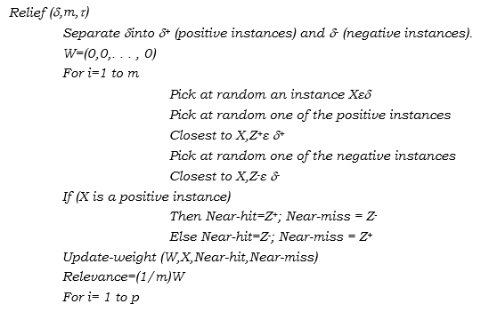
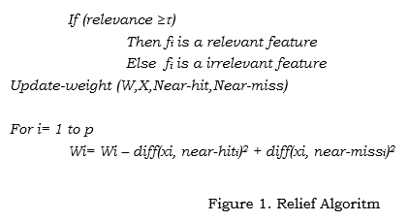
ALGORITMA RELIEF
2
1
Notes:
VIRA

Slide 24
CFS code
function correlationFeatureSelection = featureSelection()
filename = 'fitur.csv';
arr = csvread(filename);
correlationFitur(16,16) = 0;
for i=1:16
iter=1;
for j=i+1:16
[ranked,weight] = relieff(arr(:,i), arr(:,j),10);
correlationFitur(i,iter) = abs(weight);
iter = iter+1;
end
end
correlationClass(16,1)=0;
for x=1:16
[ranked,weight] = relieff(arr(:,x), arr(:,17), 10);
correlationClass(x) = abs(weight);
end
rii(16,1)=0; %untung simpan rata-rata korelasi per fitur
iter=1;
for x=16:-1:1
rii(iter) = sum(correlationFitur(iter,:))/x;
iter=iter+1;
end
rzc(16,2) = 0;
k = 16;
rzi = sum(correlationClass)/16;
for a=1:16
rzc(a,1) = (k*correlationClass(a))/sqrt((k+k*(k-1)*rii(a)));
%rzc(a,1) = (k*rzi)/sqrt((k+k*(k-1)*rii(a)));
rzc(a,2) = a;
end
[values, order] = sort(rzc(:,1));
sortedMatrix = rzc(order,:);
fiturTerpilih(9) = 0;
flag = 1;
for f=1:16
if sortedMatrix(f,1) > 0.005
fiturTerpilih(flag)=sortedMatrix(f,2);
flag = flag+1;
end
end
correlationFeatureSelection = fiturTerpilih;
end
1
2
Notes:
VIRA

Slide 25
Measurement of Dissimilarity
Mahalanobis
Notes:
HARI

Slide 26


MAHALANOBIS
Menghitung jarak antara x dan y dengan menyertakan covarience matrix (C)
$$d_{st}^{2}=\left(X_{s} − Y_{t}\right)C^{−1}(X_{s}−Y_{t})′$$
Keterangan :
C = Covariance Matrix
$X_{s}$ = Vektor Pertama
$Y_{t}$ = Vektor Kedua
$d_{st}^{2}$ = Kuadrat dari jarak mahalanobis
Notes:
VIRA

Slide 27
MAHALANOBIS CODe
function [sortedRankMahalanobis, sortedRankEuclidean, sortedRankCanberra] = distance_similiarity(array_training, array_testing, ind, d)
%array yang menampung nilai mahalanobis distance beserta label classnya
array_mahalanobis(300,3) = 0.0;
%array yang menampung nilai euclidean distance beserta label classnya
array_euclidean(300,3) = 0.0;
%array yang menampung nilai canberra distance beserta label classnya
array_canberra(300,3) = 0.0;
for i = 1:300
%covariance dari array_training ke-i
S = cov(array_training(i,1:d));
%menghitung mahalanobis distance antara data testing dengan himpunan hasil training
mahalanobis = ((array_testing(ind,1:d) - array_training(i,1:d))*(array_testing(ind,1:d) - array_training(i,1:d))')/S;
%menghitung euclidean distance antara data testing dengan himpunan hasil training
euclidean = sqrt(sum((array_testing(ind,1:d) - array_training(i,1:d)).^2));
%menghitung canberra distance antara data testing dengan himpunan hasil training
canberra = sum(abs(array_testing(ind,1:d) - array_training(i,1:d))./(abs(array_testing(ind,1:d)) + abs(array_training(i,1:d))));
array_mahalanobis(i,1) = mahalanobis;
array_mahalanobis(i,2) = array_training(i,d+1);
array_mahalanobis(i,3) = i + 1000;
array_euclidean(i,1) = euclidean;
array_euclidean(i,2) = array_training(i,d+1);
array_euclidean(i,3) = i + 1000;
array_canberra(i,1) = canberra;
array_canberra(i,2) = array_training(i,d+1);
array_canberra(i,3) = i + 1000;
end
%array disort berdasarkan nilai mahalanobis distance terendah
[values, order] = sort(array_mahalanobis(:,1));
sortedRankMahalanobis = array_mahalanobis(order,:);
%array disort berdasarkan nilai euclidean distance terendah
[values, order] = sort(array_euclidean(:,1));
sortedRankEuclidean = array_euclidean(order,:);
%array disort berdasarkan nilai canberra distance terendah
[values, order] = sort(array_canberra(:,1));
sortedRankCanberra = array_canberra(order,:);
end
1
2

Slide 28
Pengujian dan hasil
%Akurasi, Presisi dan Recall ketika menggunakan Mahalanobis no CFS
TP=0;
FP=0;
FN=0;
TN=0;
for index=1:5
if (rankMahalanobis(index,2) == array_testing(ind,17))
TP = TP + 1
else
FP = FP + 1
end
%img = strcat('.\Training\', num2str(rankMahalanobis(index,3)), '.jpg' );
%imshow(img);
end
FN = FP;
TN = 300-TP-FP-FN;
akurasi = ((TP+TN)/300)*100;
presisi = (TP/(TP+FP))*100;
recall = (TP/(TP+FN))*100;
fprintf('True Positive (Mahalanobis no CFS): %i\n', TP);
fprintf('True Negative (Mahalanobis no CFS): %i\n', TN);
fprintf('False Positive (Mahalanobis no CFS): %i\n', FP);
fprintf('False Negative (Mahalanobis no CFS): %i\n', FN);
fprintf('Akurasi (Mahalanobis no CFS): %i\n', akurasi);
fprintf('Presisi (Mahalanobis no CFS): %i\n', presisi);
fprintf('Recall (Mahalanobis no CFS): %i\n', recall);

Slide 29
Pengujian dan hasil
 | MAHANALOBIS NO CFS |  |  | EUCLIDEAN NO CFS |  |  | CANBERRA NO CFS |  |  | MAHANALOBIS WITH CFS |  |  | EUCLIDEAN WITH CFS |  |  | CANBERRA WITH CFS
DATA TEST | Acc | Precis | Recall | Acc | Precis | Recall | Acc | Precis | Recall | Acc | Precis | Recall | Acc | Precis | Recall | Acc | Precis | Recall
1301 | 96 | 0 | 0 | 96 | 0 | 0 | 97 | 20 | 20 | 96 | 0 | 0 | 96 | 0 | 0 | 99 | 80 | 80
1304 | 98 | 40 | 40 | 98 | 40 | 40 | 98 | 60 | 60 | 98 | 40 | 40 | 98 | 40 | 40 | 99 | 80 | 80
1307 | 100 | 100 | 100 | 100 | 100 | 100 | 100 | 100 | 100 | 100 | 100 | 100 | 100 | 100 | 100 | 100 | 100 | 100
1310 | 100 | 100 | 100 | 100 | 100 | 100 | 99 | 80 | 80 | 100 | 100 | 100 | 99 | 80 | 80 | 99 | 80 | 80
1313 | 100 | 100 | 100 | 100 | 100 | 100 | 100 | 100 | 100 | 100 | 100 | 100 | 100 | 100 | 100 | 100 | 100 | 100
1316 | 98 | 40 | 40 | 98 | 40 | 40 | 99 | 80 | 80 | 97 | 20 | 20 | 97 | 20 | 20 | 98 | 60 | 60
1319 | 99 | 80 | 80 | 99 | 80 | 80 | 99 | 80 | 80 | 98 | 60 | 60 | 98 | 60 | 60 | 98 | 60 | 60
1322 | 99 | 80 | 80 | 99 | 80 | 80 | 98 | 60 | 60 | 98 | 40 | 40 | 98 | 40 | 40 | 98 | 60 | 60
1325 | 99 | 80 | 80 | 99 | 80 | 80 | 98 | 60 | 60 | 98 | 60 | 60 | 98 | 60 | 60 | 98 | 60 | 60
1328 | 100 | 100 | 100 | 100 | 100 | 100 | 100 | 100 | 100 | 99 | 80 | 80 | 99 | 80 | 80 | 100 | 100 | 100
Kesimpulan
CFS dapat membantu mengurangi waktu jalan program dengan performa yang tidak jauh berbeda dengan CIBR full feature.

Slide 30
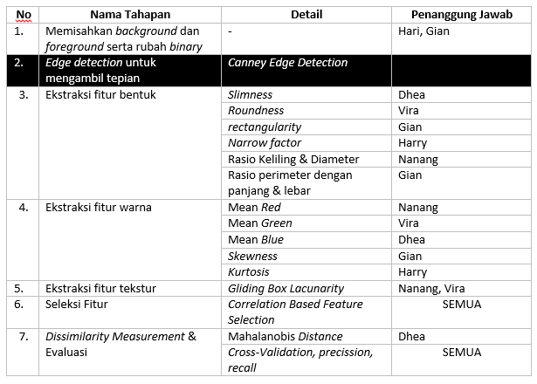
Pembagian tugas

Slide 31


