Slide 1
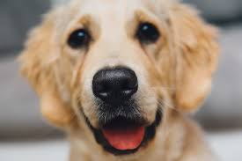
Convolutional Neural Network
Fully connected neural network can bring us too much parameters.
Some patterns are much smaller than the whole image.

Slide 2
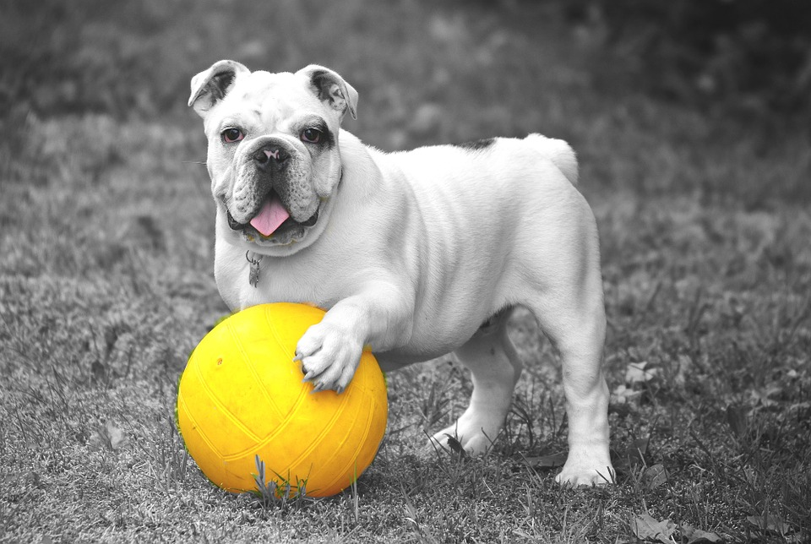
CNN
2) The same pattern appears in different regions.

Slide 3
CNN
3) Subsampling the pixels will not change the object.

Slide 4
CNN
The whole Convolutional neural network:
Convolution
Max Pooling
Flatten
Max Pooling
Convolution
Fully connected forward network

Slide 5
CNN
How does convolution work?
1 | -1 | -1
-1 | 1 | -1
-1 | -1 | 1
Filter
Stride = 1
1 | 0 | 0 | 0 | 0 | 1
0 | 1 | 0 | 0 | 1 | 0
0 | 0 | 1 | 1 | 0 | 0
1 | 0 | 0 | 0 | 1 | 0
0 | 1 | 0 | 0 | 1 | 0
0 | 0 | 1 | 0 | 1 | 0
3
-1
-3
-1
-3
1
0
-3
-3
-3
0
1
3
-2
-2
-1

Slide 6
CNN
How does convolution work?
1 | -1 | -1
-1 | 1 | -1
-1 | -1 | 1
Filter
Stride = 1
1 | 0 | 0 | 0 | 0 | 1
0 | 1 | 0 | 0 | 1 | 0
0 | 0 | 1 | 1 | 0 | 0
1 | 0 | 0 | 0 | 1 | 0
0 | 1 | 0 | 0 | 1 | 0
0 | 0 | 1 | 0 | 1 | 0
3
-1
-3
-1
-3
1
0
-3
-3
-3
0
1
3
-2
-2
-1

Slide 7
CNN
How does convolution work?
1 | -1 | -1
-1 | 1 | -1
-1 | -1 | 1
-1 | 1 | -1
-1 | 1 | -1
-1 | 1 | -1
2nd
filter
Stride = 1
1 | 0 | 0 | 0 | 0 | 1
0 | 1 | 0 | 0 | 1 | 0
0 | 0 | 1 | 1 | 0 | 0
1 | 0 | 0 | 0 | 1 | 0
0 | 1 | 0 | 0 | 1 | 0
0 | 0 | 1 | 0 | 1 | 0
3
-1
-3
-1
-1
-1
-1
-1
-3
1
0
-3
-1
-1
-2
1
-3
-3
0
1
-1
-1
-2
1
3
-2
-2
-1
-1
0
-4
3
Feature map

Slide 8
CNN
Connection between CNN and Fully Connected Neural Network.
1st
2nd
3rd
…
7th
8th
9th
…
13th
14th
15th
…
1
0
0
…
0
1
0
…
0
0
1
…
1 | -1 | -1
-1 | 1 | -1
-1 | -1 | 1
3
1 | 0 | 0 | 0 | 0 | 1
0 | 1 | 0 | 0 | 1 | 0
0 | 0 | 1 | 1 | 0 | 0
1 | 0 | 0 | 0 | 1 | 0
0 | 1 | 0 | 0 | 1 | 0
0 | 0 | 1 | 0 | 1 | 0
Only connect to 9 of the
Inputs, not fully connected

Slide 9
CNN
Connection between CNN and Fully Connected Neural Network.
1st
2nd
3rd
4th
…
8th
9th
…
13th
14th
15th
…
1
0
0
0
…
1
0
…
0
0
1
…
1 | -1 | -1
-1 | 1 | -1
-1 | -1 | 1
3
-1
1 | 0 | 0 | 0 | 0 | 1
0 | 1 | 0 | 0 | 1 | 0
0 | 0 | 1 | 1 | 0 | 0
1 | 0 | 0 | 0 | 1 | 0
0 | 1 | 0 | 0 | 1 | 0
0 | 0 | 1 | 0 | 1 | 0
Share weights

Slide 10
CNN
How does max pooling work?
1 | -1 | -1
-1 | 1 | -1
-1 | -1 | 1
-1 | 1 | -1
-1 | 1 | -1
-1 | 1 | -1
Filter 1
Filter 2
3
-1
-3
-1
-1
-1
-1
-1
-3
1
0
-3
-1
-1
-2
1
-3
-3
0
1
-1
-1
-2
1
3
-2
-2
-1
-1
0
-4
3

Slide 11
CNN
How does max pooling work?
1 | -1 | -1
-1 | 1 | -1
-1 | -1 | 1
-1 | 1 | -1
-1 | 1 | -1
-1 | 1 | -1
Filter 1
Filter 2
3
0
-1
1
1
3
0
3

Slide 12
CNN
After convolution and max pooling.
1 | 0 | 0 | 0 | 0 | 1
0 | 1 | 0 | 0 | 1 | 0
0 | 0 | 1 | 1 | 0 | 0
1 | 0 | 0 | 0 | 1 | 0
0 | 1 | 0 | 0 | 1 | 0
0 | 0 | 1 | 0 | 1 | 0
Smaller image 2x2
Convolution
3
0
-1
1
Max Pooling
3
1
0
3
Each filter is a channel

