Slide 1
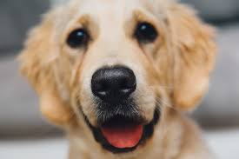
Convolutional Neural Network
Fully connected neural network can bring us too much parameters.
Some patterns are much smaller than the whole image.

Slide 2
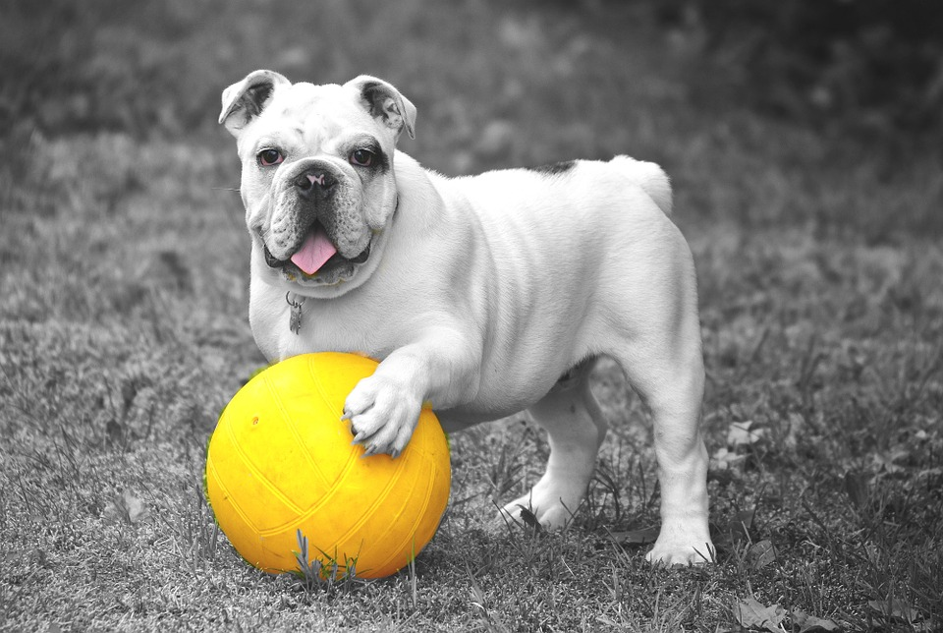
CNN
2) The same pattern appears in different regions.

Slide 3
CNN
3) Subsampling the pixels will not change the object.

Slide 4
CNN
The whole Convolutional neural network:
Convolution
Max Pooling
Flatten
Max Pooling
Convolution
Fully connected forward network

Slide 5
CNN
How does convolution work?
1 | -1 | -1
-1 | 1 | -1
-1 | -1 | 1
Filter
Stride = 1
1 | 0 | 0 | 0 | 0 | 1
0 | 1 | 0 | 0 | 1 | 0
0 | 0 | 1 | 1 | 0 | 0
1 | 0 | 0 | 0 | 1 | 0
0 | 1 | 0 | 0 | 1 | 0
0 | 0 | 1 | 0 | 1 | 0
3
-1
-3
-1
-3
1
0
-3
-3
-3
0
1
3
-2
-2
-1

Slide 6
CNN
How does convolution work?
1 | -1 | -1
-1 | 1 | -1
-1 | -1 | 1
Filter
Stride = 1
1 | 0 | 0 | 0 | 0 | 1
0 | 1 | 0 | 0 | 1 | 0
0 | 0 | 1 | 1 | 0 | 0
1 | 0 | 0 | 0 | 1 | 0
0 | 1 | 0 | 0 | 1 | 0
0 | 0 | 1 | 0 | 1 | 0
3
-1
-3
-1
-3
1
0
-3
-3
-3
0
1
3
-2
-2
-1

Slide 7
CNN
How does convolution work?
1 | -1 | -1
-1 | 1 | -1
-1 | -1 | 1
-1 | 1 | -1
-1 | 1 | -1
-1 | 1 | -1
2nd
filter
Stride = 1
1 | 0 | 0 | 0 | 0 | 1
0 | 1 | 0 | 0 | 1 | 0
0 | 0 | 1 | 1 | 0 | 0
1 | 0 | 0 | 0 | 1 | 0
0 | 1 | 0 | 0 | 1 | 0
0 | 0 | 1 | 0 | 1 | 0
3
-1
-3
-1
-1
-1
-1
-1
-3
1
0
-3
-1
-1
-2
1
-3
-3
0
1
-1
-1
-2
1
3
-2
-2
-1
-1
0
-4
3
Feature map

Slide 8
CNN
Connection between CNN and Fully Connected Neural Network.
1st
2nd
3rd
…
7th
8th
9th
…
13th
14th
15th
…
1
0
0
…
0
1
0
…
0
0
1
…
1 | -1 | -1
-1 | 1 | -1
-1 | -1 | 1
3
1 | 0 | 0 | 0 | 0 | 1
0 | 1 | 0 | 0 | 1 | 0
0 | 0 | 1 | 1 | 0 | 0
1 | 0 | 0 | 0 | 1 | 0
0 | 1 | 0 | 0 | 1 | 0
0 | 0 | 1 | 0 | 1 | 0
Only connect to 9 of the
Inputs, not fully connected

Slide 9
CNN
Connection between CNN and Fully Connected Neural Network.
1st
2nd
3rd
4th
…
8th
9th
…
13th
14th
15th
…
1
0
0
0
…
1
0
…
0
0
1
…
1 | -1 | -1
-1 | 1 | -1
-1 | -1 | 1
3
-1
1 | 0 | 0 | 0 | 0 | 1
0 | 1 | 0 | 0 | 1 | 0
0 | 0 | 1 | 1 | 0 | 0
1 | 0 | 0 | 0 | 1 | 0
0 | 1 | 0 | 0 | 1 | 0
0 | 0 | 1 | 0 | 1 | 0
Share weights

Slide 10
CNN
How does max pooling work?
1 | -1 | -1
-1 | 1 | -1
-1 | -1 | 1
-1 | 1 | -1
-1 | 1 | -1
-1 | 1 | -1
Filter 1
Filter 2
3
-1
-3
-1
-1
-1
-1
-1
-3
1
0
-3
-1
-1
-2
1
-3
-3
0
1
-1
-1
-2
1
3
-2
-2
-1
-1
0
-4
3

Slide 11
CNN
How does max pooling work?
1 | -1 | -1
-1 | 1 | -1
-1 | -1 | 1
-1 | 1 | -1
-1 | 1 | -1
-1 | 1 | -1
Filter 1
Filter 2
3
0
-1
1
1
3
0
3

Slide 12
CNN
After convolution and max pooling.
1 | 0 | 0 | 0 | 0 | 1
0 | 1 | 0 | 0 | 1 | 0
0 | 0 | 1 | 1 | 0 | 0
1 | 0 | 0 | 0 | 1 | 0
0 | 1 | 0 | 0 | 1 | 0
0 | 0 | 1 | 0 | 1 | 0
Smaller image 2x2
Convolution
3
0
-1
1
Max Pooling
3
1
0
3
Each filter is a channel

Slide 13
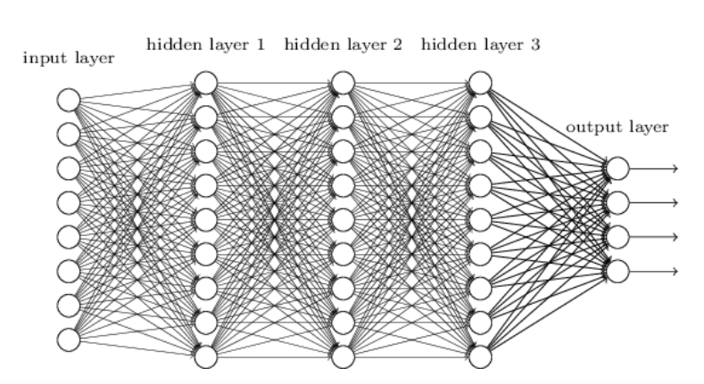
CNN
How does Flatten work?
3
0
3
3
0
-1
1
3
1
1
0
3
Flatten
-1
Fully connected forward network
1
0
3

Slide 14
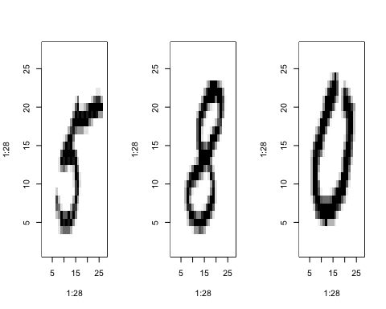
Example of CNN: MNIST
The MNIST dataset contains images of handwritten digits like below. Each image is 28 pixels by 28 pixels. It also includes labels for each image, telling us which digit it is. Next, we are going to train a model to look at images and predict which digits they are.

Slide 15

Tensorflow
About Tensorflow:
Tensorflow is an open source software library for numerical computation using data flow graphs. Nodes in the graph represent mathematical operations, which the graph edges represent the multidimensional data arrays (tensors) communicated between them.
It allows you to deploy computation to one or more CPUs or GPUs in d desktop, server, or mobile device with a single API. The Tensorflow package provide access to the complete Tensorflow API from within R.

Slide 16
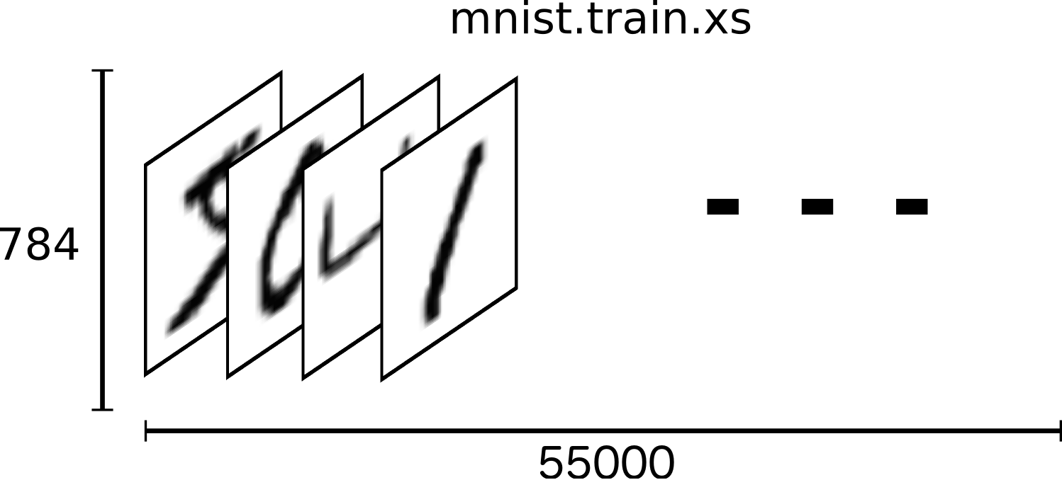
MNIST
mnist$train$image is a tensor (an n-dimensional array) with shape (55000L, 784L).

Slide 17
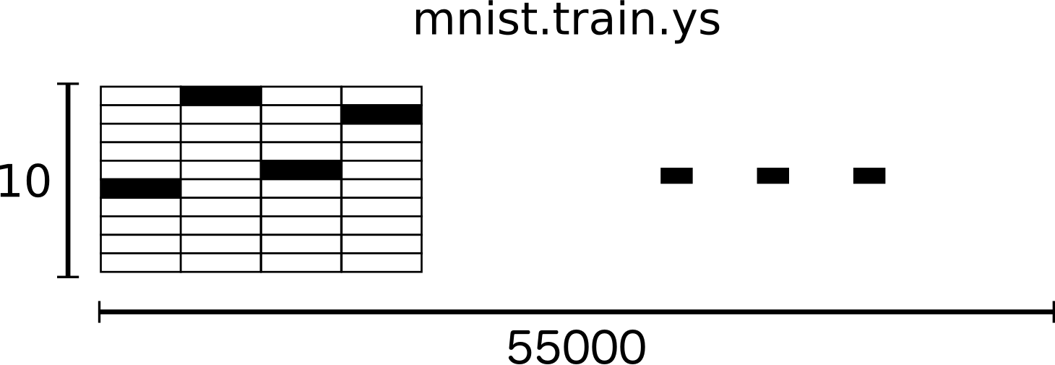
MNIST
The label is “one-hot vectors”.
For example, 3 would be [0,0,0,1,0,0,0,0,0,0]
mnist$train$labels is a tensor with shape (55000L, 10L).

Slide 18
MNIST
Why do we have 2 layers, not more?
Vanishing Gradient Problem→ Deeper does not usually imply better.
X1
… …
Y1
X2
… …
Y2
…
…
…
…
…
XN
… …
YN
Smaller gradients
Larger gradients
Almost Random
Already Converge

Slide 19
MNIST
Activation function: Rectified Linear Unit (ReLU)
a
a=z
Reason:
Fast to compute
Biological reason
Infinite sigmoid with different biases
Able to handle vanishing gradient problem
a=0
z

Slide 20
MNIST
Dropout: when you do training, each time before updating the parameters, each neuron has p% to dropout.
X1
…
…
…
…
…
…
XN
…
Thinner structure

Slide 21

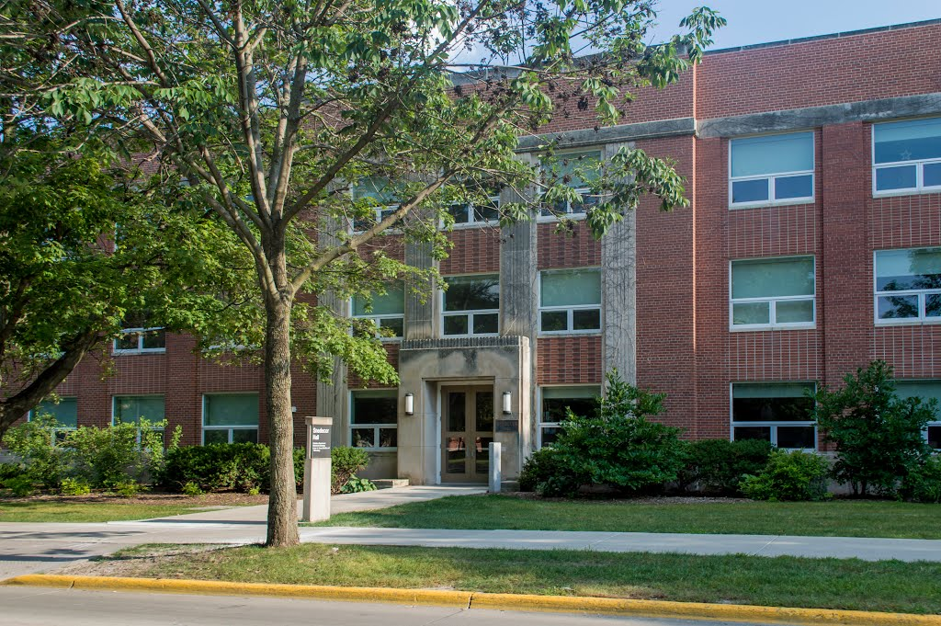
CNN
Style Transfer, A.K.A. Deep Style
Raymond Wong
Snedecor Hall
CNN
CNN
Content
CNN
Style

Slide 22
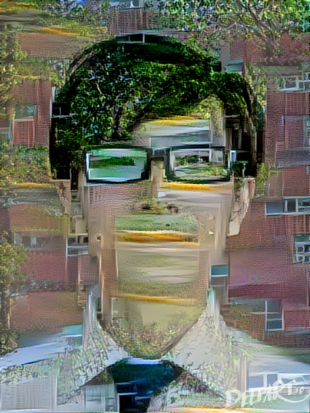
CNN
Style Transfer, A.K.A. Deep Style

Slide 23
CNN
Style Transfer, A.K.A. Deep Style
Thank you!
Good luck with your finals!

