Slide 1
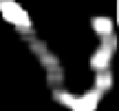
20
5x5x1
2x2
50
5x5x20
2x2
500
4x4x50
Softmaxloss
Feature maps
Max pooling
Feature maps
Max pooling
Feature maps
ReLu
Full w/ dropout
Full w/ dropout

Slide 2
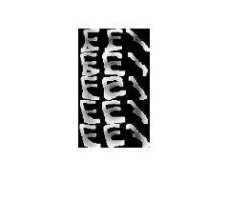
30
4x4x1
2x2
100
6x5x30
2x2
200
9x7x100
Softmaxloss
ReLu
12 Fully Connected
Feature maps
Max pooling
Feature maps
Max pooling
Feature maps
300 Fully Connected

Slide 3
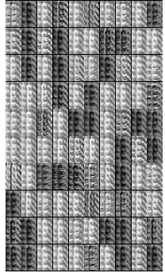
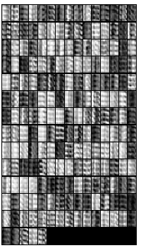
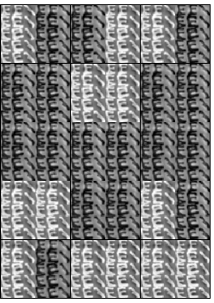
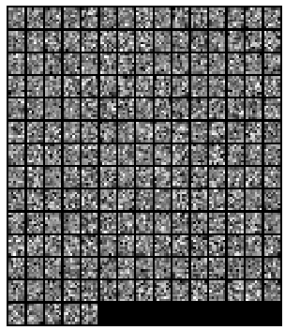
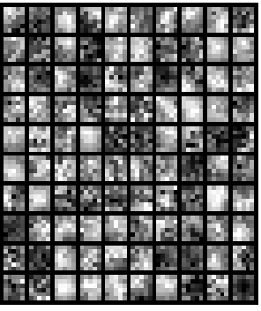
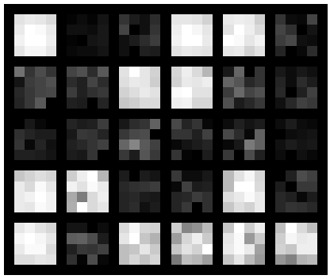
40 feature maps
Input
100 feature maps
200 feature maps
Filtered
Images
Filtered
Images
Input to fully connected NN

