Slide 1

Rajshahi University of Engineering & Technology
Heaven’s Light is Our Guide
Feature Mining for Effective Subspace Detection of Hyperspectral Image Classification
Presented By
Md. Tanvir Ahmed
Roll: 123086
Supervised by
Dr. Md. Ali Hossain
Assistant Professor
Department of CSE
July 15, 2017
Feature Mining for Effective Subspace Detection of Hyperspectral Image Classification

Slide 2
Outline
Remote Sensing
Hyperspectral Images
Objectives
Proposed Method
Feature Extraction
Classification
Conclusion
Future Work
References
Feature Mining for Effective Subspace Detection of Hyperspectral Image Classification

Slide 3
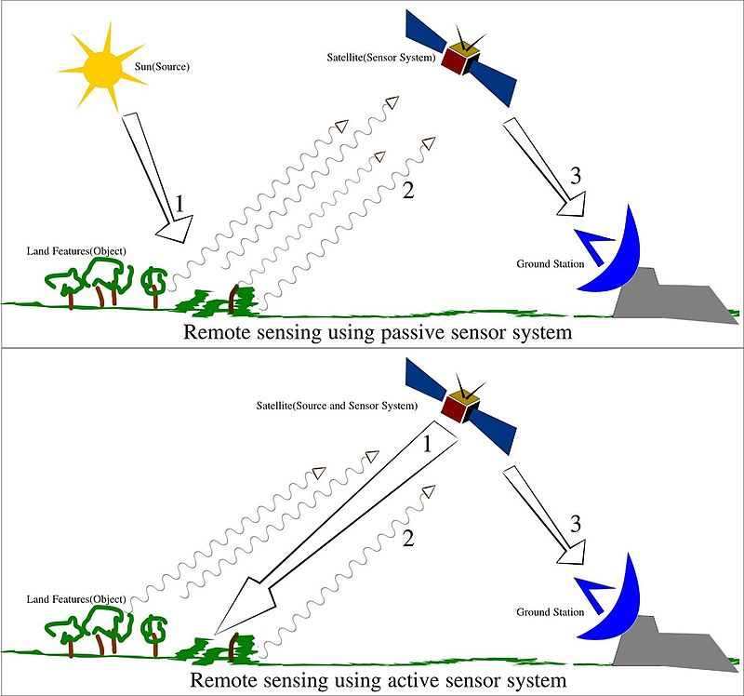
Remote Sensing
What is remote sensing?
Acquisition of information about an object
without making physical contact with the object
Used in geography, land surveying, military,
intelligence and planning
Types:
Passive Remote Sensing
Active Remote Sensing
Feature Mining for Effective Subspace Detection of Hyperspectral Image Classification

Slide 4
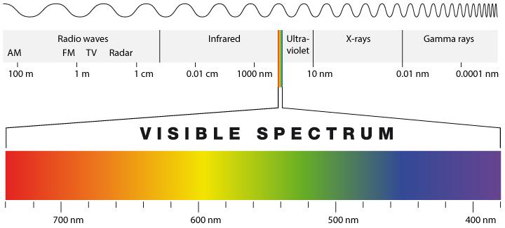
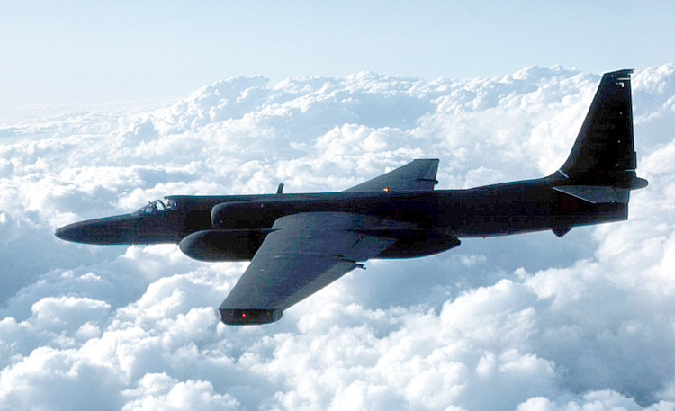
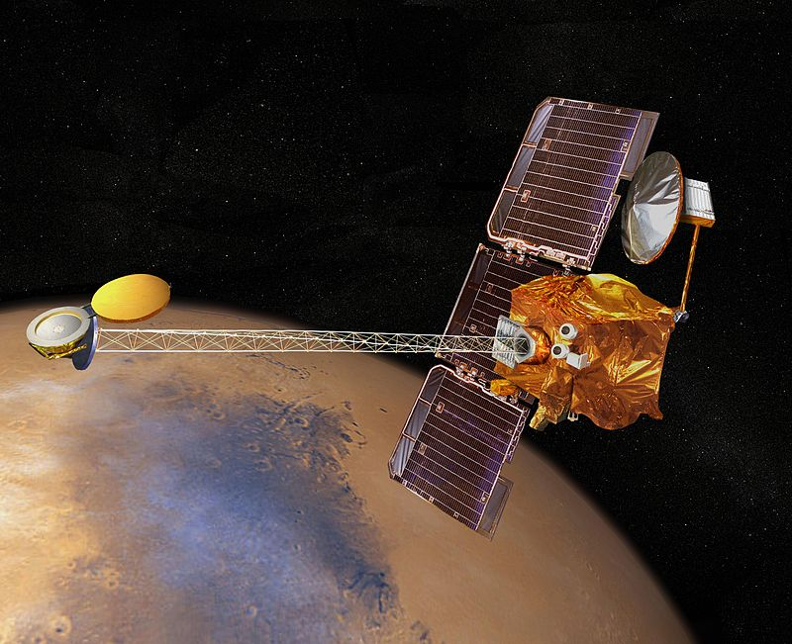
Remote Sensing(Con’t)
Figure: Survilence aircraft
Figure: Electromagnetic Spectrum
Visible and infrared range of wavelengths represents only part of the story
in remote sensing
Can also image the earth in microwave range
Figure: Remote sensing satellite
Feature Mining for Effective Subspace Detection of Hyperspectral Image Classification

Slide 5
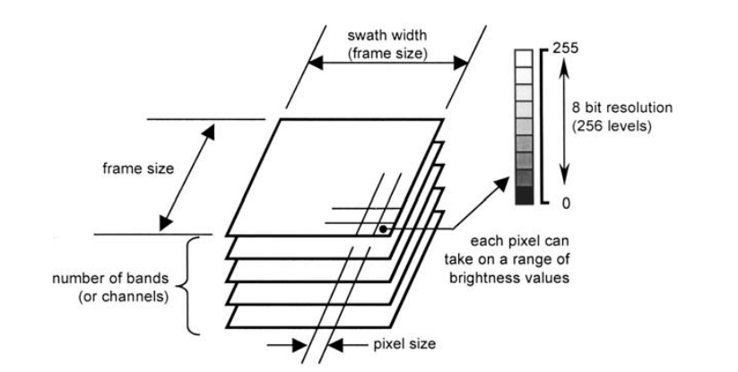
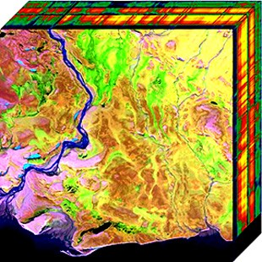
Hyperspectral Images
Figure: Two dimensional projection
of Hyperspectral cube
Figure: Technical characteristics of
digital image data[2]
Feature Mining for Effective Subspace Detection of Hyperspectral Image Classification

Slide 6
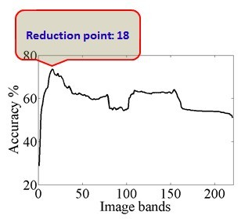
Challenges with Hyperspectral Images
Curse of dimensionality
High correlation among data
All the feature are not equally important
Figure: Curse of dimensionality [4]
Feature Mining for Effective Subspace Detection of Hyperspectral Image Classification

Slide 7
Motivations and Objectives
Extract only relevant features
Address curse of dimensionality
Improve classification accuracy
Feature Mining for Effective Subspace Detection of Hyperspectral Image Classification

Slide 8
Proposed Method
Collaboration of feature mining and classification
Feature Extraction:
Principal Component Analysis(PCA)
Feature Selection:
Mutual Information(MI)
Classification:
Support Vector Machine(SVM)
Feature Mining for Effective Subspace Detection of Hyperspectral Image Classification

Slide 9
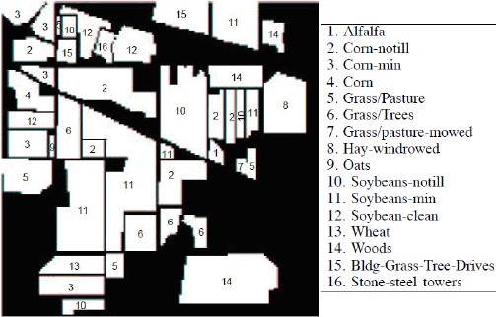
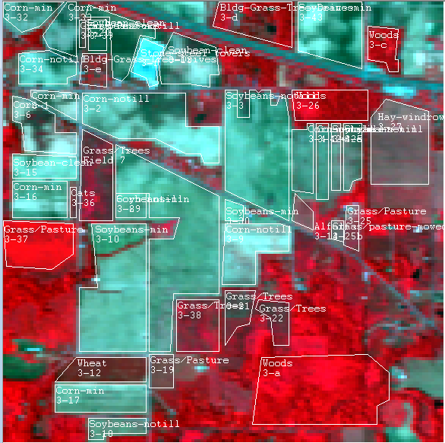
Data Set for Analysis
Data Set:
220 Band AVIRIS Hyperspectral Image
Date:
June 12, 1992 Indian Pine Test Site 3
Version 1.0
Dataset: AVIRIS 92AV3C
Spectral Resolution:
0.4µ m-2.5 µ m
Spatial Resolution: 30m
Band: 220
Classes:16
Pixels: 145 x 145
Feature Mining for Effective Subspace Detection of Hyperspectral Image Classification

Slide 10
Feature Extraction
Feature means unique measurable characteristics of an image/observed object.
Feature extraction means creating new features which have the essence of
original features.
Feature extraction helps to obtain relevant information from large dataset.
Principal Component Analysis(PCA)
Only relevant features are obtained
Dimensionality reduced
Increase classification accuracy
Feature Mining for Effective Subspace Detection of Hyperspectral Image Classification

Slide 11
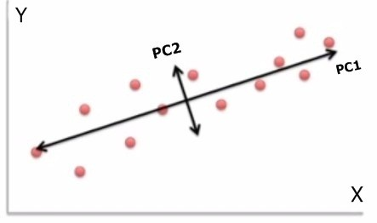
Feature extraction using Principal Component Analysis(PCA)
Principal Component Analysis (PCA) is a
process of reduction input dimensionality.
Transformed data is a set of orthogonal uncorrelated
variables called principal components(PC)
Feature Mining for Effective Subspace Detection of Hyperspectral Image Classification

Slide 12
Feature extraction using Principal Component Analysis(PCA)(Con’t)
All the steps we need to perform Principal Component Analysis[1]:
Step 1: Input the image
Step 2: Subtract the mean
Step 3: Calculate the covariance matrix
Step 4: Calculate the eigenvectors and eigenvalues of the covariance matrix
Step 5: Choose components and forming a feature vector
FeatureVector = (eig1 eig2 eig3…eign)
Step 6: Derive the new data set
FinalData = RowFeatureVector x RowDataAdjust
Feature Mining for Effective Subspace Detection of Hyperspectral Image Classification

Slide 13
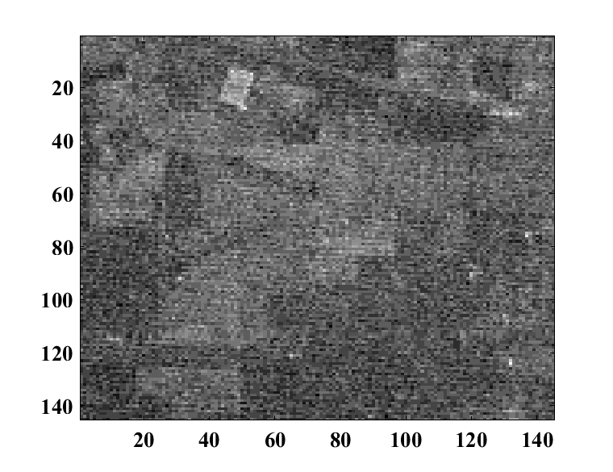
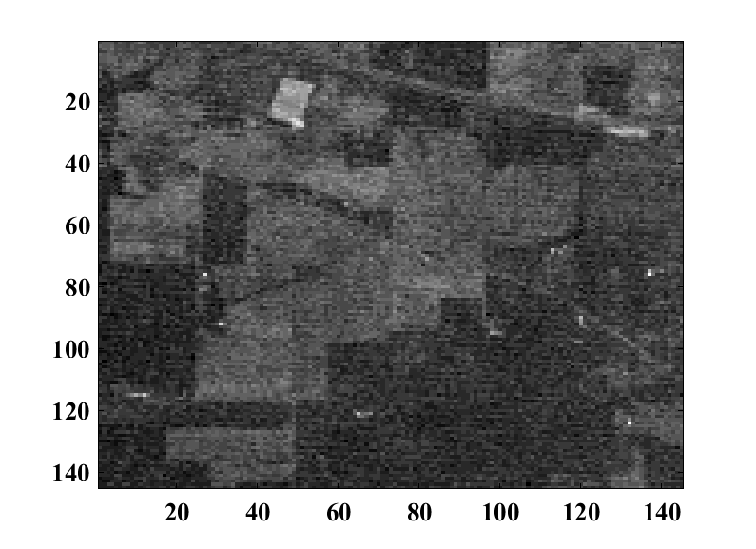
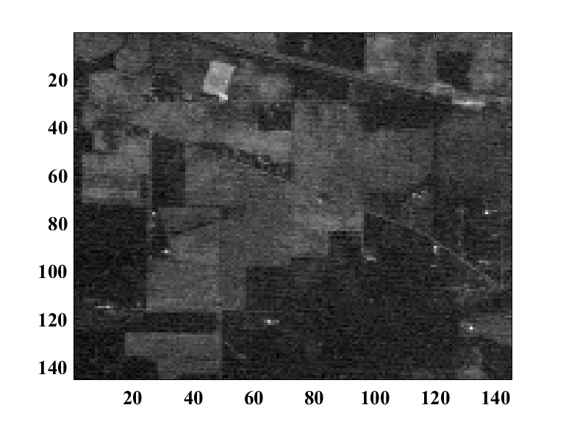
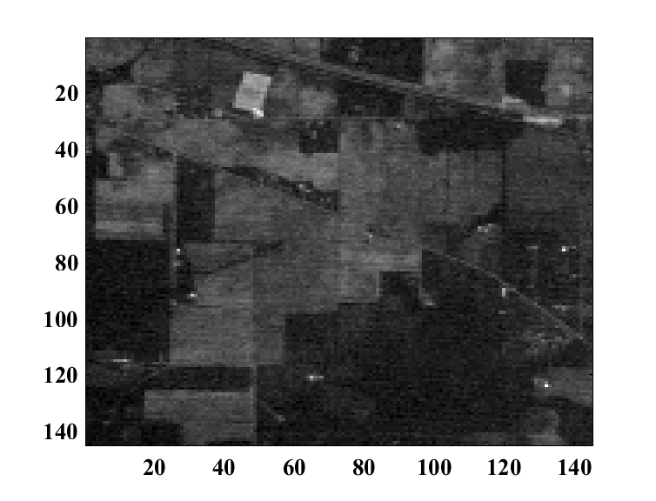
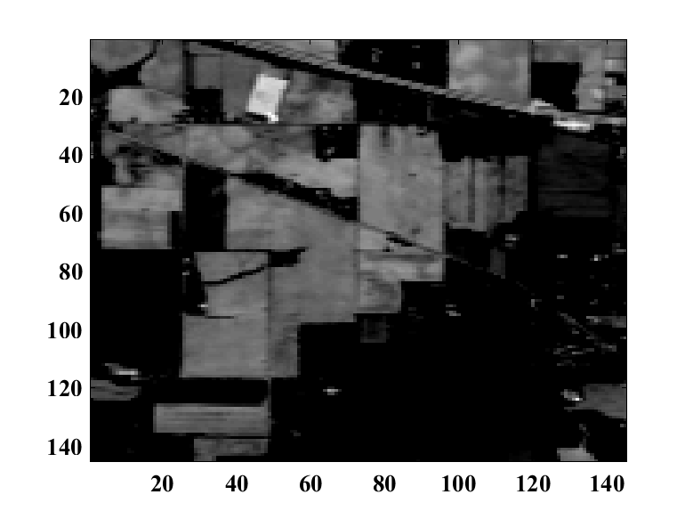
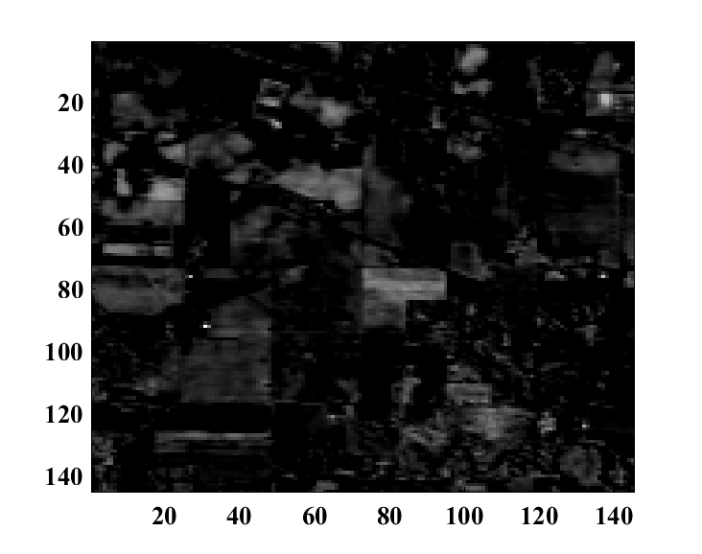
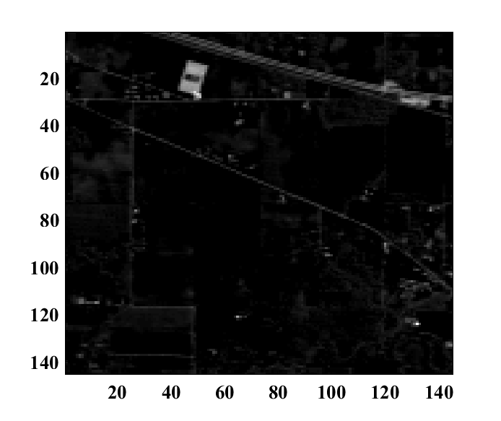
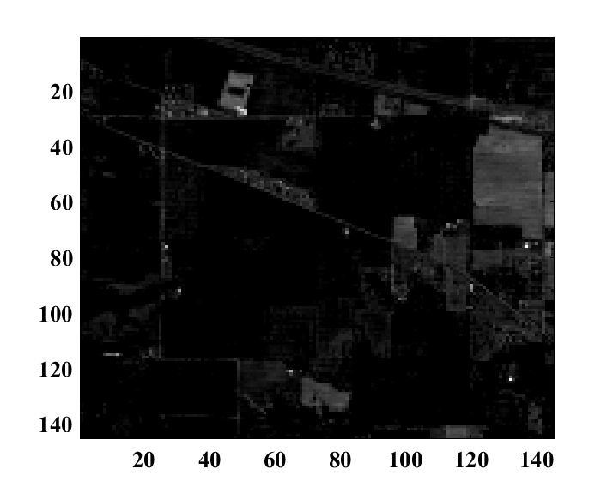
Original Band
Image Band 1 Band 2 Band 3 Band 4
PCA Band
PC 1 PC 2 PC 3 PC 4
Feature Mining for Effective Subspace Detection of Hyperspectral Image Classification

Slide 14
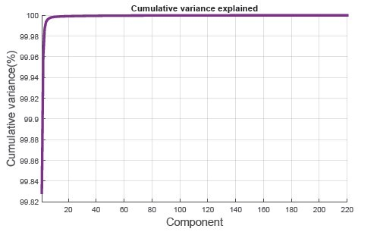
Result Principal Component Analysis(PCA)
After principal component analysis
first 14 band or component has 99.80%
variance of the dataset.
Figure: Cumulative variance
Feature Mining for Effective Subspace Detection of Hyperspectral Image Classification

Slide 15
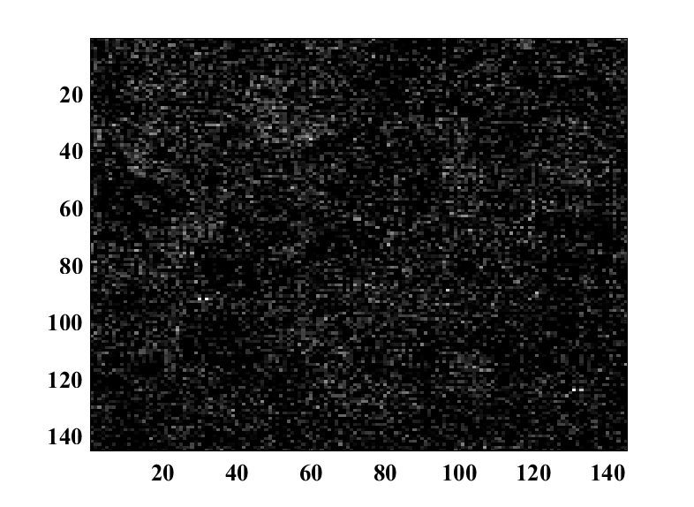
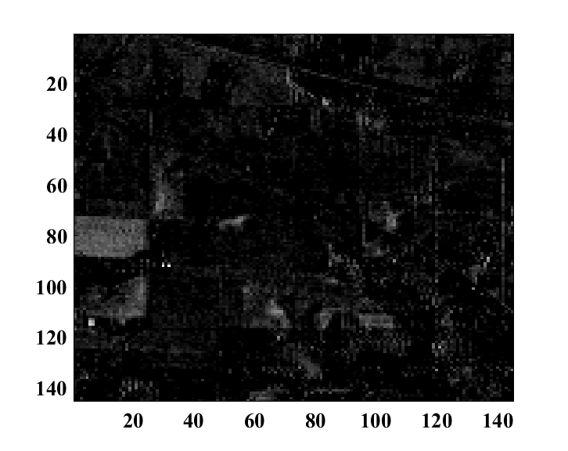
Limitations Principal Component Analysis(PCA)
PCA assumes that data is normal distributed
and high variance data contains more information.
Here though PC 8 has high variance but it contains
less information of image contents.
On the other hand PC 9 has low variance but it contains
more information of image contents.
This is the problem that I want to address in my future work.
PC 8
PC 9
Feature Mining for Effective Subspace Detection of Hyperspectral Image Classification

Slide 16
Classification
Class Name | Train | Test
Alfalfa | 12 | 12
Corn-notill | 42 | 36
Corn-min | 49 | 42
Corn | 30 | 30
Grass/Pasture | 49 | 42
Grass/Trees | 48 | 48
Hay-windrowed | 77 | 88
Soybeans-notill | 117 | 117
Soybeans-min | 120 | 84
Soybean-clean | 54 | 54
Wheat | 54 | 60
Woods | 120 | 96
Bldg-Grass-Tree-Drives | 63 | 48
Stone-steel towers | 25 | 24
One-against-one support vector machine (SVM)[3]
classifier to classify 14 classes
Steps of classification:
Step 1: Get train and test data
Step 2: Scale data set into 0 to 1
Step 3: Calculate best c and gamma for RBF
kernel of SVM
10 fold cross validation was used
Step 4: Train and Test SVM
Radial basis function (RBF) kernel
was used
Table: Data set
Feature Mining for Effective Subspace Detection of Hyperspectral Image Classification

Slide 17
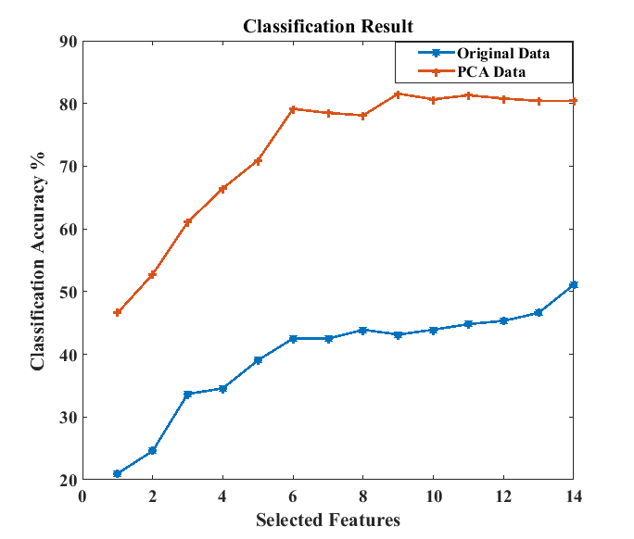
Conclusion
14 class is selected
Selecting first 14 features after applying
PCA gives 80.40% accuracy
Data set | C | g
Original Data | 10 | 2.85
PCA Data | 10 | 0.83
Data set | Classification Result ( First 14 features only)
Original Data | 51.08%
PCA Data | 80.40%
Figure: Comparison of classification result of
original data and PCA data.
Feature Mining for Effective Subspace Detection of Hyperspectral Image Classification

Slide 18
Future Work
Subset features are selected after PCA
Efficient feature selection technique can be applied for better classification
accuracy like mutual information(MI)
Feature Mining for Effective Subspace Detection of Hyperspectral Image Classification

Slide 19
Acknowledgement
Special thanks to
Professor Dr. David A. Landgrebe, Purdue University
Feature Mining for Effective Subspace Detection of Hyperspectral Image Classification

Slide 20
References
[1]Lindsay I Smith, “A tutorial on Principal Component Analysis”, February 26,2002.
[2]John A. Richards and Xiuping Jia, Remote Sensing Digital Image Analysis 4th edition,
Verlag: Springer 2006.
[3]Chih-Wei Hsu, Chih-Chung Chang, and Chih-Jen Lin,Department of Computer Science,
National Taiwan University, Taipei 106, Taiwan,"A Practical Guide to Support Vector Classication",
Initial version: 2003, Last updated: May 19, 2016.
[4]Md. Ali Hossain, Xiuping Jia, Senior Member, IEEE, and Mark Pickering, Member, IEEE,
”Subspace Detection Using a Mutual Information Measure for Hyperspectral Image Classification”
Feature Mining for Effective Subspace Detection of Hyperspectral Image Classification

Slide 21
The End
Thank You
Feature Mining for Effective Subspace Detection of Hyperspectral Image Classification

