Slide 1

Rajshahi University of Engineering & Technology
Heaven’s Light is Our Guide
Target Class Oriented Subspace Detection for Effective Hyperspectral Image Classification
Presented By
Md. Tanvir Ahmed
Roll: 123086
Supervised by
Dr. Md. Ali Hossain
Assistant Professor
Department of CSE
December 10, 2017
Target Class Oriented Subspace Detection for Effective Hyperspectral Image Classification

Slide 2
Outline
Remote Sensing
Hyperspectral Images
Challenges of Hyperspectral Images
Motivations and Objectives
Proposed Method
Dataset Description
Feature Reduction
Experimental Analysis
Classification
Conclusion
Target Class Oriented Subspace Detection for Effective Hyperspectral Image Classification

Slide 3
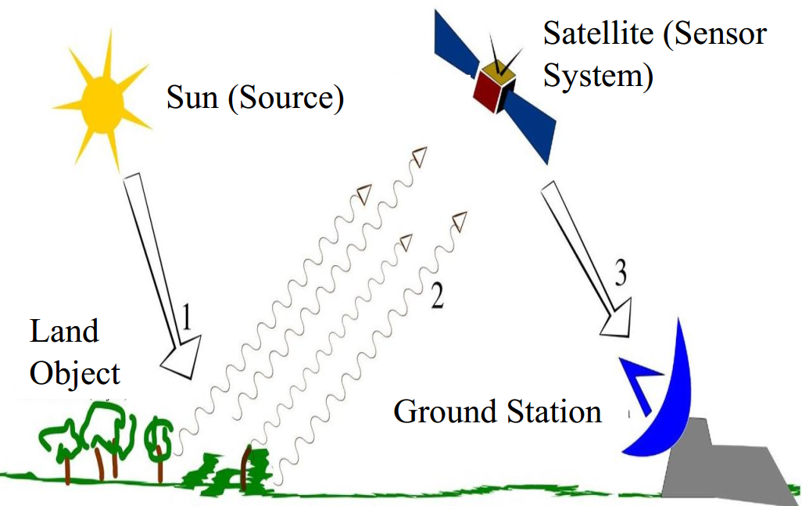
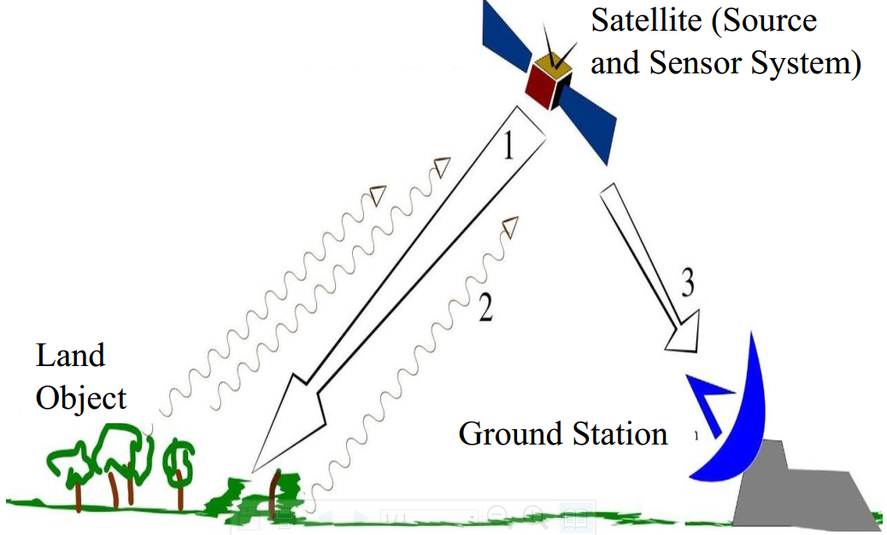
Remote Sensing
What is remote sensing?
Acquisition of information about an object
without making physical contact with the object
Used in geography, land surveying, military,
intelligence and planning
Types:
Passive Remote Sensing
Active Remote Sensing
Target Class Oriented Subspace Detection for Effective Hyperspectral Image Classification

Slide 4
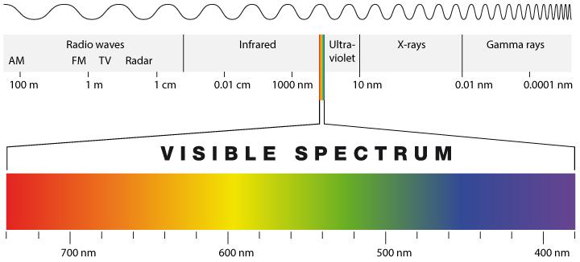
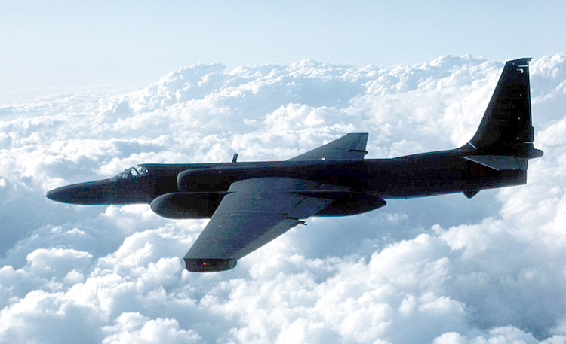

Remote Sensing (Contd..)
0.4 µm – 2.5 µm
Figure: Surveillance aircraft
Figure: Electromagnetic Spectrum
Visible and infrared range of wavelengths represents only part of the story
in remote sensing
Can also image the earth in microwave range
Figure: Remote sensing satellite
Target Class Oriented Subspace Detection for Effective Hyperspectral Image Classification

Slide 5
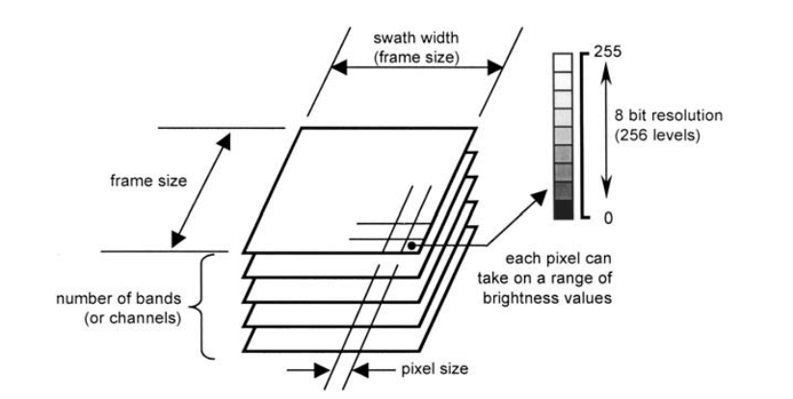
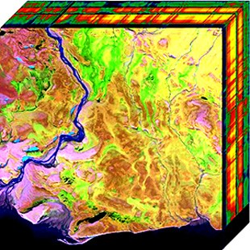
Hyperspectral Images
Figure: 3D view of Hyperspectral
data cube [1]
Figure: Technical characteristics of
digital image data [2]
Target Class Oriented Subspace Detection for Effective Hyperspectral Image Classification

Slide 6
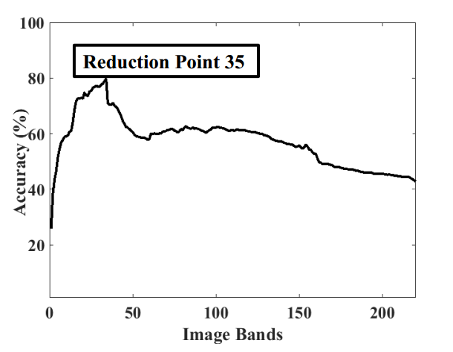
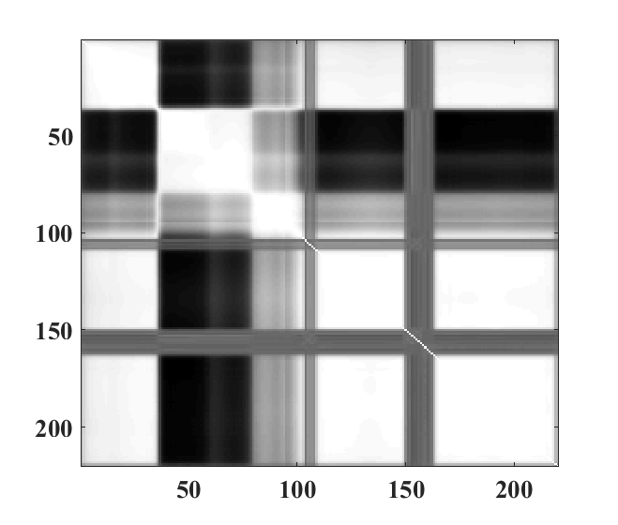
Challenges of Hyperspectral Images
Curse of dimensionality
High correlation among data
White: 100% correlation
All features are not equally important
Black: 0% correlation
Figure: Curse of dimensionality
Figure: Correlation among bands
Target Class Oriented Subspace Detection for Effective Hyperspectral Image Classification

Slide 7
Motivations and Objectives
To:
Extract only relevant features and find an effective subspace
Address curse of dimensionality
Improve classification accuracy
Target Class Oriented Subspace Detection for Effective Hyperspectral Image Classification

Slide 8
Proposed Method
Target Class Oriented Subspace Detection (TCOSD)
Feature mining:
Feature selection over feature extraction
Feature Extraction:
Principal Component Analysis (PCA)[3]
Feature Selection:
Normalized Mutual Information (NMI)[4]
Classifier to asses the performance:
Kernel Support Vector Machine (KSVM)[5][6]
Target Class Oriented Subspace Detection for Effective Hyperspectral Image Classification

Slide 9
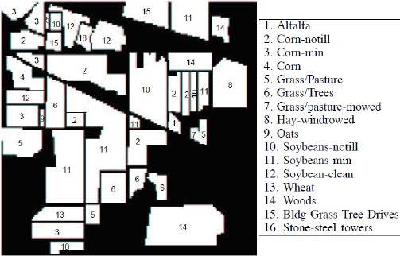
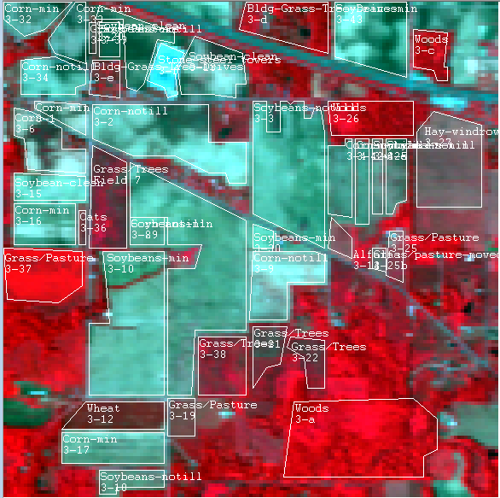
Dataset Description
Dataset: AVIRIS 92AV3C
Spectral Resolution:
0.4µ m-2.5 µ m
Spatial Resolution: 30m
Band: 220
Classes:16
Data Set:
Captured Date:
June 12, 1992 Indian Pine
Test Site 3
Version 1.0
220 Band AVIRIS
Hyperspectral Image
Each band has 145 x 145 =21025 pixel
Target Class Oriented Subspace Detection for Effective Hyperspectral Image Classification

Slide 10
Feature Extraction
Feature means unique measurable characteristics of an image/observed object
(e.g., each band)
Feature extraction means creating new features which have the essence of
original features.
Feature extraction helps to obtain relevant information from large dataset.
Principal Component Analysis (PCA)
Perform orthogonal transformation
Data are ordered based on high variance
Dimensionality reduced by taking only first few components
Classification accuracy Increased from the original set
Target Class Oriented Subspace Detection for Effective Hyperspectral Image Classification

Slide 11
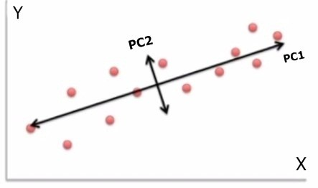
Feature extraction using Principal Component Analysis(PCA)
Principal Component Analysis (PCA) is a
process of reduction input dimensionality.
PC2 can be removed
Transformed data is uncorrelated
Target Class Oriented Subspace Detection for Effective Hyperspectral Image Classification

Slide 12
Feature extraction using Principal Component Analysis(PCA)(Contd..)
Steps of Principal Component Analysis:
Input the image
Subtract the mean
Calculate the covariance matrix
Calculate the eigenvectors and eigenvalues of the covariance matrix
Choose components and form a feature vector
FeatureVector = (eig1, eig2, eig3 ,…, eign)
Derive the new data set
FinalData = RowFeatureVector RowDataAdjust
Target Class Oriented Subspace Detection for Effective Hyperspectral Image Classification

Slide 13
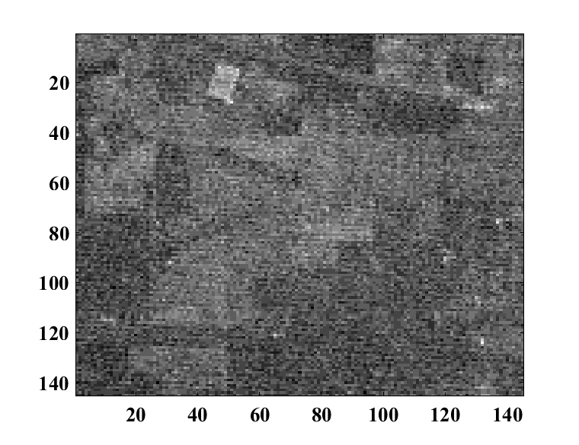
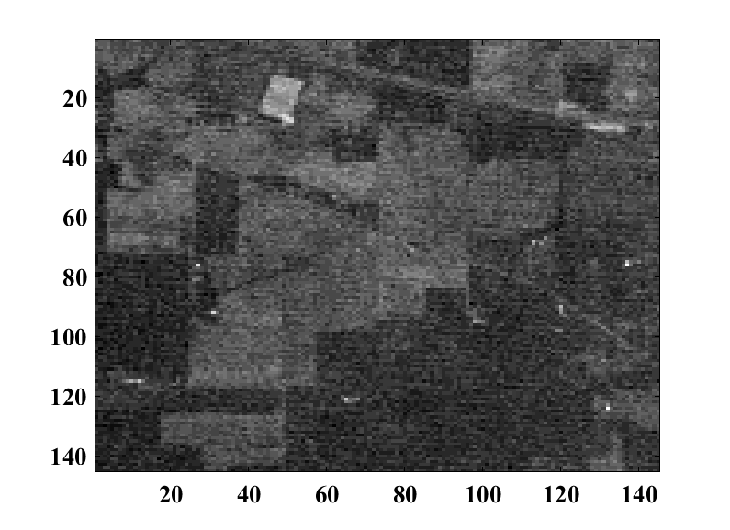
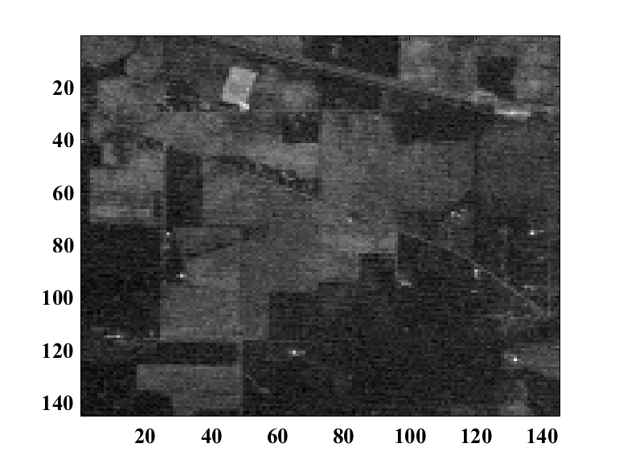
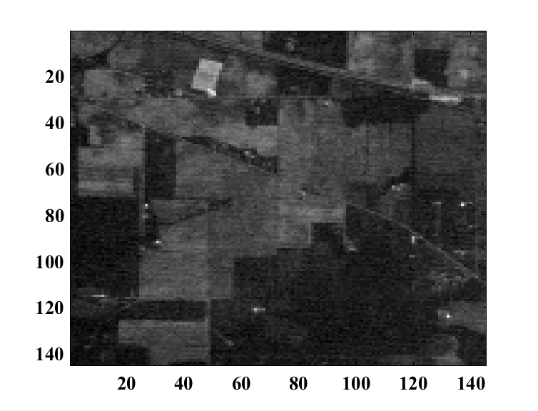
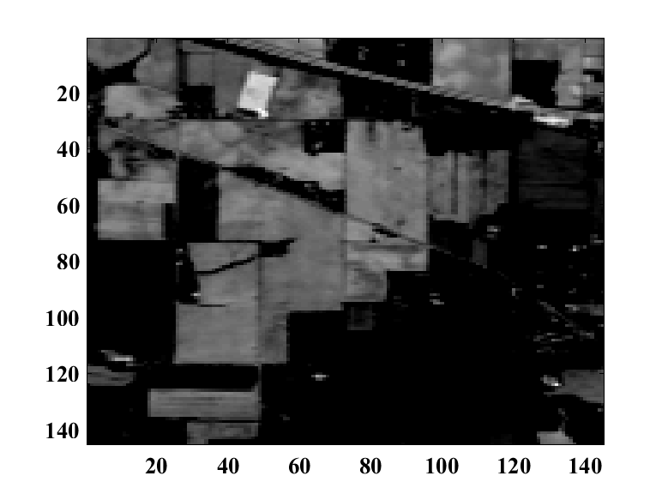
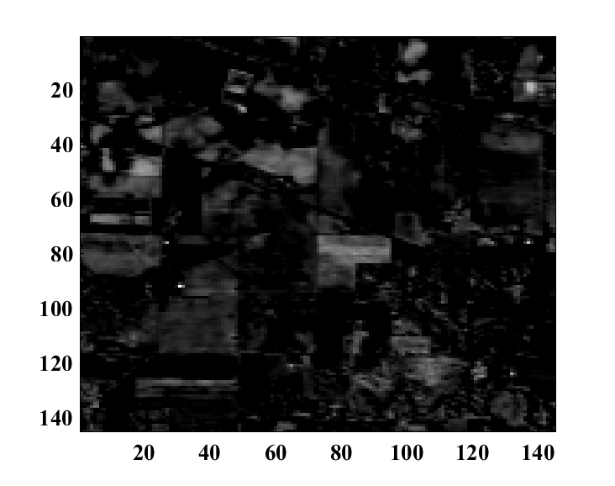
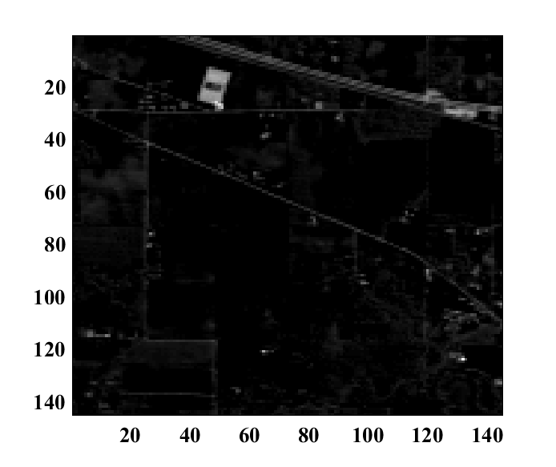
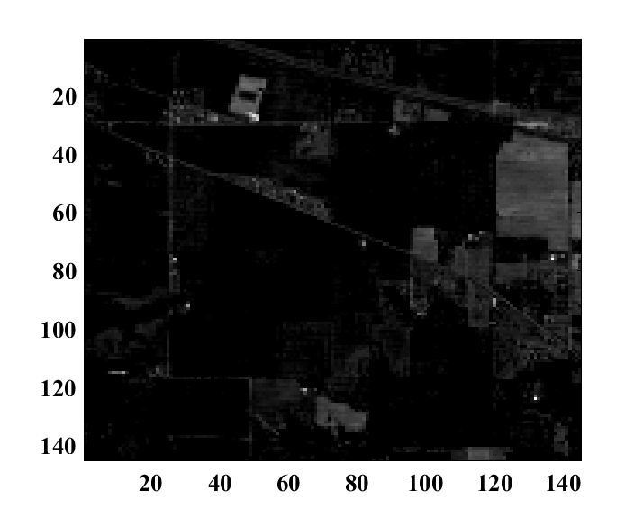
Original Band
Image Band 1 Band 2 Band 3 Band 4
PCA Band
PC 1 PC 2 PC 3 PC 4
Target Class Oriented Subspace Detection for Effective Hyperspectral Image Classification

Slide 14
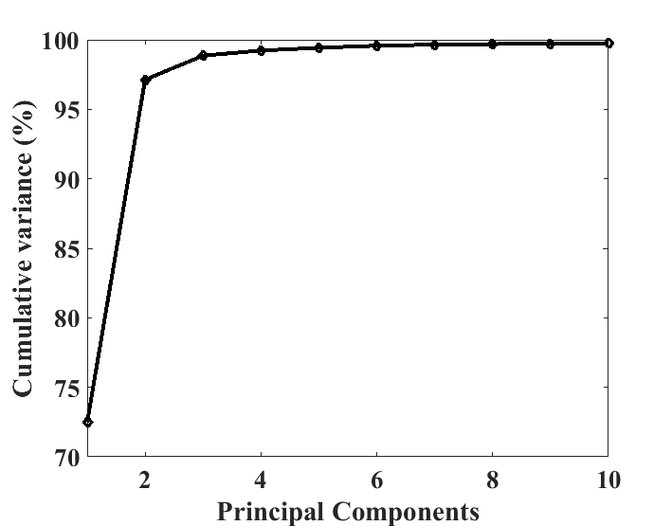
Cumulative variance of Transformed data
After principal component analysis
first 10 components have 99.75%
variance of the total
Figure: Cumulative variance
Target Class Oriented Subspace Detection for Effective Hyperspectral Image Classification

Slide 15
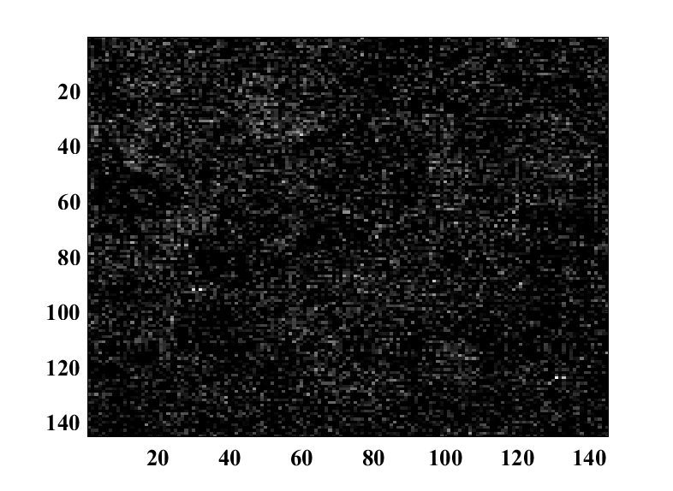
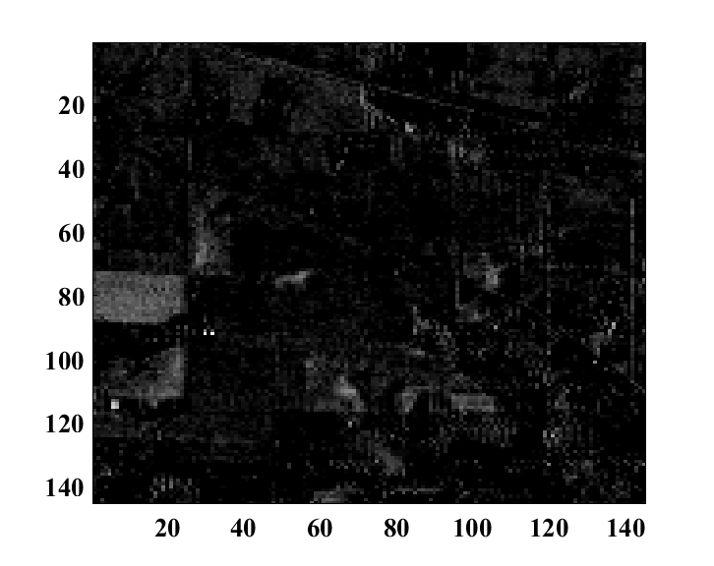
Limitations of PCA
PCA doesn’t consider the class structure of input data and depends solely on the global variance . Assumes high variance means high information
PC 8 has high variance but it contains
less information of image contents.
On the other hand PC 9 has low variance but it contains
more information of image contents.
PC 8
PC 9
Target Class Oriented Subspace Detection for Effective Hyperspectral Image Classification

Slide 16
Feature Selection
Mutual Information[7]:
……..(1)
Normalized Mutual Information[8]:
……..(2)
Relevant features has been selected as follows:
……..(3)
Target Class Oriented Subspace Detection for Effective Hyperspectral Image Classification

Slide 17
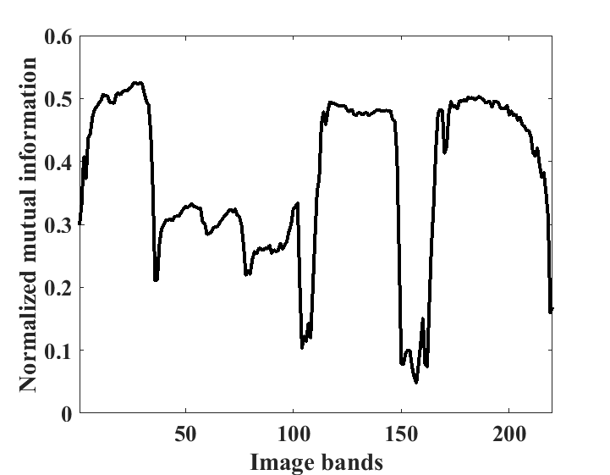
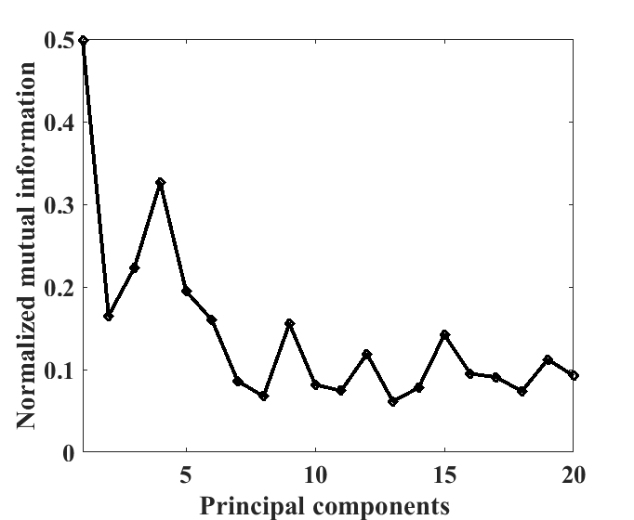
Normalized Mutual Information
Figure: NMI between Class labels and Original Image bands
Figure: NMI between Class labels and Principal Components
Method | Order of selected features
Org+NMI | Band: 27,1,167,3,139,14,2,8
PCA | PC: 1,2,3,4,5,6,7,8
PCA+NMI | PC: 1,4,3,5,9,6,2,15
Table: Selected features of Standard Approaches Studied
Target Class Oriented Subspace Detection for Effective Hyperspectral Image Classification

Slide 18
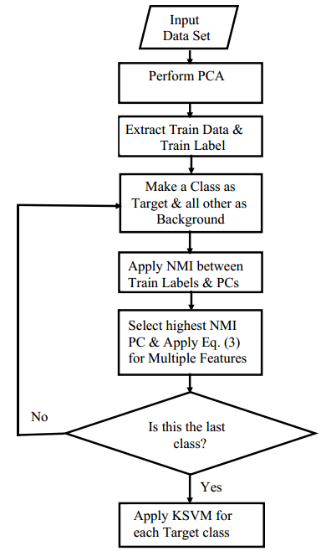
Experimental Procedure
Proposed TCOSD method (algorithm and flow chart):
Step 1: Perform PCA and extract features of the input data set.
Step 2: Extract the training data and training label from the
PCA features.
Step 3: Consider one class as target at a time, i.e, make a class as target and all other class as background.
Step 4: Apply NMI between the training labels and the principal
components.
Step 5: Select the best principal component based on the high value of NMI. List the selected subset.
Step 6: Apply the Eq. (3) for selecting multiple features based on NMI for the target class.
Step 7: Apply the selected features to the KSVM classifier.
Step 8: Repeat step 3 to 6 by making another class as target and the remaining as background.
Target Class Oriented Subspace Detection for Effective Hyperspectral Image Classification

Slide 19
Selected features for all target class
Target class | Order of selected features
Hay-windrowed | PC: 4,1,17,5,12,3,16,2
Soybean-notil | PC: 1,17,16,11,20,14,13,3
Woods | PC: 1,16,17,3,15,11,5,20
Wheat | PC: 6,19,17,3,12,16,11,5
Grass/trees | PC: 4,9,5,6,16,17,2,1
Soybean-min | PC: 1,17,16,3,5,12,11,9
Corn-min | PC: 1,17,16,5,11,3,20,19
Stone-steel | PC: 3,4,1,17,16,10,5,11
Alfalfa | PC: 4,17,15,20,3,16,6,12
Grass/Pasture | PC: 9,3,17,6,16,11,1,15
Corn-notill | PC: 1,17,2,16,11,18,20,19
Soybean-clean | PC: 1,15,17,3,16,20,12,11
Corn | PC: 1,19,17,16,18,8,11,3
Bldg-Grass | PC: 15,16,17,3,18,11,19,4
PC: Principal Component
Table: Selected features for all target class applying proposed method (TCOSD)
Target Class Oriented Subspace Detection for Effective Hyperspectral Image Classification

Slide 20
Classification
Class name | Train | Test
Hay-windrowed | 187 | 77
Soybean-notil | 128 | 105
Woods | 367 | 341
Wheat | 54 | 78
Grass/trees | 249 | 115
Soybean-min | 253 | 115
Corn-min | 253 | 115
Stone-steel | 36 | 30
Alfalfa | 24 | 24
Grass/Pasture | 156 | 92
Corn-notill | 172 | 60
Soybean-clean | 96 | 78
Corn | 30 | 15
Bldg-Grass | 40 | 12
Total | 1900 | 1179
Kernel support vector machine (KSVM)[6]
Classification procedure:
Get train and test data
Scale data set into 0 to 1
Calculate best C and g (kernel width)for RBF
kernel of SVM. 10 fold cross validation was used
Assess the test sample accuracy. Radial basis function
(RBF) kernel was used
Target Class Oriented Subspace Detection for Effective Hyperspectral Image Classification

Slide 21
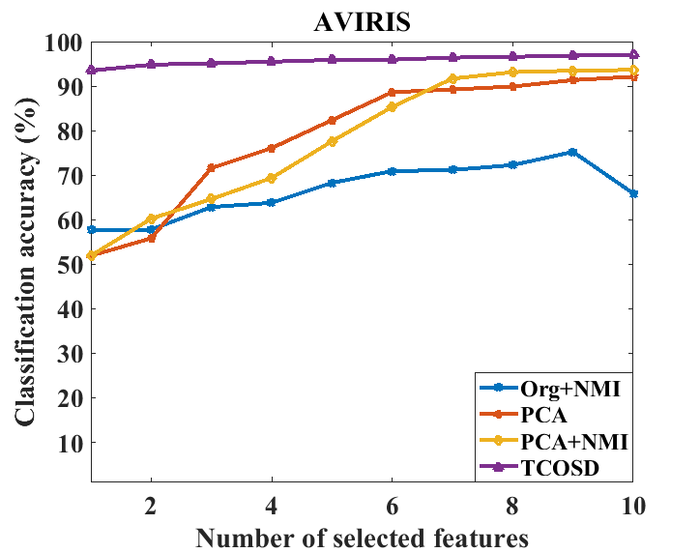
Experimental Analysis
14 out of 16 classes are selected
Selected first 8 features for proposed
TCOSD gives 96.57% accuracy
Data set | C | g
Org+NMI | 10 | 2.44
PCA | 19 | 2.40
PCA+NMI | 16 | 0.7
TCOSD (Proposed) | 5 | 0.75
Data set | Classification Result ( First 8 features only)
Org+NMI | 72.26%
PCA | 89.90%
PCA+NMI | 93.12%
TCOSD (Proposed) | 96.57%
Figure: Comparison of classification result of
Proposed TCOSD and standard approaches studied
Target Class Oriented Subspace Detection for Effective Hyperspectral Image Classification

Slide 22
Conclusion
A better subspace is detected than other standard approaches
Can provide best classification accuracy
Proposed method is most suitable for ground object detection and identification
Target Class Oriented Subspace Detection for Effective Hyperspectral Image Classification

Slide 23
Future Work
Proposed method needs some further improvement
To handle complex class relationships
Subspace detection can be performed by introducing adaptive thresholding T.
Target Class Oriented Subspace Detection for Effective Hyperspectral Image Classification

Slide 24
Acknowledgement
Special thanks to
Professor Dr. David A. Landgrebe, Purdue University
For the dataset and MultiSpec
Target Class Oriented Subspace Detection for Effective Hyperspectral Image Classification

Slide 25
References
[1] [Online]https://en.wikipedia.org/wiki/Hyperspectral_imaging [Access date: Dec 08, 2017]
[2] J. A. Richards and X. Jia, Remote Sensing Digital Image Analysis 4th edition,
Verlag: Springer 2006.
[3] L. I. Smith, “A tutorial on Principal Component Analysis”, February 26,2002.
[4] M. A. Hossain, X. Jia and M. Pickering, “Subspace detection using a mutual-information measure
for hyperspectral image classification,” IEEE Geoscience and Remote Sensing Letters, vol. 11, no.
2, pp. 424-428, Feb. 2014.
[5] C. Hsu, C. Chang, and C. Lin,Department of Computer Science,National Taiwan University,Taipei
106, Taiwan,"A Practical Guide to Support Vector Classication",
Initial version: 2003, Last updated: May 19, 2016.
Target Class Oriented Subspace Detection for Effective Hyperspectral Image Classification

Slide 26
References
[6] C. Chang and C. Lin, “LIBSVM: A library for support vector machines,” ACM Trans. Intell. Syst. Technol., vol. 2, no. 3, pp. 27:1–27:27, Apr. 2011.
[7] M. A. Hossain, M. Pickering and X. Jia, “ Unsupervised feature extraction based on a mutual information measure for hyperspectral image classification," IEEE International Geoscience and
Remote Sensing Symposium (IGARSS),Vancouver, Canada, pp. 1720-1723, Jul. 2011.
[8] M. A. Hossain, X. Jia and M. Pickering, “ Improved feature selection based on a mutual information measure for hyperspectral image classification," IEEE International Geoscience and Remote Sensing Symposium (IGARSS), Munich, Germany, pp. 3058-3061, Jul. 2012.
Target Class Oriented Subspace Detection for Effective Hyperspectral Image Classification
26/27

Slide 27
Thank You
Target Class Oriented Subspace Detection for Effective Hyperspectral Image Classification

