Slide 1
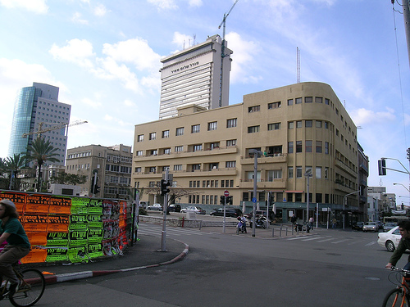
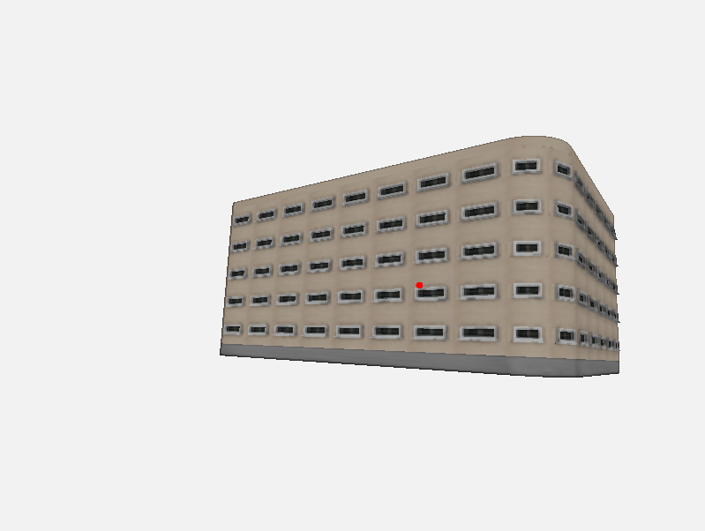
Building #2
Camera
X rot: -10.0103
Y rot: -35.8622
Z rot: -2.97995
FOV: 74.6021
Ox: 0.0349476
Oy: -0.0612827
X: -3.86381
Y: 0.317932
Z: 32.8159
Mass grammar #4
corner: 2.44
depth: 15.75
height: 11.104
width: 22.65
Façade grammar #1
floor height: 2.0
ground floor height: 0.84
tile_hori_margin: 0.2918
tile_vert_margin: 0.632
tile_width: 2.554
top_wall_height: 0.535
Window grammar #3

Slide 2
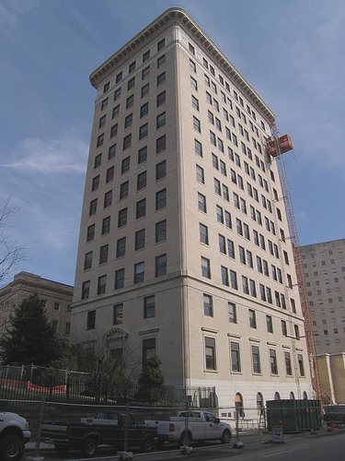
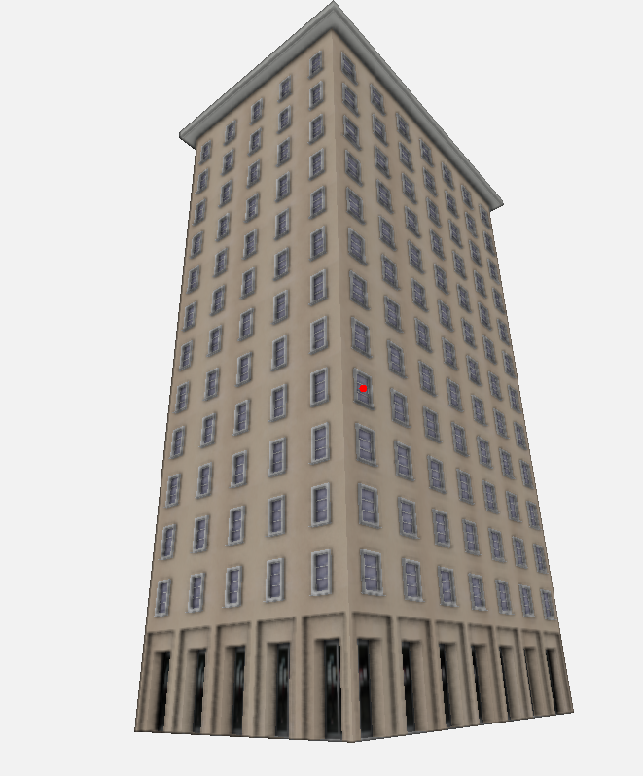
Building #3
Camera
X rot: -24.6008
Y rot: -39.9673
Z rot: 1.55795
FOV: 64.9414
Ox: 0.02727
Oy: -0.00076
X: -1.89318
Y: 0.06855
Z: 39.2865
Mass grammar #6
depth: 20.092
height: 37.084
roof_height: 0.624
roof_overhang: 0.918
width: 12.676
Façade grammar #2
floor height: 2.680
ground floor height: 4.344
tile_hori_margin: 0.746
tile_vert_margin: 0.499
tile_width: 2.680
top_wall_height: 0.817
Window grammar #2

Slide 3
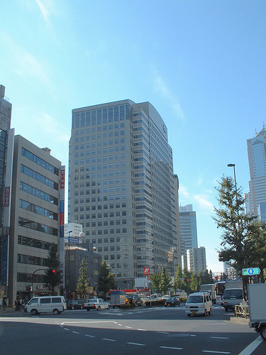
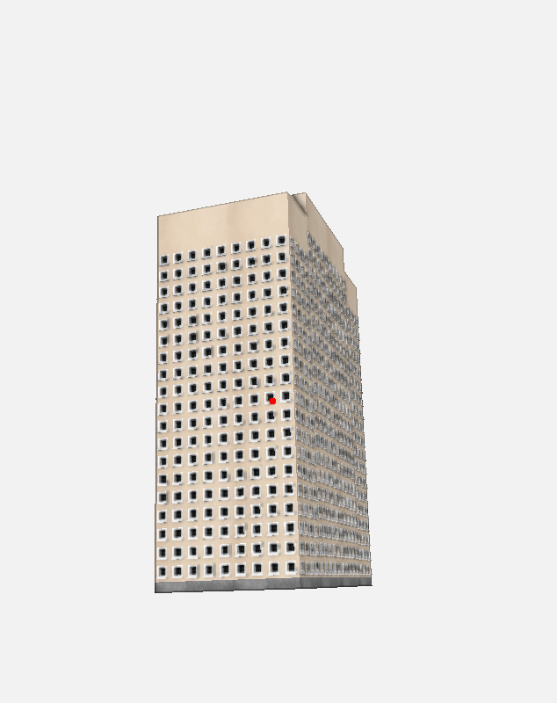
Building #4
Camera
X rot: -10.0103
Y rot: -35.8622
Z rot: -2.97995
FOV: 74.6021
Ox: 0.0349476
Oy: -0.0612827
X: -3.86381
Y: 0.317932
Z: 32.8159
Mass grammar #9
depth1: 3.8(?)
depth2: 9.6(?)
height1: 24.060
Height2: 1.900
width: 9.004
Façade grammar #1
floor height: 1.120
ground floor height: 0.624
tile_hori_margin: 0.176
tile_vert_margin: 0.176
tile_width: 0.980
top_wall_height: 2.650
Window grammar #1

Slide 4
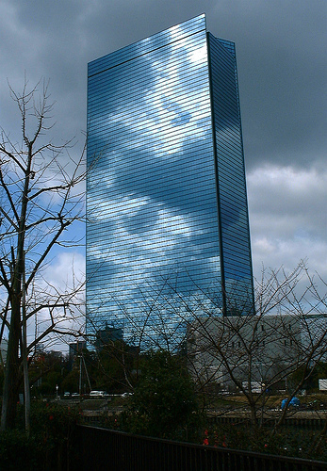
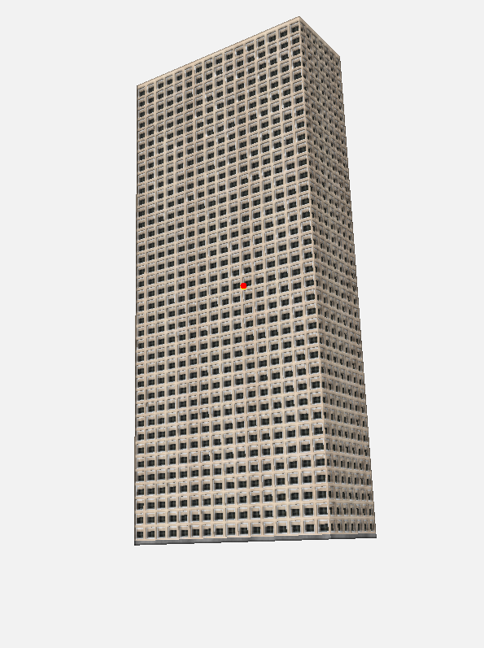
Building #5
Camera
X rot: -10.0103
Y rot: -35.8622
Z rot: -2.97995
FOV: 74.6021
Ox: 0.0349476
Oy: -0.0612827
X: -3.86381
Y: 0.317932
Z: 32.8159
Mass grammar #1
depth: 6.622
height: 37.672
width: 16.006
Façade grammar #1
floor height: 1.000
ground floor height: 0.300
tile_hori_margin: 0.005
tile_vert_margin: 0.005
tile_width: 1.000
top_wall_height: 0.112
Window grammar #8

Slide 5
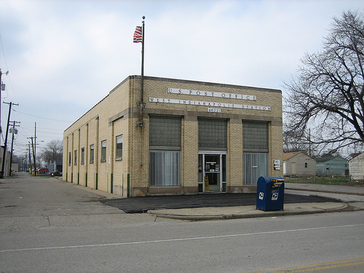
Building #7
Camera
X rot: -5.48293
Y rot: -68.4058
Z rot: -0.650489
FOV: 51.2696
Ox: -0.0714317
Oy: -0.00535228
X: -4.96421
Y: 1.92869
Z:
Mass grammar #1
depth: 13.752
height: 9.15201
width: 46.320
Façade grammar #2
floor height: 2.680
ground floor height: 4.344
tile_hori_margin: 0.746
tile_vert_margin: 0.499
tile_width: 2.680
top_wall_height: 0.817
Window grammar #1

Slide 6
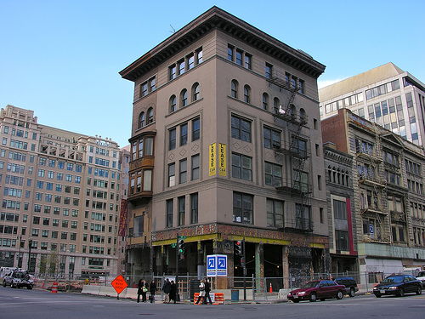
Building #8
Camera
X rot: -15.363
Y rot: -49.0081
Z rot: -0.28126
FOV: 53.2953
Ox: -0.02327
Oy: -0.03100
X: -2.25681
Y: 0.91241
Z: 49.8204
Mass grammar #6
depth: 17.156
height: 26.218
roof_height: 0.8969
roof_overhang: 1.2693
width: 15.178
Façade grammar #2
floor height: 2.680
ground floor height: 4.344
tile_hori_margin: 0.746
tile_vert_margin: 0.499
tile_width: 2.680
top_wall_height: 0.817
Window grammar #2

Slide 7
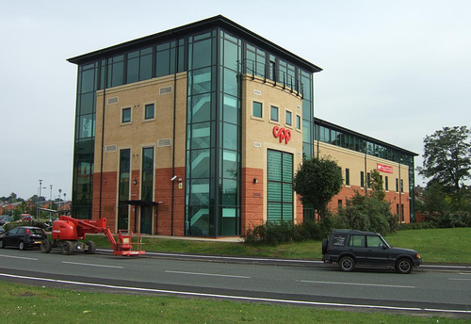
Building #12
Camera
X rot: -6.48085
Y rot: -34.8881
Z rot: -0.37085
FOV: 50.6856
Ox: 0.06592
Oy: 0.00270
X: 5.72296
Y: -1.48241
Z: 52.7858
Mass grammar #6
depth: 16.88
height: 17.708
roof_height: 0.336
roof_overhang: 0.8796
width: 18.858
Façade grammar #2
floor height: 2.680
ground floor height: 4.344
tile_hori_margin: 0.746
tile_vert_margin: 0.499
tile_width: 2.680
top_wall_height: 0.817
Window grammar #2

Slide 8
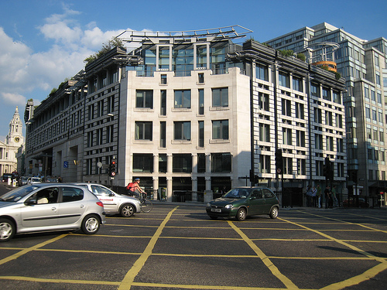
Building #13
Camera
X rot: -7.79048
Y rot: -58.3895
Z rot: -2.4909
FOV: 66.3515
Ox: -0.25415
Oy: -0.046165
X: 0.696247
Y: -0.116625
Z:
Mass grammar #3
corner: 5.35
depth: 21.13
height: 9.92001
width: 39.2
Façade grammar #2
floor height: 2.680
ground floor height: 4.344
tile_hori_margin: 0.746
tile_vert_margin: 0.499
tile_width: 2.680
top_wall_height: 0.817
Window grammar #2

Slide 9
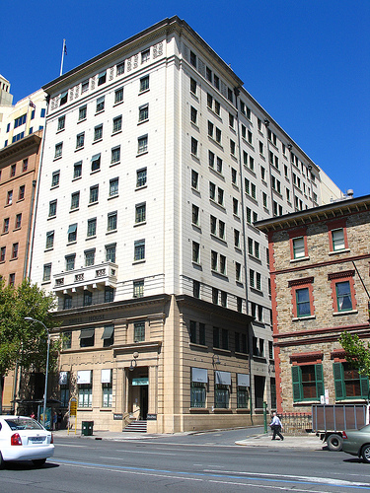
Building #14
Camera
X rot: -20.3492
Y rot: -35.938
Z rot: -0.05941
FOV: 53.9318
Ox: -0.03977
Oy: 0.06195
X: 3.93072
Y: 0.37368
Z: 49.1375
Mass grammar #6
depth: 11.774
height: 35.97
roof_height: 0.348
roof_overhang: 0.7236
width: 17.938
Façade grammar #2
floor height: 2.680
ground floor height: 4.344
tile_hori_margin: 0.746
tile_vert_margin: 0.499
tile_width: 2.680
top_wall_height: 0.817
Window grammar #2

Slide 10
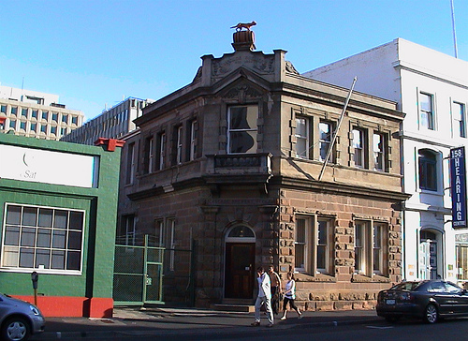
Building #15
Camera
X rot: -11.8528
Y rot: -54.7799
Z rot: -2.08634
FOV: 43.199
Ox: 0.099654
Oy: -0.00346007
X: -0.72115
Y: 4.401
Z: 63.1443
Mass grammar #3
corner: 5.1
depth: 21.01
height: 19.39
width: 19.6
Façade grammar #2
floor height: 2.680
ground floor height: 4.344
tile_hori_margin: 0.746
tile_vert_margin: 0.499
tile_width: 2.680
top_wall_height: 0.817
Window grammar #2

Slide 11
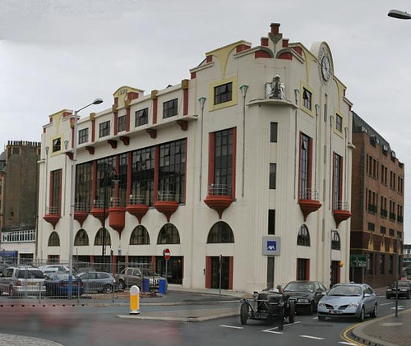
Building #16
Camera
X rot: -4.35397
Y rot: -46.1188
Z rot: -3.07834
FOV: 53.1608
Ox: -0.436314
Oy: -0.368378
X: -7.22036
Y: -5.84694
Z:
Mass grammar #3
corner: 1.96
depth: 17.29
height: 20.71
width: 33.64
Façade grammar #2
floor height: 2.680
ground floor height: 4.344
tile_hori_margin: 0.746
tile_vert_margin: 0.499
tile_width: 2.680
top_wall_height: 0.817
Window grammar #2

Slide 12
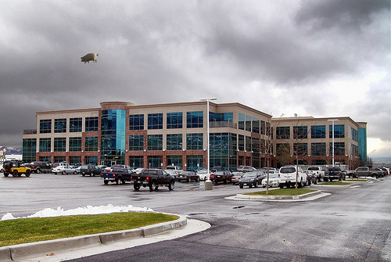
Building #17
Camera
X rot: -5.59785
Y rot: -32.6504
Z rot: -0.921558
FOV: 41.8212
Ox: -0.530448
Oy: 0.029858
X: -17.4987
Y: 3.08394
Z: 65.4322
Mass grammar #5
depth1: 19.525
depth2: 24
height: 6.44801
width1: 18.96
width2: 8.914
Façade grammar #2
floor height: 2.680
ground floor height: 4.344
tile_hori_margin: 0.746
tile_vert_margin: 0.499
tile_width: 2.680
top_wall_height: 0.817
Window grammar #2

Slide 13
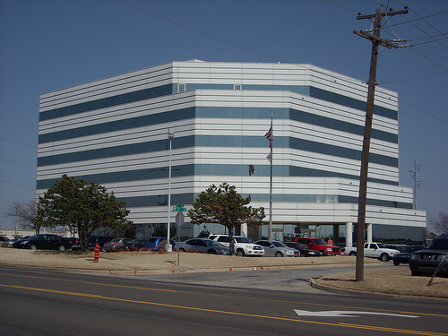
Building #22
Camera
X rot: -7.76754
Y rot: -45.9643
Z rot: -1.60543
FOV: 34.8676
Ox: -0.22923
Oy: 0.00448
X: -4.41826
Y: 0.41209
Z:
Mass grammar #3
corner: 9.082
depth: 25.54
height: 17.56
width: 31.36
Façade grammar #2
floor height: 2.680
ground floor height: 4.344
tile_hori_margin: 0.746
tile_vert_margin: 0.499
tile_width: 2.680
top_wall_height: 0.817
Window grammar #2

Slide 14
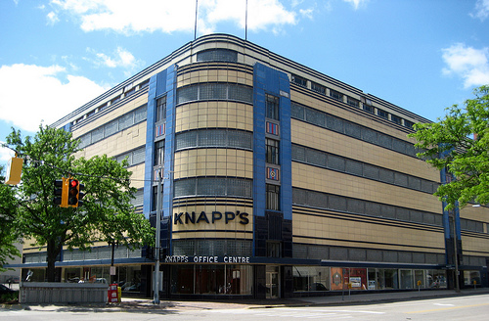
Building #24
Camera
X rot: -10.0212
Y rot: -47.6757
Z rot: -0.35424
FOV: 53.3075
Ox: 0.026938
Oy: -0.134915
X: 2.79845
Y: 2.22712
Z: 49.807
Mass grammar #4
corner: 4.04
depth: 28.63
height: 15.01
width: 32.29
Façade grammar #1
floor height: 2.0
ground floor height: 0.84
tile_hori_margin: 0.2918
tile_vert_margin: 0.632
tile_width: 2.554
top_wall_height: 0.535
Window grammar #3

Slide 15
Building #29
Camera
X rot: -3.87112
Y rot: -47.8845
Z rot: -0.712973
FOV: 53.2012
Ox: 0.213702
Oy: -0.162798
X: 7.51754
Y: -1.10746
Z: 49.9226
Mass grammar #5
depth1: 16.167
depth2: 11.719
height: 8.922
width1: 12.06
width2: 28.318
Façade grammar #2
floor height: 2.680
ground floor height: 4.344
tile_hori_margin: 0.746
tile_vert_margin: 0.499
tile_width: 2.680
top_wall_height: 0.817
Window grammar #2

Slide 16
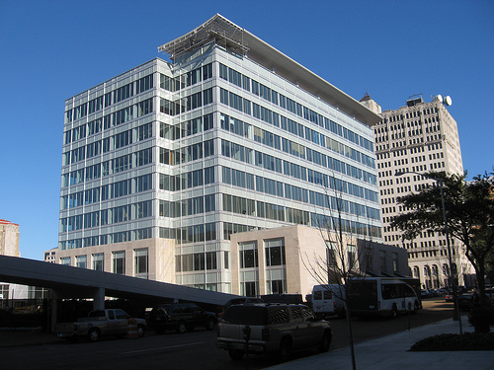
Building #35
Camera
X rot: -11.6024
Y rot: -39.7623
Z rot: 1.87003
FOV: 53.6464
Ox: -0.0907926
Oy: 0.00732733
X: -1.68231
Y: 2.97068
Z: 49.4418
Mass grammar #5
depth1: 1.87001
depth2: 28.583
height: 19.824
width1: 12.68
width2: 4.48
Façade grammar #2
floor height: 2.680
ground floor height: 4.344
tile_hori_margin: 0.746
tile_vert_margin: 0.499
tile_width: 2.680
top_wall_height: 0.817
Window grammar #2

Slide 17
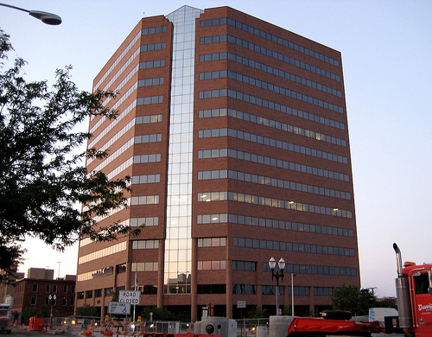
Building #30
Camera
X rot: -16.2982
Y rot: -57.3619
Z rot: 0.334347
FOV: 49.6613
Ox: 0.03592
Oy: -0.05196
X: 1.6979
Y: 0.62611
Z: 54.029
Mass grammar #3
corner: 6.47
depth: 22.48
height: 30.43
width: 22.72
Façade grammar #2
floor height: 2.680
ground floor height: 4.344
tile_hori_margin: 0.746
tile_vert_margin: 0.499
tile_width: 2.680
top_wall_height: 0.817
Window grammar #2

Slide 18
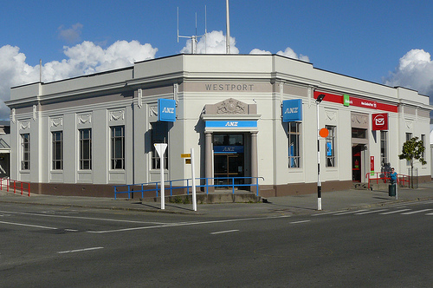
Building #31
Camera
X rot: -1.65489
Y rot: -35.9767
Z rot: 0.85611
FOV: 45.5452
Ox: 0.36911
Oy: 0.0
X: 6.47784
Y: -1.06114
Z: 59.5523
Mass grammar #3
corner: 4.765
depth: 36.61
height: 9.79
width: 31.39
Façade grammar #2
floor height: 2.680
ground floor height: 4.344
tile_hori_margin: 0.746
tile_vert_margin: 0.499
tile_width: 2.680
top_wall_height: 0.817
Window grammar #2

Slide 19
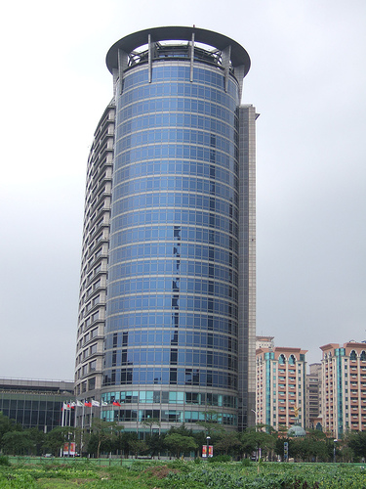
Building #36
Camera
X rot: -24.8643
Y rot:
Z rot: -4.6283
FOV: 27.3684
Ox: 0.07675
Oy: 0.66359
X: 2.99377
Y: 18.1521
Z: 102.677
Mass grammar #2
height: 38.28
radius: 6.72
Façade grammar #2
floor height: 2.680
ground floor height: 4.344
tile_hori_margin: 0.746
tile_vert_margin: 0.499
tile_width: 2.680
top_wall_height: 0.817
Window grammar #2

Slide 20
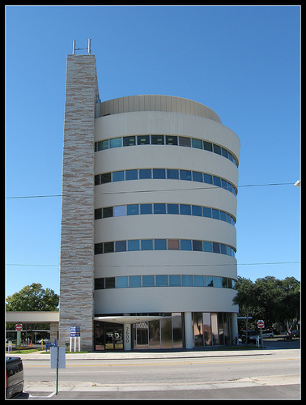
Building #37
Camera
X rot: -24.8643
Y rot:
Z rot: -4.6283
FOV: 27.3684
Ox: 0.07675
Oy: 0.66359
X: 2.99377
Y: 18.1521
Z: 102.677
Mass grammar #2
height: 25.64
radius: 9.08
Façade grammar #2
floor height: 2.680
ground floor height: 4.344
tile_hori_margin: 0.746
tile_vert_margin: 0.499
tile_width: 2.680
top_wall_height: 0.817
Window grammar #2

Slide 21
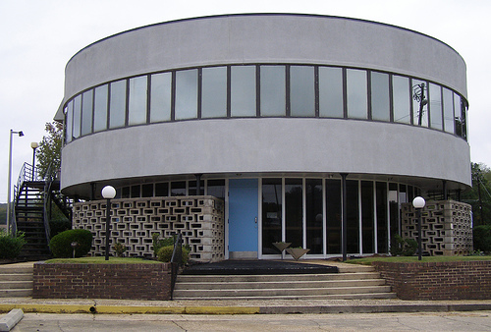
Building #39
Camera
X rot: -8.68038
Y rot:
Z rot: 0.67999
FOV: 45.862
Ox: 0.05068
Oy: 0.08678
X: -0.70802
Y: 2.34453
Z: 59.0941
Mass grammar #2
height: 17.12
radius: 19.76
Façade grammar #2
floor height: 2.680
ground floor height: 4.344
tile_hori_margin: 0.746
tile_vert_margin: 0.499
tile_width: 2.680
top_wall_height: 0.817
Window grammar #2

Slide 22
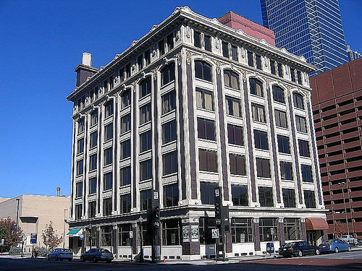
Building #41
Camera
X rot: -12.3084
Y rot: -51.5779
Z rot: 3.30957
FOV: 50.3809
Ox: 0.02533
Oy: -0.01081
X: -0.09173
Y: 3.62984
Z: 53.1507
Mass grammar #6
depth: 21.802
height: 23.274
roof_height: 0.588
roof_overhang: 1.0236
width: 27.414
Façade grammar #2
floor height: 2.680
ground floor height: 4.344
tile_hori_margin: 0.746
tile_vert_margin: 0.499
tile_width: 2.680
top_wall_height: 0.817
Window grammar #2

Slide 23
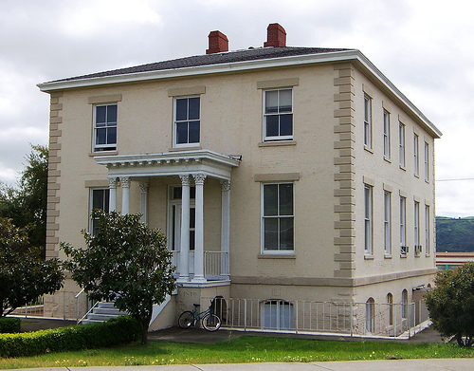
Building #43
Camera
X rot: -5.32297
Y rot: -24.0653
Z rot: -0.650247
FOV: 37.2243
Ox: 0.0329192
Oy: 0.0
X: -2.82702
Y: -0.502197
Z: 74.2339
Mass grammar #7
depth: 37.764
height: 19.916
roof_overhang: 0.76
roof_slope: 21.72
width: 27.782
Façade grammar #2
floor height: 2.680
ground floor height: 4.344
tile_hori_margin: 0.746
tile_vert_margin: 0.499
tile_width: 2.680
top_wall_height: 0.817
Window grammar #2

Slide 24
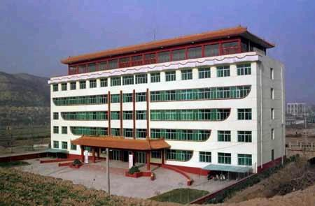
Building #47
Camera
X rot: -2.291
Y rot: -32.546
Z rot: 0.747
FOV: 56.159
Ox: 0.308469
Oy: 0.021573
X: 8.887
Y: 1.064
Z: 46.861
Mass grammar #10
depth: 9.520
depth_offset_ratio: 0.097
height1: 13.360
height2: 2.210
width: 40.294
width_offset_ratio: 0.056
Façade grammar #2
floor height: 2.680
ground floor height: 4.344
tile_hori_margin: 0.746
tile_vert_margin: 0.499
tile_width: 2.680
top_wall_height: 0.817
Window grammar #2

