Slide 1
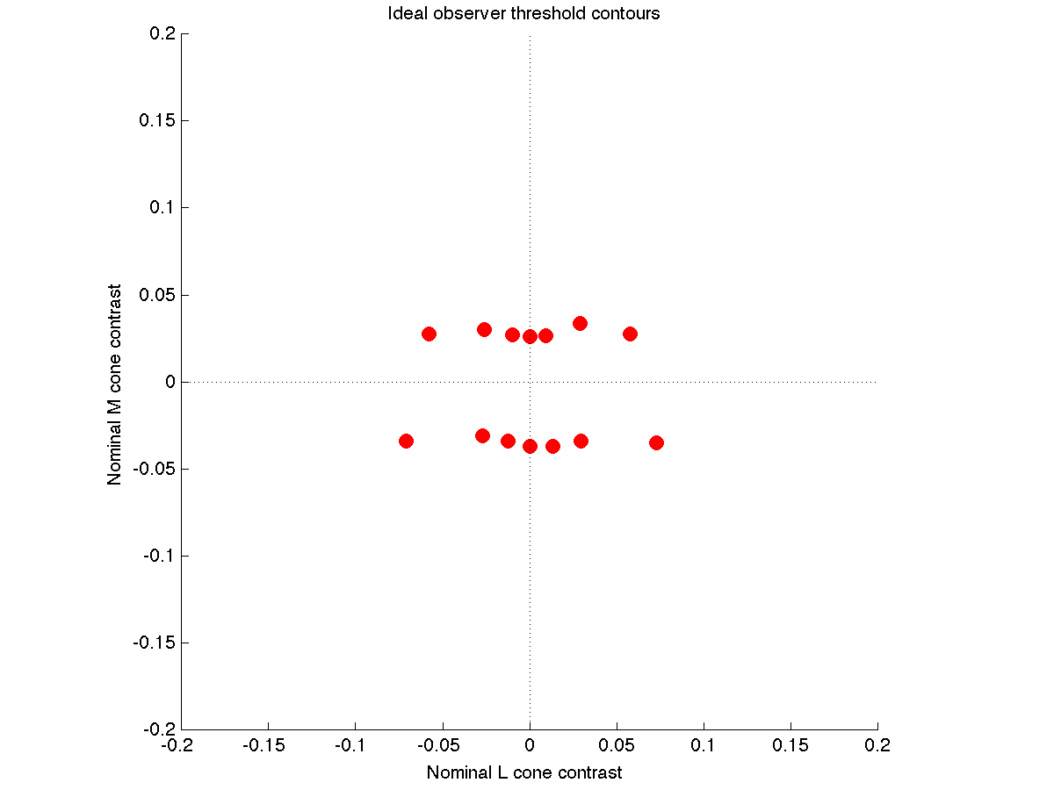
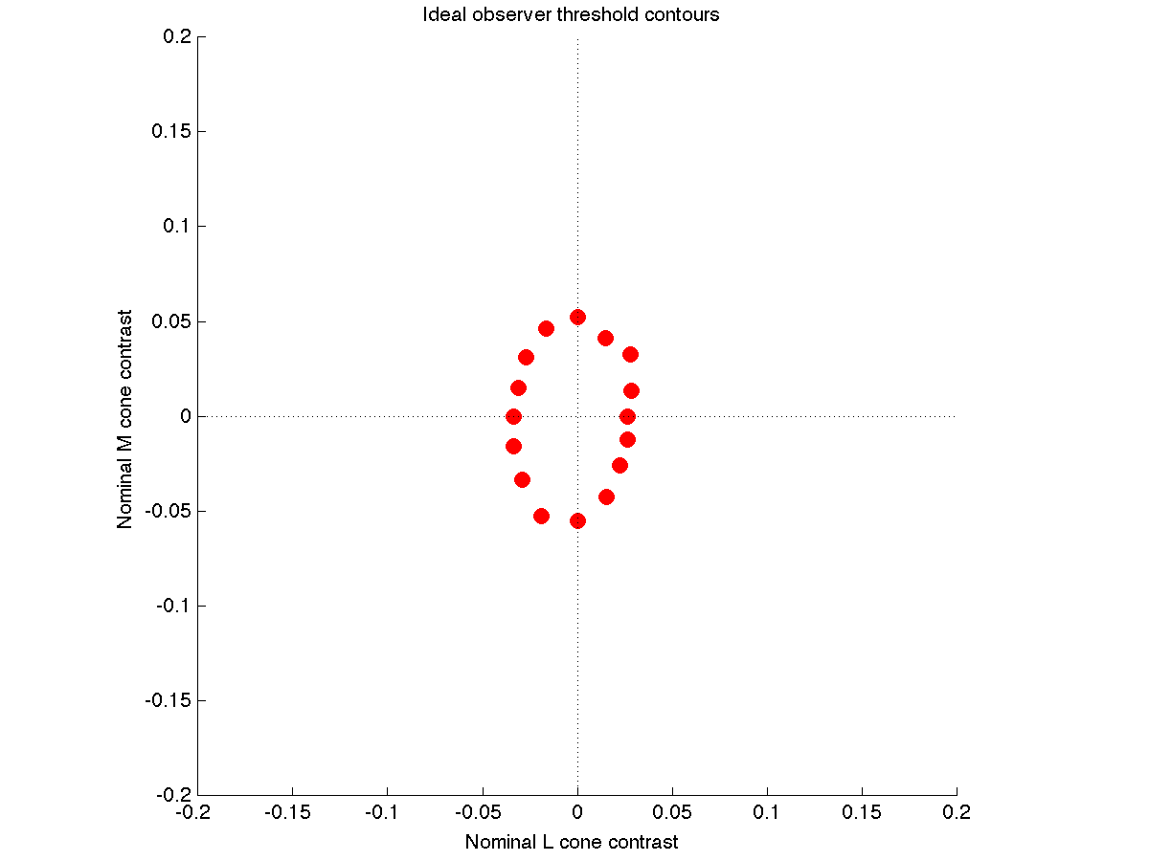
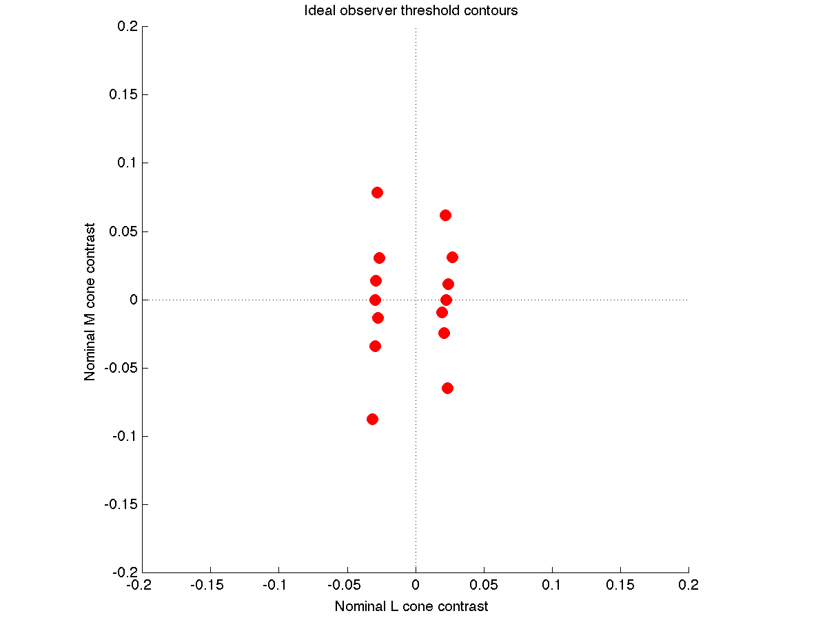
SVM at Cones
Early simulations, 9/2/13
Trichromats: 4 L, 2 M, 1 S cone. Poisson noise. TAFC.
CIE 2-deg fundamentals, quantum efficiency computed with PTB
Apple LCD primaries, about 60 cd/m2 mean luminance
These are replacement dichromats, so the have:
6 M, 1S (protanope), 6 L, 1 S (deuteranope)
This should lead to slightly higher dichromatic sensitivity in the
relevant isolating direction. Yes for M, not so much for L. The sqrt
of 1.5 is less than the sqrt of 3. That might be it. I haven’t checked
in detail.

Slide 2
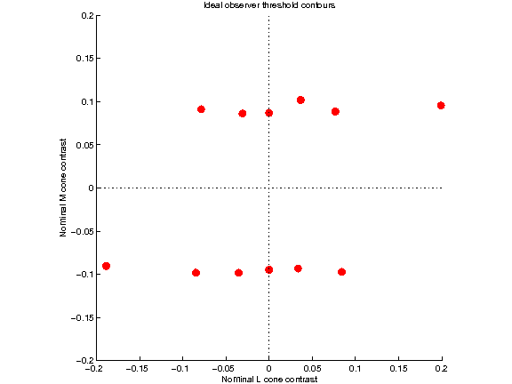
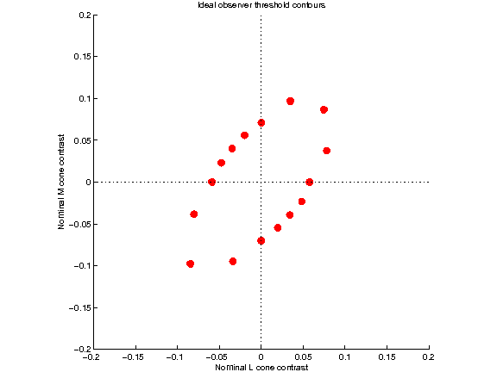
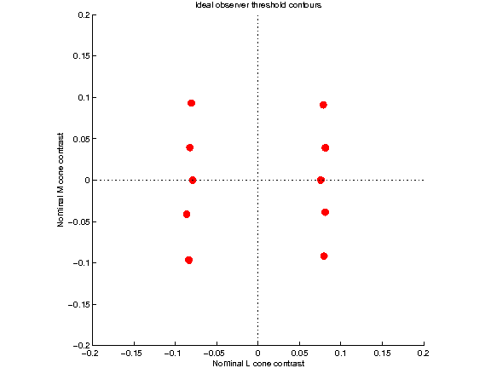
SVM at Second Site, Second Site Noise, Cone Specific Surrounds
Early simulations, 9/2/13
Trichromats: 4 L, 2 M, 1 S cone. Poisson noise. TAFC.
CIE 2-deg fundamentals, quantum efficiency computed with PTB
Apple LCD primaries, about 60 cd/m2 mean luminance
Cone specific L/M surrounds, 0.7 surround weight.
Gaussian noise at second site, Fano factor 4.
These are replacement dichromats, so the have:
6 M, 1S (protanope), 6 L, 1 S (deuteranope)
For this model, the dichromats are less sensitive than the
trichromats in all color directions. I think this makes sense,
although I don’t yet have a clean formal argument.

Slide 3
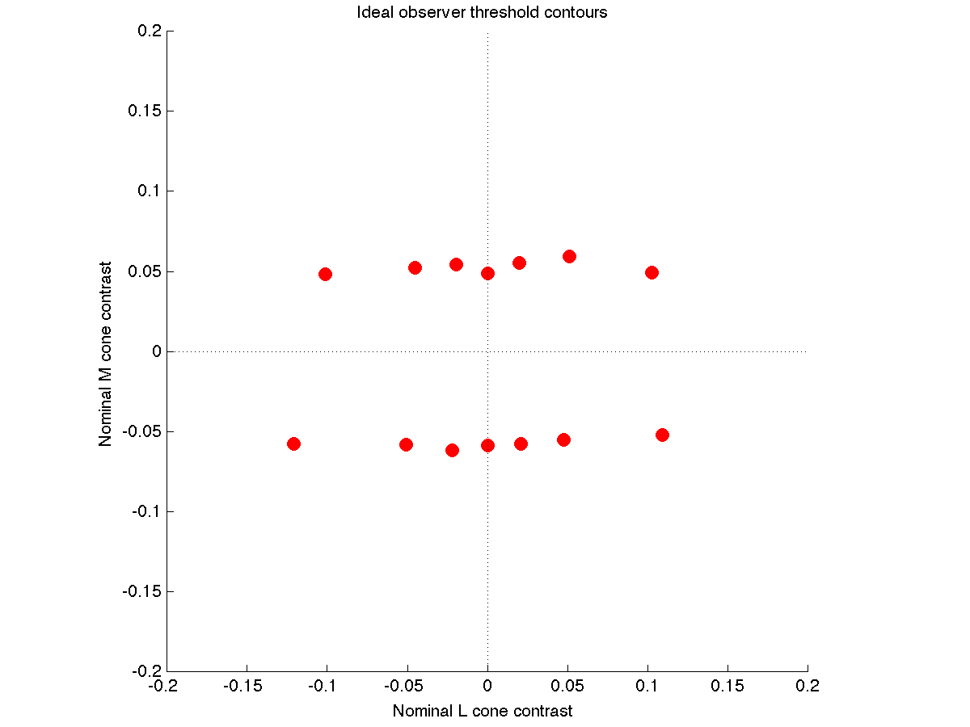
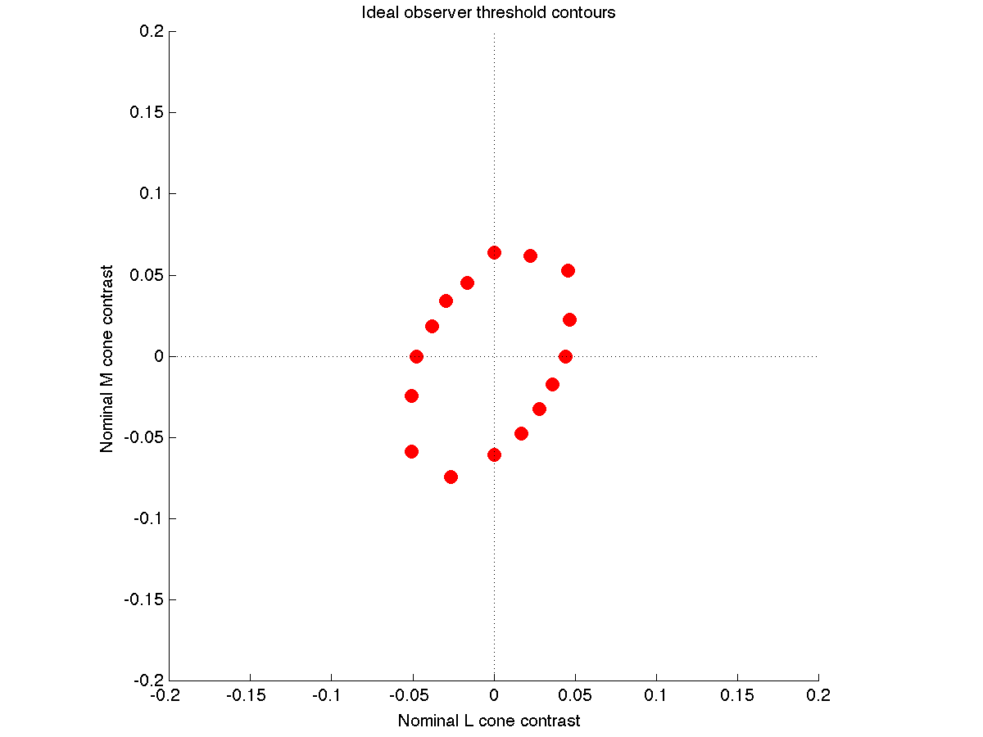
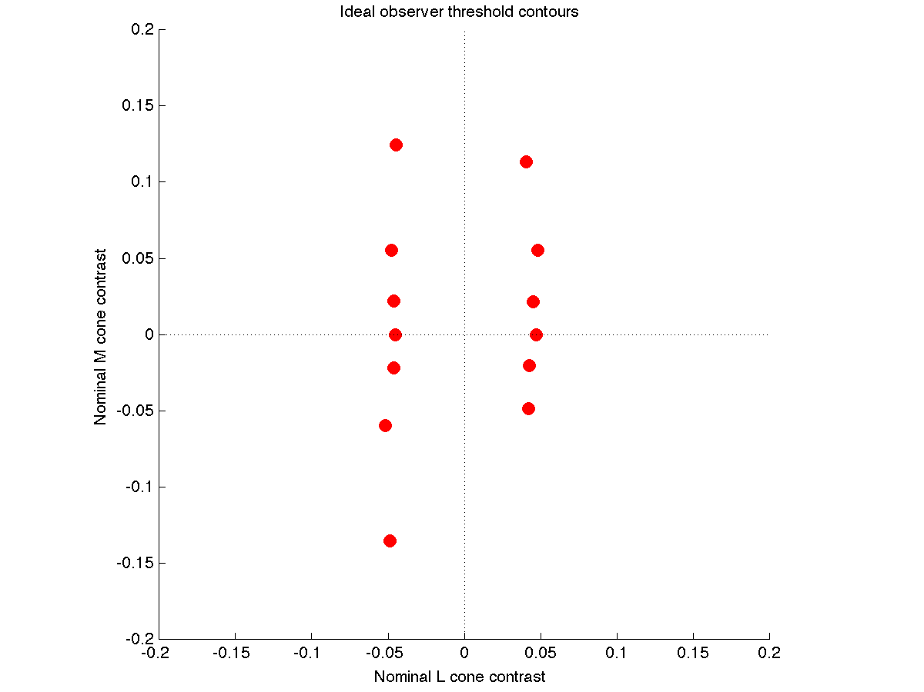
SVM at Second Site, Less Second Site Noise, Cone Specific Surrounds
Early simulations, 9/2/13
Trichromats: 4 L, 2 M, 1 S cone. Poisson noise. TAFC.
CIE 2-deg fundamentals, quantum efficiency computed with PTB
Apple LCD primaries, about 60 cd/m2 mean luminance
Cone specific L/M surrounds, 0.7 surround weight.
Gaussian noise at second site, Fano factor 1.
These are replacement dichromats, so the have:
6 M, 1S (protanope), 6 L, 1 S (deuteranope)
Perhaps not surprisingly, this seems in between the SVM at the
cones and the case where there is more noise at the second site.

Slide 4
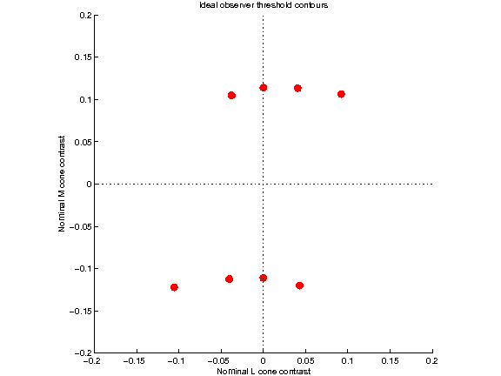
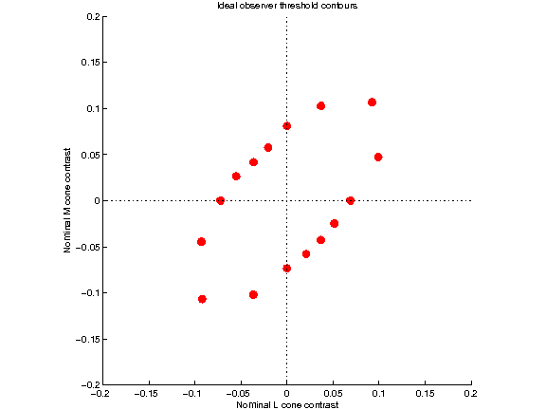
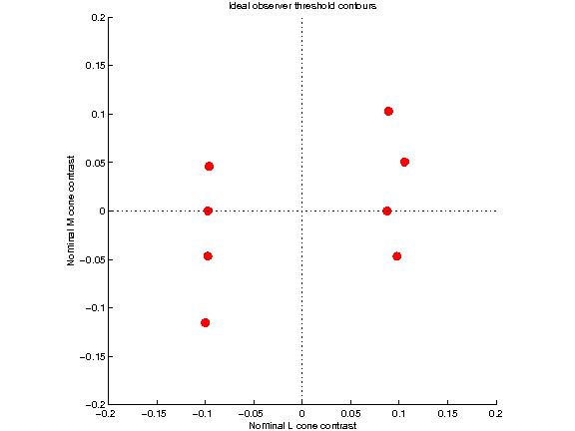
SVM at Second Site, Second Site Noise, Cone Random Surrounds
Early simulations, 9/2/13
Trichromats: 4 L, 2 M, 1 S cone. Poisson noise. TAFC.
CIE 2-deg fundamentals, quantum efficiency computed with PTB
Apple LCD primaries, about 60 cd/m2 mean luminance
Cone specific L/M surrounds, 0.7 surround weight.
Gaussian noise at second site, Fano factor 4.
These are replacement dichromats, so the have:
6 M, 1S (protanope), 6 L, 1 S (deuteranope)
This looks pretty much like the cone specific picture, but with
slightly higher thresholds. I don’t understand why the dichromats
differ, because with just one LM cone type I think the model is the same
with random and cone selective surrounds.

Slide 5
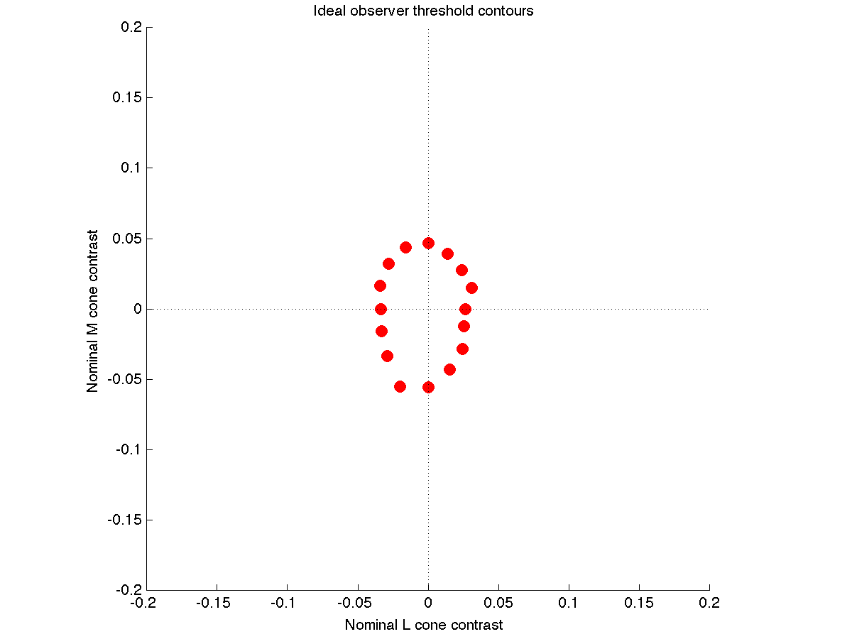
SVM at Second Site, No Second Site Noise
Early simulations, 9/2/13
Trichromats: 4 L, 2 M, 1 S cone. Poisson noise. TAFC.
CIE 2-deg fundamentals, quantum efficiency computed with PTB
Apple LCD primaries, about 60 cd/m2 mean luminance
Upper right panel, SVM at cones.
Upper left and lower right panels (both same), SVM at opponent site.
This looks just like putting the SVM at the cones, which is should since
without second site noise the information is unchanged.

