Slide 1
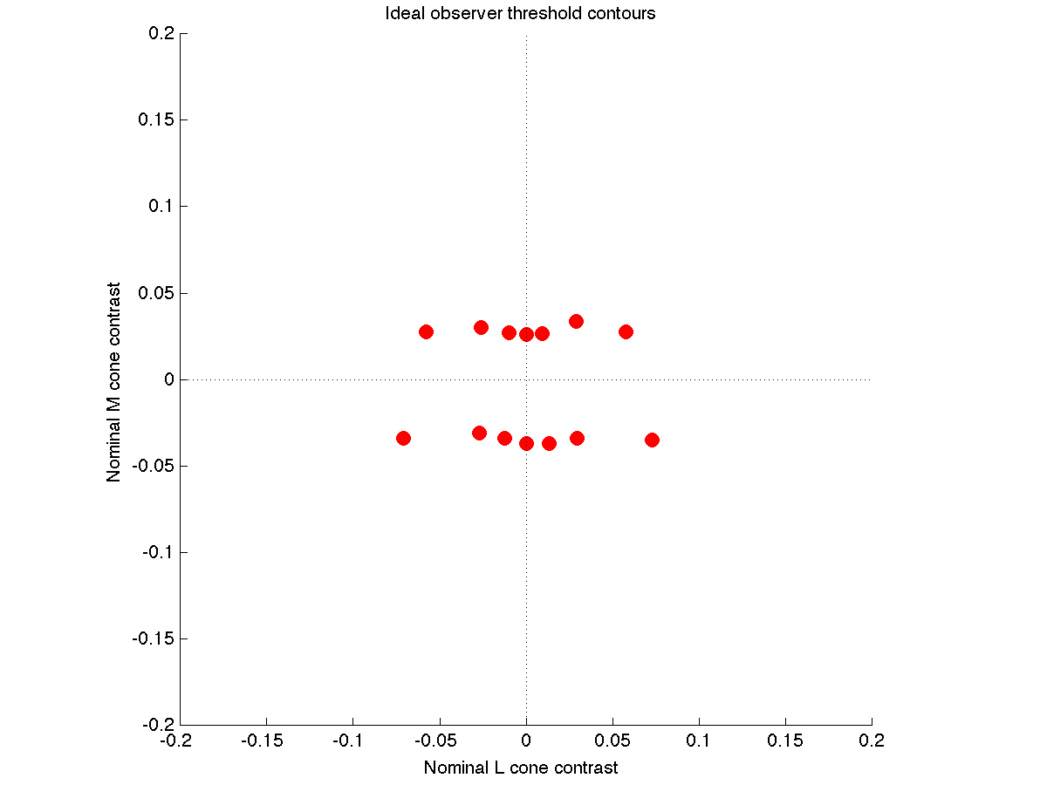
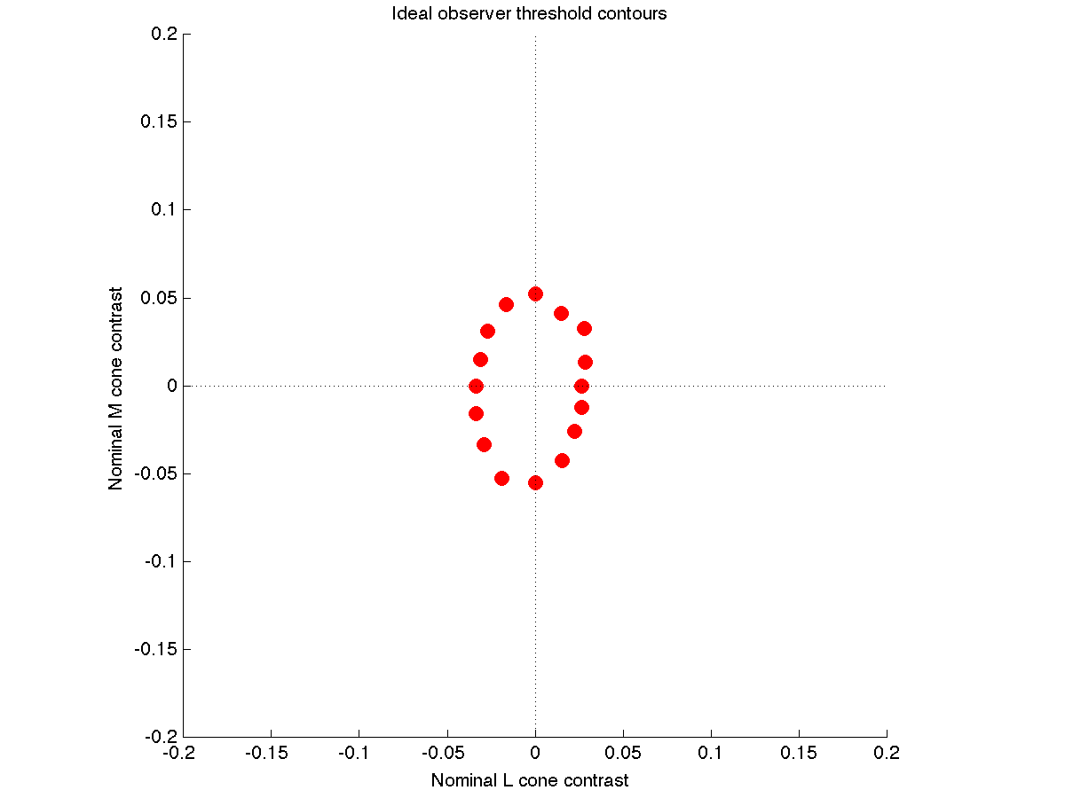
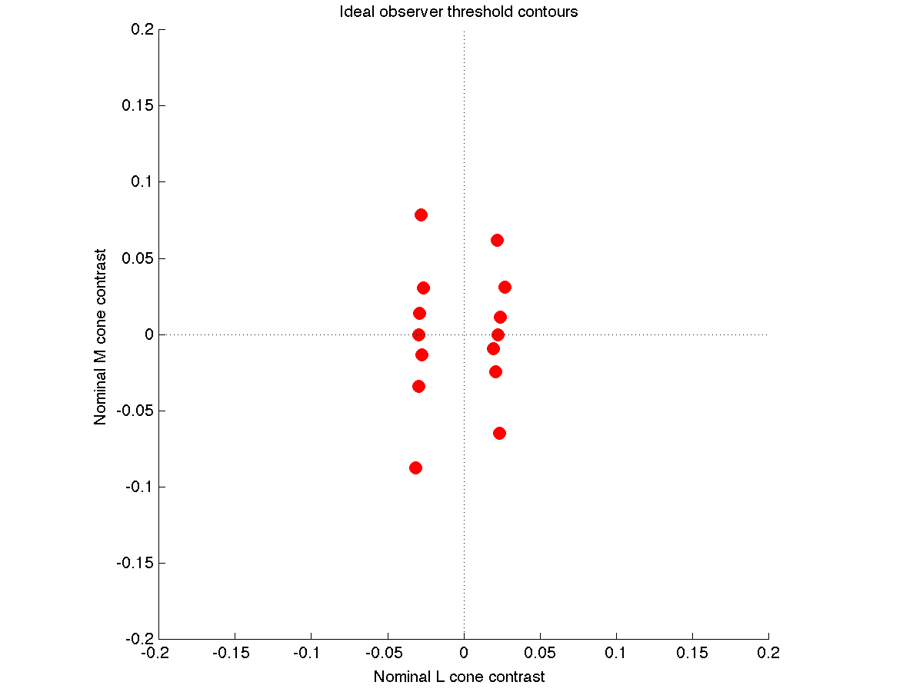
SVM at Cones
Early simulations, 9/2/13
Trichromats: 4 L, 2 M, 1 S cone. Poisson noise. TAFC.
CIE 2-deg fundamentals, quantum efficiency computed with PTB
Apple LCD primaries, about 60 cd/m2 mean luminance
These are replacement dichromats, so the have:
6 M, 1S (protanope), 6 L, 1 S (deuteranope)
This should lead to slightly higher dichromatic sensitivity in the
relevant isolating direction. Yes for M, not so much for L (?)

Slide 2
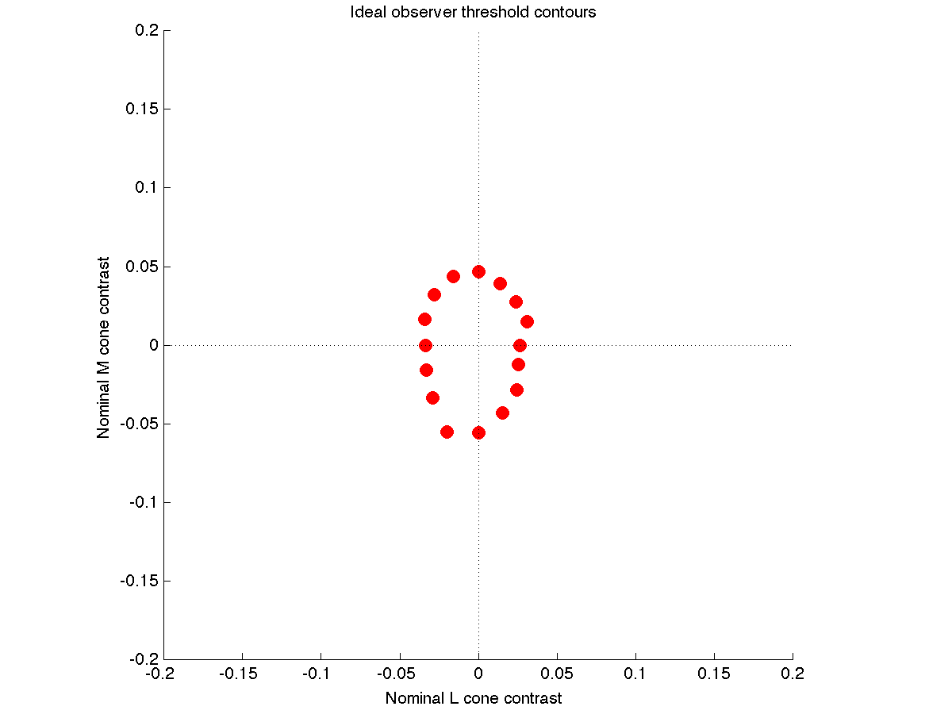
SVM at Opponent Site, No Opponent Site Noise
Early simulations, 9/2/13
Trichromats: 4 L, 2 M, 1 S cone. Poisson noise. TAFC.
CIE 2-deg fundamentals, quantum efficiency computed with PTB
Apple LCD primaries, about 60 cd/m2 mean luminance
Upper right panel, SVM at cones.
Upper left and lower right panels (both same), SVM at opponent site.
This has little if any effect. That is as it should be.

Slide 3
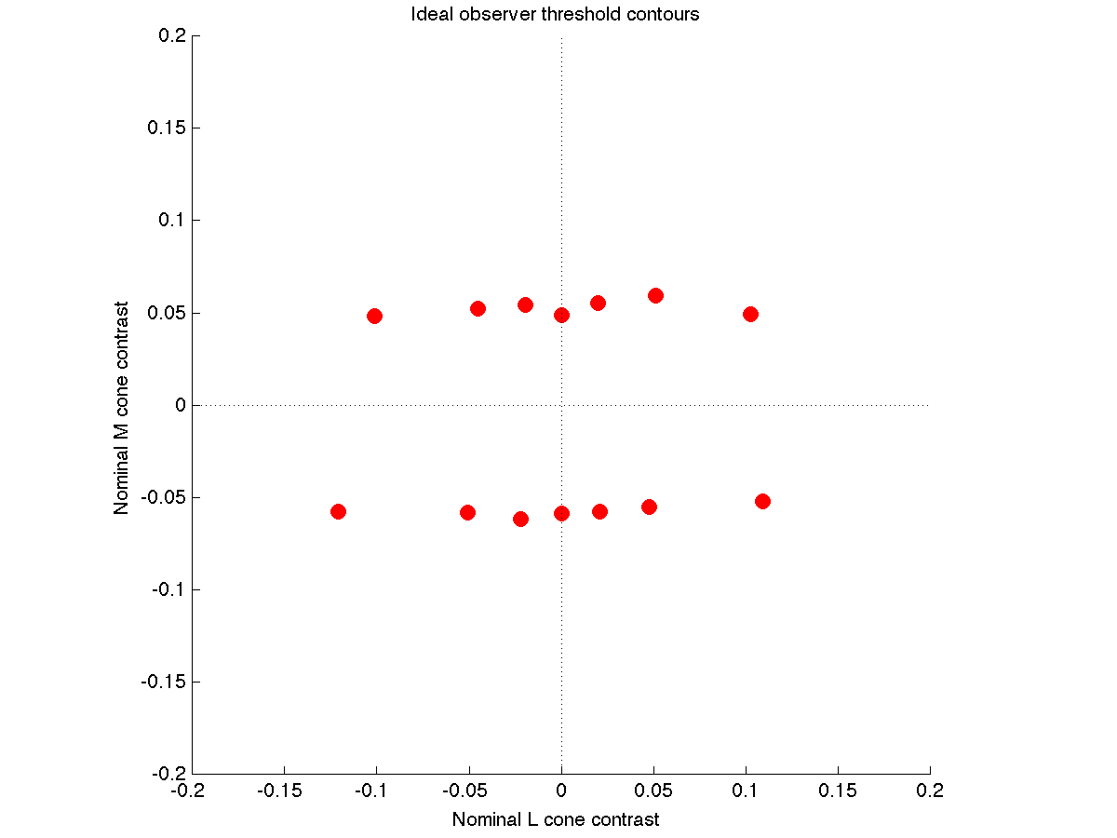
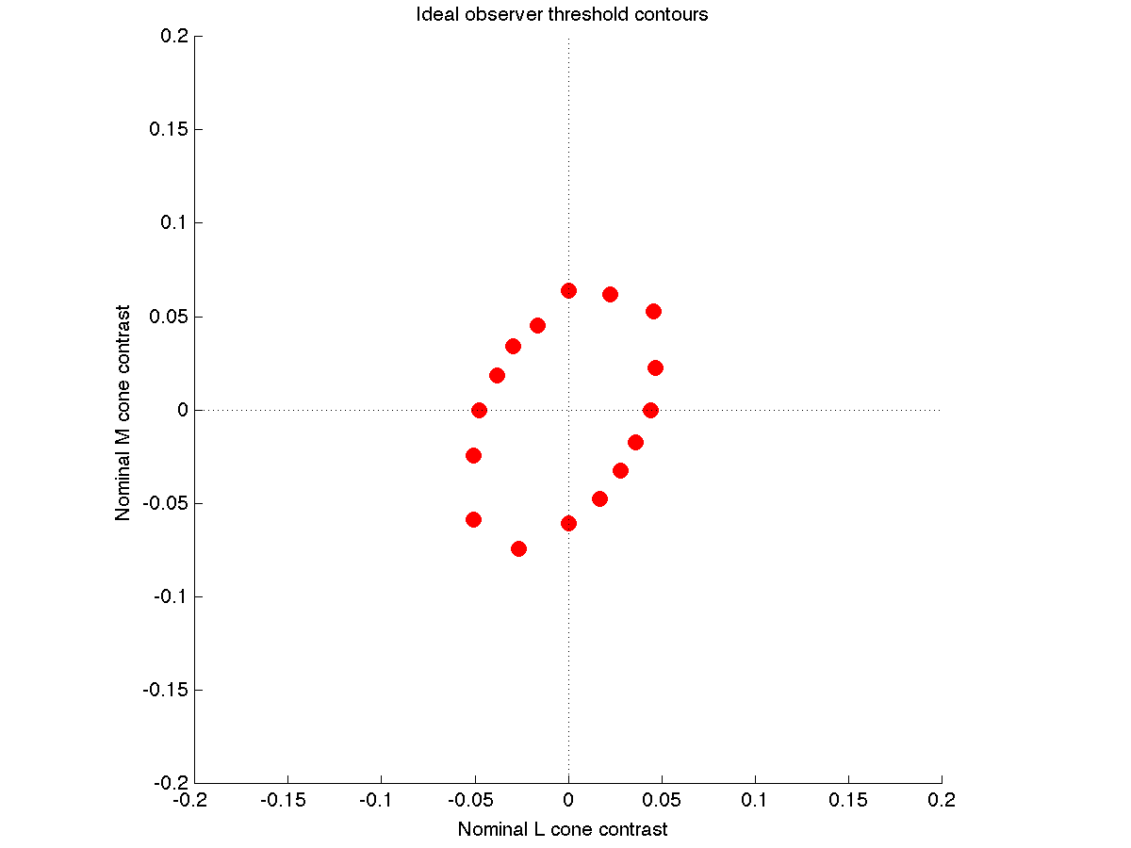
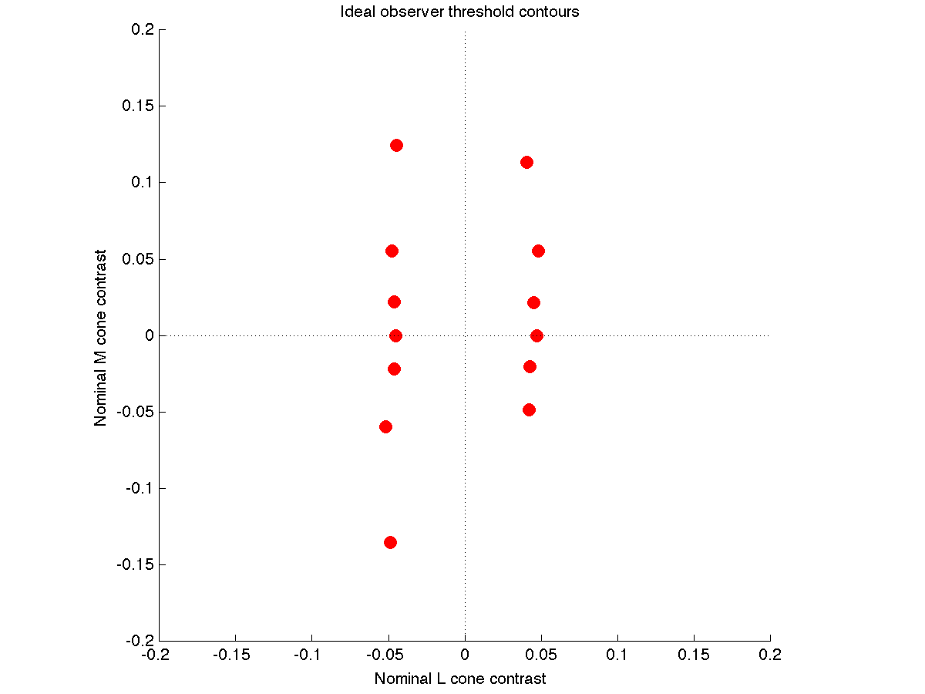
SVM at Second Site, Second Site Noise, Cone Specific Surrounds
Early simulations, 9/2/13
Trichromats: 4 L, 2 M, 1 S cone. Poisson noise. TAFC.
CIE 2-deg fundamentals, quantum efficiency computed with PTB
Apple LCD primaries, about 60 cd/m2 mean luminance
Cone specific L/M surrounds, 0.7 surround weight.
Gaussian noise at second site, Fano factor 1.
These are replacement dichromats, so the have:
6 M, 1S (protanope), 6 L, 1 S (deuteranope)

