Slide 1
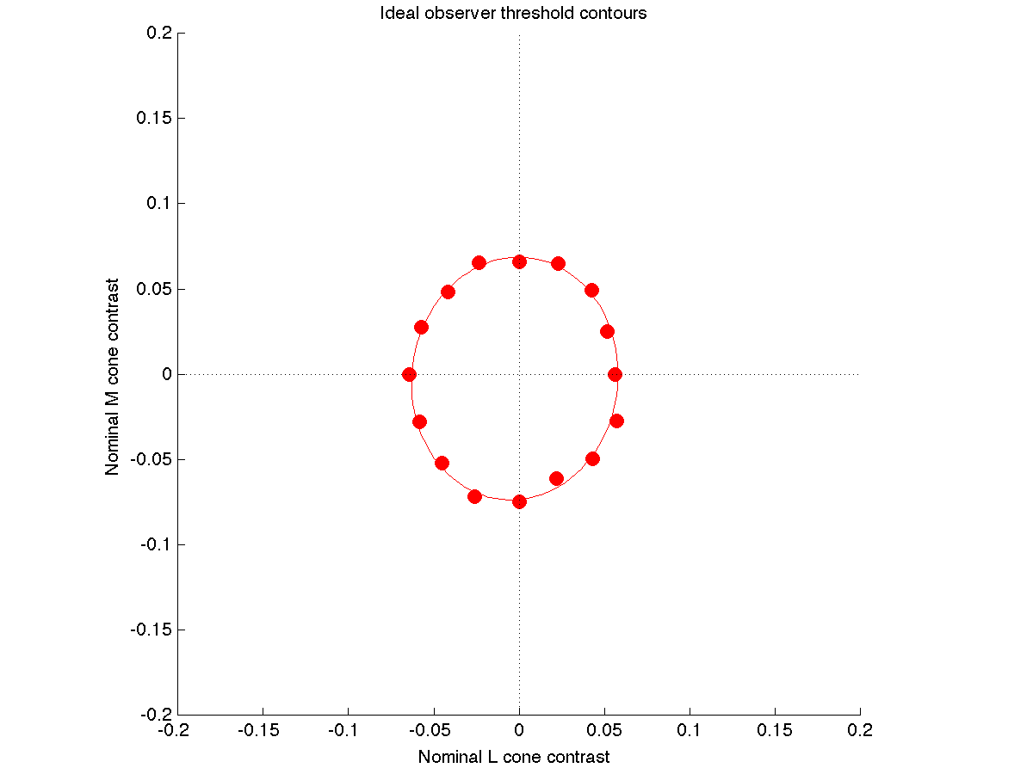
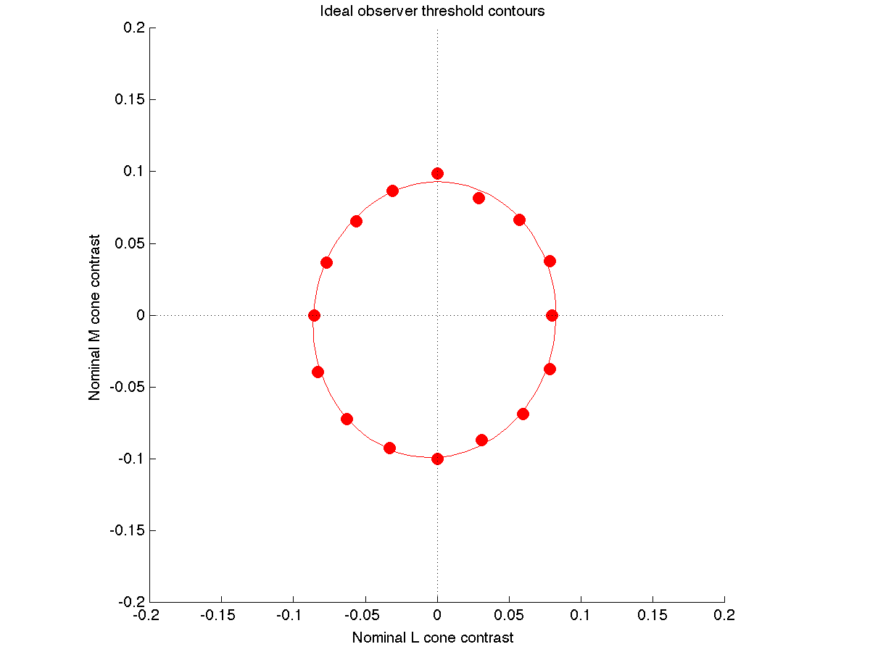
TAFC versus Y/N simulations
Early simulations, 8/14/13
1 L, 1M, 1S cone. Poisson noise.
CIE 2-deg fundamentals, quantum efficiency computed with PTB
Apple LCD primaries, about 60 cd/m2 mean luminance

Slide 2
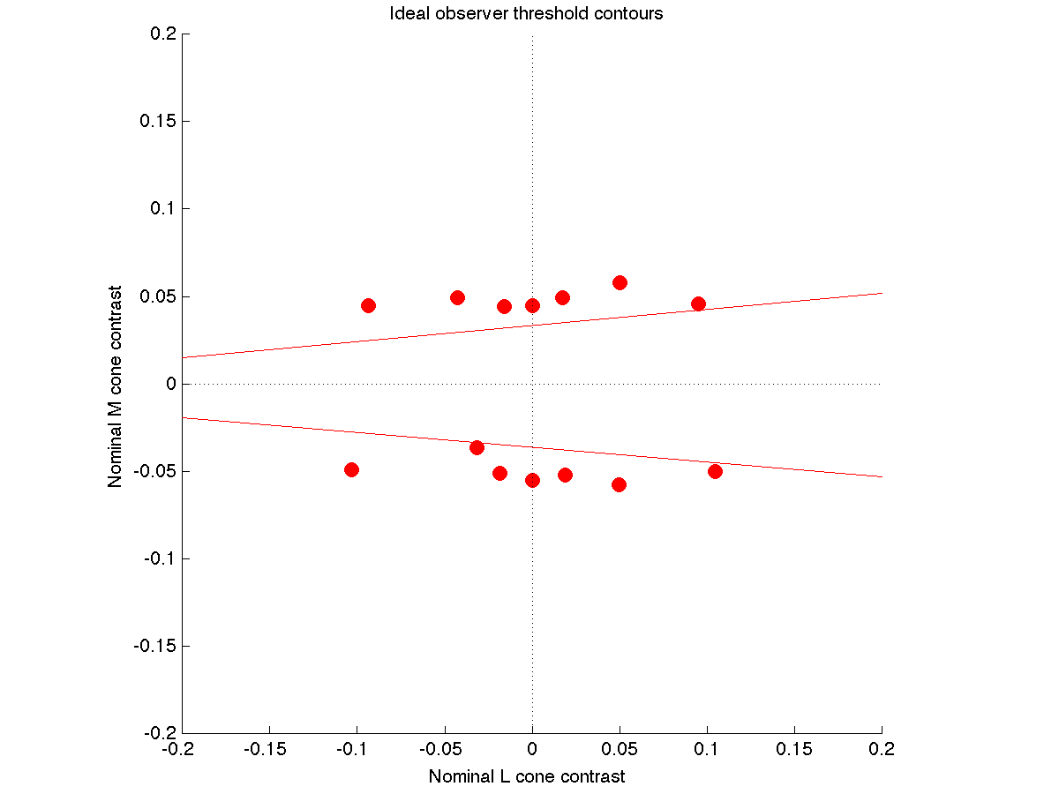
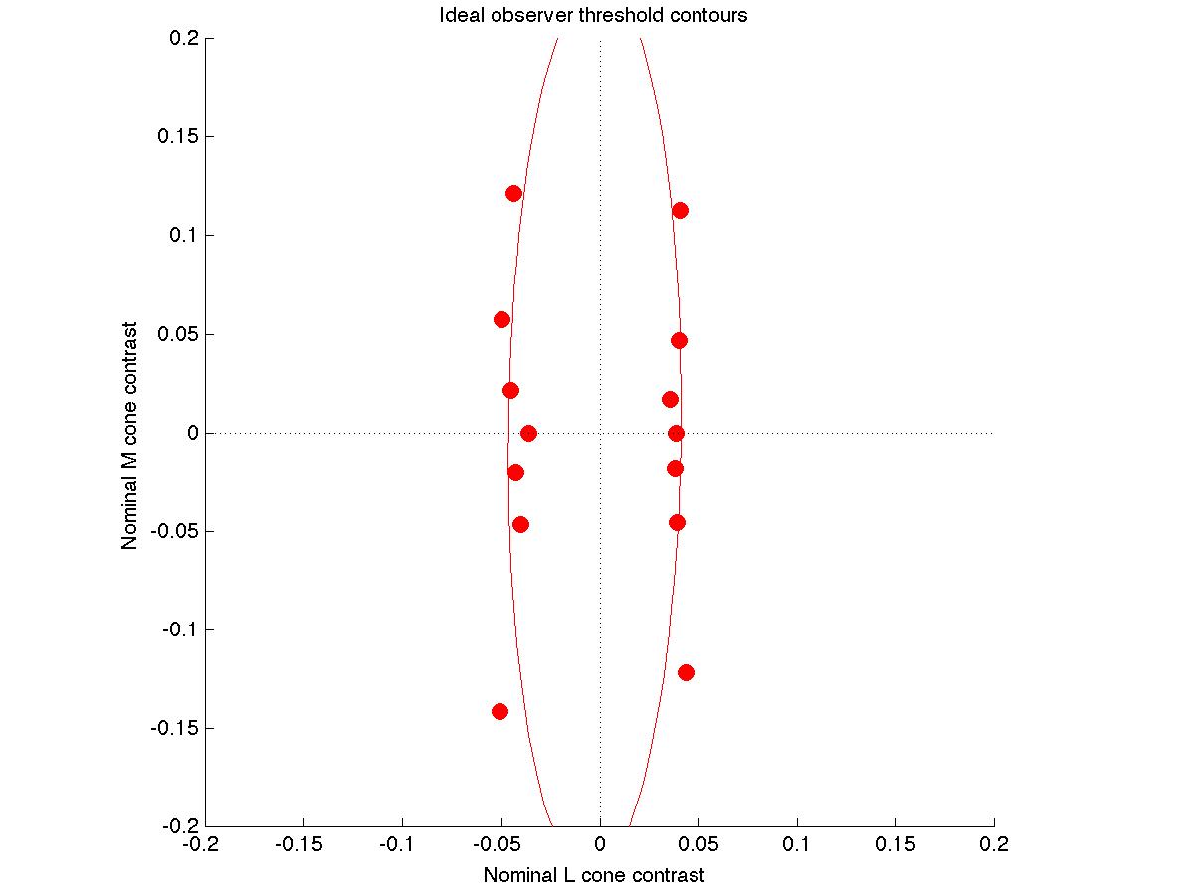
Dichromat versus trichromat
Early simulations, 8/14/13
Trichromats: 1 L, 1M, 1S cone. Poisson noise. TAFC.
CIE 2-deg fundamentals, quantum efficiency computed with PTB
Apple LCD primaries, about 60 cd/m2 mean luminance
These are replacement dichromats, so the have:
2 M, 1S (protanope), 2L, 1S (deuteranope)
This leads to slightly higher dichromatic sensitivity in the
relevant isolating direction. (Dashed lines drawn by hand in ppt.)

Slide 3
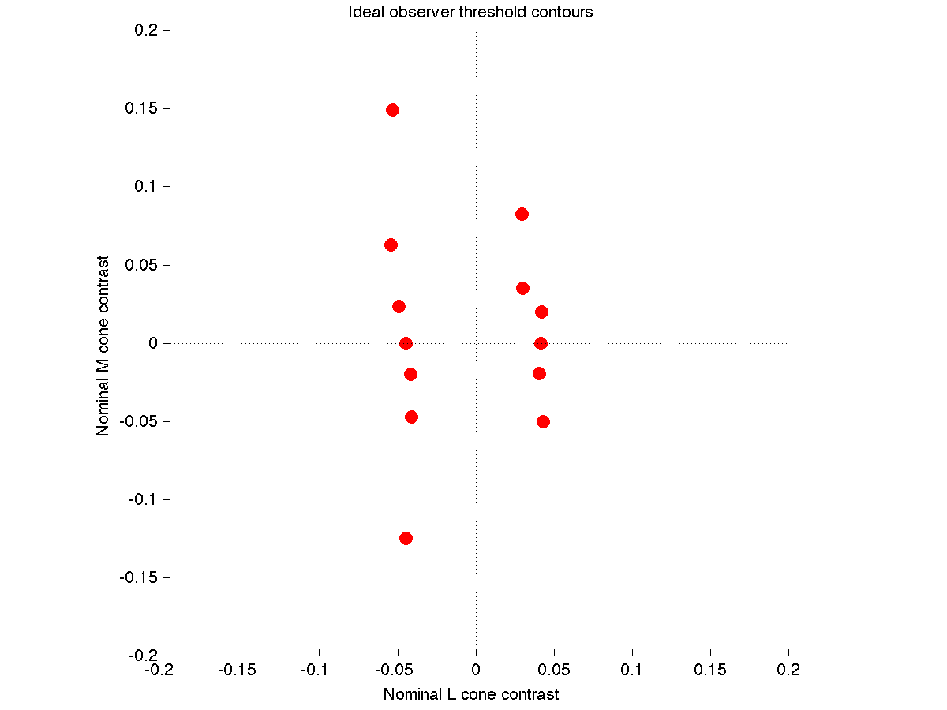
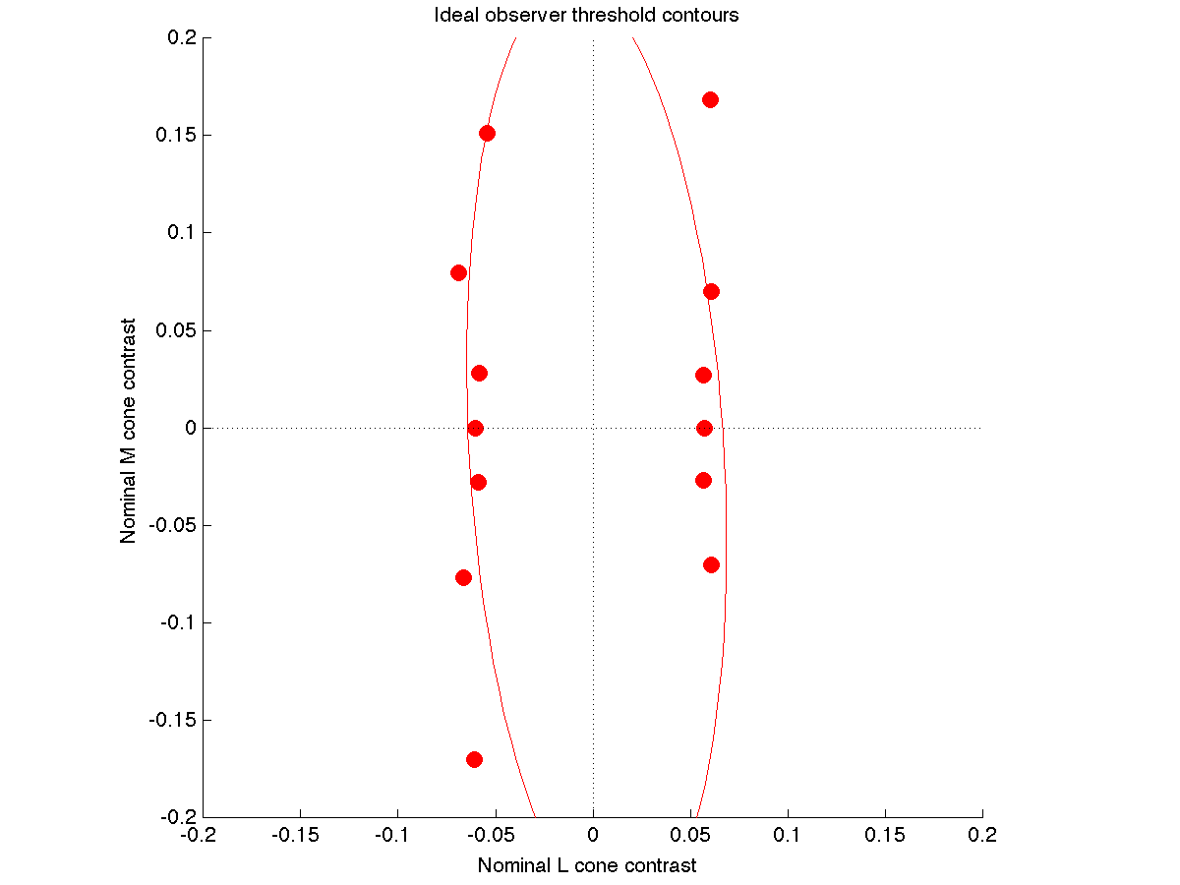
Effect of macular pigment on deuteranope contours
Early simulations, 8/14/13
2L, 1S (deuteranope). Poisson noise. TAFC.
CIE 2-deg fundamentals, quantum efficiency computed with PTB
Apple LCD primaries, about 60 cd/m2 mean luminance
From left to right, macular pigment density adjusted by -0.3, 0, and 0.3
Note that these should be fit by pairs of lines, not ellipses. And, the
ellipse in the right hand plot gives a misleading impression of the
tilt of the data.

Slide 4
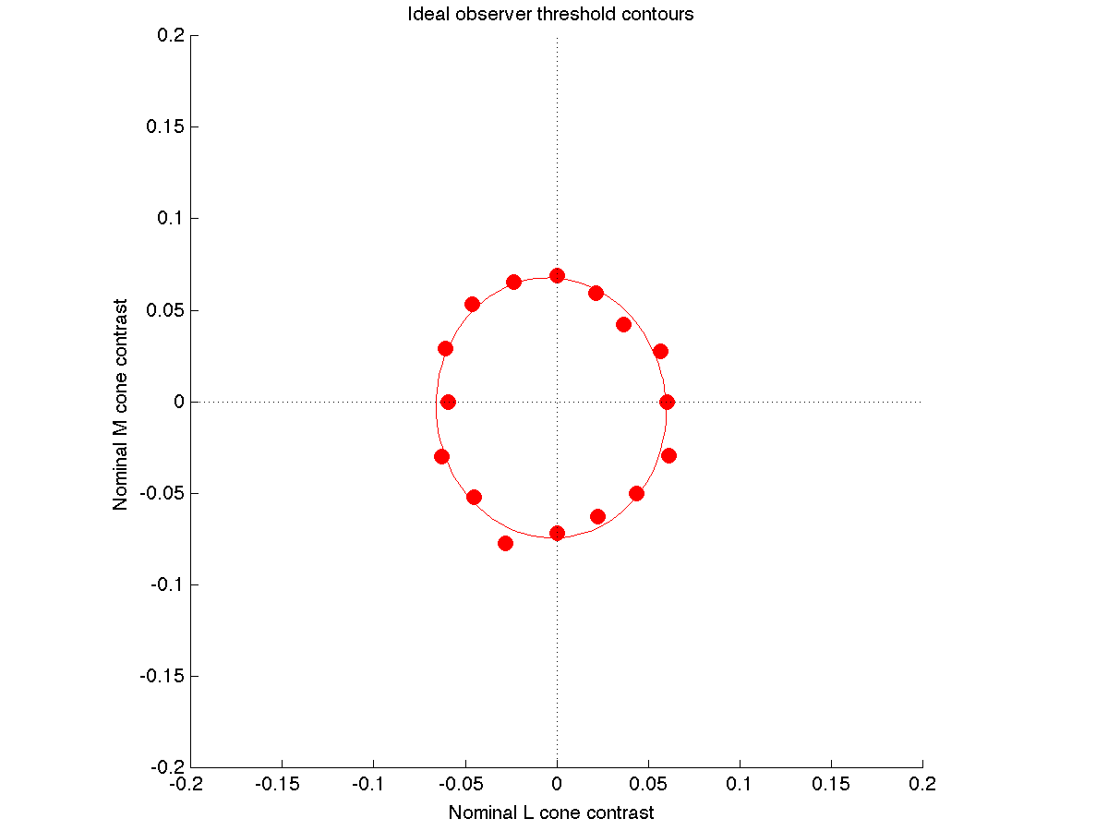
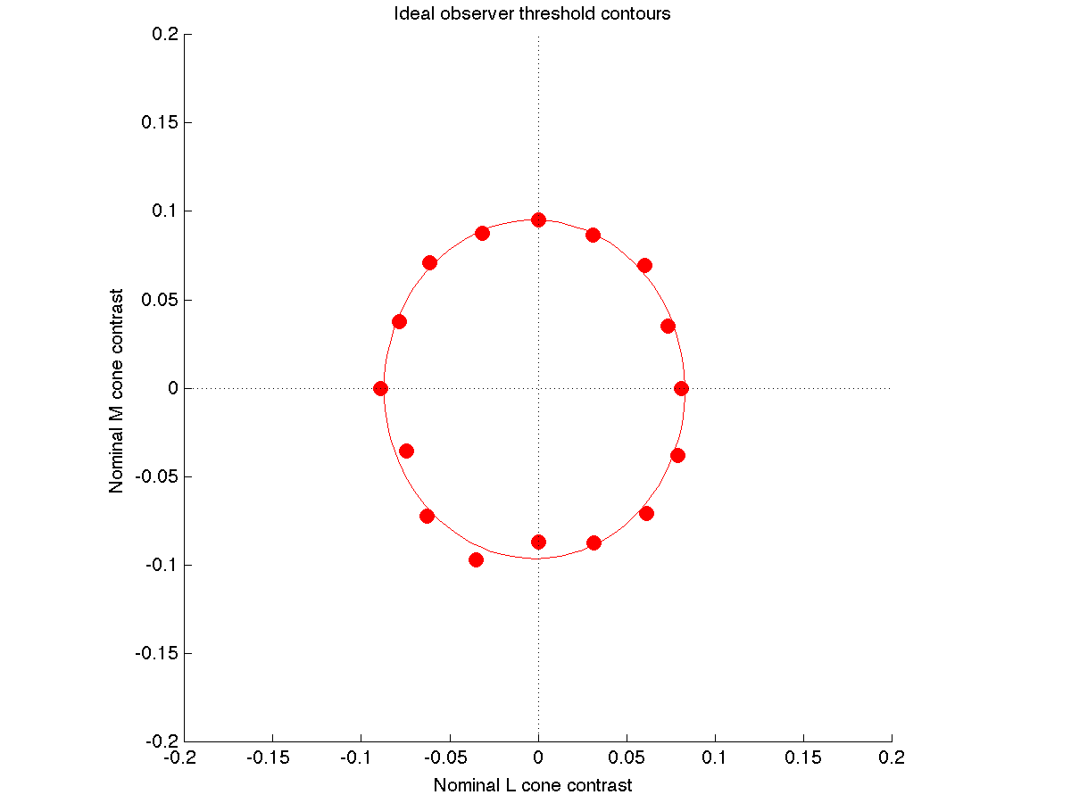
Effect of macular pigment on trichromat contours
Early simulations, 8/14/13
1 L, 1M, 1S cone. Poisson noise. TAFC.
CIE 2-deg fundamentals, quantum efficiency computed with PTB
Apple LCD primaries, about 60 cd/m2 mean luminance
From left to right, macular pigment density adjusted by -0.3, 0, and 0.3
It seems right that the contour gets bigger with more macular pigment.
I am not sure why it doesn’t get smaller with less. Need to look at
the actual spectral quantal efficiencies

