Slide 1
Soft Computing Particle swarm optimization Sphere function & Rastrigin function
M10159011 杜雪吟

Slide 2
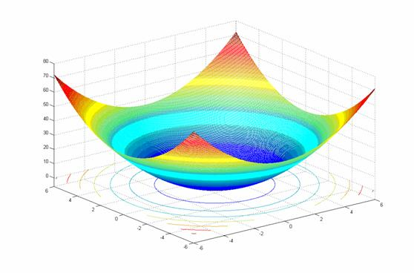
Sphere Function
The global minima
X² = (0, 0) , f(x²) = 0

Slide 3
Sphere Function - parameters
Particle number: 100
Search domain: -100 < X_{i} < 100
C₁: 2
C₂: 2
Rand₁: 0.26159124447458926
Rand₂: 0.056226893824293245
V₀: [0, 0]
W: 0
Terminate condition: t = 100

Slide 4
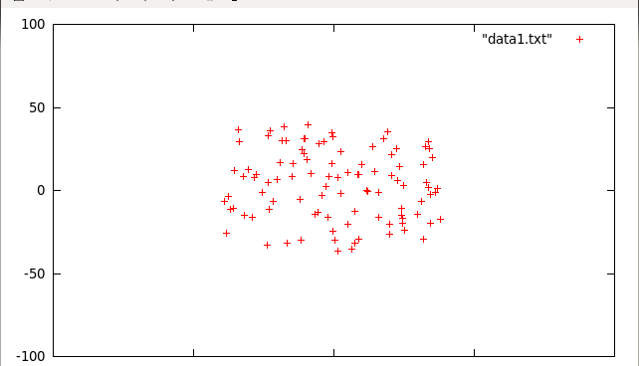
Sphere Function - Process (1/7)

Slide 5
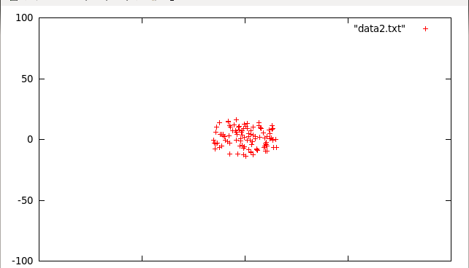
Sphere Function - Process (2/7)

Slide 6
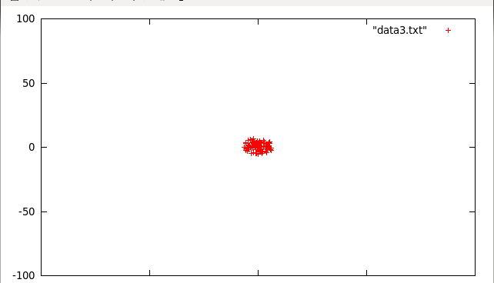
Sphere Function - Process (3/7)

Slide 7
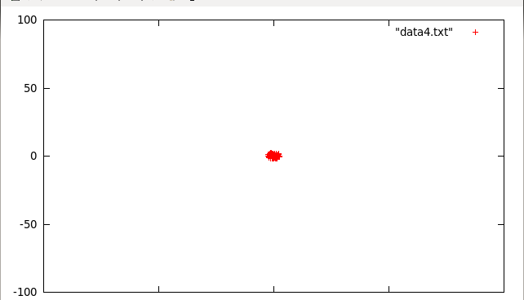
Sphere Function - Process (4/7)

Slide 8
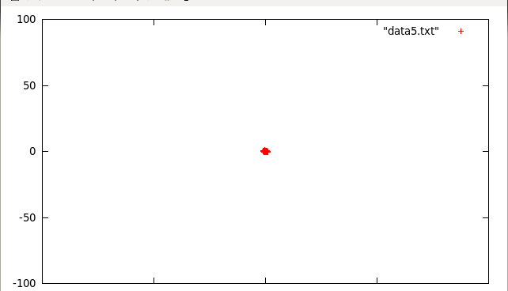
Sphere Function - Process (5/7)

Slide 9

Sphere Function - Process (6/7)

Slide 10
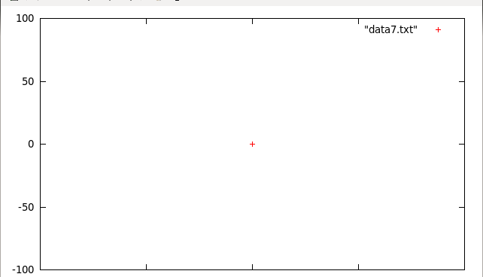
Sphere Function - Process (7/7)

Slide 11
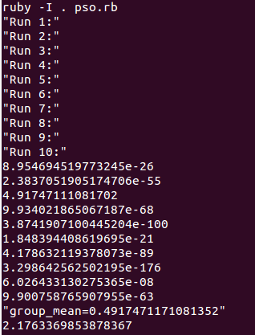
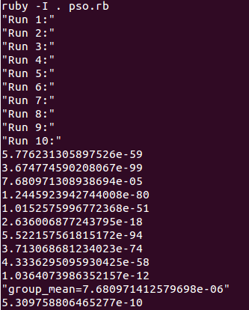
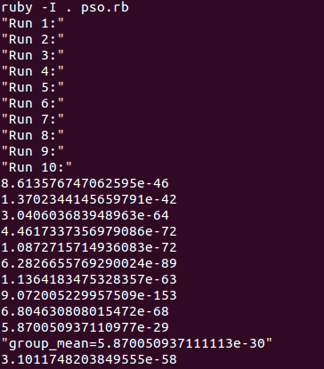
Sphere Function - statistics
N=20
N=50
N=100

Slide 12
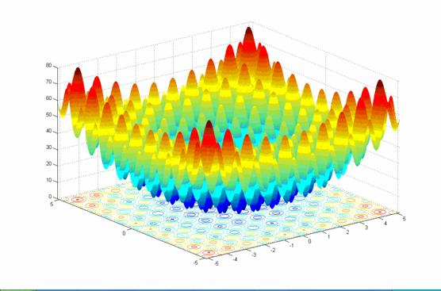
rastrigin Function
The global minima
X² = (0, 0) , f(x²) = 0

Slide 13
Rastrigin function - PARAMETERS
Particle number: 100
Search domain: -4 < X_{i} < 4
C₁: 2
C₂: 2
Rand₁: 0.28019110555769167
Rand₂: 0.081576937926788
V₀: [0, 0]
W: 0
Terminate condition: t = 100

Slide 14
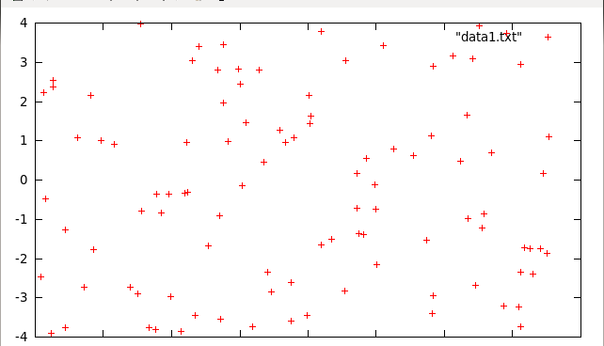
rastrigin Function - Process (1/7)

Slide 15
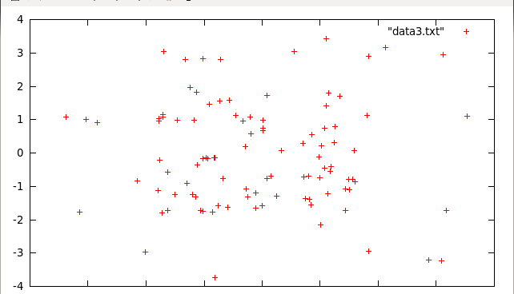
rastrigin Function - Process (2/7)

Slide 16
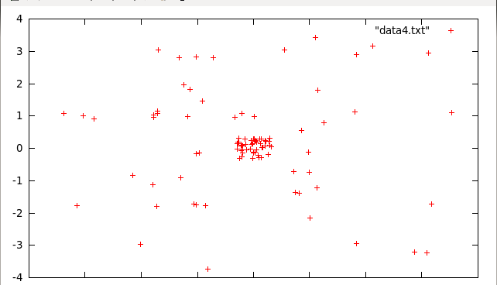
rastrigin Function - Process (3/7)

Slide 17
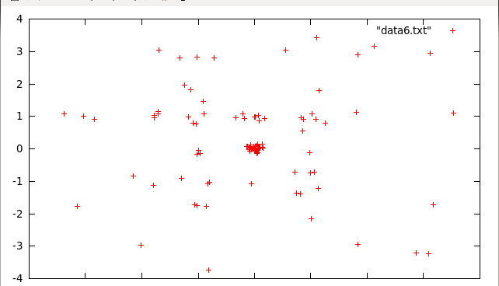
rastrigin Function - Process (4/7)

Slide 18
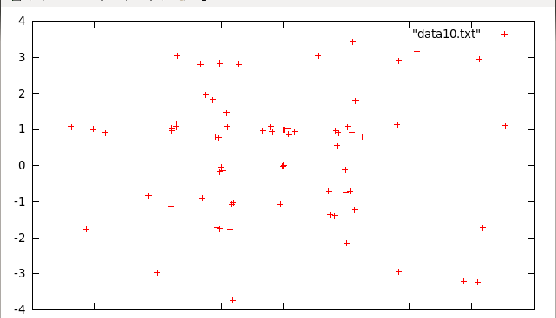
rastrigin Function - Process (5/7)

Slide 19
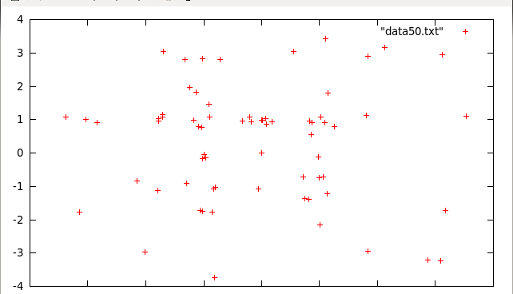
rastrigin Function - Process (6/7)

Slide 20

rastrigin Function - Process (7/7)

Slide 21
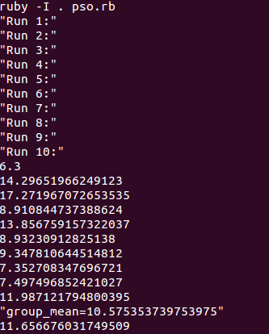
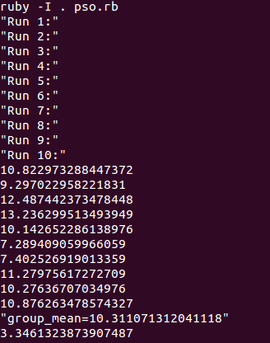
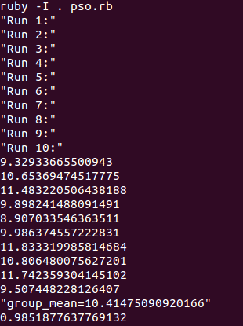
rastrigin Function - statistics
N=20
N=50
N=100

Slide 22
Thank you!
Monica.service@gmail.com

