Slide 1
GA algorithm Find Global minimum of SPHERE function & rastrigin fucntion
M10159011 杜雪吟

Slide 2
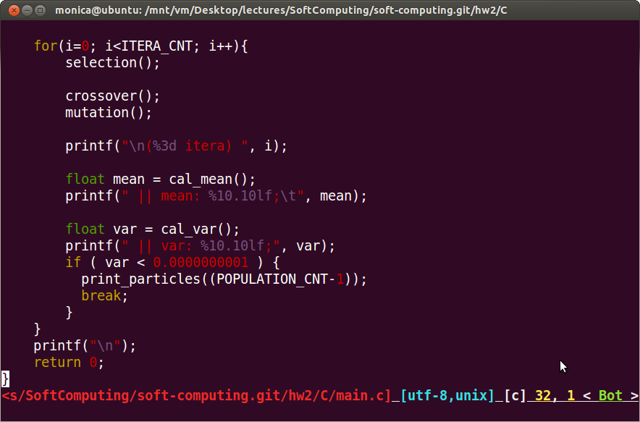
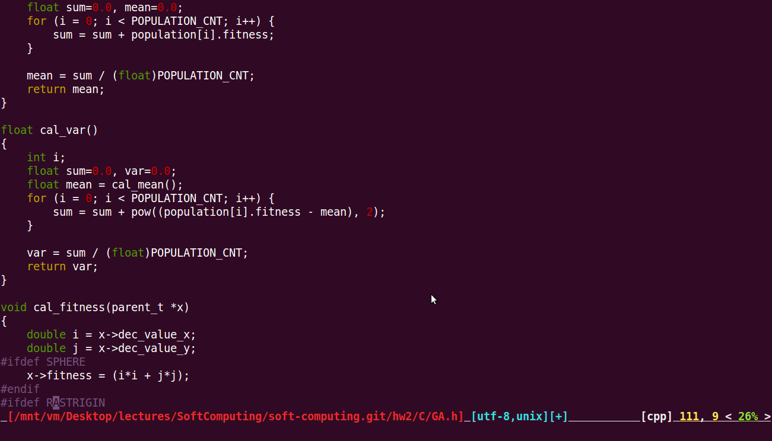
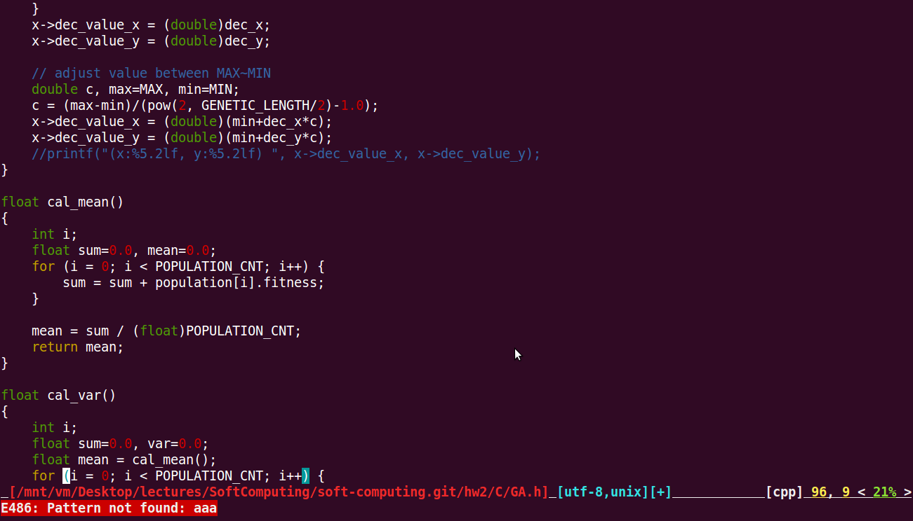
Terminate condition

Slide 3
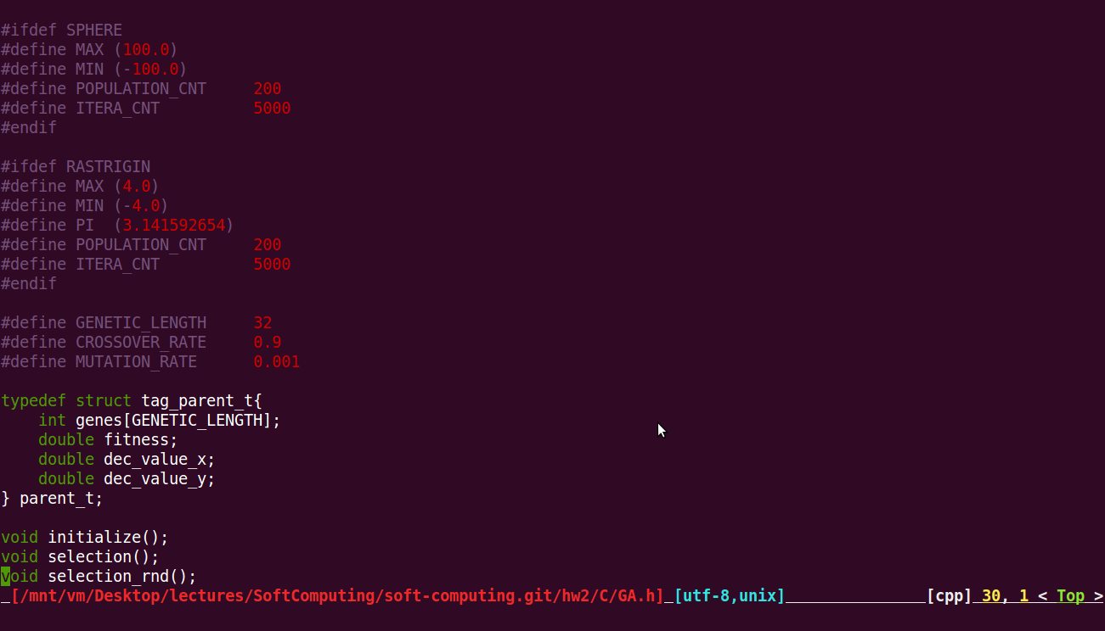
Sphere parameters

Slide 4
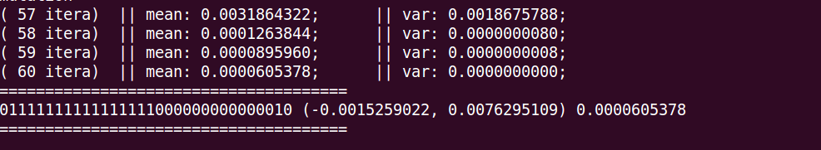
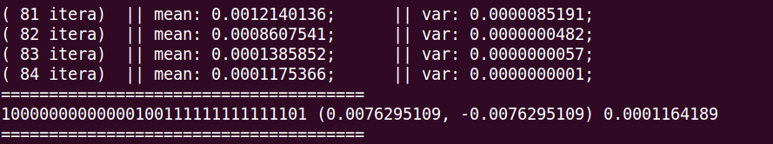

sphere data of 1~3 run

Slide 5

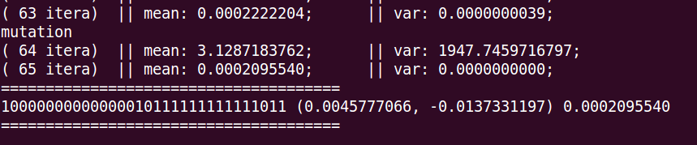
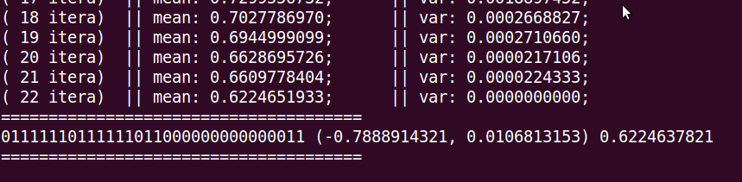
sphere data of 4~6 run

Slide 6
sphere Summary
Average iteration
67
Best ever found
(x, y) = (-0.0015259022, 0.0076295109)
Fitness =0.0000605378

Slide 7
Rastrigin parameters

Slide 8
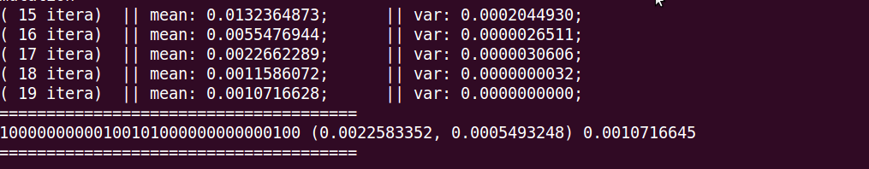
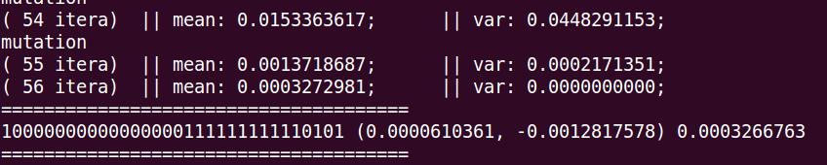
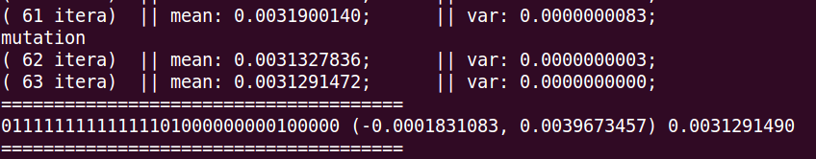
rastrigin Data of 1~3 RUN

Slide 9
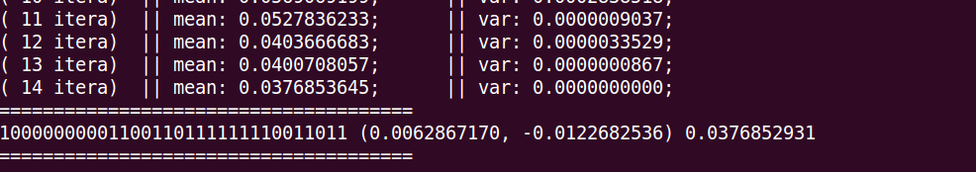
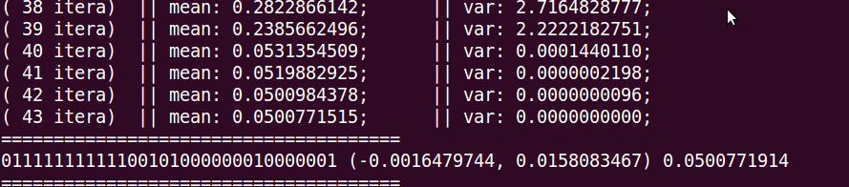
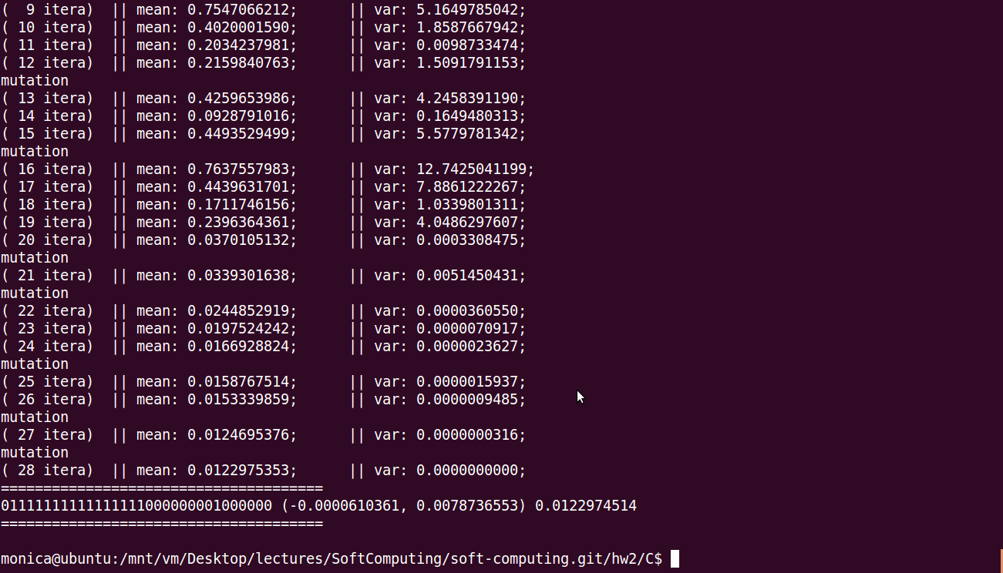
rastrigin Data of 4~6 RUN

Slide 10
rastrigin Summary
Average iteration
37
Best ever found
(x, y) = (0.0022583352, 0.0005493248)
Fitness =0.0010716645

Slide 11
Thank you!
Monica.service@gmail.com

