Slide 1
Case Study 08
Maris Grundy

Slide 2
library(tidyverse) library(knitr) library(kableExtra) URL<- "https://gml.noaa.gov/webdata/ccgg/trends/co2/co2_annmean_mlo.txt" Data<- read_table(URL, skip=57, col_names=c("year", "mean", "unc"))
ggplot(data=Data, aes(x=year, y=mean))+ geom_line()

Slide 3
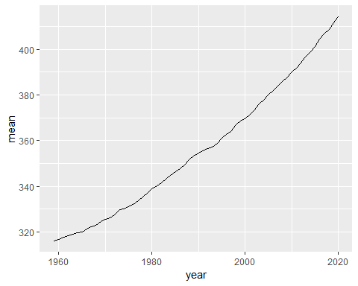

Slide 4
top5 <- Data %>% arrange(desc(mean))%>% top_n(mean, n=5) knitr::kable(top5)
year
mean
unc
2020
414.24
0.12
2019
411.66
0.12
2018
408.72
0.12
2017
406.76
0.12
2016
404.41
0.12

