Slide 1
Case Study 08
Maris Grundy

Slide 2
library(tidyverse) URL<- "https://gml.noaa.gov/webdata/ccgg/trends/co2/co2_annmean_mlo.txt" Data<- read_table(URL, skip=57, col_names=c("year", "mean", "unc"))
## ## -- Column specification ------------------------------------------------------ ## cols( ## year = col_double(), ## mean = col_double(), ## unc = col_double() ## )
ggplot(data=Data, aes(x=year, y=mean))+ geom_line()

Slide 3
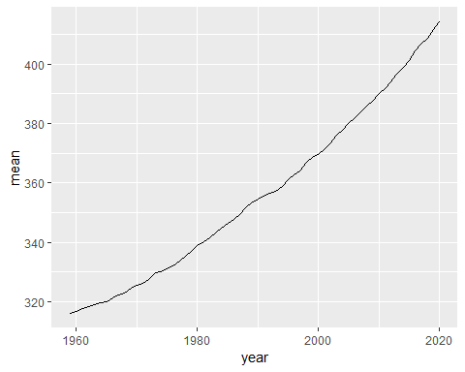

Slide 4
top5 <- Data %>% arrange(desc(mean))%>% top_n(mean, n=5) knitr::kable(top5)

Slide 5
year | mean | unc
2020 | 414.24 | 0.12
2019 | 411.66 | 0.12
2018 | 408.72 | 0.12
2017 | 406.76 | 0.12
2016 | 404.41 | 0.12

