Slide 1
Case Study 08
Alex Gould

Slide 2
library(tidyverse) URL <- "https://gml.noaa.gov/webdata/ccgg/trends/co2/co2_annmean_mlo.txt" Data <- read_table(URL, skip = 57, col_names =c("year", "mean", "unc"))
## ## ── Column specification ──────────────────────────────────────────────────────── ## cols( ## year = col_double(), ## mean = col_double(), ## unc = col_double() ## )
ggplot(data=Data, mapping=aes(x=year, y=mean))+ geom_line(color= "green")

Slide 3
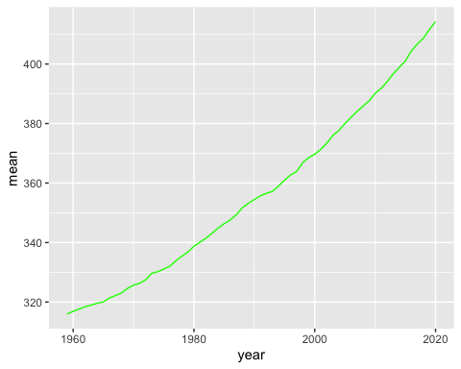

Slide 4
Top5 <- Data %>% arrange(desc(mean)) %>% top_n(mean, n=5) knitr::kable(Top5)

Slide 5
year | mean | unc
2020 | 414.24 | 0.12
2019 | 411.66 | 0.12
2018 | 408.72 | 0.12
2017 | 406.76 | 0.12
2016 | 404.41 | 0.12

Slide 6
#run rmarkdown::render("week_08/case_study_08.Rmd", output_format = "all") below

