Slide 1
Case Study 08: One Script, Many Products
Qingqing Chen

Slide 2
Load data
url <- "ftp://aftp.cmdl.noaa.gov/products/trends/co2/co2_annmean_mlo.txt" df <- read.table(url, col.names = c("year", "mean", "unc"))

Slide 3
Visualize
#Use ggplot to plot a time series of CO2 levels through time min_year <- df$year %>% min() max_year <- df$year %>% max() df %>% mutate(sd = sd(mean)) %>% as_tibble() %>% ggplot(., aes(x = year, y = mean)) + geom_line(color = "black", lwd = 0.7) + # geom_errorbar(aes(ymin = mean-sd, ymax = mean+sd), # width = 0.4) + geom_point(size = 1.5, color = "red") + scale_x_continuous(breaks = seq(min_year, max_year, 5)) + theme_bw() + labs(x = "Year", y = "Mean", title= "Trends in Atmospheric Carbon Dioxide")

Slide 4
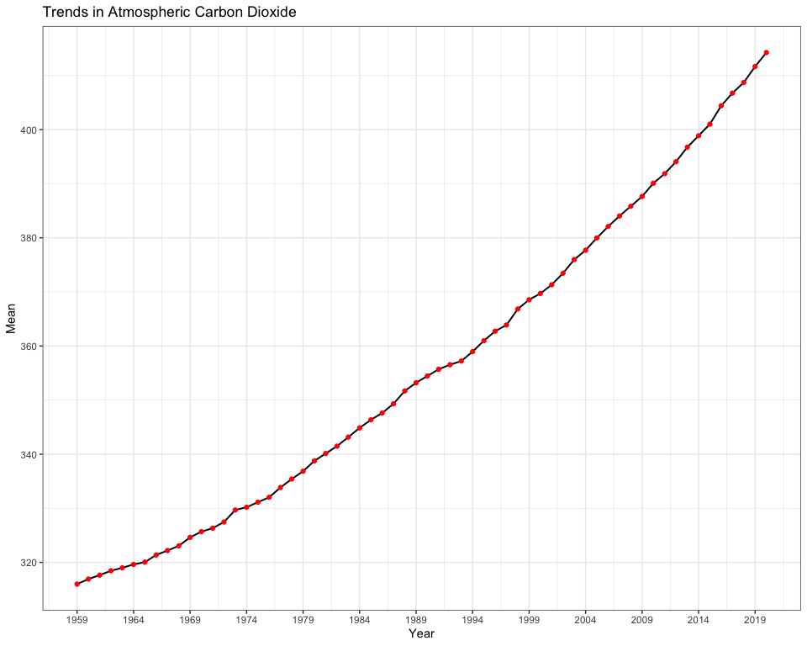

Slide 5
Creat table
Method 1
# statistical summary summ <- df %>% slice(-1) %>% mutate(Years = case_when( year %in% seq(1960, 1969) ~ "1960 - 1969", year %in% seq(1970, 1979) ~ "1970 - 1979", year %in% seq(1980, 1989) ~ "1980 - 1989", year %in% seq(1990, 1999) ~ "1990 - 1999", year %in% seq(2000, 2009) ~ "2000 - 2009", year %in% seq(2010, 2019) ~ "2010 - 2019", year %in% seq(2020, 2029) ~ "2020 - " )) %>% group_by(Years) %>% dplyr::summarise(Mean = mean(mean), S.D. = sd(mean), Min = min(mean), Max = max(mean))
# suitable for github doc output knitr::kable(summ)
# suitable for html output kbl(summ, caption = "Mean Mauna Loa CO2 every decade", format = "html", table.attr = "style='width:40%;'") %>% kableExtra::kable_styling(bootstrap_options = "striped", position = "float_right") %>% as_image(width = 10, file = "table.png")

Slide 6
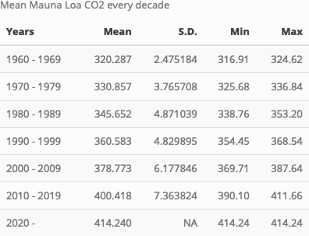

Slide 7
Method 2
# suitable for html output DT::datatable(summ, caption = 'Mean Mauna Loa CO2 every decade', rownames = F, filter = 'top')

Slide 8
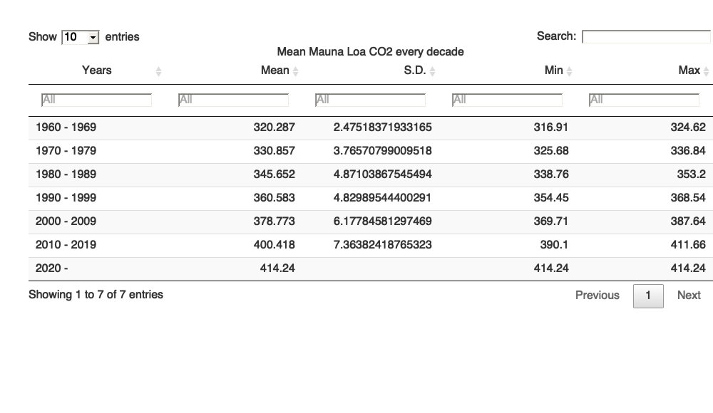

Slide 9
Render output files
rmarkdown::render("week_08/case_study_08.Rmd",output_format = "all")

