Slide 1
Case Study 08
Hui Gao

Slide 2
Load libraries
library(tidyverse) library(knitr) library(kableExtra)

Slide 3
Read data
data <- read_table("ftp://aftp.cmdl.noaa.gov/products/trends/co2/co2_annmean_mlo.txt", skip = 57, col_names = c("year", "mean", "unc"))

Slide 4
Plot
ggplot(data, aes(year, mean)) + geom_line(color = 'red') + # geom_ribbon(aes(ymin=mean-unc, ymax=mean+unc), color = "grey", alpha = .1) + theme_bw()

Slide 5
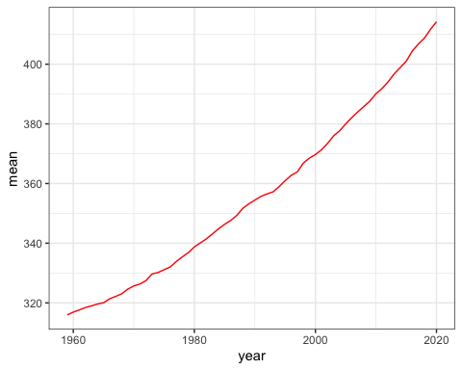

Slide 6
data %>% kable() %>% as_image(width = 10,file = "table.png")

