Slide 1
Case Study 08
Zhenqi Zhou

Slide 2
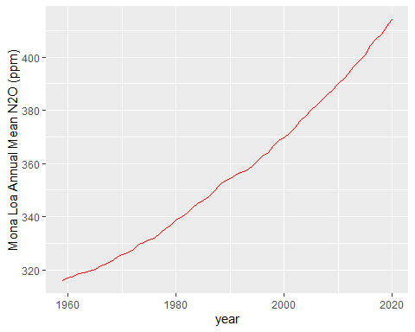
Annual Mean Carbon Dioxide Concentrations 1959-Present

Slide 3
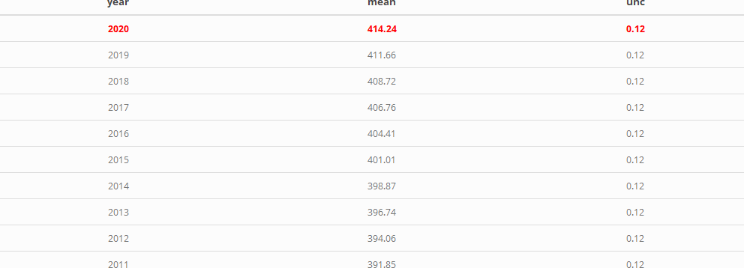
Top Five Annual Mean Carbon Dioxide Concentrations at Mona Loa

