Slide 1
Case Study 08
Sean Colby

Slide 2
#Load Packages library(tidyverse) library(dplyr) library(kableExtra) #Read data in URL<- ("https://gml.noaa.gov/webdata/ccgg/trends/co2/co2_annmean_mlo.txt") Data <- read_table(URL, skip=57, col_names= c("year", "mean", "unc"))
## ## -- Column specification ------------------------------------------------------------ ## cols( ## year = col_double(), ## mean = col_double(), ## unc = col_double() ## )
#Plot it ggplot(data=Data,mapping=aes(x=year, y=mean))+ geom_line(color="red", size=2)+ xlab("Year")+ ylab("Manual Loa Annual Mean CO_2(ppm)")

Slide 3
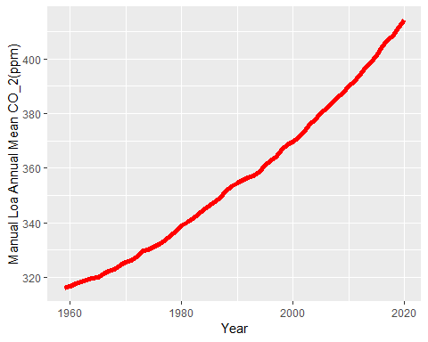

Slide 4
#Top 5 Mean Table Top5 <- Data%>% arrange(desc(mean))%>% top_n(mean, n=5) #Print Top5 Top5
## # A tibble: 5 x 3 ## year mean unc ## <dbl> <dbl> <dbl> ## 1 2020 414. 0.12 ## 2 2019 412. 0.12 ## 3 2018 409. 0.12 ## 4 2017 407. 0.12 ## 5 2016 404. 0.12
#Knit knitr::kable(Top5)
year
mean
unc
2020
414.24
0.12
2019
411.66
0.12
2018
408.72
0.12
2017
406.76
0.12
2016
404.41
0.12

