Slide 1
Case Study 08: One Script, Many Products
Wei Liu

Slide 2
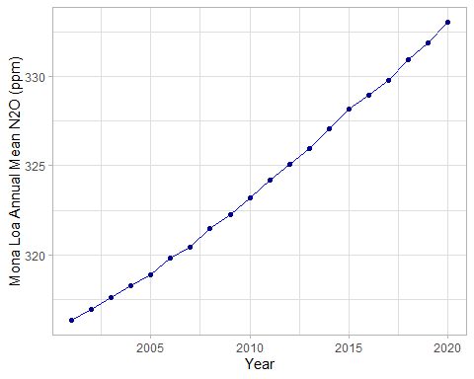
Annual Mean Nitrous Oxide Concentrations 2001 - 2020

Slide 3

Top Five Annual Mean Nitrous Oxide Concentrations at Mona Loa

