Slide 1
Great Bear Petroleum LLC
Diagnostic Fracture Injection Test
HRZ Formation
Alcor #1
S5-T7N-R14E
North Slope Borough, Alaska
API 50223200260000
October 7, 2012

Slide 2
General Information
HRZ Formation
Vertical Cemented Well
Perforations 9160-9170’ MD (9150-9160’ TVD)
Wellbore Fluid – 9.8 lb/gal water
DFIT Fluid – 9.8 lb/gal water
BHT ~ 180°F
Hydrocarbon Assumptions
38 API Oil
1000 scf/bbl GOR

Slide 3
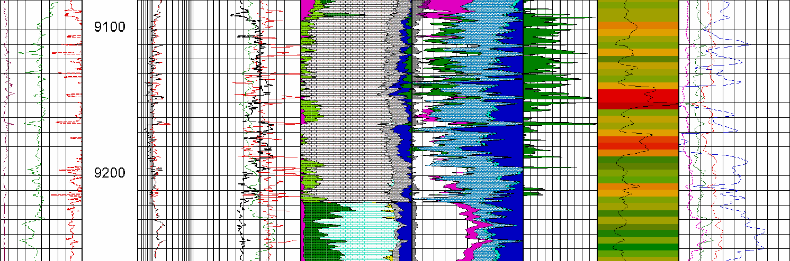
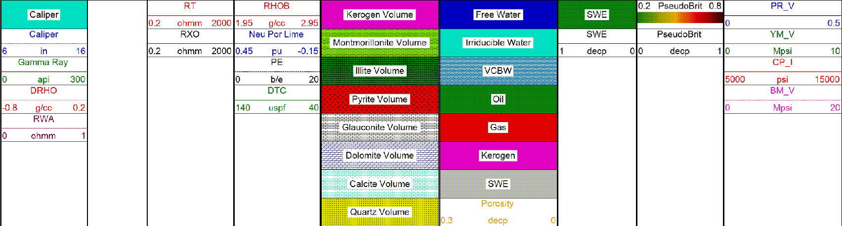
ShaleXpert

Slide 4
October 22 Data Download

Slide 5
Treating Van Chart

Slide 6
Memory Gauge Chart Data from Oct 22 download

Slide 7
Zoomed view of memory gauge pressure curve. This is very “noisy” and irregular data. Since both gauges exhibit the same response, the fluctuations are due to something happening in the well, on the well, or on the gauges. In particular, it appears that the pressure dips are associated with minimum temperature values.

Slide 8
Merged Van and Oct 22 Primary Memory Gauge Data

Slide 9
Zoomed view of pump in
~ 7200 gallons of fluid was injected at a pump rate of ~ 13 bpm

Slide 10
Closure is not indicated on the log-log plot. The semilog curve appears to be on a continuing positive slope. Before closure bilinear flow (+ ¼ and – ¾ curve slopes). BH ISIP ~ 7449 psi.
Notes:
According to SPE 107877, a log-log plot as shown above should be sufficient to identify closure and the various flow regimes before and after-closure. The log-log plot shows a positive ¼ slope in the semilog derivative (light blue curve) and pressure difference curves (green and red curves) in conjunction with a negative ¾ slope in the 1st derivative (dark blue) curve indicating bi-linear flow before-closure. Then closure occurs when indicated by the change in slope from positive to negative in the semilog derivative curve. The Oct 11 download of data indicated that closure may have occurred at shut in time of about 1300 minutes. But this appears to have been a temporary flattening of the semilog curve slope and use of all of the data from the final download indicates that closure did not occur at that time. In fact, it appears that closure did not occur during the entire time of the shut in. The fluctuations in the semilog and derivative curve near the end of the shut in can be attributed to the noise and fluctuations in the pressure measured at the wellhead by the surface memory gauge.

Slide 11
G function plot agrees with log-log plot indicating that closure has not occurred. The apparent downward trend of the G*dP/dG superposition curve is caused by the erratic undulating pressure curve and is not an indication of closure. BHCP < 5833 psi. Process Zone Stress > 1617 psi. Fracture Tip Extension leak off type.
False indication of closure where the G*dP/dG superposition curve has a temporary negative slope before returning to a positive slope for the remainder of the shut in time
Fracture Tip Extension
Erratic pressure curve with ± 30 psi pressure fluctuations
Notes:
The first download of data on Oct 11 suggested that closure had occurred at G time ~ 22. However, it is apparent from the total data download that this was a false indication of closure and that the superposition G*dP/dG curve returns to a positive slope indicating that closure has not occurred.

Slide 12
Before Closure Modified Mayerhofer Plot
Notes:
The modified Mayerhofer method may provide a method for estimating the upper limit value of reservoir permeability. However, the method is not as accurate as an after closure analysis. If leak off types other than normal leak off exist, then only a range for permeability could be given

Slide 13
Summary
The gauge data is very noisy. It appears that the heater used to keep the gauge warm was the cause. A relatively constant wellhead temperature of approximately 90 to100 °F is desired.
BH ISIP ~ 7449 psi (0.82 psi/ft)
It appears that fracture tip extension was the type of leakoff observed and closure was not observed during shut-in.
BHCP < 5833 psi (0.64 psi/ft)
Process Zone Stress > 1617 psi (0.18 psi/ft), moderately high

Slide 14
Summary
Because closure was not observed during the shut in, only a Before Closure Analysis can be performed
Reservoir pore pressure determined by using the Uniaxial Strain Calculation. Estimated pore pressure ~ 4725 psi* (0.52 psi/ft).
Upper limit pore pressure estimate using the final surface measured pressure plus the hydrostatic pressure ~ 5830 psi. The actual pore pressure is most certainly less than this value.
Notes:
*This is a calculated value that considers formation rock properties, tectonic strain, overburden gradient, etc. It is not an extrapolation of actual after closure pressure data and is less accurate than an after closure analysis.

Slide 15
Summary
Because closure was not observed during the shut in, only a Before Closure Analysis can be performed
Considered as a hydrocarbon reservoir, Before Closure Analysis for formation flow capacity estimate using the Modified Mayerhofer method, upper limit value only, kh << 0.3 md*ft
Considered as a water bearing reservoir, Before Closure Analysis for formation flow capacity estimate using the Modified Mayerhofer method, upper limit value only, kh << 0.08 md*ft
Notes:
Please note that the following parameters were assumed for the hydrocarbon reservoir case for our analysis and they need to be verified as it can change the resultant kh:
Sw=40%
GOR = 1000 scf/bbl
API = 38
Bubble point pressure = 4000 psi
Porosity cutoff = 8%

