Slide 1
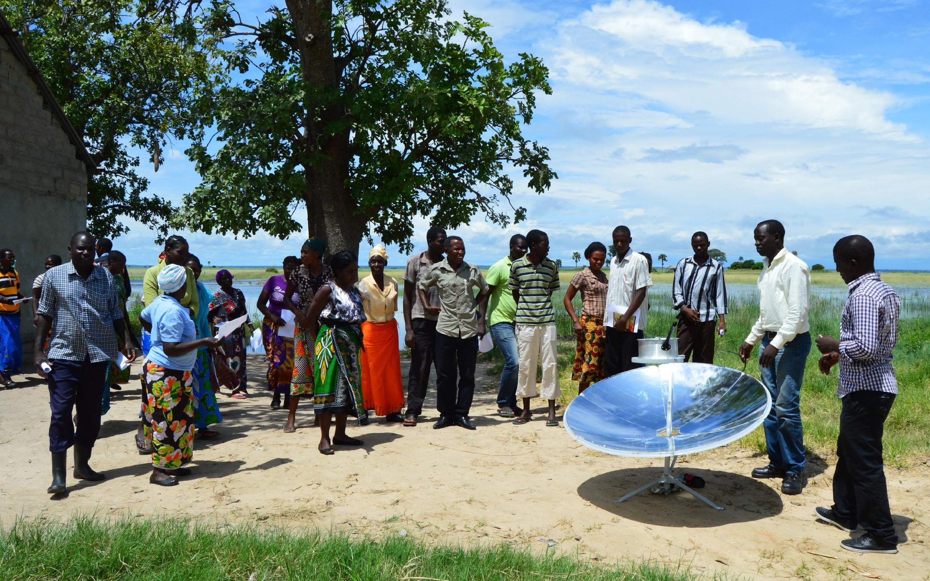
Introduction to causal inference

Slide 2
What Works and What Doesn’t?
Causality
The selection problem

Slide 3
Why do we care?
understanding the world
we want to know what interventions/policies work (impact evaluation)
we want to know how to change things

Slide 4
Causality

Slide 5
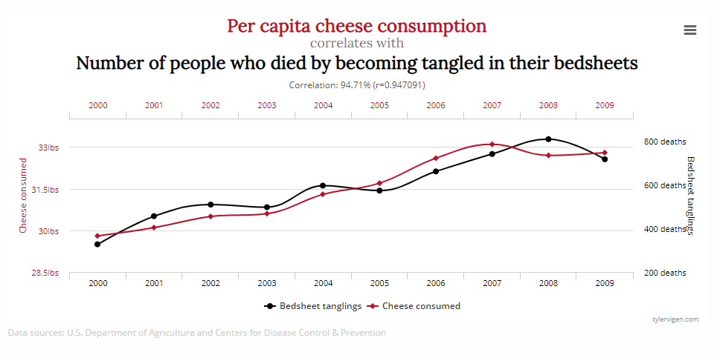
http://www.tylervigen.com/spurious-correlations

Slide 6
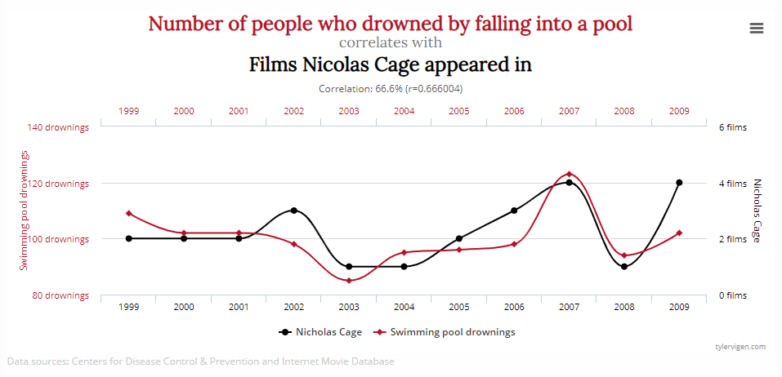
http://www.tylervigen.com/spurious-correlations

Slide 7
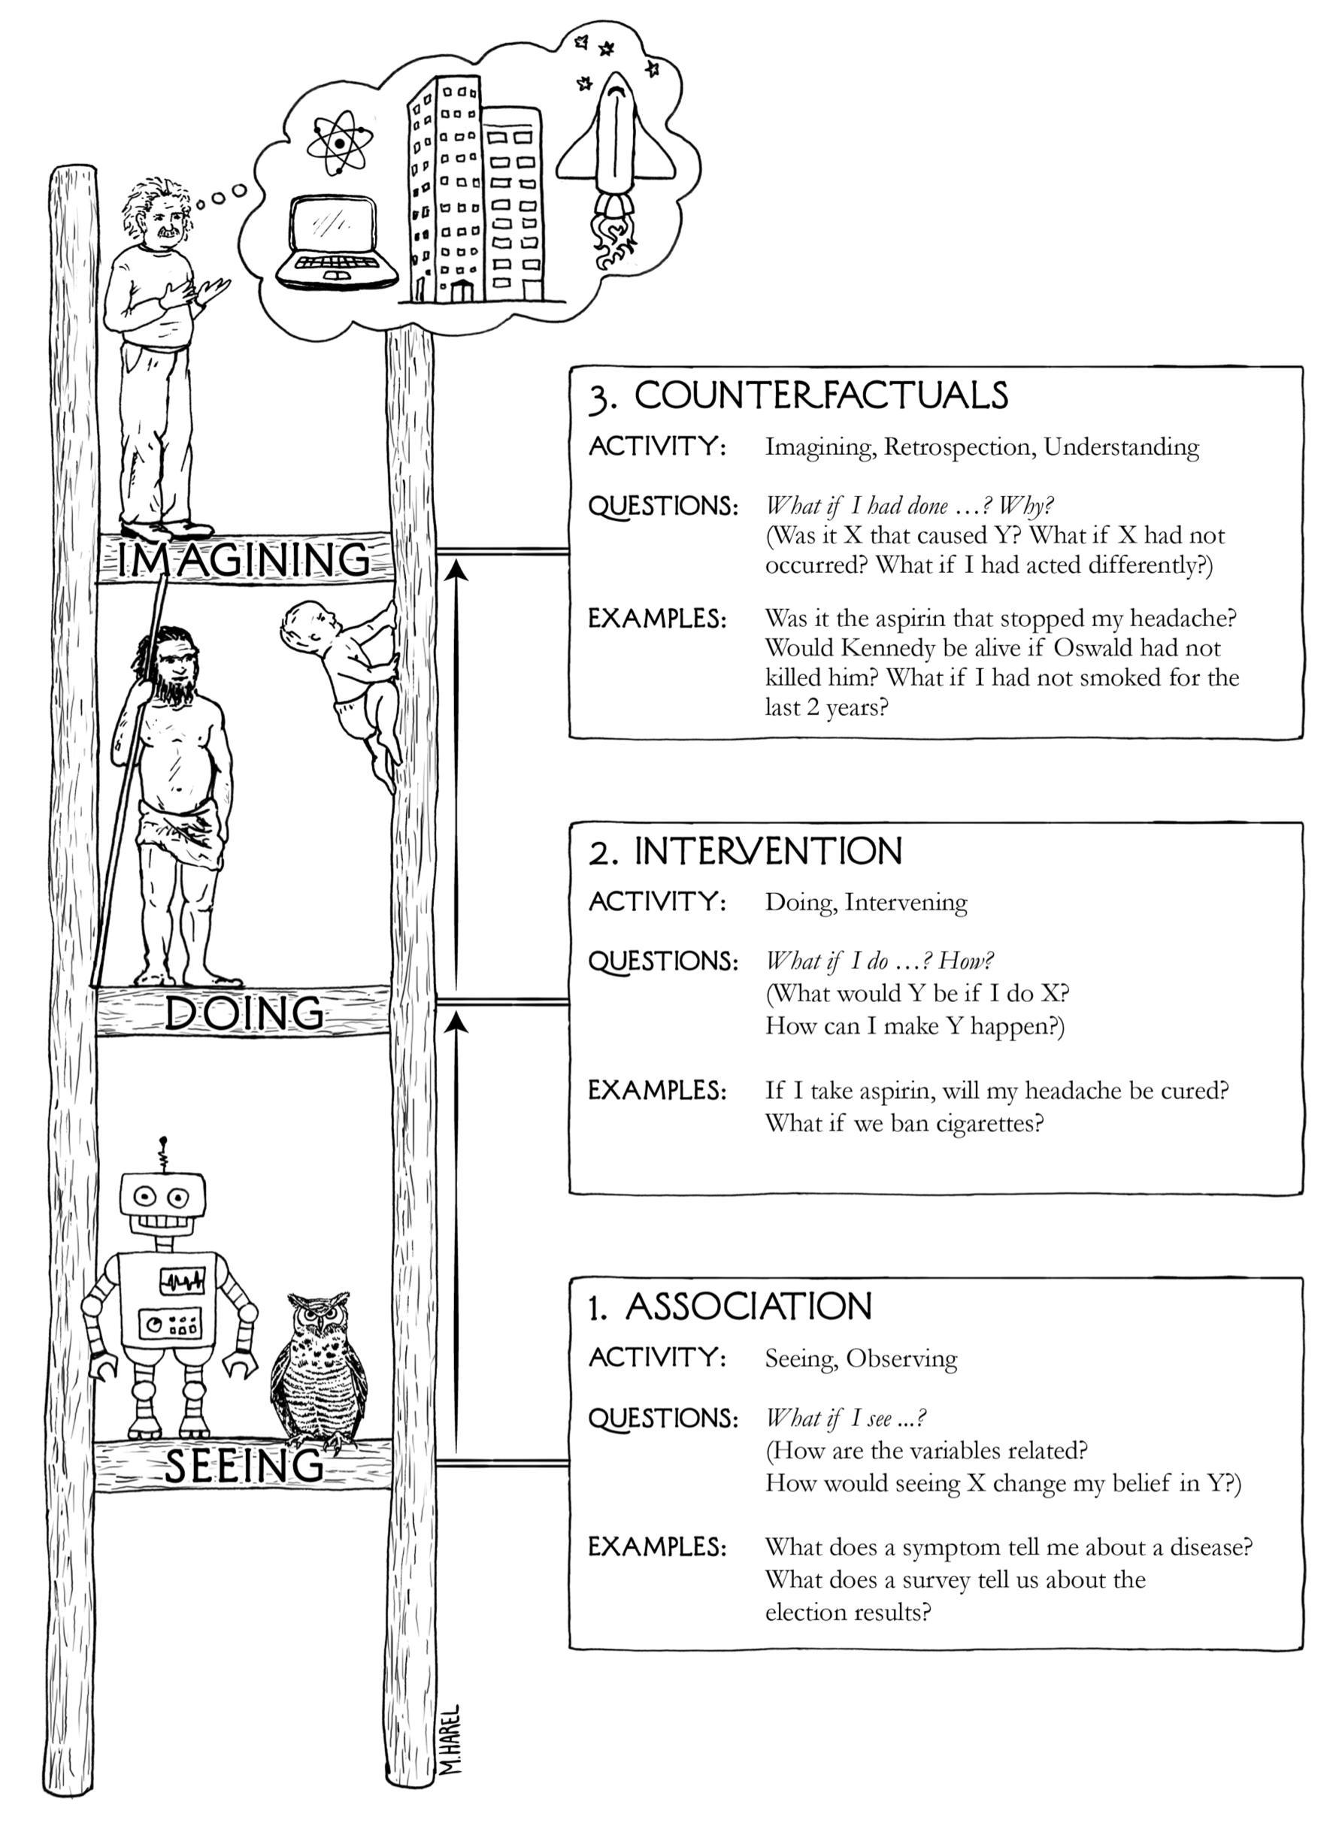
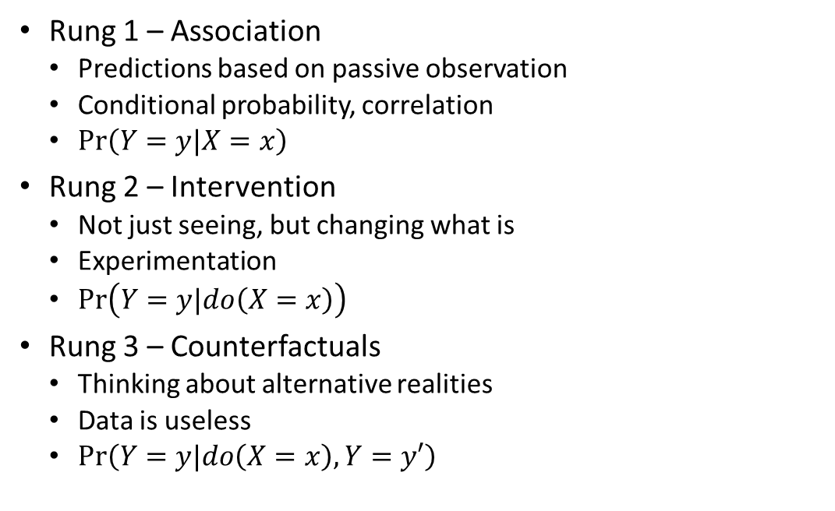
How Do We Know What Causes What? From Pearl and Mackenzie, The Book of Why

Slide 8






















Vaccines and Smallpox
$$1,000,000 kids$$
Vaccination
$$99\%$$
Y
$$1\%$$
N
Vaccination (Y, N)
$$Reaction$$
$$Smallpox$$
$$Reaction$$
$$Smallpox$$
$$1\%$$
Y
$$99\%$$
N
$$0\%$$
Y
$$100\%$$
N
$$0\%$$
Y
$$100\%$$
N
$$2\%$$
Y
$$98\%$$
N
$Reaction$ (Y, N)
$Smallpox$ (Y, N)
$$Death$$
$$Death$$
$$1\%$$
Y
$$99\%$$
N
$$20\%$$
Y
$$80\%$$
N
$99$ deaths
$40$ deaths
Death (Y, N)
Based on this example, someone might conclude that vaccinations are a bad thing for children

Slide 9











Counterfactual
But what if… Vaccinations were at 0%?
$$1,000,000 kids$$
Vaccination
$$0\%$$
Y
$$100\%$$
N
Vaccination
$$Reaction$$
$$Smallpox$$
$$Reaction$$
$$Smallpox$$
$$1\%$$
Y
$$99\%$$
N
$$0\%$$
Y
$$100\%$$
N
$$0\%$$
Y
$$100\%$$
N
$$2\%$$
Y
$$98\%$$
N
$$Reaction$$
$$Smallpox$$
$$Death$$
$$Death$$
$$1\%$$
Y
$$99\%$$
N
$$20\%$$
Y
$$80\%$$
N
$0$ deaths
$4,000$ deaths
Death

Slide 10
Causal Inference
Patient A
Assigning a causal relationship requires knowing the counterfactual!
Requires moving beyond simply observing and requires thinking about alternative realities
Treatment
No Treatment
Outcome w/ Treatment
Outcome w/o Treatment
Difference in outcomes is causal effect of treatment

Slide 11
What causes lung cancer?
Smoking
Smoking gene
Some third thing?

Slide 12
What causes cholera?
Poverty
Water purity
Some third thing?

Slide 13
The Selection Problem

Slide 14
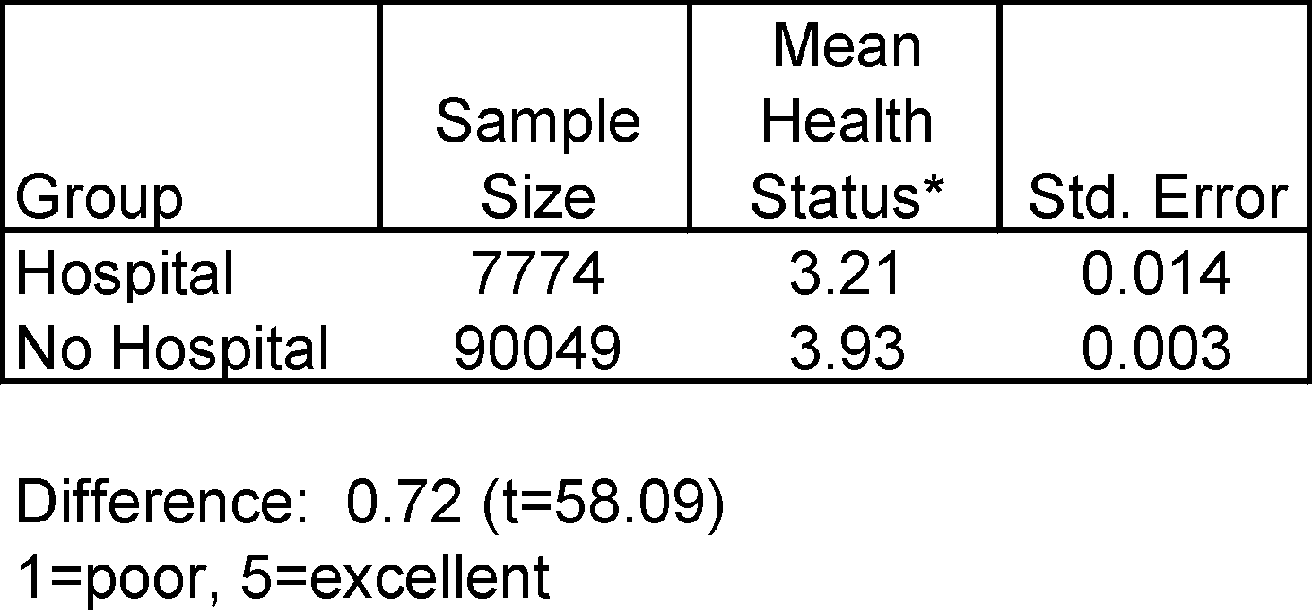
Are Hospitals Good for You?
From Angrist and Pischke, Mostly Harmless Econometrics

Slide 15

What Do We Want to Measure?
Want to estimate the impact of going to a hospital
$$T⟶M⟶Y_{t}$$
Treatment
(Visit Hospital)
Mechanism
Outcome
(Health Status)

Slide 16
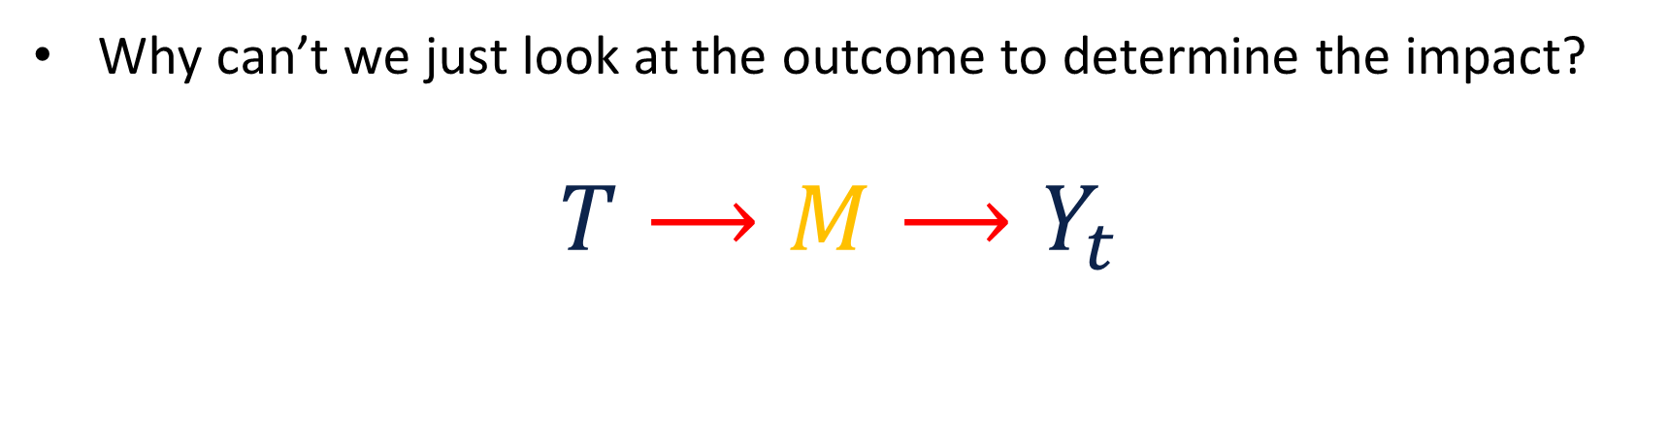
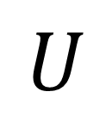
What is Missing?
Why can’t we just look at the outcome to determine the impact?
$$T⟶M⟶Y_{t}$$
Treatment
(Visit Hospital)
Mechanism
Outcome
(Health Status)
$$U$$
Confounder
(Lifestyle, Genes, etc.)

Slide 17

What is a Treatment Effect?
Two potential outcomes
$$Y_{i}=\left\{\begin{matrix}Y_{1i} if T_{i}=1 \\ Y_{0i} if T_{i}=0\end{matrix}\right.$$
$T_{i}$ is the treatment status of person $i$
$Y_{1i}$ is the outcome for person $i$ when they are treated
$Y_{0i}$is the outcome of person $i$ when they are untreated
We would like to know is the treatment effect on person $i$:
$$ρ=Y_{1i}−Y_{0i}$$

Slide 18
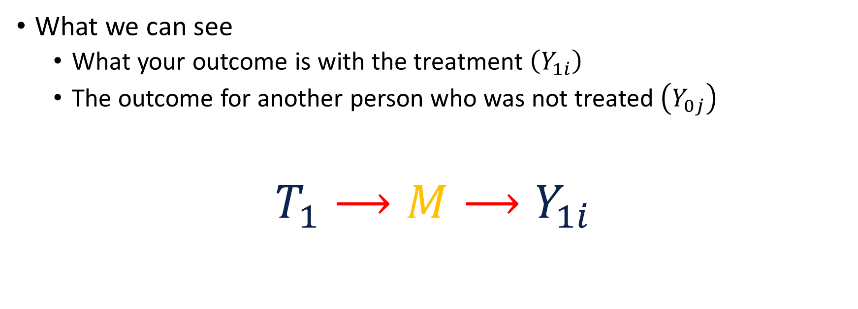
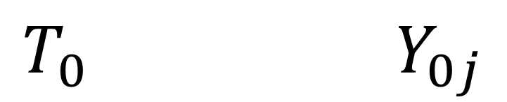
What We Can See

Slide 19
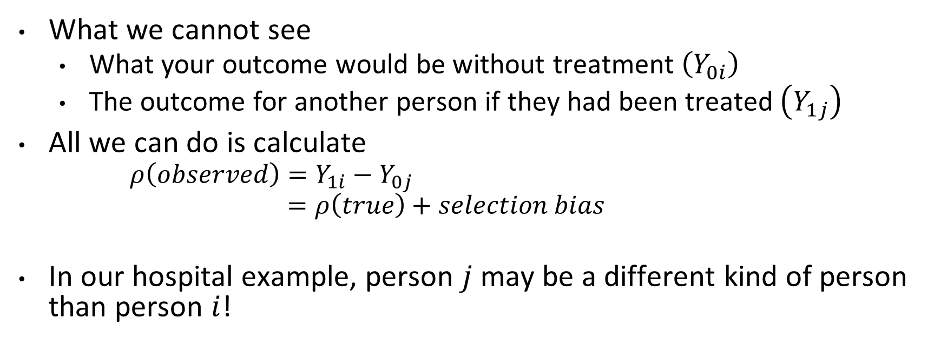
What We Cannot See
What we cannot see
What your outcome would be without treatment $\left(Y_{0i}\right)$
The outcome for another person if they had been treated $\left(Y_{1j}\right)$
All we can do is calculate
$$ρ\left(observed\right)=Y_{1i}−Y_{0j}$$
$$=ρ\left(true\right)+selection bias$$
In our hospital example, person $j$ may be a different kind of person than person $i$!

Slide 20
Treatment Effects + Selection Bias
5
4
Mean Health Status
Observed difference in outcomes
3
Selection bias
Treatment effect on the treated
2
1
No Hospital
Hospital

Slide 21






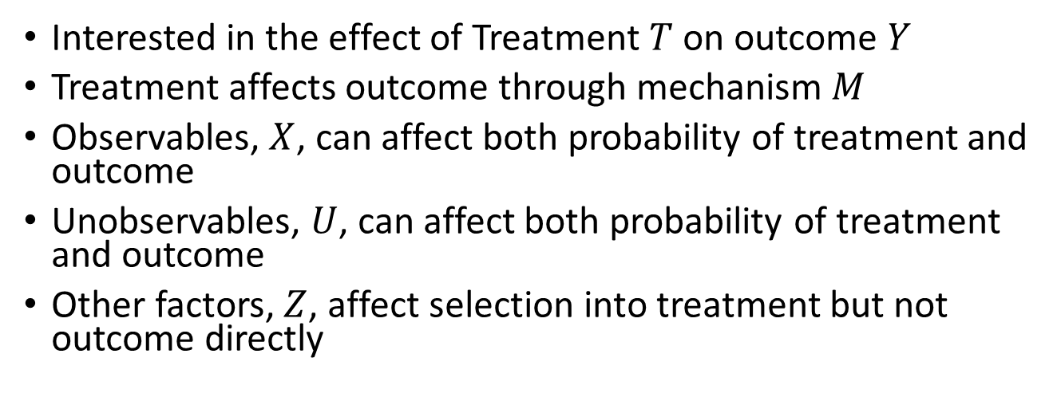
Understanding Causal Pathways

