Slide 1
GitHub Configuration
SI Team

Slide 2

GitHub $≠$ Git
Git is a version control system – a tool to manage source code history. While CVS is a central VCS, Git is distributed
GitHub is a hosting service for Git repositories accessible through their website https://github.com. This is where GEOS source code lives now (under GEOS-ESM organization).

Slide 3
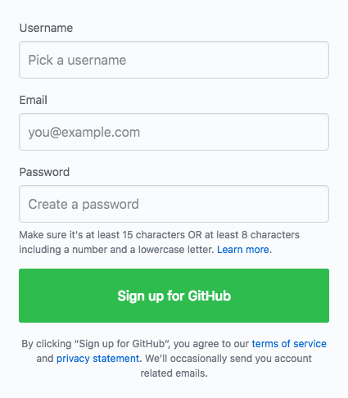
GitHub (https://github.com) – create account
Try using NASA AUID, if not available, try gmao-<auid>
Use NASA email
Email your GitHub username to GEOS support
(geos5-support@lists.nasa.gov)
You will then be invited to the GEOS-ESM organization – that is where GEOS code lives

Slide 4
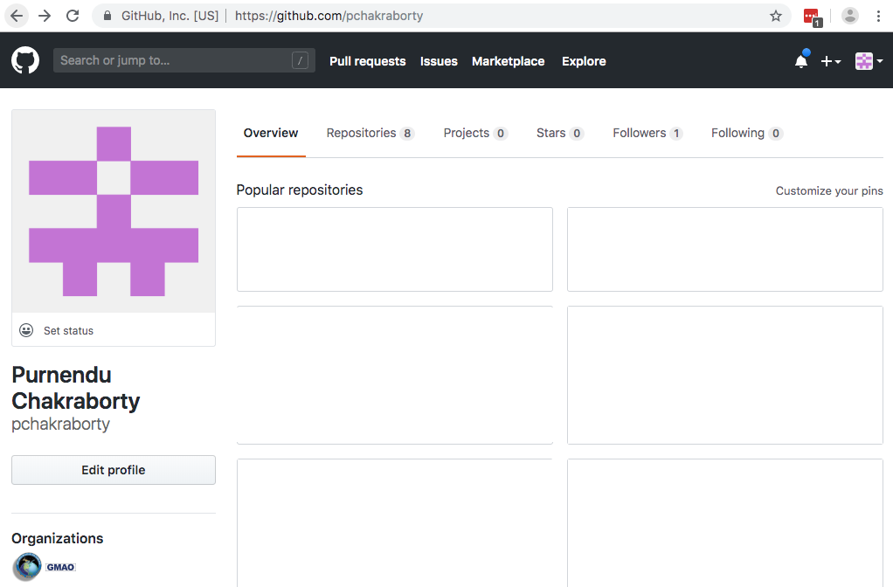
GitHub (https://github.com/<user-id>)
Access
account
settings

Slide 5
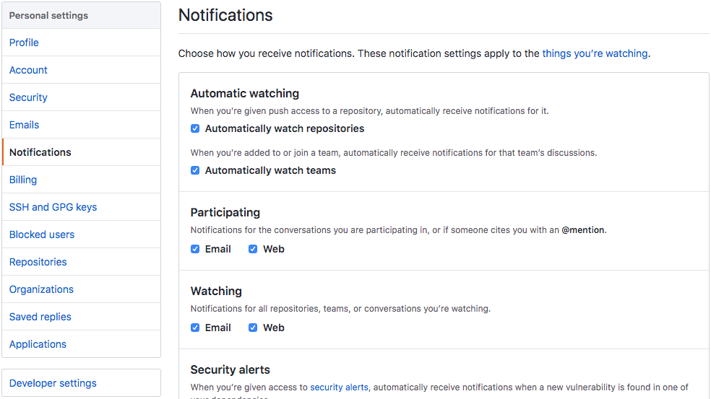
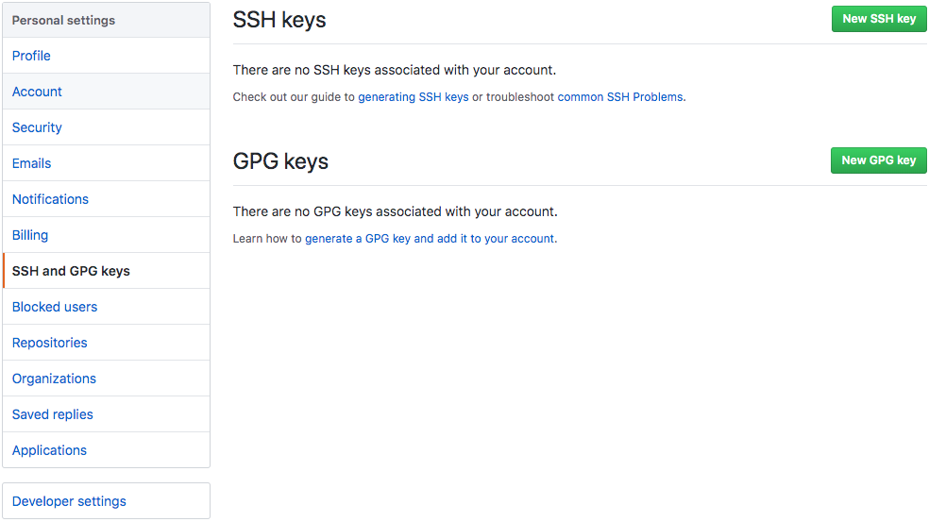
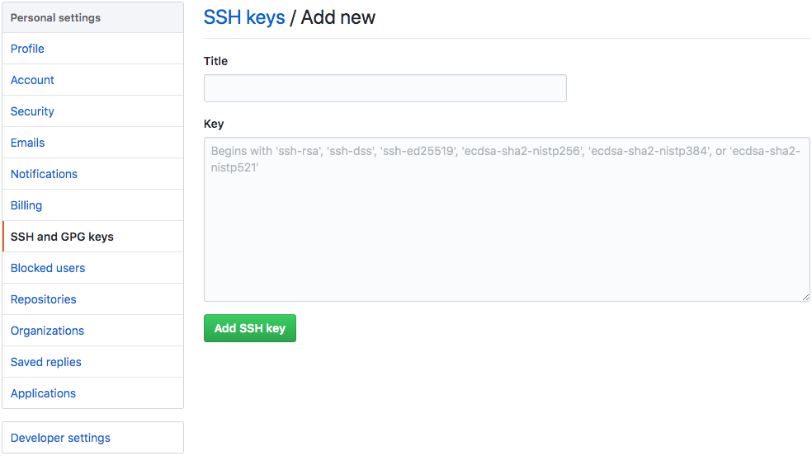
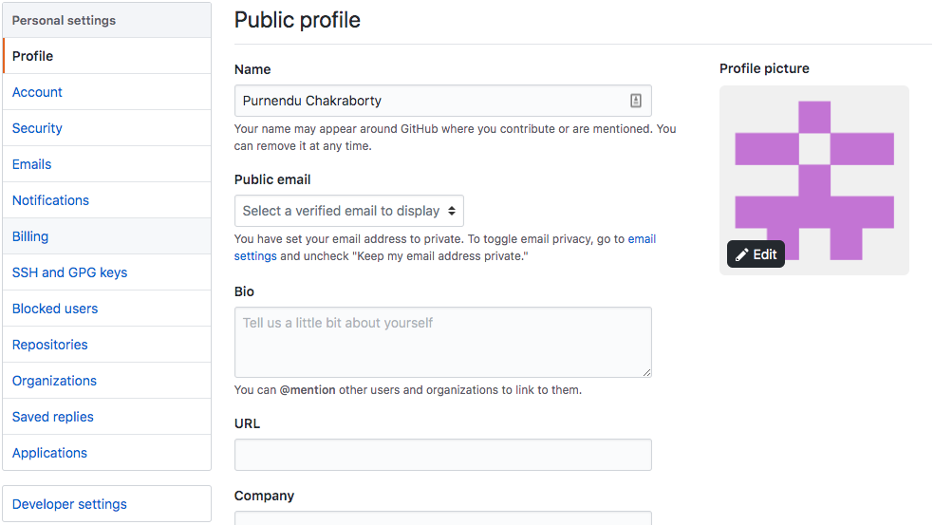
GitHub – update settings
Enter your full name here
Uncheck these two boxes
public ssh key ~/.ssh/id_rsa.pub

Slide 6
GitHub (https://github.com/<user-id>)
GEOS-ESM

Slide 7
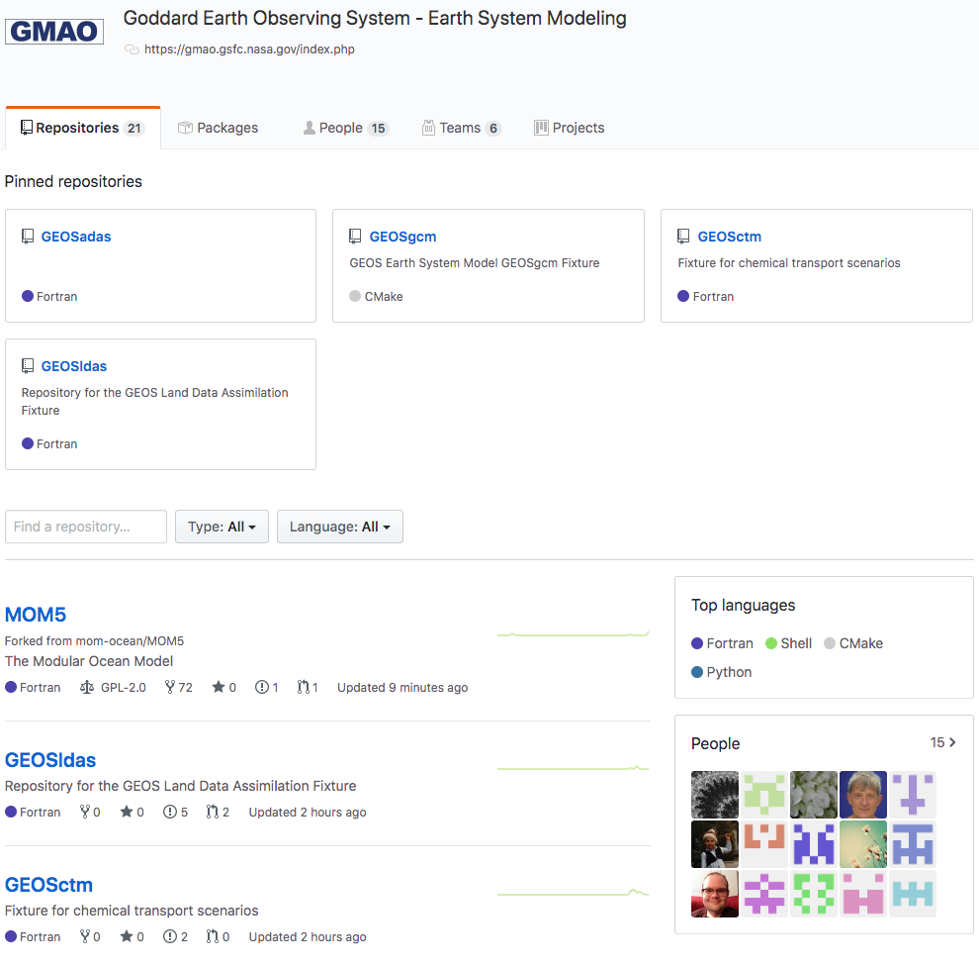
GitHub – https://github.com/GEOS-ESM
GEOS has been split into several repositories
All fixtures are here for easy access
All repositories

Slide 8
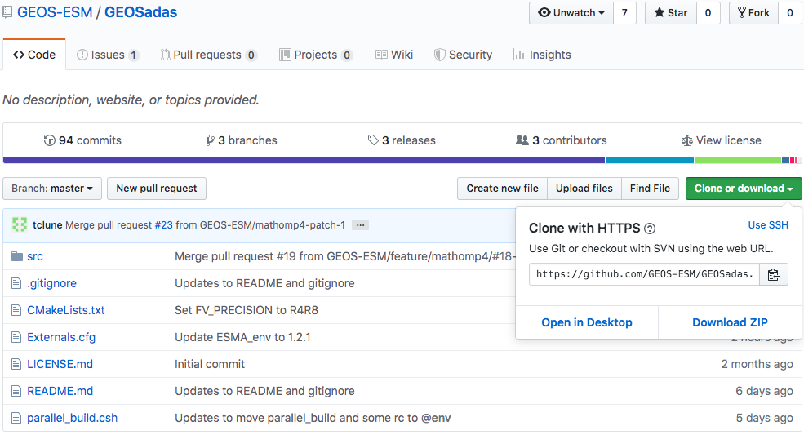

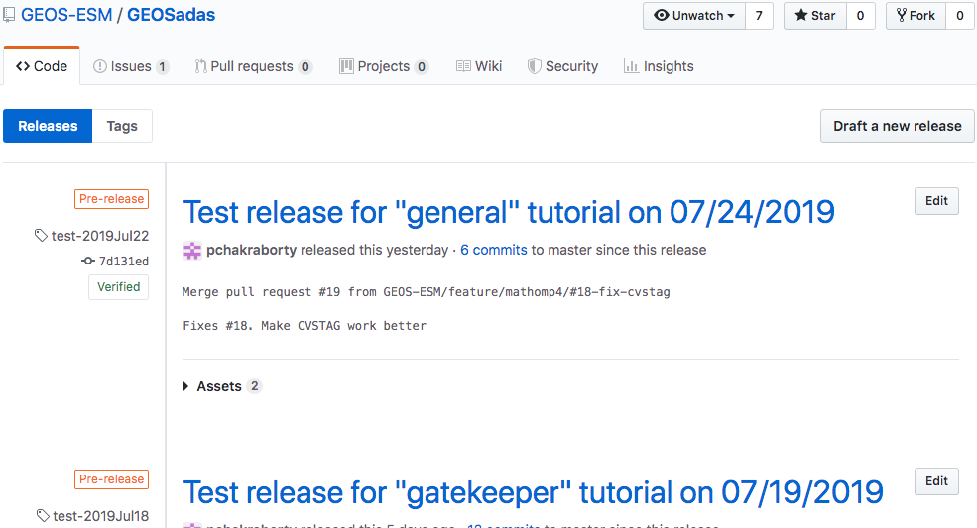
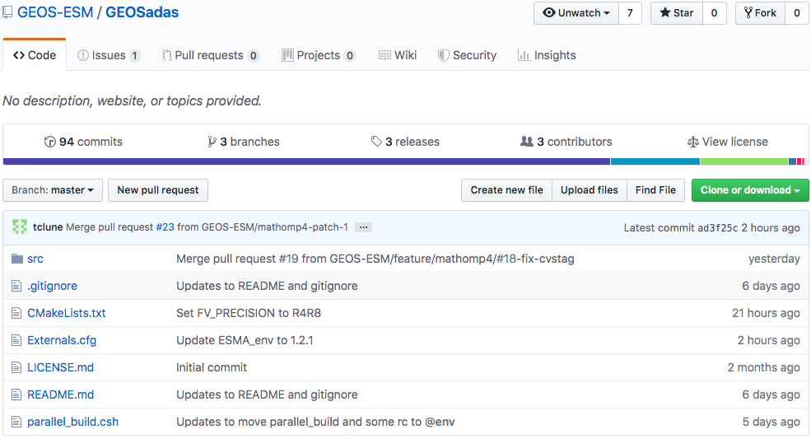
GitHub – GEOSadas fixture – repo link

Slide 9
Checkout & build GEOSadas on Discover
SI Team

Slide 10
Environment setup on Discover (one time op)
On Discover, in .bashrc or .cshrc or .tcshrc add
module use -a /discover/swdev/gmao_SIteam/modulefiles-SLES11
This gives us access to newer versions of tools like git, cmake that are needed to checkout and build GEOS fixtures.
> git config --global user.name “Purnendu Chakraborty”
> git config --global user.email “purnendu.chakraborty@nasa.gov”
Same name and email as on github.com

Slide 11
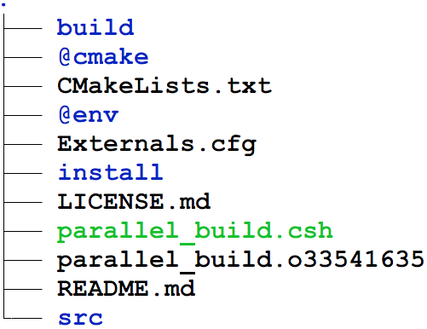
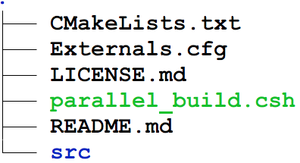
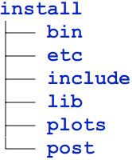
GEOSadas – build on Discover
0) module load GEOSenv
Loads latest git, cmake, and manage_externals
1) git clone -b test-2019Jul22 git@github.com:GEOS-ESM/GEOSadas.git
2) cd GEOSadas
fvsetup
gcm_setup
g5_modules
GEOSgcm.x
GSIsa.x
...
Install info
3) ./parallel_build.csh
(1) git clone (2) cd (3) ./parallel_build.csh
Notes:
The line “module load GEOSenv” can be safely included in .bashrc
Can run “git clone -b test-2019Jul18 git@github.com:GEOS-ESM/GEOSadas.git blah” – GEOSadas, in that case, gets checked out in the directory “blah”

Slide 12
GEOSadas – steps hidden in parallel_build
0) module load GEOSenv
Loads latest git, cmake, and manage_externals
1) git clone -b test-2019Jul22 git@github.com:GEOS-ESM/GEOSadas.git
2) cd GEOSadas
3) checkout_externals
Reads Externals.cfg and retrieves GridComps, Shared Libraries/Utilities
4) source @env/g5_modules.sh
source @env/g5_modules for t/csh users
5) mkdir build
out-of-source build
6) cd build
7) cmake .. -DBASEDIR=$BASEDIR/Linux \
-DCMAKE_Fortran_COMPILER=ifort \
-DCMAKE_INSTALL_PREFIX=../install
Install to a directory parallel to build
8) make –jN install
Use N parallel jobs

Slide 13
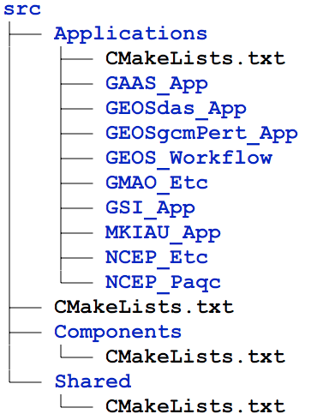
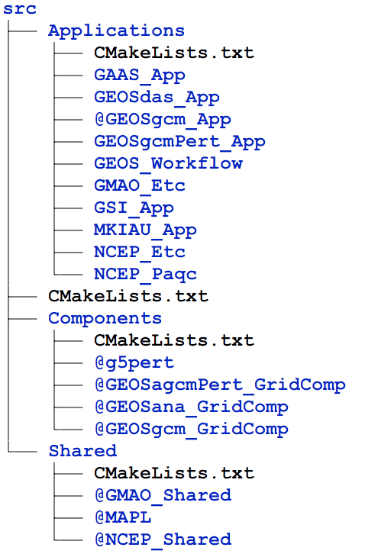
Before/after running checkout_externals

Slide 14
?
https://gmao.gsfc.nasa.gov/intranet/presentations/git_transition
Date | Time | Location
07/29/2019 | 10:00 – 2:00 | G125G
07/30/2019 | 8:00 – 11:00 | A116
 | 1:00 – 5:00 | A128
07/30/2019 | 8:00 – 11:00 | E108
 | 1:00 – 4:00 | G125G
Office hours
geos5-support@lists.nasa.gov

