Slide 1
Git – Basics
SI Team

Slide 2
Main content
Git concepts
Getting started with Git
Useful tools/aliases
Oops
CVS to Git cheat sheet

Slide 3
Git concepts
Git ≠ GitHub
Git is a Distributed Version Control System
Git stores snapshots, not differences
Git commit id – SHA-1 hash
Notes:
GitHub is a website for hosting git projects

Slide 4
Git ≠ GitHub
Git is a version control system – a tool to manage source code history. On discover:
module load GEOSenv
GitHub is a hosting service for Git repositories accessible through their website https://github.com. This is where GEOS source code lives now

Slide 5

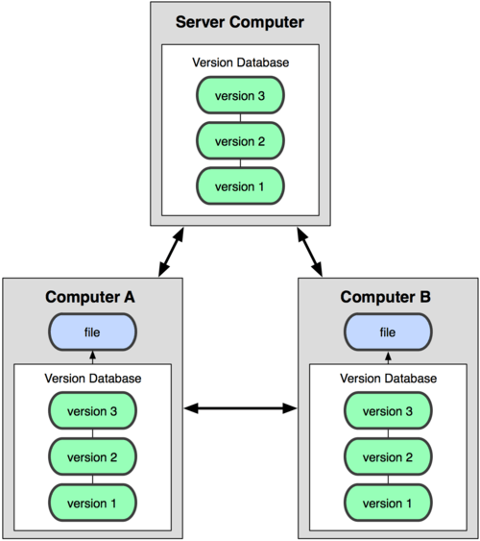
Centralized VCS vs Distributed VCS
Notes:
A CVCS (e.g. CVS) has a single server that contains all the versioned files, and a number of clients that check out files from that central place. Single point of failure.
A DVCS (e.g. Git), clients don’t just check out the latest snapshot of the files: they fully mirror the repository. Every clone is a full backup of all the data.

Slide 6
Distributed Version Control
Clone a repository instead of ‘checkout’
> git clone git@github.com:GEOS-ESM/MAPL.git
> cd MAPL
> ls -1a
...
.git/ # all of git magic happens here
.gitignore # list of files/directories we do not want to track
‘git clone’ is similar to ‘cvs checkout’ except that you get a copy of the entire repository. This local copy itself is a repository and can be cloned from.

Slide 7
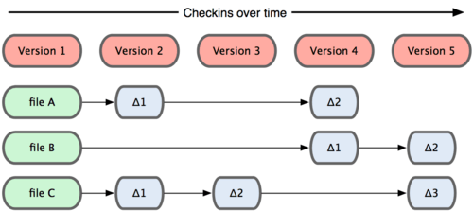
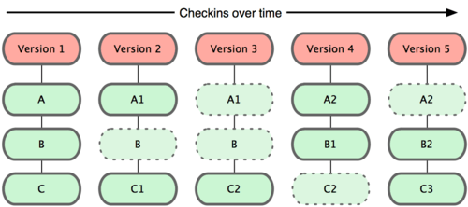
Snapshots, not differences
CVS thinks of versioning as a set of files and changes made to files over time
Git thinks of its data as a snapshot of a mini filesystem. It takes a picture of what all files look like at that moment and stores a reference to that snapshot.
Notes:
To be efficient, if files have not changed, Git stores a link to the previous identical file if it is already stored.
TLC: Although this is a useful concept to get across, how crucial is it in the introductory material? I used Git for years without understanding this, and am still rather fuzzy on the details.

Slide 8
SHA-1 commit id
Every commit in git is checksummed before it is stored and referred to using the checksum.
Git uses SHA-1 hash (Secure Hash Algorithm), a 40-character string of hexadecimals for checksumming that looks like
e44e73bad900aaa5d121e52b36028eb31c79be7e
7 digits is the git default for a short SHA
e44e73b
Linux kernel, which has more than 800k commits, typically needs 8-10 digits
Notes:
Linux kernel, which has more than 800k commits, typically needs 8-10 digits

Slide 9
Main content
Git concepts
Getting started with Git
Useful tools/aliases
Oops
CVS to Git cheat sheet

Slide 10
Getting started with Git
User configuration
Clone repository
Local workflow
Create feature branch
Edit, add and remove files
Merge with local master
Tagging
Integrate with remote
Push local feature branch
Create pull request
Update local master

Slide 11
User configuration
On discover:
module load GEOSenv
can be safely added to .bashrc
Setup name, email
> git config --global user.name “Purnendu Chakraborty”
> git config --global user.email “purnendu.chakraborty@nasa.gov”

Slide 12
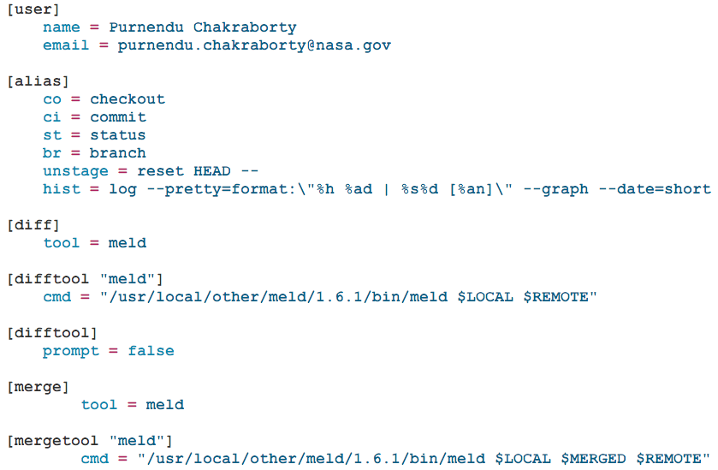
Discover: ~pchakrab/.gitconfig
Notes:
TLC: Are you planning on explaining all of these? Seems like we want a single slide for [user] to emphasize that everyone needs to deal with that issue for consistency across platforms.

Slide 13
Getting started with Git
User configuration
Clone repository
Local workflow
Create feature branch
Edit, add and remove files
Merge with local master
Integrate with remote
Push local feature branch
Create pull request
Update local master
Tagging

Slide 14
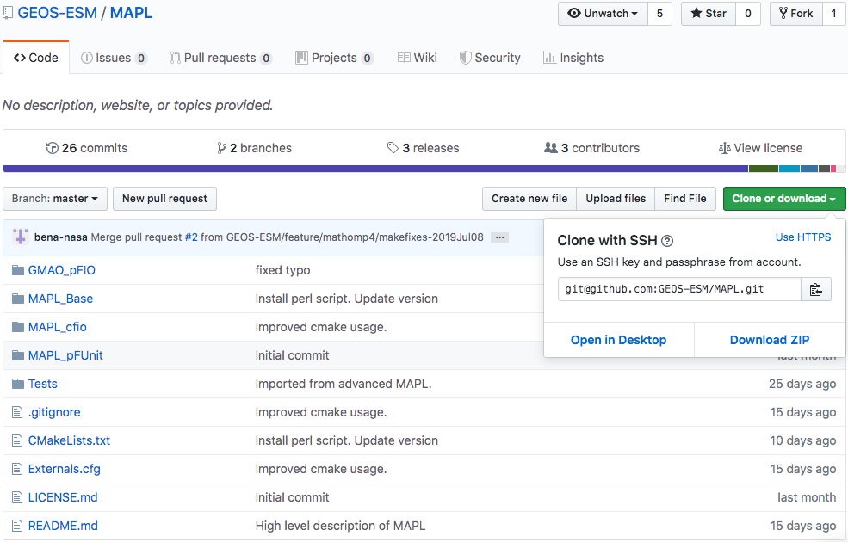

Slide 15
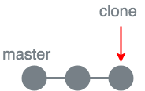
Clone a repository
Make a fresh clone
> git clone git@github.com:GEOS-ESM/MAPL.git
> git clone git@github.com:GEOS-ESM/MAPL.git my-mapl
Re-use an existing clone – in MAPL directory
> git checkout master # switch to “master” branch
> git pull
Protected branch on GitHub
‘cvs checkout’ is used to retrieve a snapshot from the repository
‘git checkout’ is used to
switch between branches in the local working directory
un-modify a modified file via ‘git checkout -- <file>’
Notes:
TLC: Most attendees will not have accounts on developer. Switch to GitHub?
TLC: Maybe covered elsewhere, but everyone needs to create a GitHub account and forward to the GMAO repository admins.

Slide 16
Getting started with Git
User configuration
Clone repository
Local workflow
Create feature branch
Edit, add and remove files
Merge with local master
Integrate with remote
Push local feature branch
Create pull request
Update local master
Tagging

Slide 17
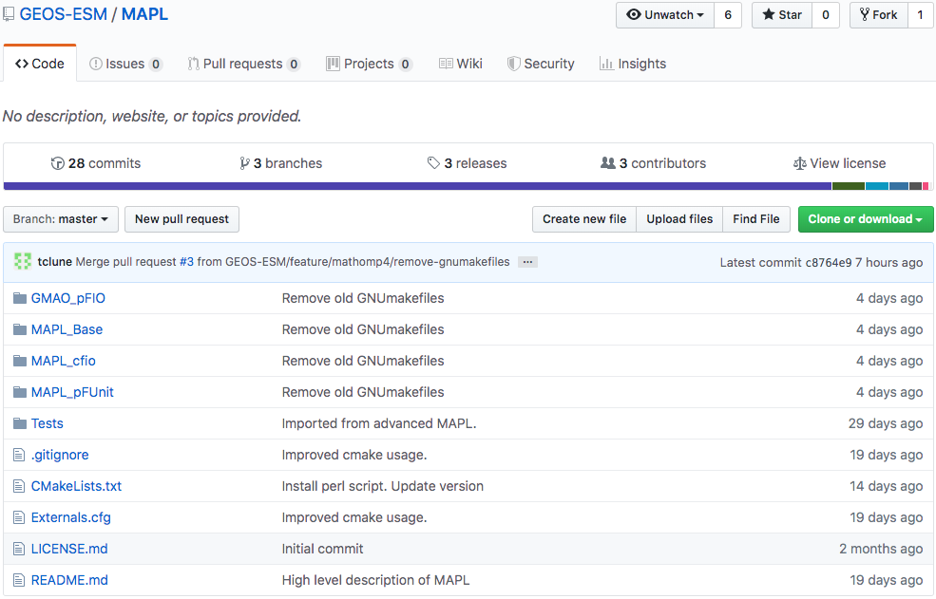
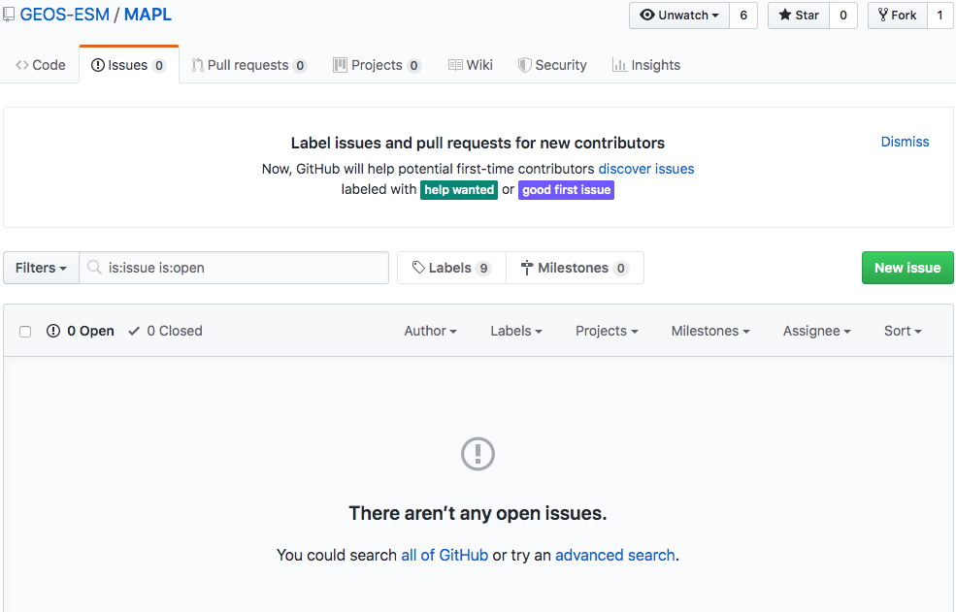
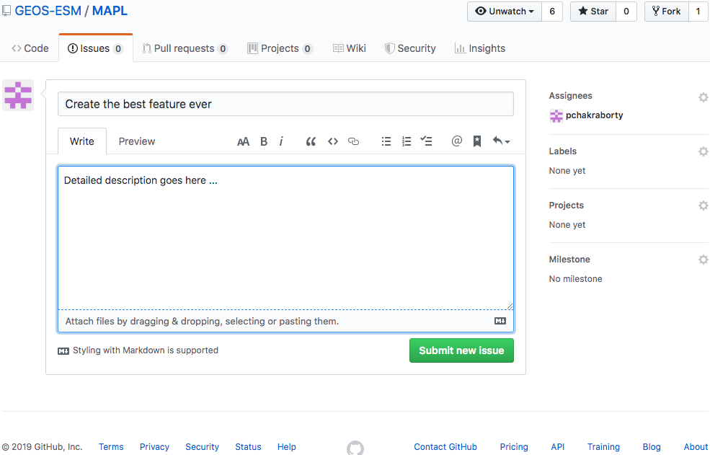
Create new MAPL feature
Get the issue number

Slide 18
Local workflow – create feature branch
Git branching is “almost” free – some metadata is added to .git folder
Create a new branch locally and switch to it
> git branch feature/pchakrab/#123-best-feature-ever # create branch
> git checkout feature/pchakrab/#123-best-feature-ever # switch
OR use the shorthand
> git checkout -b feature/pchakrab/#123-best-feature-ever # create + switch
> git branch
master
* feature/pchakrab/#123-best-feature-ever

Slide 19
Local workflow – edit, stage & commit
Modify files
> emacs MAPL_Base/MAPL_Cap.F90
Check repo status
> git status
On branch feature/pchakrab/#123-best-feature-ever
Changes not staged for commit:
(use “git add/rm <file>...” to update what will be committed
(use “git checkout -- <file>...” to discard changes in working directory)
modified: MAPL_Base/MAPL_Cap.F90
no changes added to commit (use “git add” and/or “git commit -a”)

Slide 20
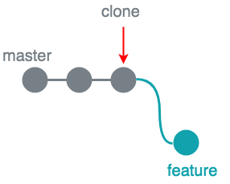
Local workflow – edit, stage & commit
Stage changes
> git add MAPL_Base/MAPL_Cap.F90
Check repo status
> git status
‘git add’ is used to stage changes
On branch feature/pchakrab/#123-best-feature-ever
Changes to be committed:
(use “git reset HEAD <file>...” to unstage)
modified: MAPL_Base/MAPL_Cap.F90
Commit changes to local repo
> git commit -m "Use a detailed message instead”
[feature/pchakrab/#123-best-feature-ever eb81172] Use a detailed message instead
1 files changed, 1 insertions(+)
Two-step process – (1) stage and (2) commit
Changes are committed to the local repo – remote does not know anything about it, yet!
Notes:
TLC: I really wish we could recommend a Git client at this point. (This is a vent, not a constructive criticism.)

Slide 21
Local workflow – add, stage & commit
Add files and directories
> mkdir MAPL_Base/new-dir
> touch MAPL_Base/new-dir/new-file.txt
Check repo status
> git status
On branch feature/pchakrab/#123-best-feature-ever
Untracked files:
(use “git add <file>...” to include in what will be committed)
MAPL_Base/new-dir/
nothing added to commit but untracked files present (use ”git add” to track)

Slide 22
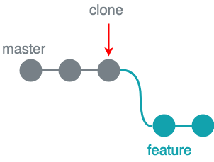
Local workflow – add, stage & commit
Stage changes
> git add MAPL_Base/new-dir/new-file.txt
Check repo status
> git status
‘git add’ is used to stage changes
On branch feature/pchakrab/#123-best-feature-ever
Changes to be committed:
(use “git reset HEAD <file>...” to unstage)
new file: MAPL_Base/new-dir/new-file.txt
Commit changes to local repo
> git commit -m ”Added new file”
[feature/pchakrab/#123-best-feature-ever c8db846] Added new file
1 file changed, 0 insertions(+), 0 deletions(-)
create mode 100644 MAPL_Base/new-dir/new-file.txt
Two-step process – (1) stage and (2) commit
Changes are committed to the local repo – remote does not know anything about it, yet!
Notes:
TLC: I really wish we could recommend a Git client at this point. (This is a vent, not a constructive criticism.)

Slide 23
Local workflow – remove, stage & commit
Remove files and directories
> rm MAPL_Base/new-dir/new-file.txt
Check repo status
> git status
On branch feature/pchakrab/#123-best-feature-ever
Changes not staged for commit:
(use "git add/rm <file>..." to update what will be committed)
(use "git checkout -- <file>..." to discard changes in working directory)
deleted: MAPL_Base/new-dir/new-file.txt
no changes added to commit (use "git add" and/or "git commit -a")

Slide 24
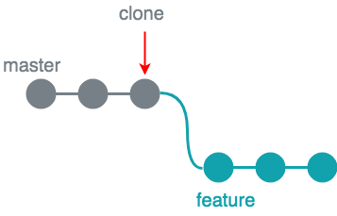
Local workflow – remove, stage & commit
Stage changes
> git add MAPL_Base/new-dir/new-file.txt
Check repo status
> git status
‘git add’ is used to stage changes
On branch feature/pchakrab/#123-best-feature-ever
Changes to be committed:
(use “git reset HEAD <file>...” to unstage)
deleted: MAPL_Base/new-dir/new-file.txt
Commit changes to local repo
> git commit -m ”Deleted a file”
[feature/pchakrab/#123-best-feature-ever 60f5453] Deleted a file
1 file changed, 1 deletion(-)
delete mode 100644 MAPL_Base/file-b.txt
Two-step process – (1) stage and (2) commit
Changes are committed to the local repo – remote does not know anything about it, yet!
Notes:
TLC: I really wish we could recommend a Git client at this point. (This is a vent, not a constructive criticism.)

Slide 25
Shortcuts
Rename and stage
> git mv MAPL_Base/file-b.txt MAPL_Base/file-x.txt
Delete and stage
> git rm MAPL_Base/file-y.txt
Still need to commit staged changes
> git commit ...

Slide 26
Check local history
> git log
commit 60f5453a1c36b06b472b9dd622499ec458036b12 (HEAD -> feature/pchakrab/#123-best-feature-ever)
Author: Purnendu Chakraborty <purnendu.chakraborty@nasa.gov>
Date: Thu May 9 10:38:02 2019 -0400
Deleted a file
commit c8db8469bfa512b46d80d81de61492b5f6b9ed48
Author: Purnendu Chakraborty <purnendu.chakraborty@nasa.gov>
Date: Thu May 9 10:37:10 2019 -0400
Added new file
commit eb811724dd2700ef74117bc337609ed495535abb
Author: Purnendu Chakraborty <purnendu.chakraborty@nasa.gov>
Date: Thu May 9 10:36:13 2019 -0400
Use a detailed message instead

Slide 27
Check local history
> git log --pretty=oneline --abbrev-commit
> git log --pretty=format:'%h %ad | %s%d [%an]' --graph --date=short
60f5453 (HEAD -> feature/pchakrab/#123-best-feature-ever) Deleted a file
c8db846 Added new file
eb81172 Use a detailed message instead
* 60f5453 2019-05-09 | Deleted a file (HEAD -> feature/pchakrab/#123-best-feature-ever) [Purnendu Chakraborty]
* c8db846 2019-05-09 | Added new file [Purnendu Chakraborty]
* eb81172 2019-05-09 | Use a detailed message instead [Purnendu Chakraborty]

Slide 28
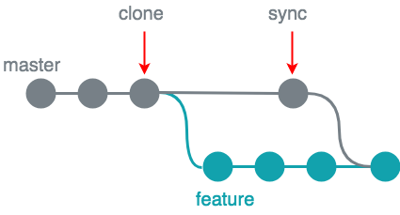
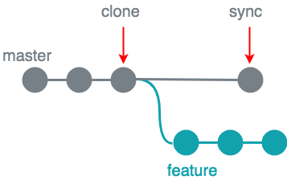
Local workflow – merge: master → feature
Cannot push local “master” to remote (remote “master” is a protected branch)
(1) check if local master is up-to-date
> git checkout master
> git pull
(2) check differences with sync-ed local master
> git checkout feature/pchakrab/#123-best-feature-ever
> git diff master
(3) now, merge
> git merge master -m “Merge branch master into feature”
Conflict resolution is discussed in the “advanced” tutorial
Merge made by the 'recursive' strategy.
...

Slide 29
* 7dcc2eb 2019-05-09 | Merge branch master into feature (HEAD -> feature/pchakrab/#123-best-branch-ever)
|\
| * a11728e 2019-05-09 | Added a space to g5_modules (master) [Purnendu Chakraborty]
* | 60f5453 2019-05-09 | Deleted a file [Purnendu Chakraborty]
* | c8db846 2019-05-09 | Added new file [Purnendu Chakraborty]
* | eb81172 2019-05-09 | Use a detailed message instead [Purnendu Chakraborty]
|/

Slide 30
Getting started with Git
User configuration
Clone repository
Local workflow
Create feature branch
Edit, add and remove files
Merge with local master
Integrate with remote
Push local feature branch
Create pull request
Update local master
Tagging

Slide 31
Integrate with remote – push local feature branch
Remote “master” branch is protected and cannot be pushed
Push local feature branch to remote
> git checkout feature/pchakrab/#123-best-feature-ever
> git push
fatal: The current branch feature/pchakrab/#123-best-feature-ever has no upstream branch. To push the current branch and set the remote as upstream, use
git push --set-upstream origin feature/pchakrab/#123-best-feature-ever
origin == git@github.com:GEOS-ESM/MAPL.git
Notes:
TLC: You might want/need to explain what “origin” is here.

Slide 32
Integrate with remote – push local feature branch
> git push --set-upstream origin feature/pchakrab/#123-best-feature-ever
Enumerating objects: 14, done.
Counting objects: 100% (14/14), done.
Delta compression using up to 8 threads
Compressing objects: 100% (9/9), done.
Writing objects: 100% (10/10), 865 bytes | 865.00 KiB/s, done.
Total 10 (delta 7), reused 0 (delta 0)
remote: Resolving deltas: 100% (7/7), completed with 4 local objects.
remote:
remote: Create a pull request for 'feature/pchakrab/#123-best-feature-ever' on GitHub by visiting:
remote: https://github.com/GEOS-ESM/MAPL/pull/new/feature/pchakrab/#123-best-feature-ever
remote:
To github.com:GEOS-ESM/MAPL.git
* [new branch] feature/pchakrab/#123-best-feature-ever -> feature/pchakrab/#123-best-feature-ever
Branch 'feature/pchakrab/#123-best-feature-ever' set up to track remote branch 'feature/pchakrab/#123-best-feature-ever' from 'origin'.

Slide 33
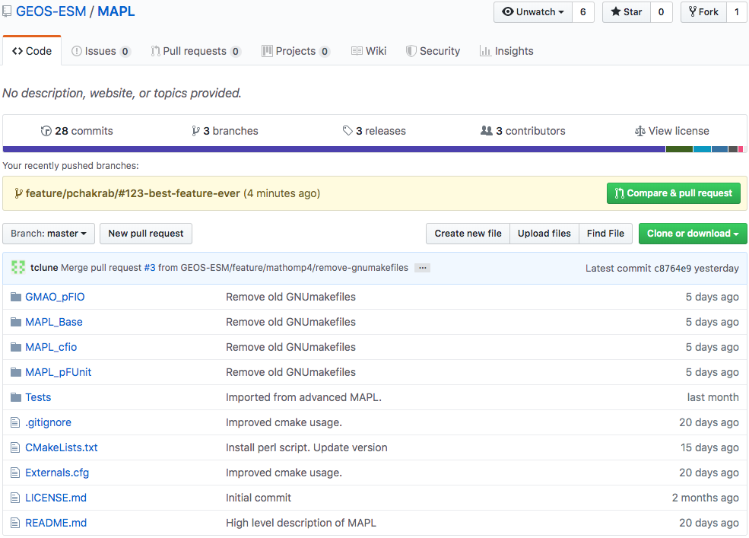
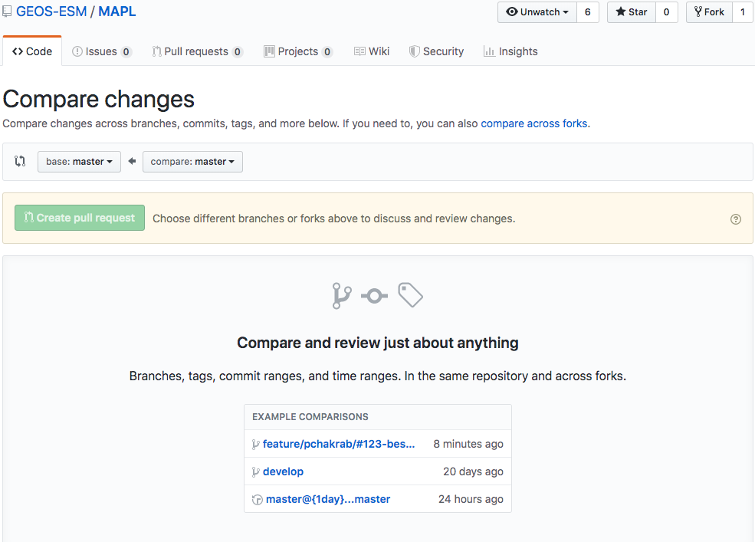
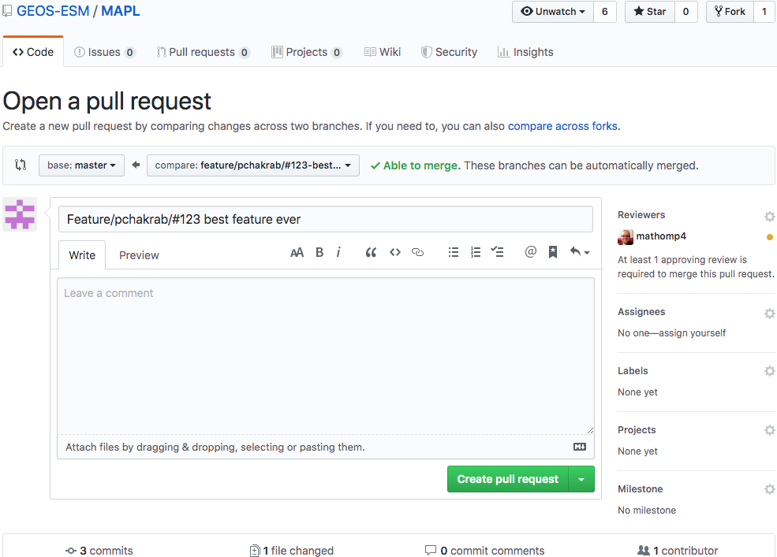
Integrate with remote – create pull request
Select “to” and “from” branches
And that’s it!

Slide 34
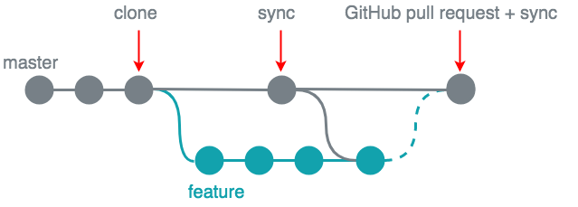
Well, almost – still need to update local master
> git checkout master
> git pull

Slide 35
Getting started with Git
User configuration
Clone repository
Local workflow
Create branch
Edit, add and remove files
Merge with local master
Integrate with remote
Push local branch
Create pull request
Tagging

Slide 36
Tagging
Lightweight tag (don’t do this)
Does no more than just pointing to a commit
> git tag some_tag
Annotated tag
Can contain a message, creator, and date different than the commit’s
> git tag -a v2019.6 -m “Version 2019.6”
Need to explicitly push tag to remote
> git push origin v2019.6
Git tags can have “.”
Notes:
TLC: Emphasize that tags can have “.” (a nice improvement over CVS)

Slide 37
Main content
Git concepts
Getting started with Git
Useful tools/aliases
Oops
CVS to Git cheat sheet

Slide 38
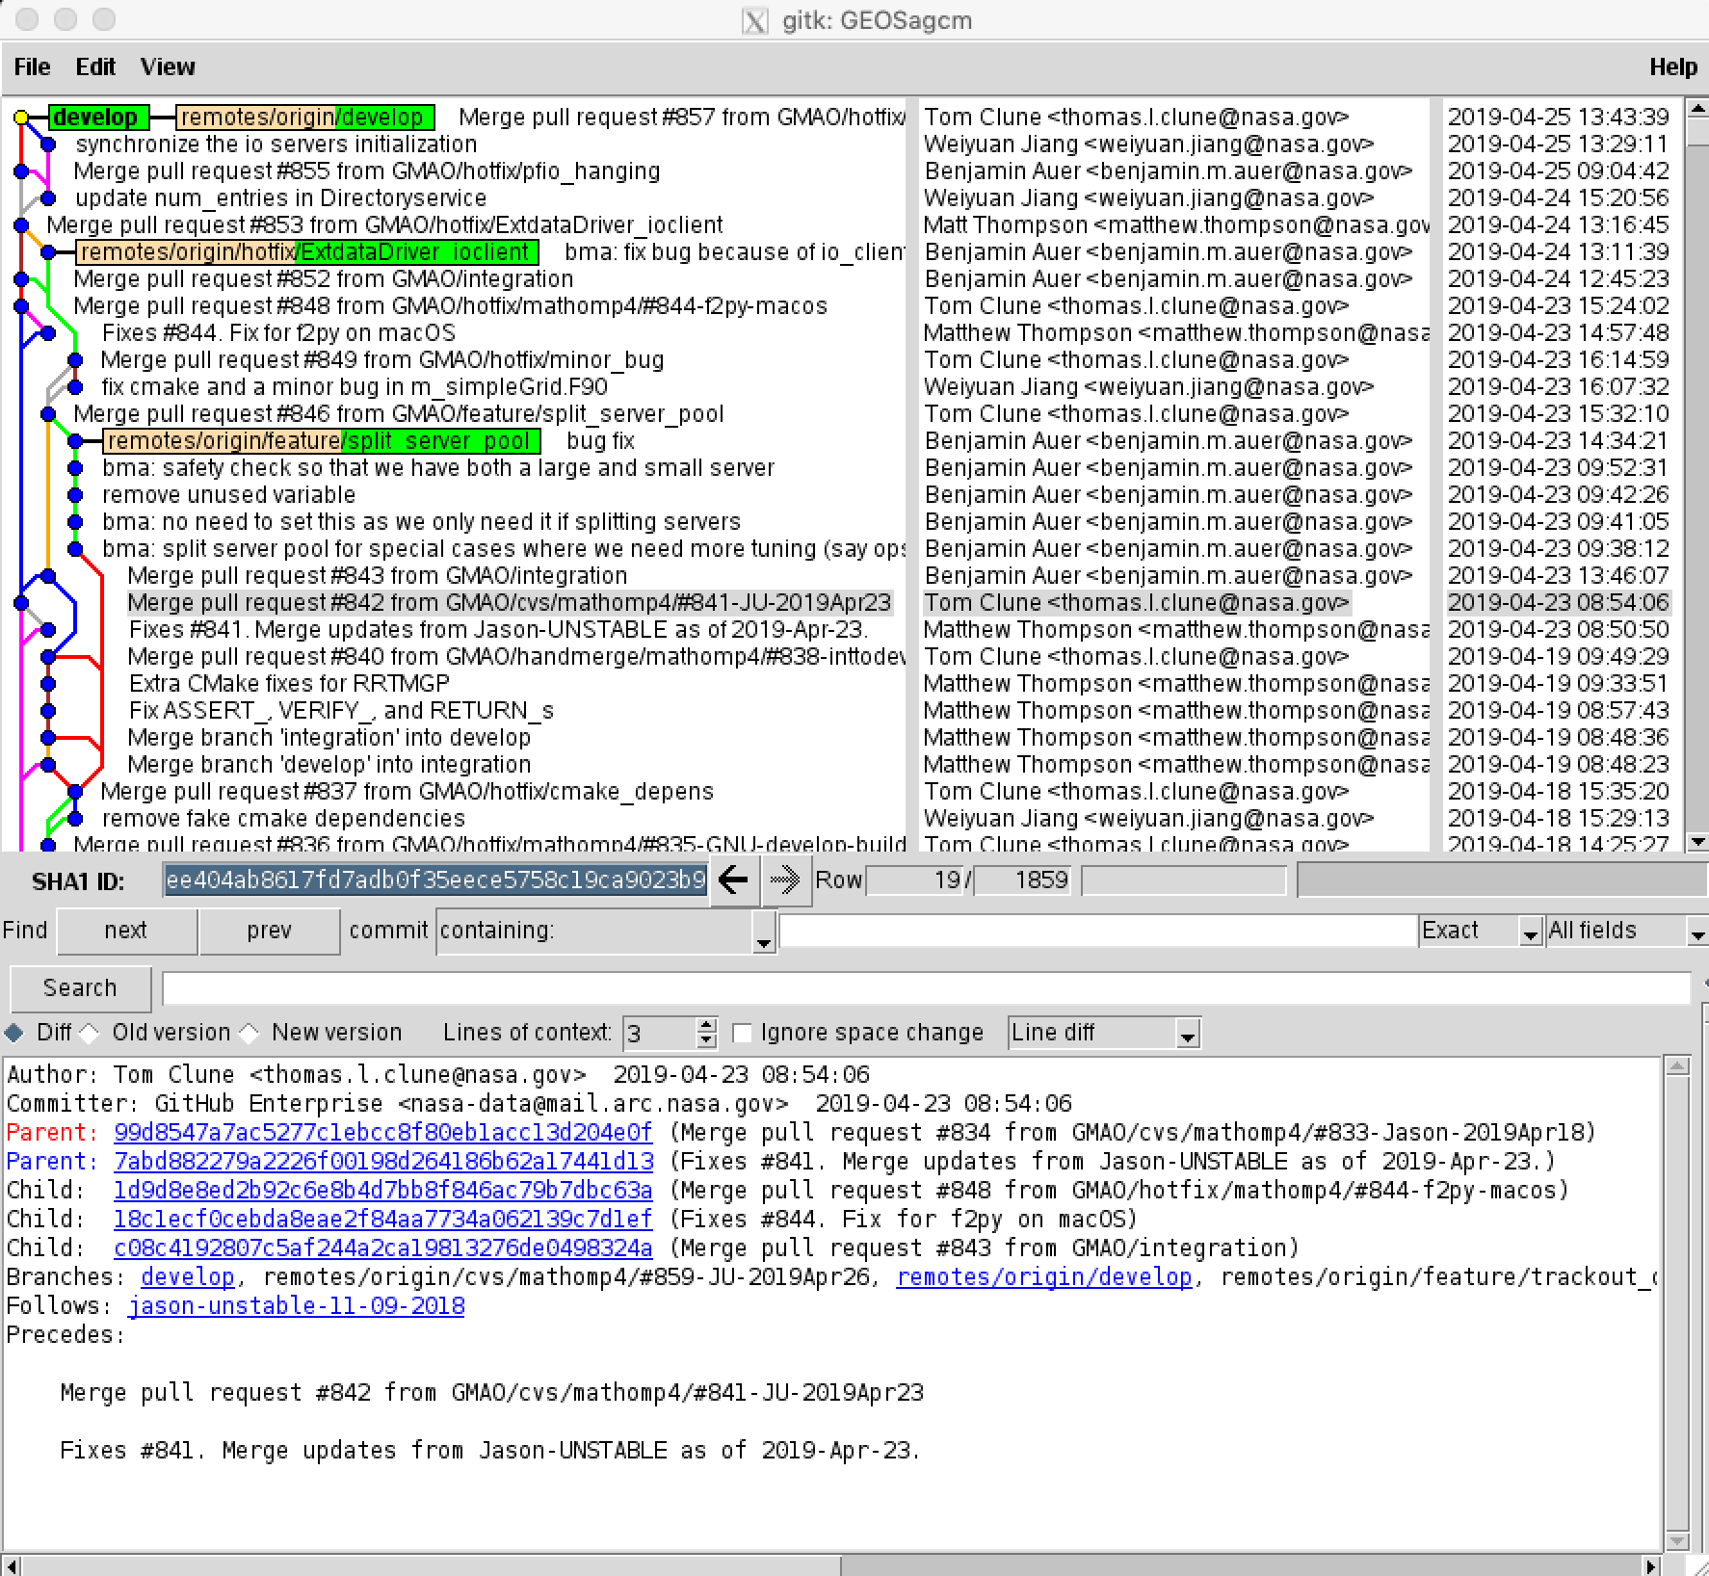
Useful tool: gitk

Slide 39
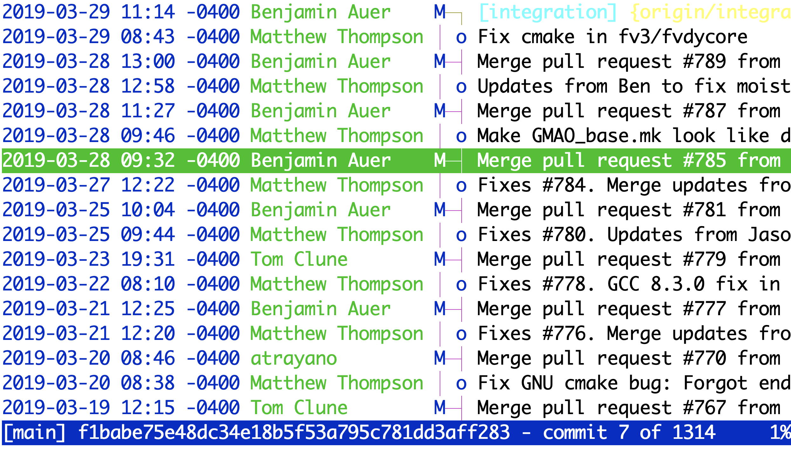
Useful tool: tig (run from command line)

Slide 40
Useful aliases: ~pchakrab/.gitconfig

Slide 41
Main content
Git concepts
Getting started with Git
Useful tools/aliases
Oops
CVS to Git cheat sheet

Slide 42
Premature (local) commits
Fix the last commit message
> git commit --amend -m “Updated commit message”
Forgot to add a file to the last commit
> git add the-file-i-forgot-to-add.py
> git commit --amend --no-edit # do not change message
The resulting commit will replace the incomplete one
Undo last commit
> git reset --soft HEAD~1 # preserve file changes
> git reset --hard HEAD~1 # discard file changes

Slide 43
Committed to the wrong (local) branch
> git checkout wrong-branch
> git reset --soft HEAD~1 # undo commit, preserve file changes
> git stash # modifications are stashed away
> git checkout correct-branch
> git stash pop # pop = apply + drop
> git add . # or add files individually
> git commit -m “My commit message”

Slide 44
‘git diff’ does nothing
Git doesn’t do a diff of files that have been staged. Try
> git diff --staged

Slide 45
I give up
> cd /path/to/my-git-repo/..
> rm -rf my-git-repo # or rename it
> git clone git@github.com:GEOS-ESM/my-git-repo.git
> cd my-git-repo

Slide 46
Main content
Git concepts
Getting started with Git
Useful tools/aliases
Oops
CVS to Git cheat sheet

Slide 47
Cheat sheet
Action | CVS command | Git command
Checkout repository | cvs checkout repo | git clone repo
Checkout a branch of the repo | cvs checkout –r branch repo | git clone -b branch repo
Check status | cvs status | git status
Update code checkout | cvs update | git remote update git pull
Commit changes | cvs commit | git add git commit git push (optional)
Create branch | cvs tag -b branch-tag | git branch branch-name
Update to a branch | cvs update –r branch-tag | git checkout branch-name
Tag code | cvs tag tag-name | git tag tag-name (don’t do this) git tag -a tag-name
Merge code from branch | cvs update -j remote-branch | git merge remote-branch

Slide 48
Cheat sheet
Action | CVS command | Git command
Add file | cvs add file | git add file
Delete file | cvs rm file | git rm file
Rename file | mv file1 file2 cvs rm file1 cvs add file2 | git mv file1 file2
Check differences | cvs diff –u | git diff
Revert file changes | rm file cvs update file | git checkout file

Slide 49
Coming later – advanced tutorial
Topics to be covered are:
How to handle merge conflicts
git stash/squash
Detached head
How to manage (multiple) remotes
GitHub – Codeowners/Forks
Anything else?

Slide 50
?
https://gmao.gsfc.nasa.gov/intranet/presentations/git_transition
Date | Time | Location
07/29/2019 | 10:00 – 2:00 | G125G
07/30/2019 | 8:00 – 11:00 | A116
 | 1:00 – 5:00 | A128
07/30/2019 | 8:00 – 11:00 | E108
 | 1:00 – 4:00 | G125G
Office hours
geos5-support@lists.nasa.gov

