Slide 1
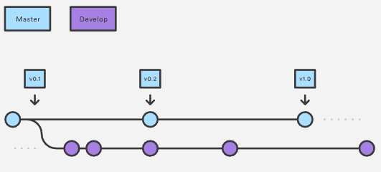
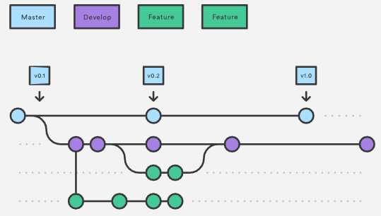
Gitflow Model – Feature Branches
Gitflow is one option for managing the development workflow in with git.
Abstract idea of git branching that specifics what kind of branches to make and when to merge them
Uses 2 branches to record history, a master branch to store official releases and a development branch to serve as integration for new features.
All new features are branched off of develop and back there when complete. Features never interact with master.

Slide 2
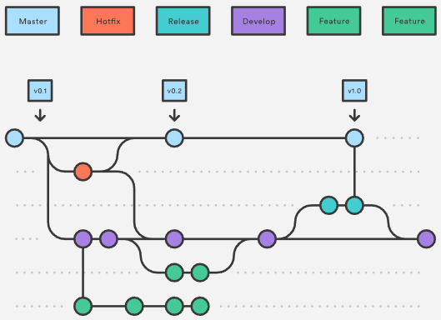
Gitflow Model - Hotfixes
What about when a production version needs a patch.
Hotfix branches based off of master.
Should be merged into both development and master

