Slide 1
General Introduction
Change is Difficult

Slide 2
Introducing 3 disruptive changes into GEOS
All-at-once vs one-at-a-time?
New build tool: Cmake (+ecbuild macros)
Minor impact to most developers
New version control software: Git
Medium impact – some steps have direct anlogs
Multiple repositories: manage-externals
Major impact to some development aspects
Significant uncertainty in decomposition decisions

Slide 3
Under CVS, GEOS (esma) was a single, monolithic, centralized repository.
Under Git, GEOS is subdivided into multiple independent repositories with distinct concerns.
Repositories are composed into a work-tree via a separate technology, “manage-externals” (discussed later).
Rationale:
Supports inter-agency development of shared code layers
GEOSchem_GridComp (NOAA)
MAPL (GCHP)
MOM5, FV3, …
Facilitates semi-independent development cycles for ANA and GCM.

Slide 4
Repository categories
Fixtures – thin top-level repositories that are analogs of CVS modules
Bundles other repos into a coherent code set
Examples: GEOSadas, GEOSgcm, GEOSctm, GEOSldas
More on the way: GISsa, radapp,
Components
GridComps
E.g., GEOSana_GridComp, GEOSgcm_GridComp, GEOSchem_GridComp …
Apps
E.g., GEOSgcm_App, GEOSdas_App, …
Shared
Libraries: NCEP_Shared, GMAO_Shared, MAPL
Utilities: GEOS_env, ESMA_cmake

Slide 5
The Good
Enables highly customized configurations of GEOS
The Bad
Fixtures might diverge in terms of versions of sub-repositories
The Ugly
Many changes will span multiple repositories. This significantly complicates the otherwise elegant process of merges under Git/GitHub.

Slide 6
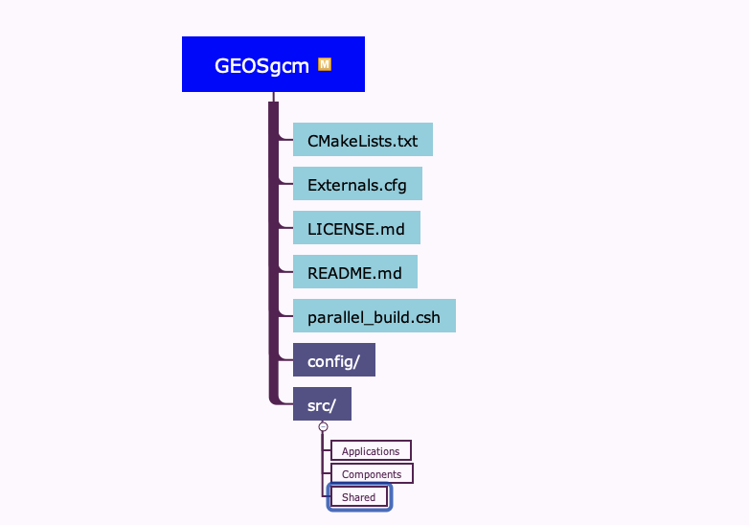
Initial git clone of
GEOSgcm fixture

Slide 7
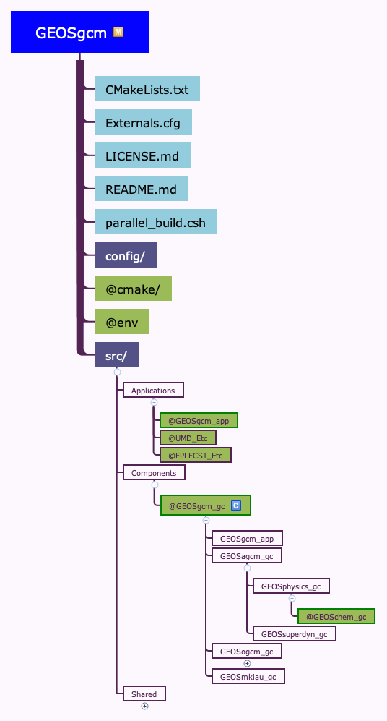
After assembly via manage-externals

