Slide 1
manage_externals
Manage_externals checks out a set of external version control repositories (git or svn) “externals” into a configureable structure
Allows nesting of externals; will seem like CVS modules for those familiar,
Managed by configuration files that control the externals. For each external we define:
Repository url
Local path to clone into
The branch/tag/hash to checkout
The type of repository (git or svn)
Whether an external itself requires additional sub-externals
The sparsing of repository on checkout

Slide 2
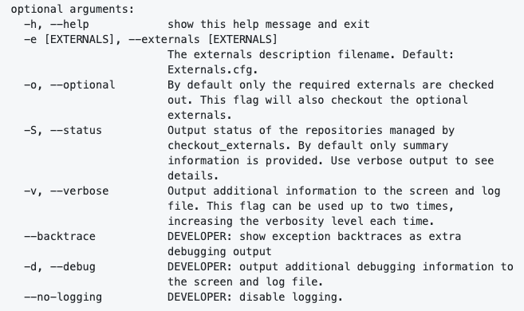
manage_externals: arguments
Manage externals has a single command:
checkout_externals; with no arguments, checkout the externals described in the default Externals.cfg file
Will not overwrite an existing checkout on subsequent calls of checkout_externals

Slide 3
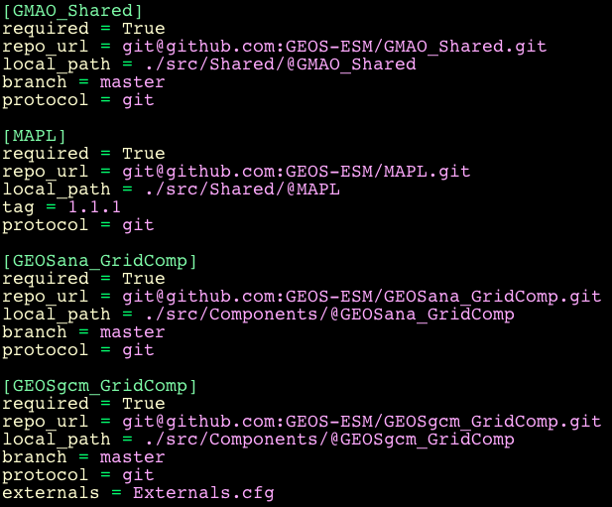
GEOSadas Example
Snippet of the top level Externals.cfg file for GEOSadas fixture:
The GEOSgcm_GridComp has an externals line.
This repository contains its own Externals.cfg file specifying repositories to be nested inside it

Slide 4
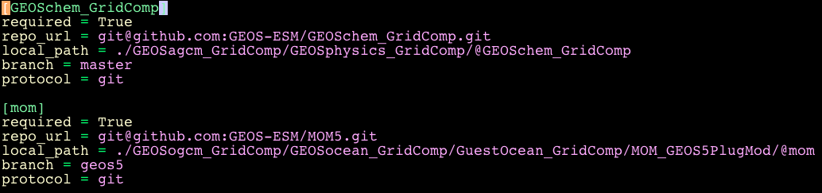
GEOSadas Example
Externals.cfg file in GEOSgcm_GridComp repository to bring in Chemistry and Mom:

Slide 5
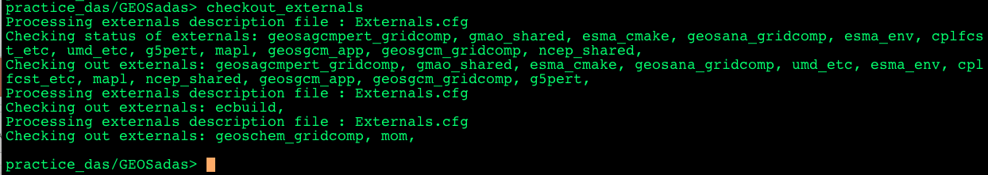
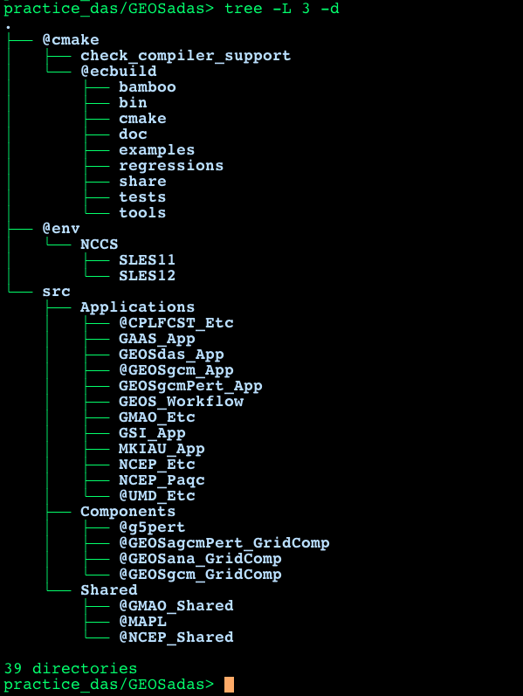
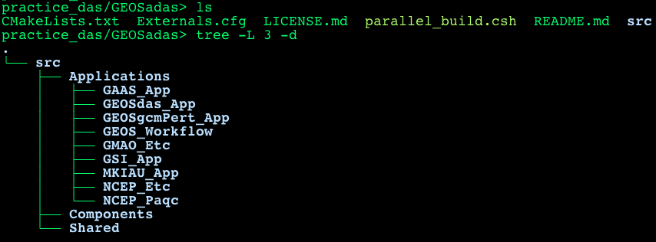
GEOSadas Example
Run checkout_exteranals:
Brings in the external repositories:

Slide 6
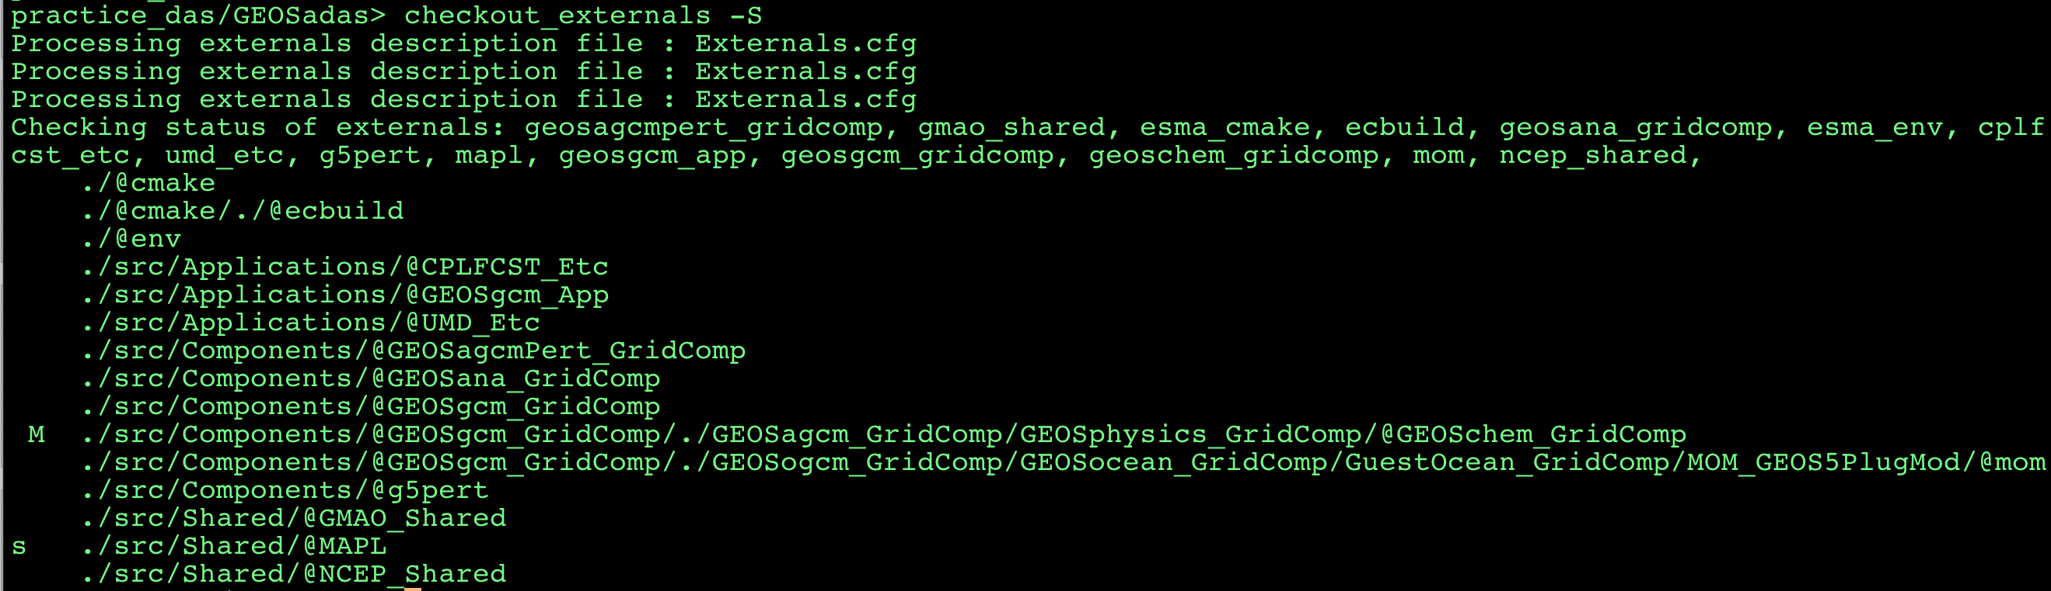
manage_externals – status
Run “manage_externals --status” to see the current status of your checkout. Will report possible status messages in 3 columns for each repository
No change in your checkout, all 3 columns blank
Modified a file (M in the 2nd column, modified, added, or deleted files)
Updated to a different branch/tag/hash than specified in Externals file (s in the 1st column, out-of-sync)

