Slide 1
GEOS Repository Policy
Branches, tags, versions, …

Slide 2
Roles and privileged access
Access to GEOS-ESM (our GitHub org) can be restricted by a variety of mechanisms.
Anyone:
can view and clone our repositories
GitHub users:
can fork, open issues, and make pull requests
GitHub Collaborators (GMAO staff and outside collaborators)
Can push to non-protected branches
Repository administrators (Gatekeepers)
Can approve pull requests onto protected branches
Will be implemented as teams – work does not stop when someone is on vacation
Some repos/directories will also have “codeowner” teams that must review and approve changes prior to merging pull requests.
Admins have the ability to override protections in an emergency.
Generally should not be needed – can always due peer-to-peer pulls/pushes until gatekeeper is available.

Slide 3
Branch management and naming
Most GEOS repositories should use GitFlow (https://datasift.github.io/gitflow/IntroducingGitFlow.html)
Permanent (and protected) branches are “master” and “develop”
Most other branches should be temporary
Simple repos (e.g. fixtures can use “GitHub flow”) (one permanent branch: “master”)
https://guides.github.com/introduction/flow/
Temporary branches should generally reference an open GitHub issue
Especially important for bug fixes
Naming temporary branches
New feature branch: feature/tclune/#xxx-enabled-foo
Bug fix for develop: bugfix/mathomp4/#xxx-fixed-blah-blah-blah
Hotfix on master: hotfix/pchakrab/#xxx-fixed-yatta-yatta-yatta
Remember - changing branch names is easy in Git.
First line of pull requests should be “Fixes #xxx”
Enables issue #xxx to be automatically closed when commit is merged into master.

Slide 4
Special case: Forks of external repos (e.g., MOM5)
For these repos we should maintain consistency of master and develop with the external organization’s repo
Instead use geos/master and geos/develop
Feature/bugfix branches can use usual names

Slide 5
Use Semantic Versioning: https://semver.org
3.2.11 > 3.2.10
3.2.11 > 3.1.25
3.2.11 > 2.17.188
3 . 2 . 11
Non backward compatible changes
Major
Minor
Patch
Minor changes, bug fixes.
New features
Note: Actual Git tags should prefix with a “v”.
E.g., tag “v2.7.0” is semantic version 2.7.0

Slide 6
Semantic Versioning (cont’d)
3 . 2 . 11-beta
Major
Minor
Patch
Optional
Pre-release label
CAUTION:
3.2.11-beta < 3.2.11
“A pre-release version indicates that the version is unstable and might not satisfy the intended compatibility requirements as denoted by its associated normal version.”

Slide 7
Tagging
Always use annotated tags (i.e, use “git tag –a …” option)
Tags that reference original CVS tags shall be of the form: cvs/<cvs-tag>
Pre-release tags to reference CVS tags shall be of the form cvs/<cvs-tag>.<rev> Note that “.” cannot appear in CVS tags, so there is no ambiguity.
Each repository should adopt “semantic versioning” (next slides)
Supplemental tags across multiple repositories may be useful for coordination.
E.g., it is probably useful to reference the version of the underlying GCM
Such tags should be of the form <meta>/<version> (next slide)

Slide 8
Tagging cont’d
Note: We expect policy on this to evolve as we gain experience with multi-repository management.
GEOSgcm v1.2.3 gcm/v3.2.7
GEOSadas
v5.26.0 gcm/v3.2.7
GEOSgcm_App
v2.2.1 gcm/v3.2.7
GEOSgcm_GridComp v3.2.7
GCM grid comp is the “main” tag. Other repos reference this tage.

Slide 9
CMake
Build a better mousetrap ...

Slide 10
Previously, GEOS built using GNU “make”. In each source directory you would find a file called “GNUmakefile”
GEOS now builds with a newer technology called CMake. In each source directory you will find a file called “CMakeLists.txt”.
During the initial configuration step, Cmake generates conventional makefiles.
Rationale:
JEDI
Framework for exporting/importing software components
Reduced complexity
Improved portability, reduced build-times, out-of-source builds, …

Slide 11
CMake: What you need to know
Out-of-source build: build artifacts (*.o, *.a, *.x, …) go into a separate directory tree that mirrors the source tree.
The source tree is never* changed by the build process.
Installation is a distinct process after the build that copies artifacts into yet another directory tree (bin, lib, etc, include, …)
Post-build experiment creation, plotting, etc. should all be performed from the install directory!
Sensible defaults for these are set by parallel_build.csh
How to add new source files to the build (next slide)
* Minor annoying exception for python scripts.

Slide 12
CMake: Seek SI team help for
Modifying compiler flags
Introducing new library/component
New dependencies between libraries/components
Race conditions in the build

Slide 13
Adding a new source to a CMakeLists.txt file
esma_set_this ()
set (srcs
gw_drag.F90 GEOS_GwdGridComp.F90
machine.F90 gwdps.f gwdc.f
)
esma_add_library (${this}
SRCS ${srcs}
DEPENDENCIES GEOS_Shared MAPL_Base)
target_include_directories (${this} PUBLIC ${INC_ESMF} ${INC_NETCDF})

Slide 14
Gatekeeper
Responsibilities & Recipes

Slide 15
Approving pull requests
Each repository will have a designated “team” of developers that are permitted to approve pull requests onto develop and master branches.
These are the “gatekeepers” for the given repo.
Note: master and develop branches are protected
When a pull request is submitted, gatekeepers receive an email
Link to the pull request is conveniently embedded
Note that gatekeeper approval may not be the only requirement
Some repos will have automated tests
Some directories or file-types may have mandatory reviews by other teams (e.g., changes to CMake scripts)

Slide 16
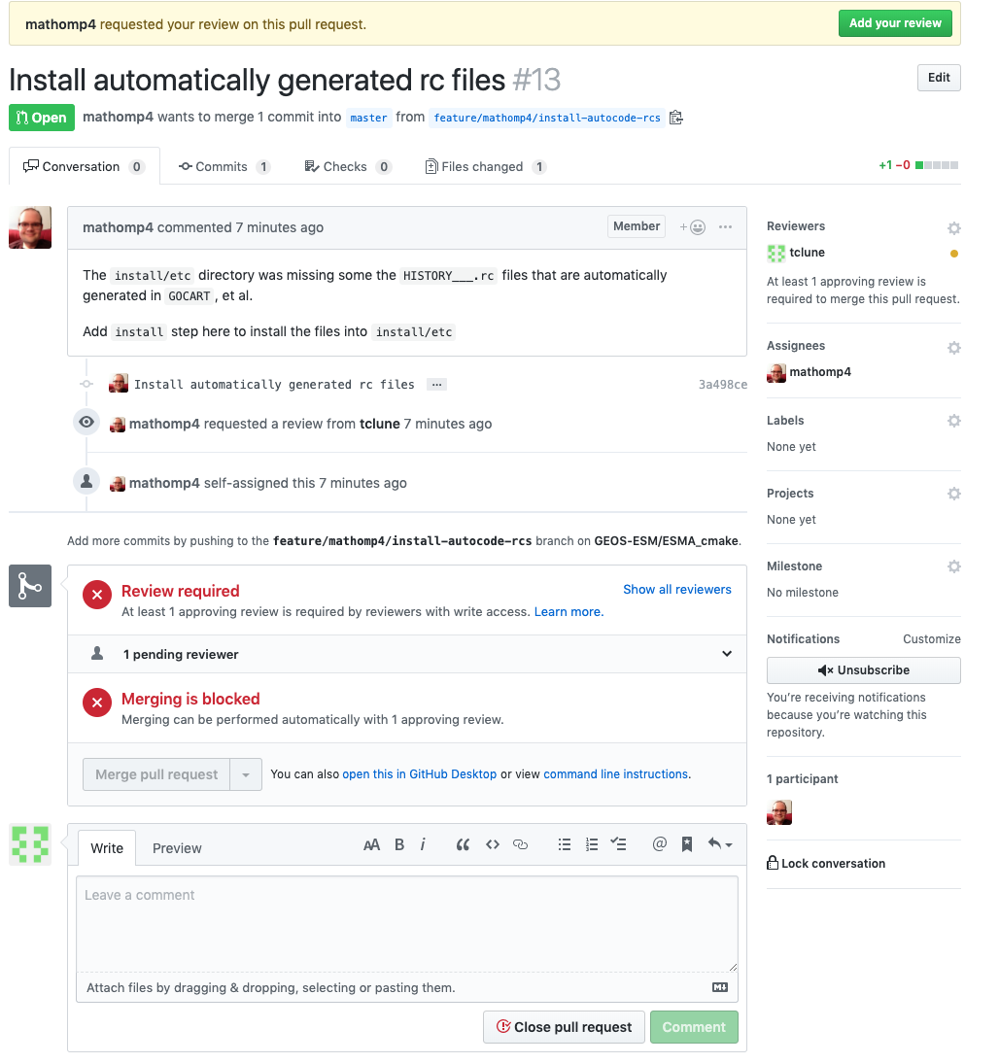
GitHub mechanics for approving pull requests.

Slide 17
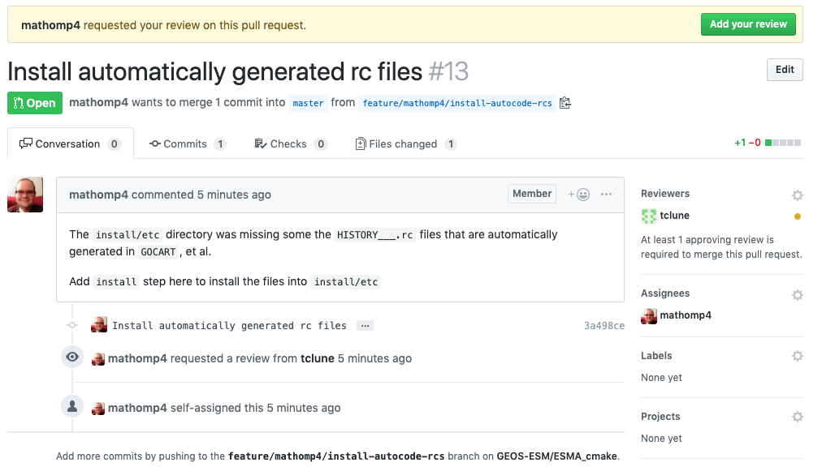

Slide 18
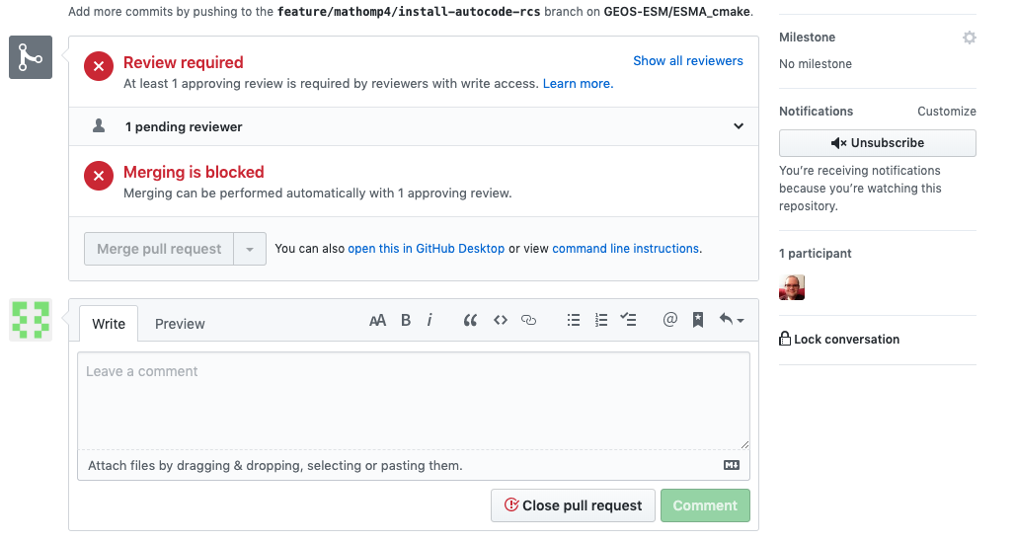

Slide 19
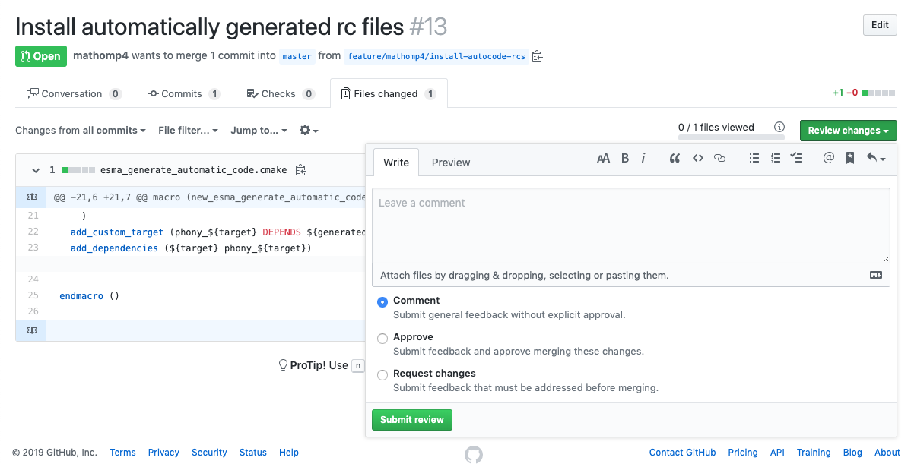

Slide 20
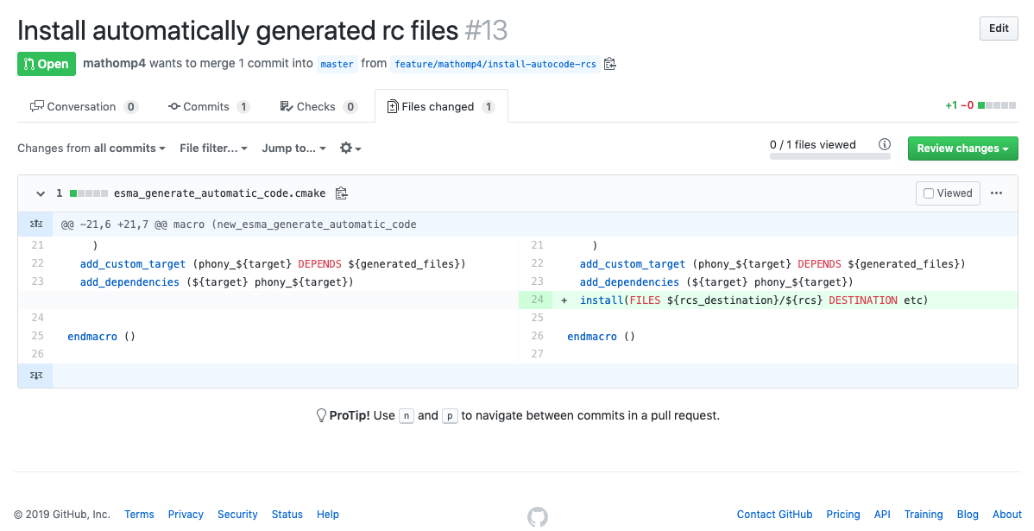

Slide 22
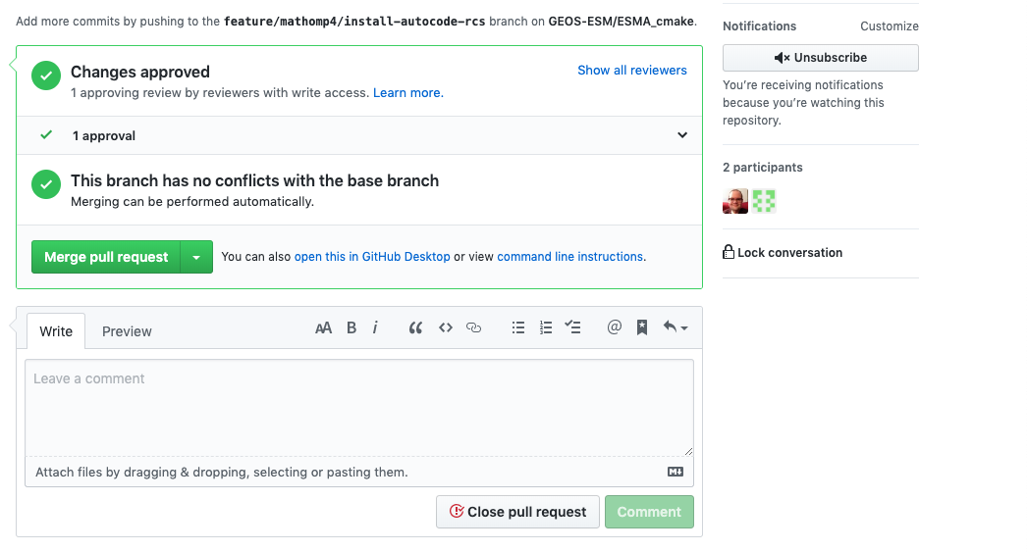

Slide 23
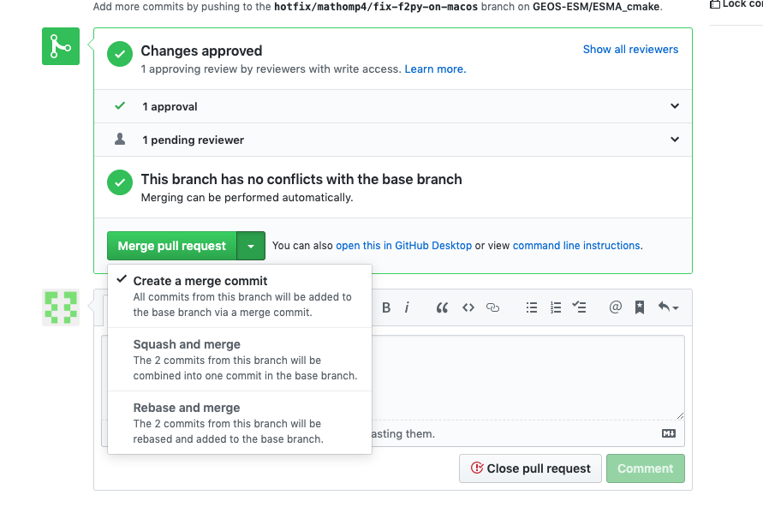

Slide 24
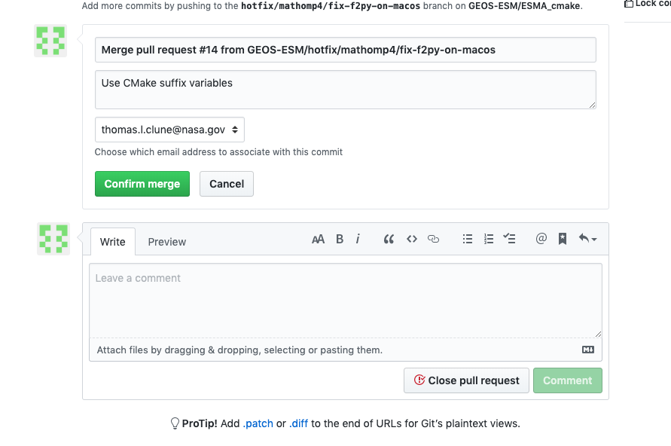

Slide 25
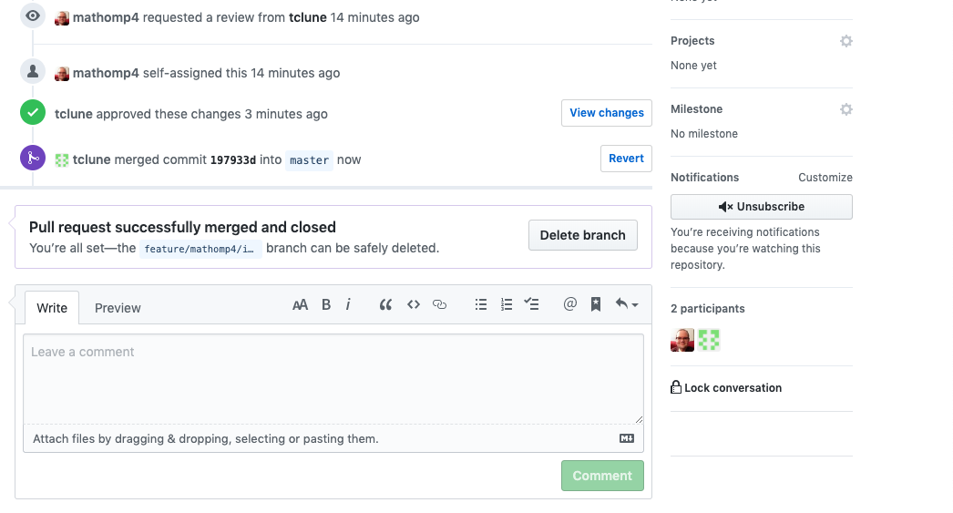

Slide 26
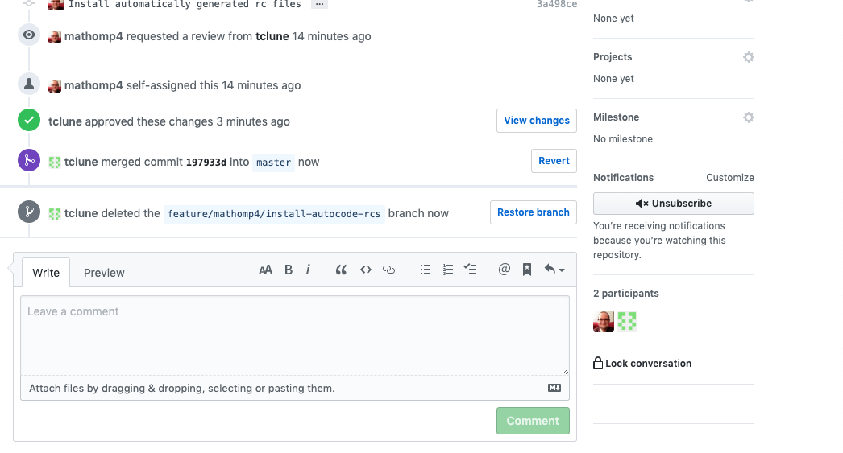

Slide 27
Realistic scenario
A pull-request is submitted to repo GEOSgcm_GridComp
From branch feature/me/#1-very-important onto develop
The GCM gatekeeper wants to validate the change before approving
This step makes model development somewhat different than mainstream software development where one would just automatically (and quickly) run all of the unit tests for the repository.
What does the gatekeeper do in practice?

Slide 28
Validation recipe
In validation environment (e.g., discover) clone GEOSgcm fixture
perform parallel_build.csh
or start from existing clean clone
In ./src/Components/@GEOSgcm_GridComp:
% git fetch origin # obtain feature from GitHub
% git checkout feature/me/#1-very-important
In build dir: % make install
Perform and evaluate validation runs
Approve (or reject) pull request in GitHub

Slide 29
Updating the fixture?
If the PR was approved, you will may want to update the fixture to “point” at the updated component repo
Optional: update version of GEOSgcm_GridComp
Determine new semantic version X.Y.Z
If minor or major update, bonus points for updating cmake project version (new PR)
Create release with new semantic version (see screenshot on next slide)
Create feature branch in fixture: feature/update-gcm-gridcomp-version
Edit Externals.cfg to update semantic version of GEOSgcm_GridComp
Commit, push, create pull-request (onto master)
Probably self-approve pull-request

Slide 30
Go Forth
and suffer

