Slide 1



Tobler’s First Law of Geography
Everything is related to everything else, but near things are more related than distant things.
- Waldo Tobler
Objects near each other are more likely to be similar to one another
Objects that are distant from each other are more likely to be different from each other
This aspect of nature keeps coming up again and again in GIS!
VSP 2018: Spatial Analysis using Geographic Information Systems

Slide 2
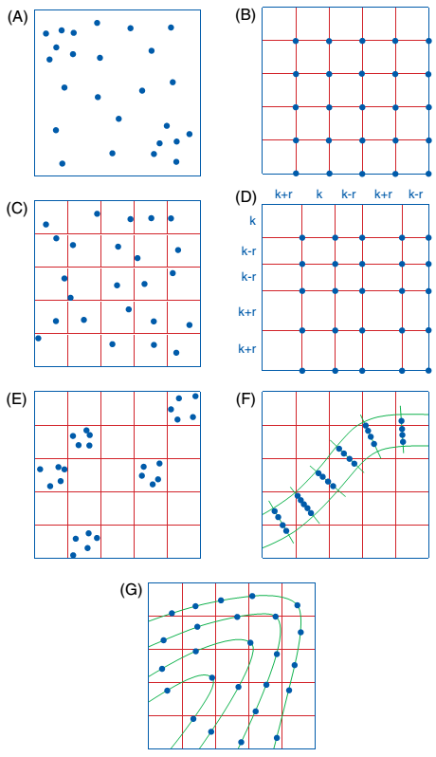
Spatial Sampling
You can think of sampling as the process of selecting points from within an area, called a sample frame
We select some areas within the frame, but discard most others
How we choose which points to keep can determine the quality of our data

Slide 3
Spatial Sampling
Scientific sampling requires that each element in the sample frame have a known and pre-specified chance of selection
If some elements have a greater or lower chance of being selected our sample is said to be biased
If every element of interest has an equal chance of being selected our sample is said to be unbiased

Slide 4
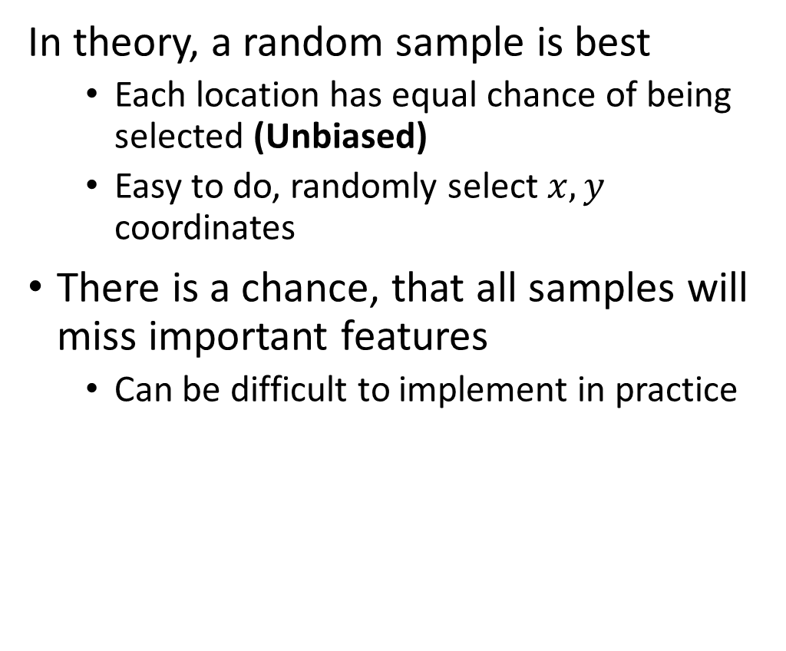
Random Sampling
In theory, a random sample is best
Each location has equal chance of being selected (Unbiased)
Easy to do, randomly select $x,y$ coordinates
There is a chance, that all samples will miss important features
Can be difficult to implement in practice
Smaller elements may be
completely missed
Large elements, like buildings or
crop fields, may be over sampled

Slide 5
Spatial Sampling
We have a number of approaches to account for the drawbacks of random sampling
Repeated sampling
Repeated samples should average towards the actual population values
More time consuming, and requires more resources
Systematic (Biased) sampling
Create a sample design that trades a sampling scheme for randomness
May miss features that have a regular pattern or cluster

Slide 6
Systemic Sampling
Coordinates for each sample unit are assigned at regular intervals in a square or rectangular grid
A regular grid is drawn on the sample space to ensure evenness
Can be a good for areas that contain few features and abrupt boundaries
Not ideal for attributes that exhibit periodicity, like roads
May completely miss regularly spaced features like roads that are offset from the grid
May oversample regularly spaced features like roads that line up with the grid

Slide 7
Stratified Random Sampling
Coordinates for each sample unit are assigned at regular intervals in a square or rectangular grid
Helps to address the issues with Systematic Sampling by sampling at random locations within a regularly spaced grid
However, this can be time consuming and costly
Alternatively use a grid, but add a random space between grid lines
Image source: Longley et al (2015), p. 40

Slide 8
Cluster Sampling
Intense sampling of features in clusters around a number of selected locations
Locations can be selected for specific features:
E.g., all shopping centers
Or, locations can be selected at random across the grid
Efficient, but may not be representative of the broader population you are interested in
Image source: Longley et al (2015), p. 40

Slide 9
Transect & Contour Sampling
Sample clusters made along transects across linear features
Samples along transect may be randomly spaced, stratified, or some combination of the two approaches
Allows you to focus your efforts along observed areas of variability
Efficient: you only sample in the area features of interest are likely to be found
No sampling outside of area of focus
Requires a good understanding of spatial structure for maximum effectiveness
Transect: Most commonly used along line features like roads, rivers
Contour: can be used on hillslopes, drainage basins, etc.

Slide 10
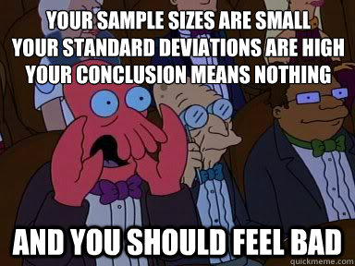
How Many Samples?
The number of samples required to adequately represent a population is a function of how similar units of that population are.
Spatial structure can vary wildly across a landscape
A little knowledge of your study area will help you to establish ways to best stratify to maximize returns with minimal effort
Need to balance effective coverage with the cost (in $ or time)
Eg. short vs. long census form

Slide 11
Spatial Autocorrelation
When the value of one object is related to the value of other nearby objects
If you know the value of one object, you can make a reasonable guess at the value of the other object
That doesn’t mean that the values are the same, however!
It also doesn’t mean that the values of one object directly affect the values of the other (although that is possible)
Correlation does not imply causation!
Merely that there is a relationship between them, or a relationship to a third object that determines the values of the other two

Slide 12
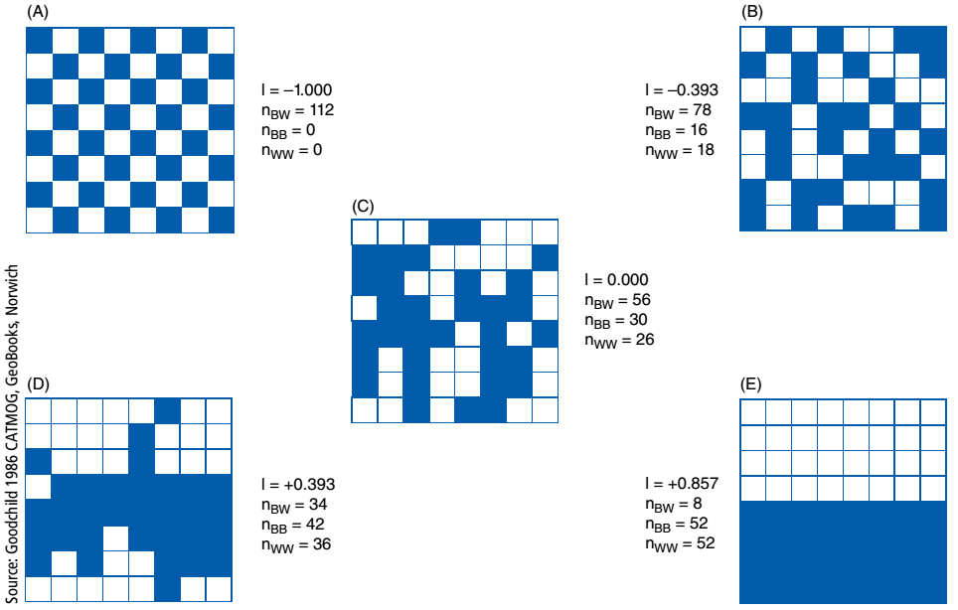
Patterns of Spatial Autocorrelation
Here are some examples of different kinds of spatial autocorrelation:
Extreme negative autocorrelation
A dispersed arrangement
Spatial independence
Spatial clustering
Extreme positive autocorrelation
VSP 2018: Spatial Analysis using Geographic Information Systems
Image source: Longley et al (2015), p. 37

Slide 13
Spatial Autocorrelation & Violating Statistical Assumptions
This is a problem when it comes to spatial statistics, because most statistics assume that there is no relationship between objects
By violating this assumption, we “break” many common statistics!
For this reason, a separate field of spatial statistics explores different ways of accessing similar information, or we acknowledge this as a flaw in our assumptions
It is also a benefit! We can exploit spatial autocorrelation to our advantage.

Slide 14
Spatial Interpolation
The process of “filling in the blanks” that you just performed is called interpolation
Over a 2D or 3D surface we call this spatial interpolation
Intelligent guesswork in which we attempt to make reasonable estimates of the values of a continuous field at places where we do not have measurements

Slide 15
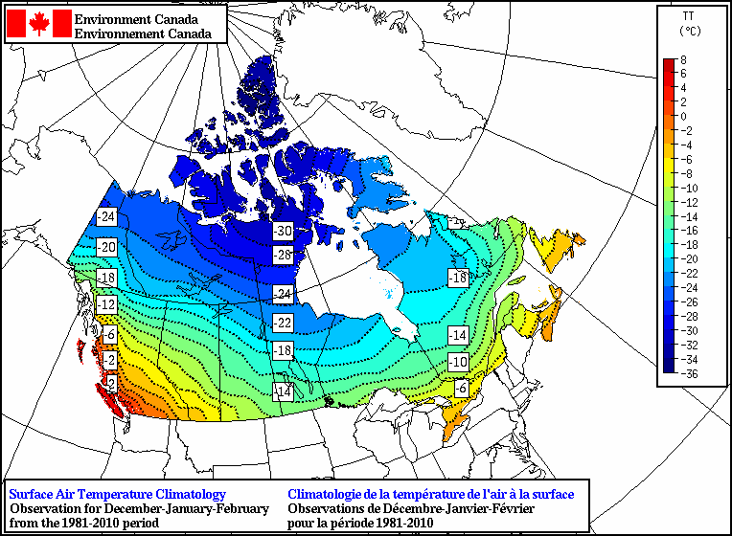
Spatial Interpolation
Spatial interpolation only makes sense for a continuous field
With Nominal (categorical) data, this can be problematic
Works well with:
Rainfall, temperature, pressure
Estimate between weather stations
Elevation between measured locations
Changing resolutions for rasters

Slide 16
Spatial Interpolation & Tobler’s First Law
All spatial interpolation methods incorporate distance to known samples
Sound familiar? This is Tobler’s First Law!
Closer samples may be given more weight than distant ones
A threshold is usually set, to determine the maximum distance to take samples from
Continuous fields tend to exhibit strong positive spatial autocorrelation, it is reasonable to assume that missing values are likely to be similar to those around them in the field

Slide 17
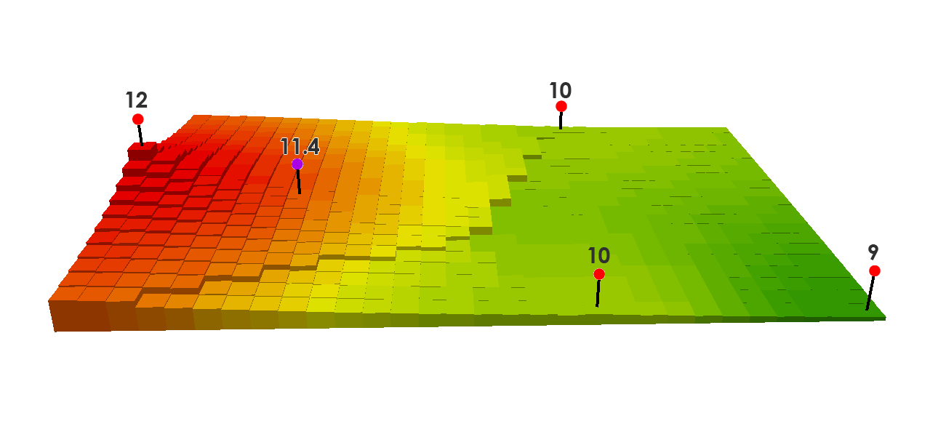

Inverse Distance Weighting
One of the most common methods
Adjusts cells based on nearby observations
Weight cells by distance from observation points

