Slide 1
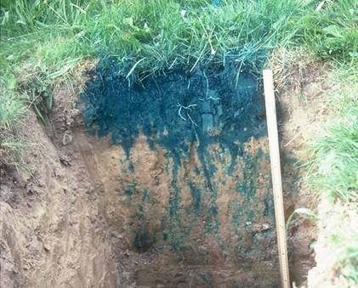
Richards’ equation:
The 1D case
https://nrcca.cals.cornell.edu/soil/CA2/CA0211.1.php
N. Tubini & R. Rigon

Slide 2
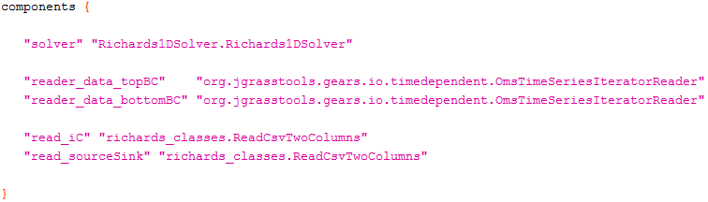
Solving Richards’ equation with OMS console
.sim file: components
& N. Tubini

Slide 3
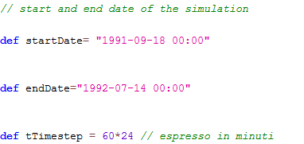
Solving Richards’ equation with OMS console
.sim file
DATE FORMAT: yyyy-MM-dd HH:mm
START DATE
END DATE
TIME STEP
expressed in minutes
& N. Tubini

Slide 4
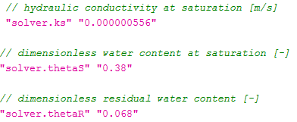
Solving Richards’ equation with OMS console
.sim file: parameters
SOIL PARAMETERS
& N. Tubini

Slide 5
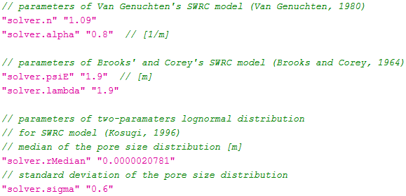
Solving Richards’ equation with OMS console
.sim file: parameters
PARAMETERS OF SWRC MODEL
& N. Tubini

Slide 6
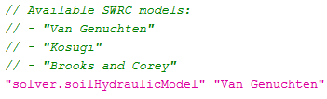
Solving Richards’ equation with OMS console
.sim file: components
SWRC MODEL
& N. Tubini

Slide 7

Solving Richards’ equation with OMS console
.sim file: parameters
BOUNDARY CONDITION
TOP → AT THE SOIL SURFACE
RAINFALL HEIGTH HAS TO BE EXPRESSED IN [mm]
IN CASE OF NEUMANN BOUNDARY CONDITION THE CODE HANDLES WITH THE COMPUTATION ON THE WATER FLUX STARTING FROM THE KNOWLEDGE OF THE RAINFALL HEIGHT
& N. Tubini

Slide 8
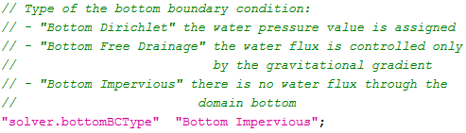
Solving Richards’ equation with OMS console
.sim file: parameters
BOUNDARY CONDITION
BOTTOM → AT THE BOTTOM OF THE SOIL COLUMN
THE BOTTOM BOUNDARY CONDITION HAS TO BE EXPRESSED IN [m].
& N. Tubini

Slide 9

Solving Richards’ equation with OMS console
.sim file: parameters
DOMAIN GEOMETRY
SOIL COLUMN DEPTH
& N. Tubini

Slide 10

Solving Richards’ equation with OMS console
.sim file: parameters
DOMAIN GEOMETRY
& N. Tubini

Slide 11

Solving Richards’ equation with OMS console
.sim file: parameters
TOLERANCE FOT THE NESTED NEWTON ALGORITHM(${10}^{−3}{\sim 10}^{−14}$)
& N. Tubini

Slide 12
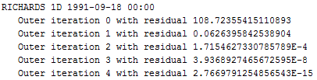

Solving Richards’ equation with OMS console
.sim file: parameters
‘’solver.nestedNewton’’ ‘’0’’ → JUST ONE ITERATION
AT THE ITERATION Outer iterarion 4 THE ERRORE IS SMALLER THAN THE TOLERANCE HENCE THE CODE FORWARDS TO THE NEXT TIME STEP
TOLERANCE IS SET TO ${10}^{−11}$
& N. Tubini

Slide 13
Solving Richards’ equation with OMS console
.sim file: parameters
‘’solver.nestedNewton’’ ‘’0’’ → JUST ONE SIMULATION
WITH JUST ONE SIMULATION THE CODE IS FASTER
& N. Tubini

Slide 14
Solving Richards’ equation with OMS console
.sim file: parameters
‘’solver.nestedNewton’’ ‘’0’’ → JUST ONE ITERATION
IF WITH JUST ONE ITERATION THE ERROR IS NEVER SMALLER THAN THE TOLERANCE, YOU SHOULD TRY TO USE THE NESTED ITERATION
(NESTED NEWTON)
& N. Tubini

Slide 15
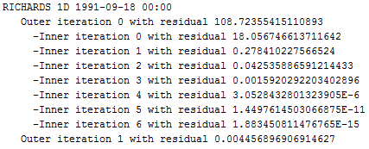
Solving Richards’ equation with OMS console
.sim file: parameters
‘’solver.nestedNewton’’ ‘’1’’ → NESTED ITERATION
Outer iterarion 0 IS NOT SMALLER THAN THE TOLERANCE, HENCE THE NESTED ITERATION STARTS Inner iterarion
& N. Tubini

Slide 16
Solving Richards’ equation with OMS console
.sim file: parameters
‘’solver.nestedNewton’’ ‘’1’’ → NESTED ITERATION
Inner iterarion 6 IS SMALLER THAN TOLERANCE, HENCE THE CODE FORWARDS WITH THE MAIN ITERATION Outer iterarion 1
& N. Tubini

Slide 17
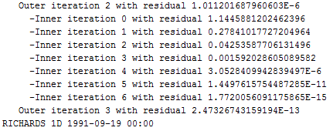
Solving Richards’ equation with OMS console
.sim file: parameters
‘’solver.nestedNewton’’ ‘’1’’ → NESTED ITERATION
Outer iterarion 3 IS SMALLER THAN THE TOLERANCE, HENCE THE CODE FORWARDS WITH THE NEXT TIME STEP
& N. Tubini

Slide 18
Solving Richards’ equation with OMS console
.sim file: parameters
’solver.nestedNewton’’ ‘’0’’ → JUST ONE ITERATION
‘’solver.nestedNewton’’ ‘’1’’ → NESTED ITERATION
IT MAY HAPPEN THAT THE CHOOSEN TOLERANCE IS NEVER REACHED.
IN THIS CASE THE CODE RUNS A CERTAIN NUMBER OF ITERATIONS AFTER THAT THE SOLUTION FOUND IS TAKEN AS THE SOLUTION OF THE CURRENT TIME STEP, DOES NOT MATTER HOW BIG IS THE ERROR.
& N. Tubini

Slide 19

Solving Richards’ equation with OMS console
.sim file: parameters
Solver.tTimestep is expressed in seconds.
& N. Tubini

Slide 20

Solving Richards’ equation with OMS console
.sim file: parameters
& N. Tubini

Slide 21
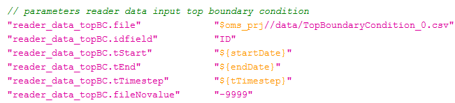
Solving Richards’ equation with OMS console
.sim file: parameters
FILE PATH FOR THE TOP BOUNDARY CONDITION
& N. Tubini

Slide 22
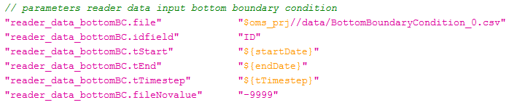
Solving Richards’ equation with OMS console
.sim file: parameters
FILE PATH FOR THE BOTTOM BOUNDARY CONDITION
& N. Tubini

Slide 23
Solving Richards’ equation with OMS console
.sim file: parameters
FILE PATH FOR THE INITIAL CONDITION OF THE WATER PRESSURE
& N. Tubini

Slide 24
Solving Richards’ equation with OMS console
.sim file: parameters
FILE PATH FOR THE SOURCE/SINK TERM
& N. Tubini

Slide 25

Solving Richards’ equation with OMS console
.sim file: parameters
PATH OF THE OUTPUT FOLDER
& N. Tubini

Slide 26
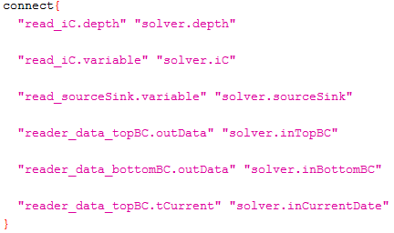
Solving Richards’ equation with OMS console
.sim file: connect
& N. Tubini

Slide 27
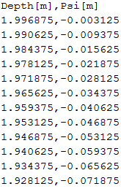
Solving Richards’ equation with OMS console
INPUT FILE FOR THE INITIAL CONDITION
& N. Tubini

Slide 28
Solving Richards’ equation with OMS console
INPUT FILE FOR THE INITIAL CONDITION
THE FIRST LINE REFERS TO THE DEEPEST LAYER.
THE DEPTH OF THE DEEPEST LAYER IS ALWAYS SMALLER THAN spaceBottom
THE LAST LINE REFERS TO THE UPPERMOST LAYER.
THIS DEPTH IS ALWAYS GRATER THAN 0m
& N. Tubini

Slide 29
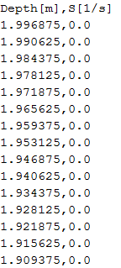
Solving Richards’ equation with OMS console
INPUT FILE FOR THE SOURCE/SINK TERM
& N. Tubini

Slide 30
Solving Richards’ equation with OMS console
INPUT FILE FOR THE SOURCE/SINK TERM
THE FIRST LINE REFERS TO THE DEEPEST LAYER.
THE DEPTH OF THE DEEPEST LAYER IS ALWAYS SMALLER THAN spaceBottom
THE LAST LINE REFERS TO THE UPPERMOST LAYER.
THIS DEPTH IS ALWAYS GRATER THAN 0m
& N. Tubini

Slide 31
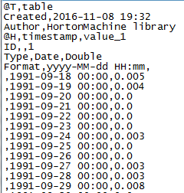
Solving Richards’ equation with OMS console
INPUT FILE FOR THE TOP BOUNDARY CONDITION
RAINFALL HEIGHT [mm]
& N. Tubini

Slide 32
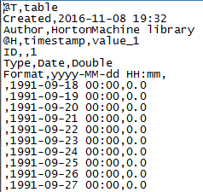
Solving Richards’ equation with OMS console
INPUT FILE FOR
THE BOTTOM BOUNDARY CONDITION
WATER PRESSURE AT THE BOTTOM OF THE DOMAIN [m]
& N. Tubini

Slide 33
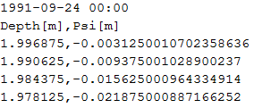
Solving Richards’ equation with OMS console
WATER PRESSURE OUTPUT FILE
TIME AT WHICH THE SOLUTION IS COMPUTED
DEPTH [m]
WATER PRESSURE [m]
& N. Tubini

Slide 34
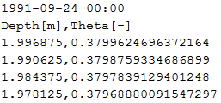
Solving Richards’ equation with OMS console
WATER CONTENT OUTPUT FILE
TIME AT WHICH THE SOLUTION IS COMPUTED
DEPTH [m]
WATER CONTENT [-]
& N. Tubini

Slide 35
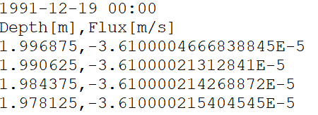
Solving Richards’ equation with OMS console
WATER FLUX OUTPUT FILE
TIME AT WHICH THE SOLUTION IS COMPUTED
DEPTH [m]
WATER FLUX [m/s]
& N. Tubini

Slide 36
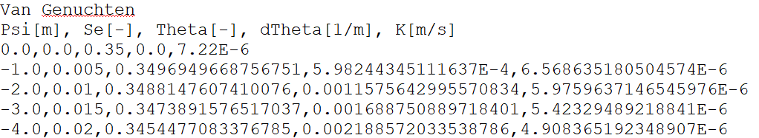
Solving Richards’ equation with OMS console
HYDRAULIC PARAMETRIZATION
SWRC MODEL
Se: saturation degree as a function of Psi
Theta: water content as a function of Psi
dTheta: derivative of Theta with respect to Psi
K: hydraulic conductivity as a function o Psi
& N. Tubini

Slide 37

Thank you for your attention !
G.Ulrici - 2000 ?
& N. Tubini

