Slide 1
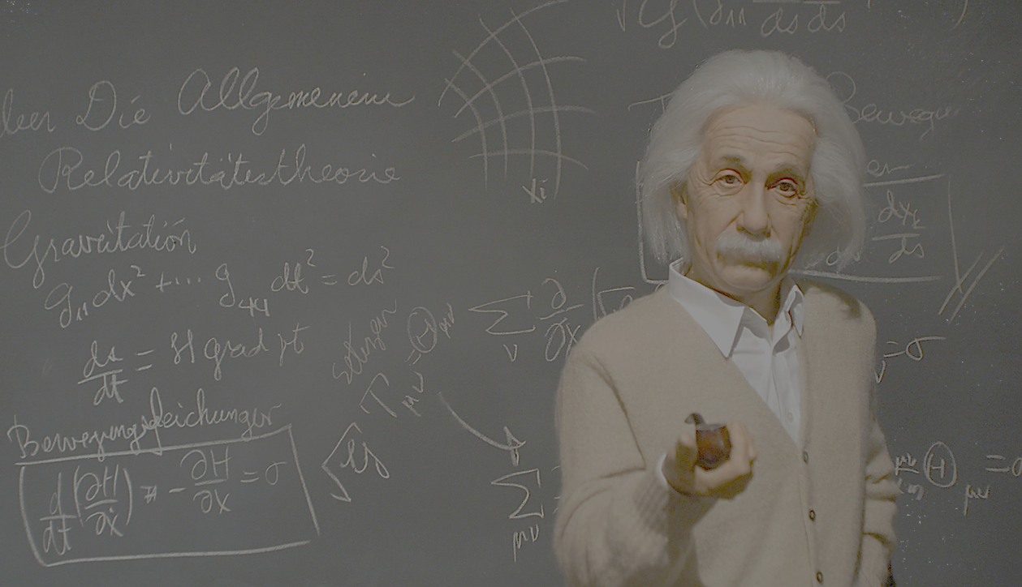


Graduate Engineering and Science Students Association (GESSA)
Presents
Tutoring Sessions
Why learn alone? Ever interested in learning something different, but wanted a kick to get started? GESSA has got beginner level tutoring classes for you.
Never learn hungry with us! Free Food and Drinks!
Starting September 4, 4 – 6 PM.
Attend a session every Friday.
Register for attending - https://goo.gl/U31fW5
Tutor registration at http://asu.orgsync.com/org/gessa
(Free goodies for Tutors)
For further details contact:
Vignesh Natarajan
(425) 326 - 0153
nvignesh@asu.edu

