Slide 1
Version Control with Git

Slide 2
Version Control
A Version Control System (VCS) keeps track of changes to a file over time.
It records what was changed, when it was changed, and who changed it.
Many different reports can be made using the information stored using a VCS.
Differences between files.
List of changes by a user.
Users can work on different copies of the same project and combine (merge) them later on.

Slide 3
Git
Open source version control system used primarily as a source code management (SCM) system.
Distributed Version Control Systems allows both clients and server to have a full backup of the entire repository.

Slide 4
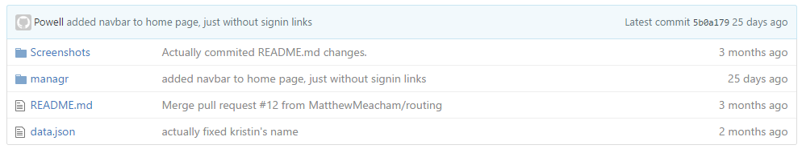
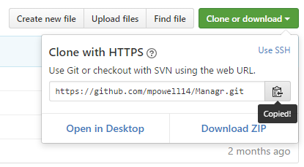

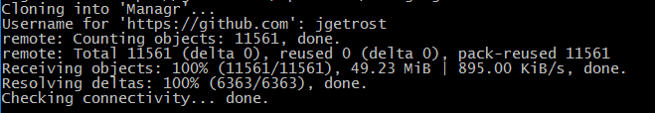
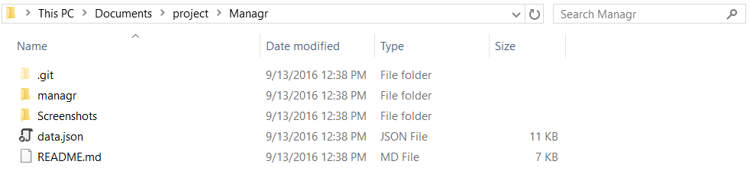
Basic Git workflow
Cloning a remote repository:

Slide 5
Adding files to a commit
git add source.js
OR
git add *.js
OR
git add *

Slide 6
Committing to local repository.
git commit –m “A detailed message about your commit.”

Slide 7
Pushing local changes to server (GitHub)
git push origin master

Slide 8
Pulling changes from server to local.
git pull origin master

