Slide 1
Bayesian Bandits and their applications
Dr. Ben, Hoyle, Senior Scientist and Data Scientist at Carl Zeiss

Slide 2

Carl Zeiss
Offices around the globe: HQ in DE: Jena / Oberkochen / Aalen,
10k employees in DE, 50k around the globe
→ ~10k people get their vision back each day!
Owned by employees
Very strong research culture + funding (X%->RnD)
Marriage of Research and Technical implementation
Carl Zeiss + Ernst Abbe = Zeiss
Management structure for Scientists
Write papers / give talks/ students etc
Hoyle: Bayesian Bandits
12.Aug.20

Slide 3
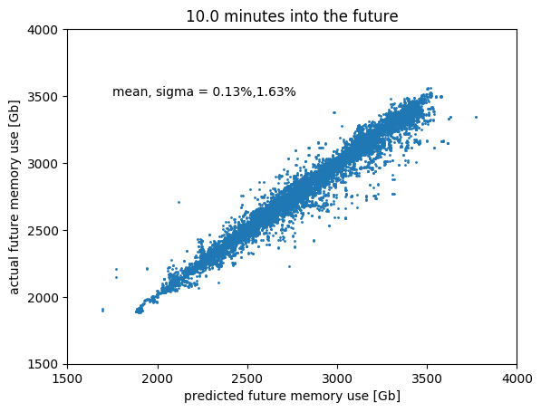
Carl Zeiss: Data Science
Predictive maintence:
When will production line machines fail?
When will countries shut down/open up Covid?
When will computing clusters run out of memory?
Hoyle: Bayesian Bandits
12.Aug.20

Slide 4
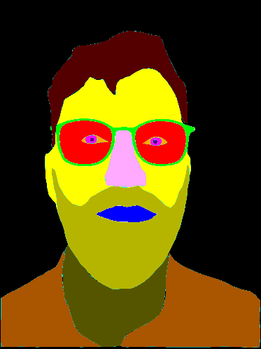
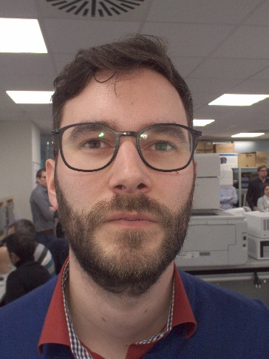
Carl Zeiss: Data Science
Predictive maintence:
When will production line machine fail?
When will countries shut down/open up Covid
When will computing clusters run out of memory?
Image based Deep ML:
Segmentation: helping opticians/surgens with AR highlighting of body parts
Fault detection of lenses during manufactoring
Hoyle: Bayesian Bandits
12.Aug.20

Slide 5
Carl Zeiss: Data Science
Predictive maintence:
When will production line machine fail?
When will countries shut down/open up Covid
When will computing clusters run out of memory?
Image based Deep ML:
Segmentation: helping opticians/surgens with AR highlighting of body parts
Fault detection of lenses during manufactoring
Recommender Systems:
Glasses/Frames for consumers
Products that can run on different machines
Hoyle: Bayesian Bandits
12.Aug.20

Slide 6
Overview
About Carl Zeiss
Probabilities in everyday life.
Estimating probability distribution functions.
Bernoli processes
Classes of problems
Bayesian Bandits
Worked examples
Implementing e.g. Bayesian Bandits
Docker containers
APIs and apps
Swagger
Expected timeline
5 min introduction
15 min talk
20 min Jupyter notebook
15 min Docker container
5 min API calls
3 min summary
Hoyle: Bayesian Bandits
12.Aug.20

Slide 7
Probability recap
Almost every action you take, is based on the estimation of probabilities, we denote by P.
Will this person marry me, if I ask them?
P(Yes| marry me, information about the relationship)
What is the probability that this coin is fair?
P(heads | information about the coin)
Will I find a better job YES|NO, doing a DataScience camp?
P(better job| data science camp, other information)
compared to
P(better job| not doing a data science camp, other information)
Rather than just estimating one number for a probability, it is better to describe our uncertainty of the probability using a probabaility distribution function.
Hoyle: Bayesian Bandits
12.Aug.20

Slide 8
Estimating probabilities
Is this a fair coin (dice) YES|NO? P(heads| information about the coin, information about coins)
What “prior” information do we need to answer this question?
What “experimental” evidence do we need?
Which of the N possible items, should I show to recommend to this user, to maximise a purchase? P(purchase-rate | item_i) compared to P(purchase-rate| item_j)
Which of the N possible creatives, should I show to a website user, to maximise click through rates? P(click_through| creative_i, other information) compared to P(click_through| creative_j, other information)
What “prior” information do we need to answer this question?
What “experimental” evidence do we need?
Which of the N creatives is most likely to give me a “YES”
Hoyle: Bayesian Bandits
12.Aug.20

Slide 9
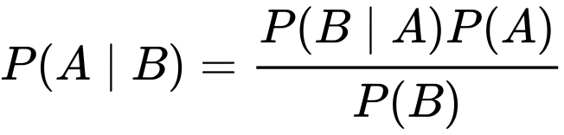
Estimating probabilities in a data-science setting
Bayes’ theorem provides a very nice framework for estimating probabilities, based on updating previous knowledge.
https://en.wikipedia.org/wiki/Bayes%27_theorem
P(A|B) => P(click-through-rate| some new results after showing users the creative)
P(A) => P(prior knowledge of the click-through-rate)
P(B|A) => P(new observed behaviour| click-through-rate)
P(B) => P(observing this user behaviour)
Hoyle: Bayesian Bandits
12.Aug.20

Slide 10
Estimating probabilities in a data-science setting
Bayes’ theorem provides a very nice framework for estimating probabilities, based on updating previous knowledge.
https://en.wikipedia.org/wiki/Bayes%27_theorem
P(A|B) => P(click-through-rate| some new results after showing users the creative)
P(A) => P(prior knowledge of the click-through-rate) --- Our Prior knowledge
P(B|A) => P(new observed behaviour| click-through-rate) – our new knowledge
P(B) => P(observing this user behaviour) ➔ let’s consider this as just a normalisation constant.
Sampling from these probability distribution functions can be a mess!
MCMC -> PyMC3
Hoyle: Bayesian Bandits
12.Aug.20

Slide 11
Modelling Yes|No questions: Bernoulli distribution
But, if we able to cast the question in a particular way, and we are happy to guess the allowed shapes of the final PDFs, then we can (instantly) analytically calculate all of the probabilities.
Bernoulli : “probability distribution of a random variable which takes the value 1 with probability p and the value 0 with probability q=1-p ”
“Less formally, it can be thought of as a model for the set of possible outcomes of any single experiment that asks a yes–no question. ”
[True, False, True, True]
[H,T, T, T, H]
Will the user click-through if they see an particular a web-page creative? YES | NO
Will the user click-through if they see a second web-page creative? YES | NO
Hoyle: Bayesian Bandits
12.Aug.20

Slide 12
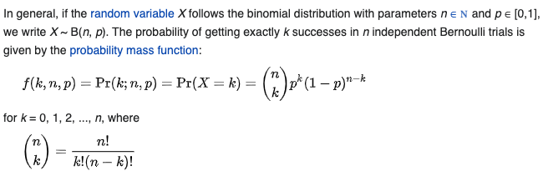
Modelling Yes|No questions: Bernoulli distribution
But, if we able to cast the question in a particular way, and we are happy to guess the allowed shapes of the final PDFs, then we can (instantly) analytically calculate all of the probabilities.
The Beta distribution is the conjugate prior of the Bernoulli distribution.
P(A|B), P(A) , have the same functional form. They are all Beta distributions.
P(B|A) = Binomial distribution: K success from N attempts.
.. wikipedia
Hoyle: Bayesian Bandits
12.Aug.20

Slide 13
Modelling Yes|No questions: Bernoulli distribution
But if we able to cast the question in a particular way, and we are happy to guess the allowed shapes of the final PDFs, then we can (instantly) analytically determine all of the probabilities.
This allows the update process of P(A|B) to be analytically and trivially calculated given new information.
N_S = previous success
N_t = previous trials
P(A) = Beta(1 + N_S, 1 + N_t – N_S)
Hoyle: Bayesian Bandits
12.Aug.20

Slide 14
Modelling Yes|No questions: Bernoulli distribution
But if we able to cast the question in a particular way, and we are happy to guess the allowed shapes of the final PDFs, then we can (instantly) analytically determine all of the probabilities.
This allows the update process of P(A|B) to be analytically and trivially calculated given new information.
N_S = previous success
N_t = previous trials
P(A) = Beta(1 + N_S, 1 + N_t – N_S)
Then the update becomes
ALL_S = new success + previous successes
ALL_T = new trials + previous trials
P(A| B) = Beta(1+ ALL_S, 1 + ALL_T)
Hoyle: Bayesian Bandits
12.Aug.20

Slide 15
When might this be useful? The multi-armed bandit problem
You are in Las Vegas. In front of you are 5 slot-machines, (one armed bandit machines). Each machine has a different probability of paying out. You don’t know anything about the machines. What strategy should you take to maximise your reward?
P(pay out rate| information about machine j)
You are amazon. The user wants to look at a toaster. Which toaster should you recommend to them, to maximise a sale?
P(make a sale| toaster information, customer information)
You own a website. You have 5 different creatives to show to your visitors, in an attempt to maximise a “click-through-rate” to get the visitor to the payment page. You don’t know which creative provides the best click-through-rate. Getting a visitor on your site is *expensive*, therefore you want to minimising the showing of a “bad” creative. What strategy should you take? Which creative should you show the visitor?
Hoyle: Bayesian Bandits
12.Aug.20

Slide 16
The multi-armed bandit solution
The algorithm is quite straight forward. Image we have N creatives, i=0..N
>while True:
Use your prior information to estimate PDFs: P_i(click_through_rate) for each N
Draw a random sample from each of the N PDFs
Choose the ”i” with the largest value
Show “i” to the user
Was this a success or a failure?
Update the Bayesian information about creative “i”
It tells us, which choice should we make (which creative to show, or which lever to pull), based on our past information.
We should use this algorithm, when each showing of “i” costs (e.g. money or time/resources) and we want to reduce costs.
Hoyle: Bayesian Bandits
12.Aug.20

Slide 17
Notebook part 1
Go here https://github.com/hoyleb/bayesian_bandit_demo
Enter notebooks/
Start the jupyter notebook
Complete parts 1 & 2
Hoyle: Bayesian Bandits
12.Aug.20

Slide 18
Notebooks and Docker containers
Let’s now package the project in a way that can be deployed locally, or on any cloud resource.
Docker, python-flask, interactive APIs
Hoyle: Bayesian Bandits
12.Aug.20

Slide 19
Notebook part 3
Enter web_app/
Build the docker container
Complete parts 3 in the jupyter notebook
Hoyle: Bayesian Bandits
12.Aug.20

Slide 20
Other classes of problems with similar PDF solutions
Checkout this link, and read about the different classes of problems that can be tackled with different PDF distribution choices.
When should you use a Poisson distribution?
When should you use the Normal distribution?
When use other distributions?
https://en.wikipedia.org/wiki/Conjugate_prior
Hoyle: Bayesian Bandits
12.Aug.20

Slide 21
Summary
Bayeisan Bandit algorithms can be used to tackle a range of interesting problems.
Even the base algorithm is great! Check it out.
An assumption about the shape of the PDF is required.
Docker + flask + APIs make your life more stable!
Internship opportunities at Carl Zeiss.
Hoyle: Bayesian Bandits
12.Aug.20

