Slide 1
Fossil Fuels
https://www.youtube.com/watch?v=zaXBVYr9Ij0
What is a fossil fuel?

Slide 2
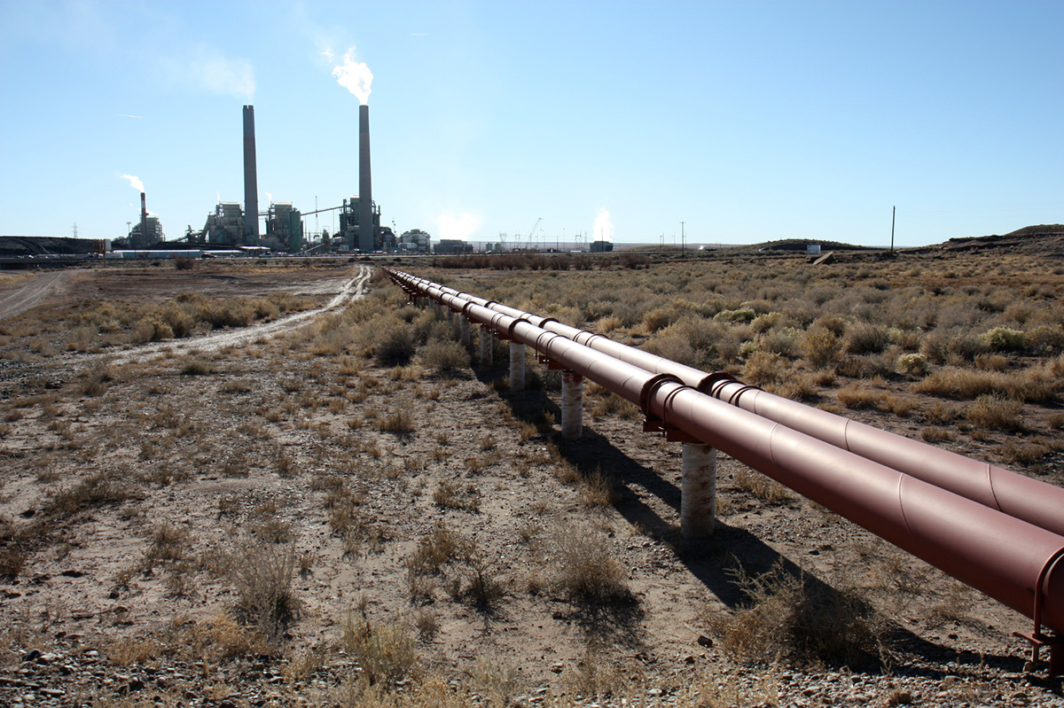
What is a Fossil Fuel?
A fossil fuel is formed by a natural process, many fossil fuels age up to 650 million years or sometimes even more! The three most important fossil fuels, are natural gas, coal and petroleum. Oil and petroleum are a liquid substance, natural gas is the most lethal and flammable source. (It is also the most unearthed fossil fuel) They produce carbon dioxide when burnt.

Slide 3
What are fossil fuels made from? (More detail on slide 5)
Fossil fuels, are made from the remains of dead animals or plants. These fuels are found in the earths crust and contain carbon and hydrogen.
FORMS OF FOSSIL FUELS
There are many types of coal for example. Antharacite is the purest form of coal containing 97% of carbon. Coal is made up of a lot carbon. There are lots more fuels like methane. Marsh gas is a form of methane. Carbon tetrahydride (CH4) which is a type of methane. Methane is one atom of carbon and four atoms of hydrogen.

Slide 4
Why do people say fossil fuel is bad?
Burning fossil fuels, is sulphur dioxide which causes acid and pollution and a bunch of air pollutants. One of the 6 major air pollutants is carbon monoxide which will make you sleepy then you sleep and then you die. There is also sulphur dioxide which is responsible for acid and toxic gas. It is bad for climate change as well.

Slide 5
How are fossil fuels made?
Fossil fuels are made from dead animals and plants/dead organisms. But there is much more to that, lets say you go to a beach and you drown or die, you will be sunk to the bottom of the sea or ocean. Then you will be covered by sand and there will be more pressure on you. Your stronger parts of your body, will turn into coal the weaker parts will turn into crewed oil or natural gas.

Slide 6
Some good links –If you did not understand-
https://www.nationalgeographic.com/environment/energy/reference/fossil-fuels/
https://www.nationalgeographic.com/environment/2019/07/we-have-too-many-fossil-fuel-power-plants-to-meet-climate-goals/
https://www.theguardian.com/environment/2015/apr/22/earth-day-scientists-warning-fossil-fuels-
https://www.theguardian.com/environment/2015/apr/22/earth-day-scientists-warning-fossil-fuels-
https://www.theguardian.com/environment/2015/may/18/fossil-fuel-companies-getting-10m-a-minute-in-subsidies-says-imf

Slide 7
What is good about fossil fuels?
Extremely Efficient: Fossil fuels are very efficient, as it makes a large amount of energy. Without it there will not any coal, petrol or oil which we might use a small amount but it will affect cars. You would need to find other sources for cars. Fossil fuels are not renewable which is a disadvantage but an advantage is that there are many things in the world which we couldn’t really do like fill up our car if there was no fossil fuels.

