Slide 1

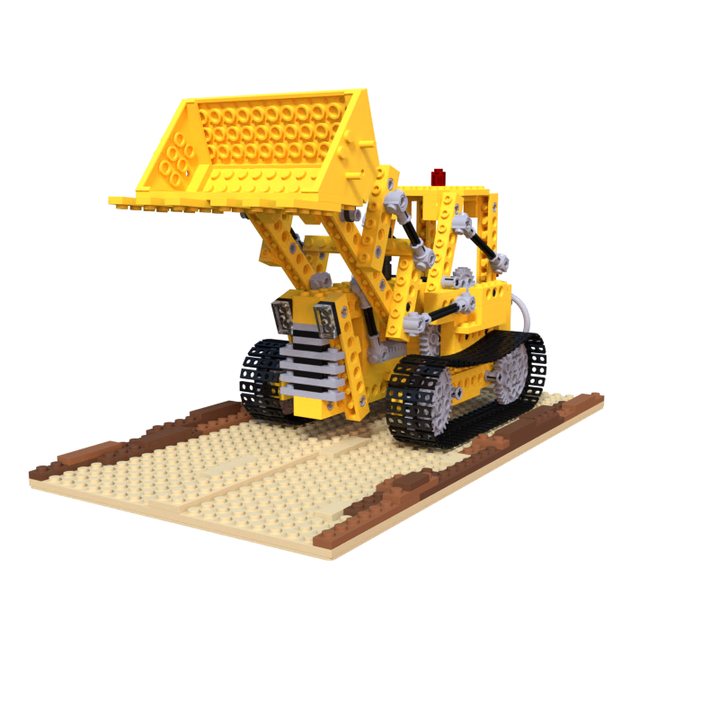
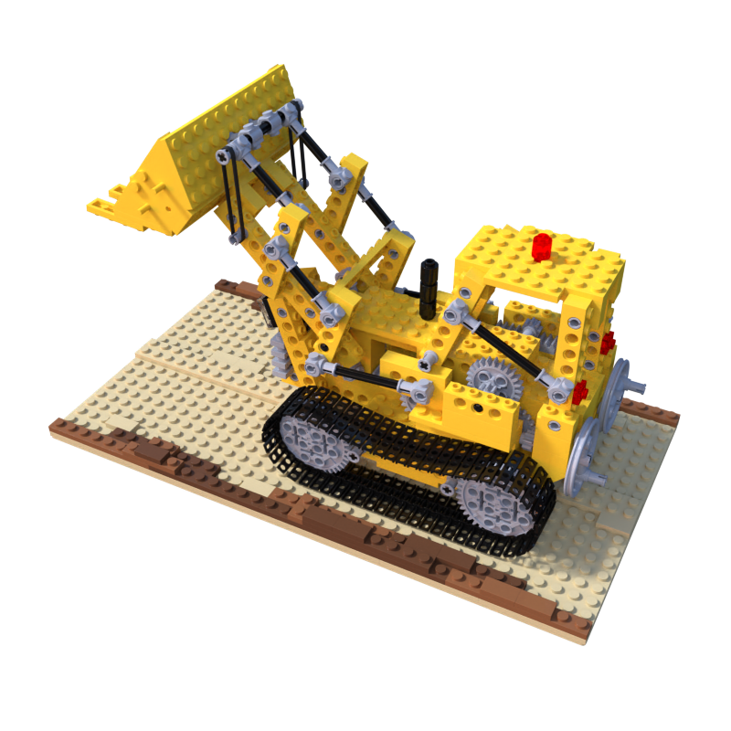
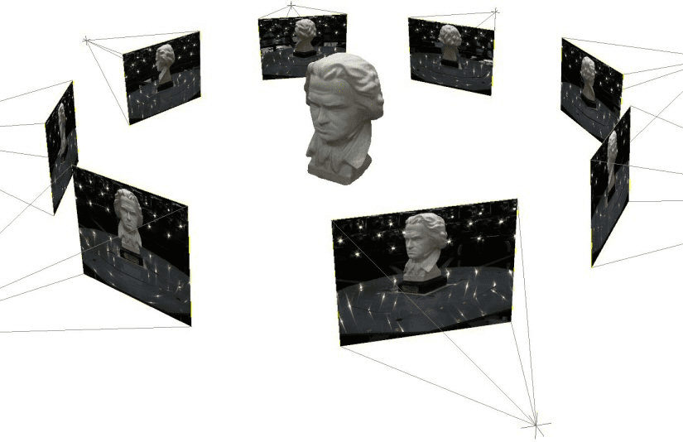
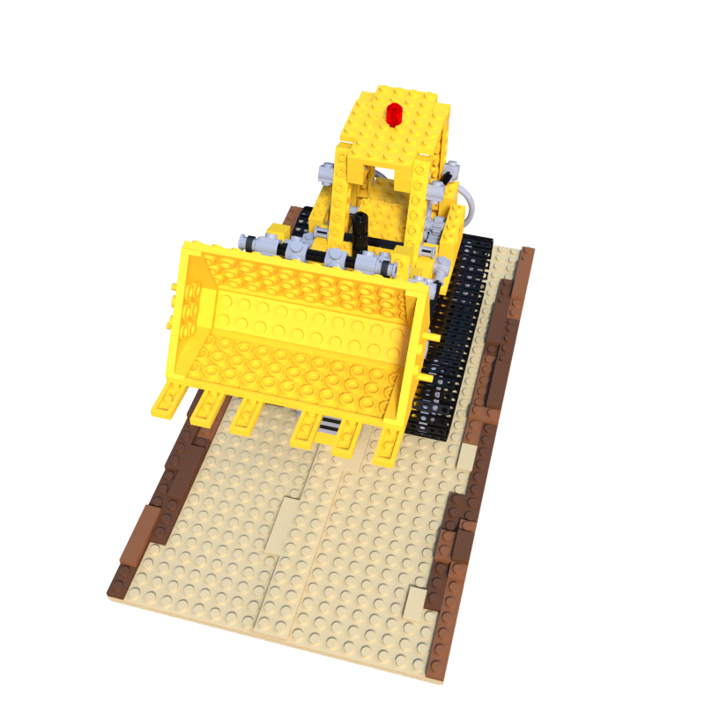
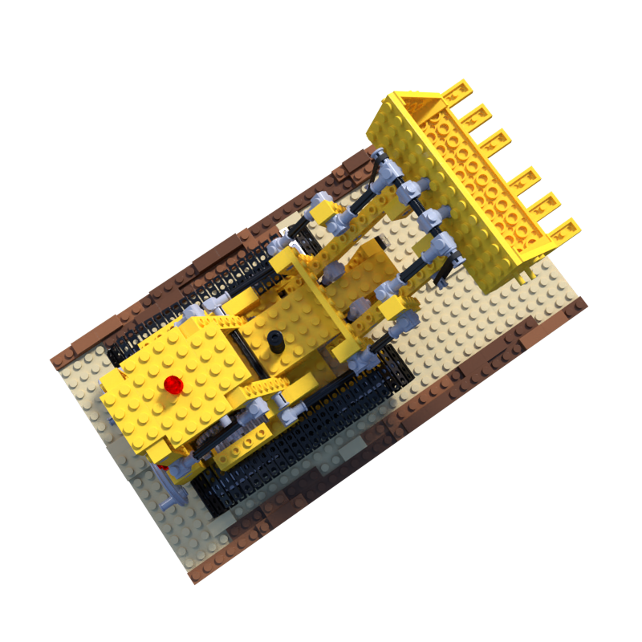
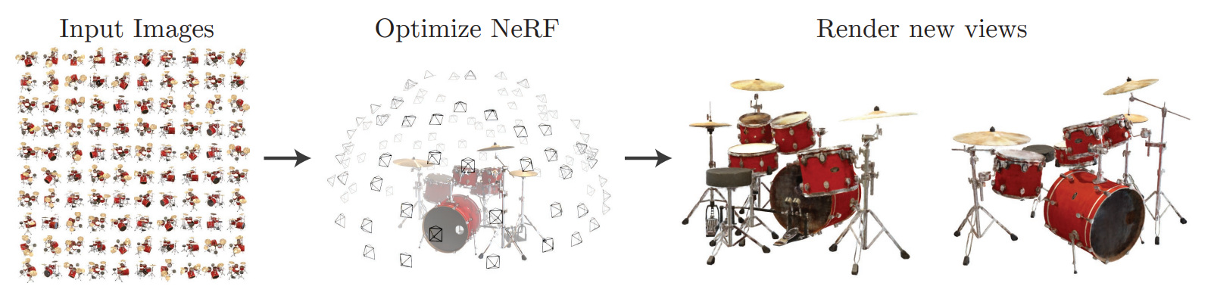
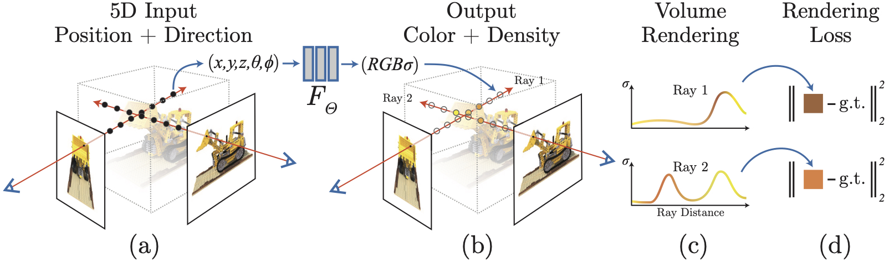
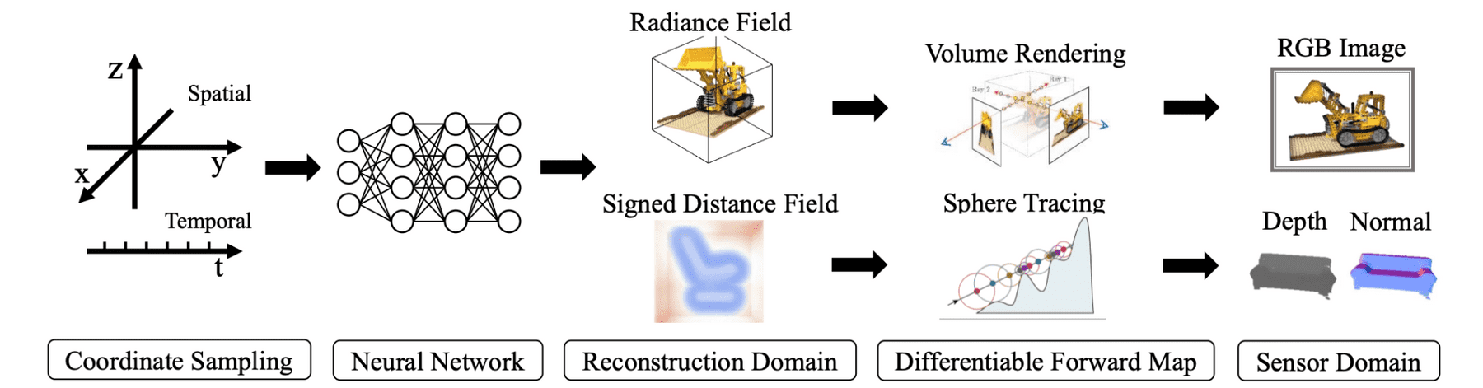

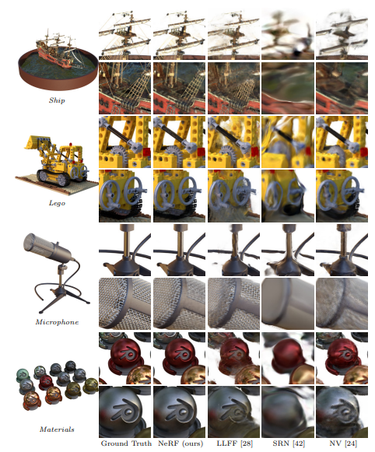
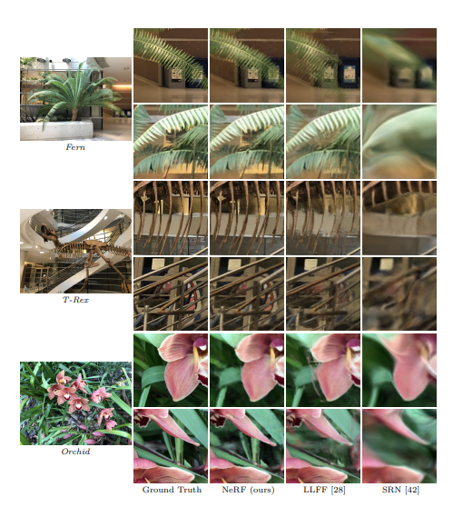
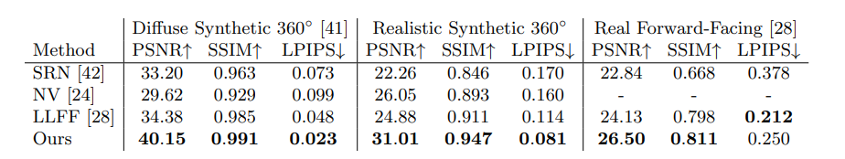
NeRF: Representing Scenes as Neural Radiance Fields for View Synthesis
Jianxin Gu, Ning Li
Motivation
Define the problem
Goal
NeRF tries to find a method that achieve state-of-the-art results for synthesizing novel views of complex scenes by optimizating an underlying continuous volumetric scene function using a sparse set of input views
Problem Statement The problem NeRF attempts to solve is called Novel View Synthesis, which is trying to synthesize a target image with an arbitrary target camera pose from given source images and their camera pose.
State Goals
Generate novel views of complex 3D scenes, based on a partial set of 2D images.
What is the insight into the problem that leads to the solution?
More details. Explain how it works.
NeRF presents a method that represents a scene using a fully connected (Non-convolutional) deep network, whose input is 5D coordinate (spatial location (x, y, z) and view direction ()) and whose output is the volume density and view-dependent emitted radiance at that spatial location.
Srinath Sridhar
Results (images/figures)
More results
NeRF quantitatively outperforms prior work on datasets of both synthetic and real images.
References
Acknowledgements
[1] Ben Mildenhall, Pratul P. Srinivasan, Matthew Tancik, Jonathan T. Barron, Ravi Ramamoorthi, and Ren Ng. 2021. NeRF: representing scenes as neural radiance fields for view synthesis. Commun. ACM 65, 1 (January 2022), 99–106. https://doi.org/10.1145/3503250
[2] ….
We would like to thank Professor Srinath and all TAs …

