Slide 1

DIPARTIMENTO DI ECONOMIA E MANAGEMENT
THE IMPACT OF ICT INVESTMENTS ON EMPLOYMENT IN OECD COUNTRIES:
A SECTORAL ANALYSIS
Gabriele Ferraresi
Relatore: Chiar.mo Prof. Jacopo Bonan
corso di laurea in economia e azienda digitale

Slide 2
Introduction
THE RELATIONSHIP BETWEEN ICT INVESTMENTS AND EMPLOYMENT
Positive effects
Productivity and efficiency gains
Creation of new jobs categories
Enhanced global competitiveness
Improved labour market flexibility and remote work
Skill development and workforce adaptation
Economic spillover effects
Negative effects
Automation and human labour replacement
Labour market polarization
Displacement of traditional positions

Slide 3
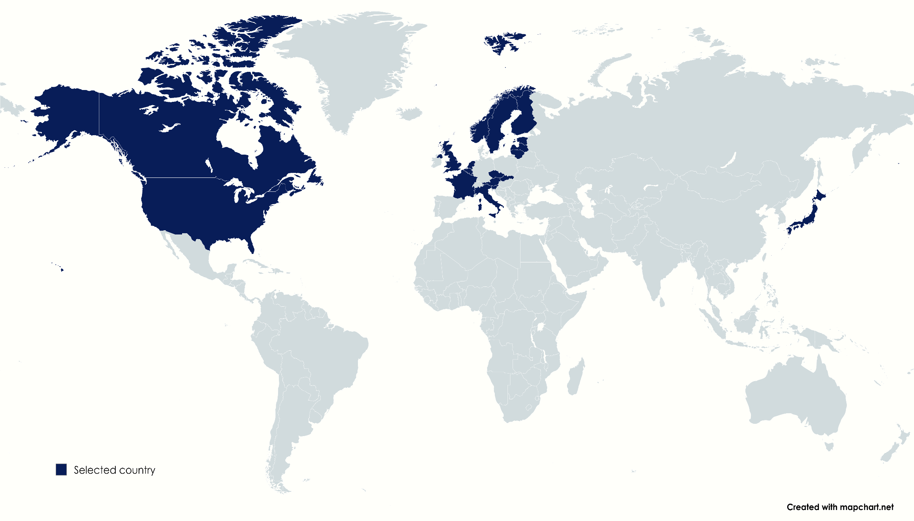
Introduction
RESEARCH QUESTION, DATA SOURCE AND EMPIRICAL APPROACH
Since there is not a uniform perspective, we’ll need to use an OLS approach with panel data regression models.
RQ: How do ICT investments affect employment?
OECD Data Explorer, analysis considering Countries, Years and Economic activities
Time span: 2000 - 2019
Selected economic activities:
Manufacturing
Information and communication
Financial and insurance activities
Professional, scientific and technical activities; administrative and support service activities

Slide 4
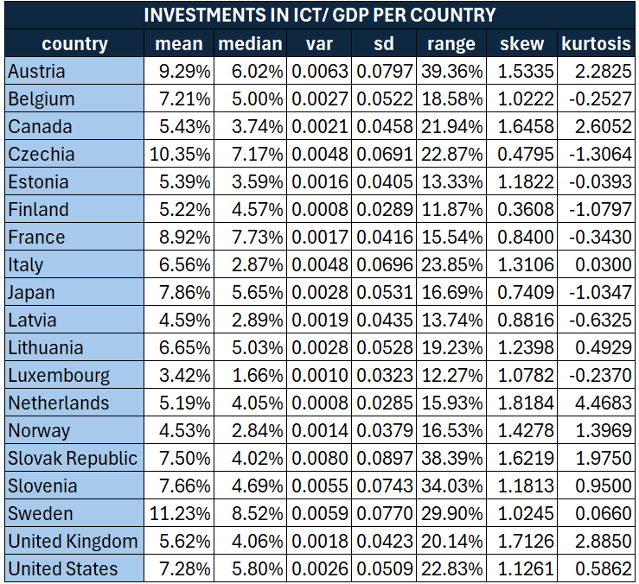
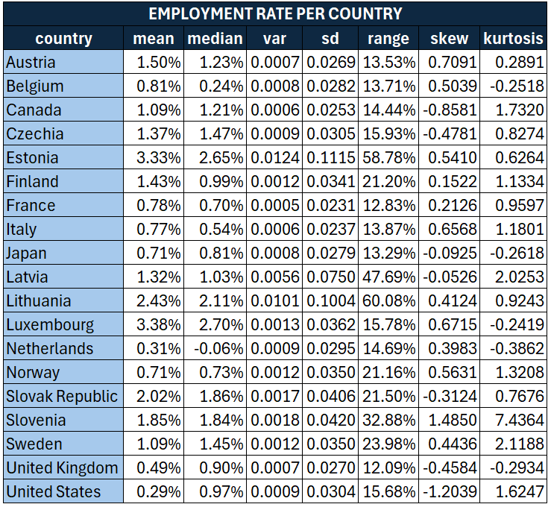
DATA
Data grouped by country

Slide 5
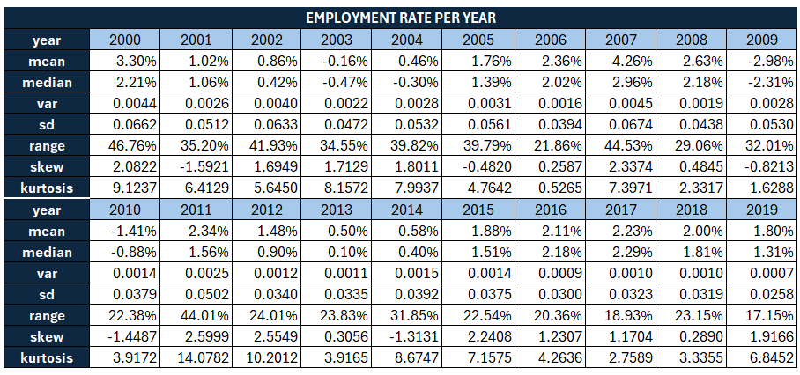
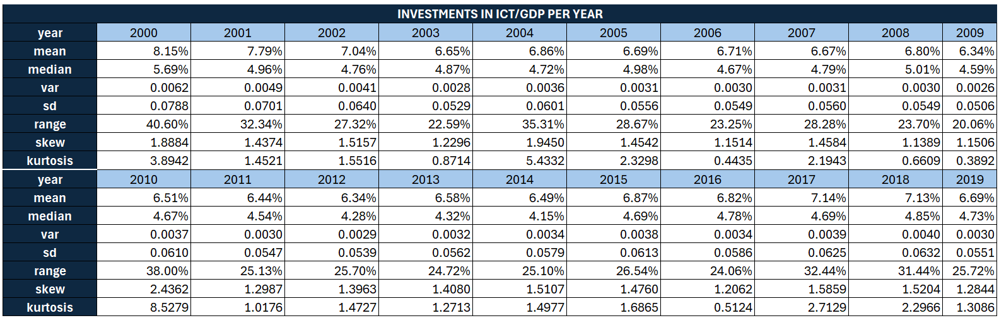
DATA
Data grouped by year

Slide 6
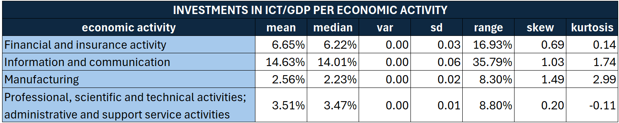
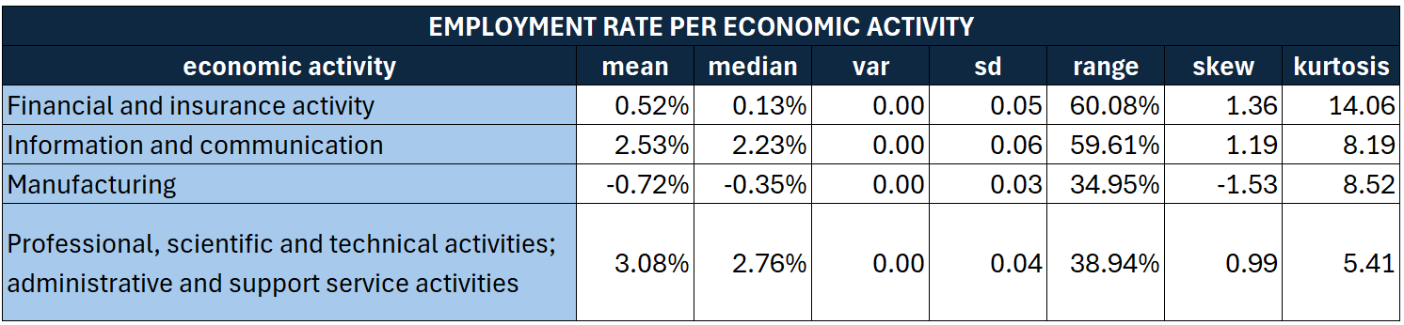
DATA
Data grouped by economic activity

Slide 7
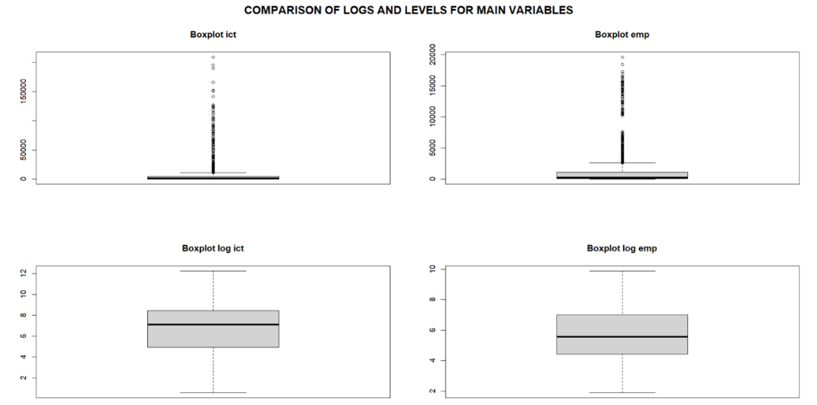
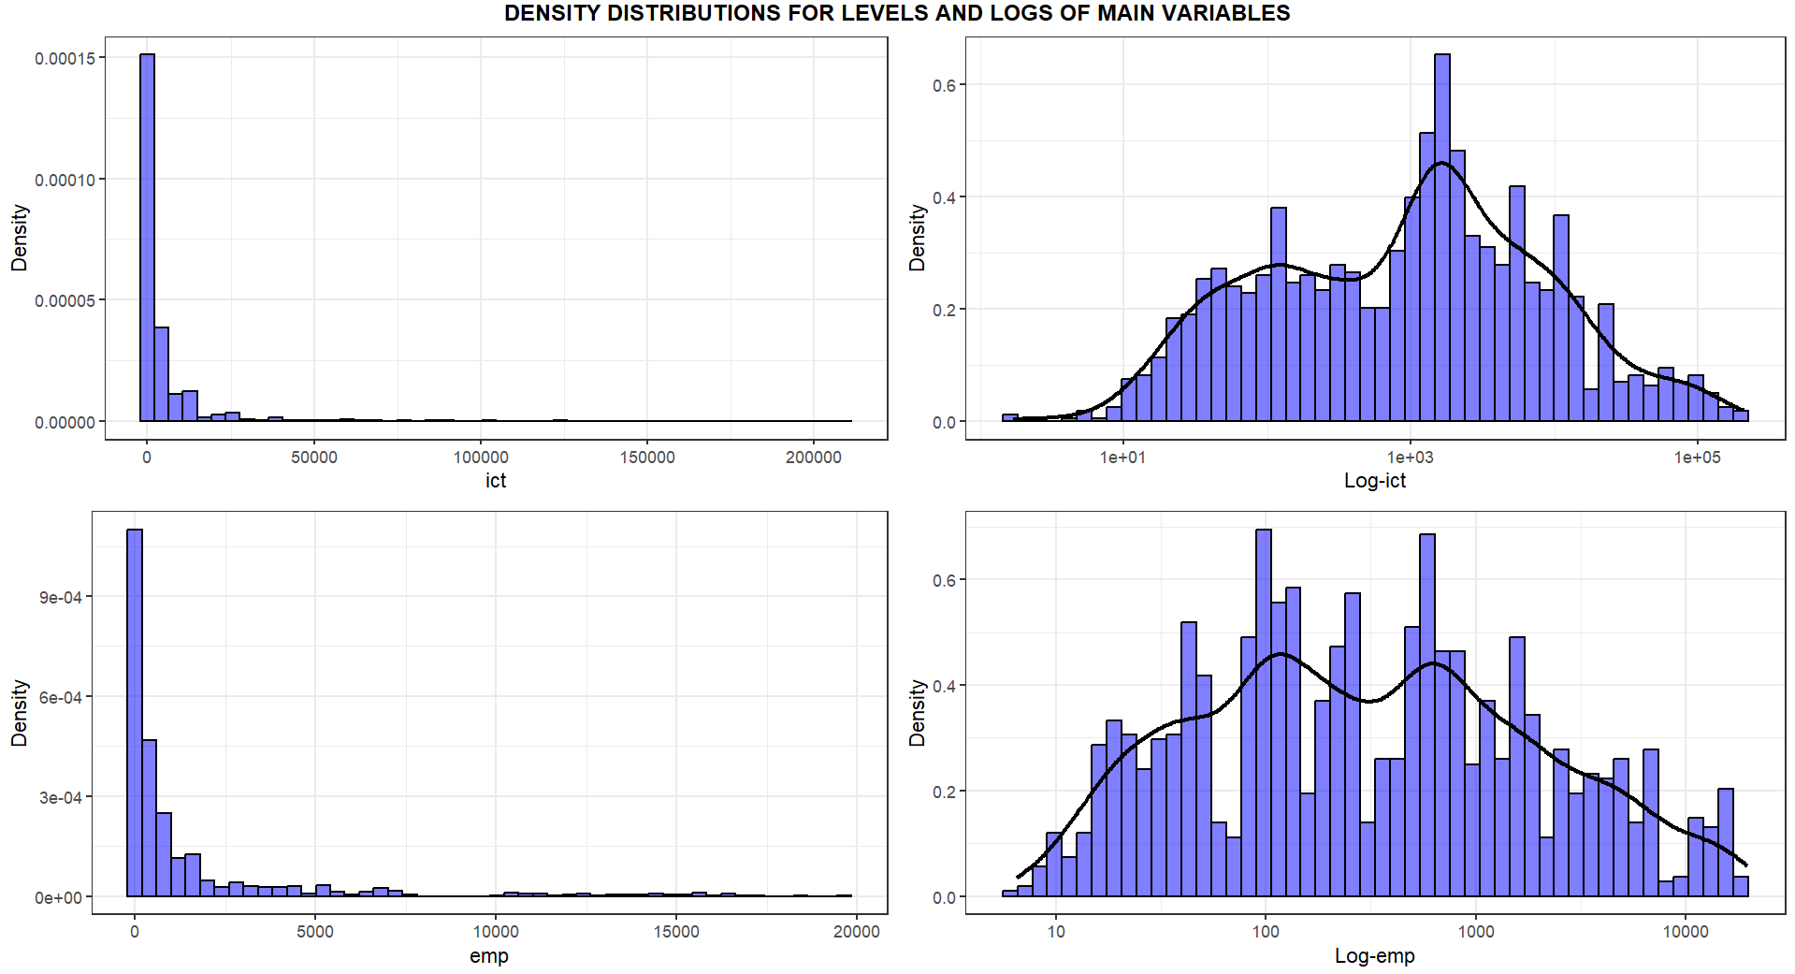
REGRESSION
Levels or logs?

Slide 8
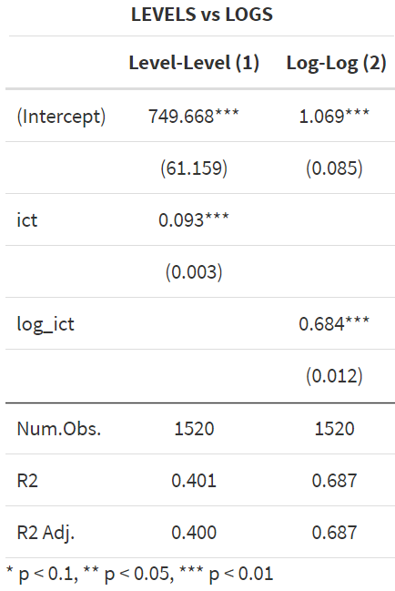

REGRESSION
$$\left(1\right) {EMP}_{i,j,t}=β_{0}+β_{1}∗{ICT}_{i,j,t}+u_{i,j,t}$$
$$\left(2\right) {\log\left(EMP\right)}_{i,j,t}=β_{0}+β_{1}∗{\log\left(ICT\right)}_{i,j,t}+u_{i,j,t}$$

Slide 9
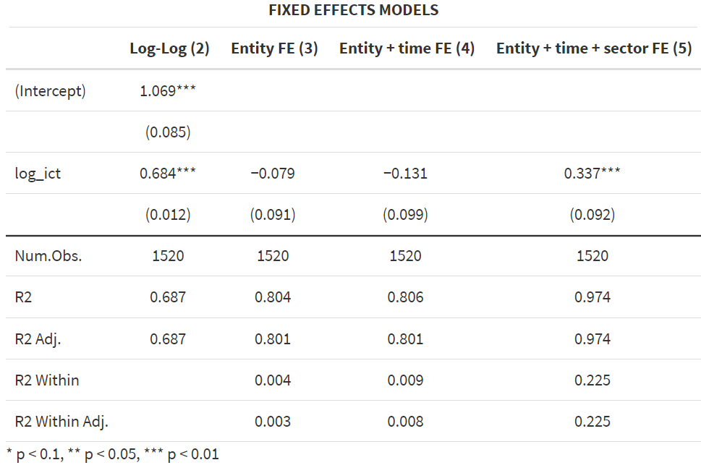
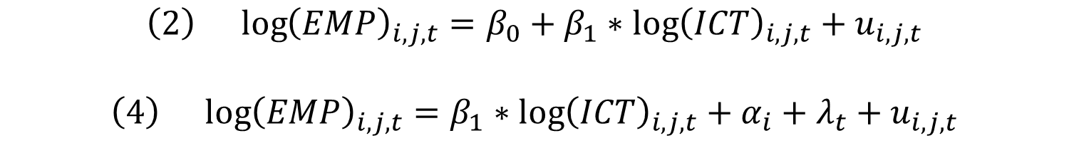

REGRESSION
$$\left(2\right) {\log\left(EMP\right)}_{i,j,t}=β_{0}+β_{1}∗{\log\left(ICT\right)}_{i,j,t}+u_{i,j,t}$$
$$\left(4\right) {\log\left(EMP\right)}_{i,j,t}=β_{1}∗{\log\left(ICT\right)}_{i,j,t}+α_{i}+λ_{t}+u_{i,j,t}$$
$$\left(3\right) {\log\left(EMP\right)}_{i,j,t}=β_{1}∗{\log\left(ICT\right)}_{i,j,t}+α_{i}+u_{i,j,t}$$
$$\left(5\right) {\log\left(EMP\right)}_{i,j,t}=β_{1}∗{\log\left(ICT\right)}_{i,j,t}+α_{i}+λ_{t}+γ_{j}+u_{i,j,t}$$

Slide 10
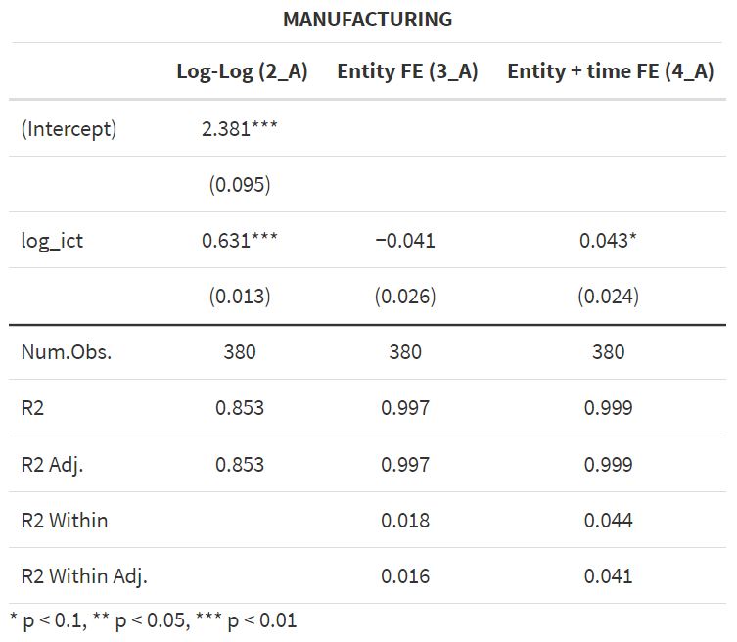
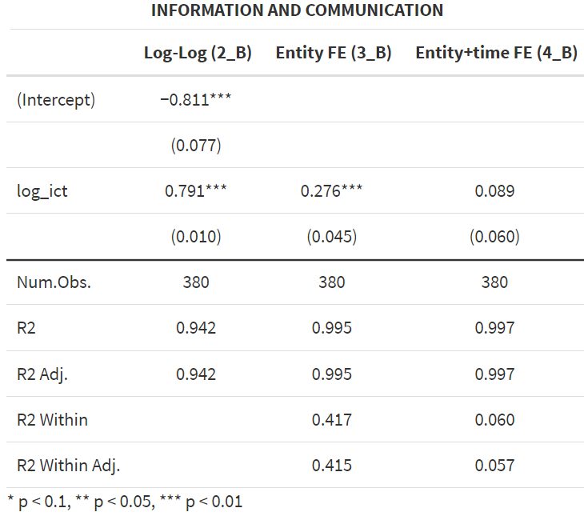
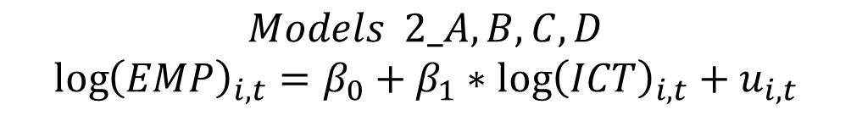
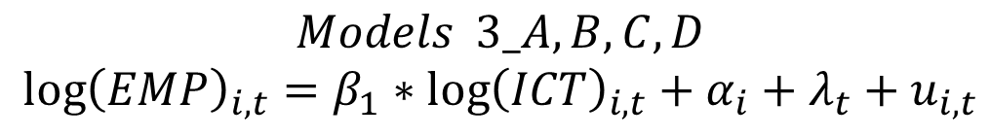
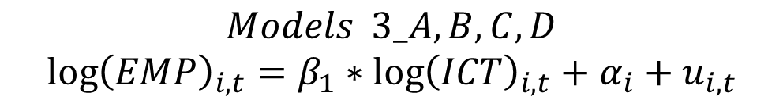
REGRESSION
$$Models 2_A,B,C,D$$
$${\log\left(EMP\right)}_{i,t}=β_{0}+β_{1}∗{\log\left(ICT\right)}_{i,t}+u_{i,t}$$
$$Models 3_A,B,C,D$$
$${\log\left(EMP\right)}_{i,t}=β_{1}∗{\log\left(ICT\right)}_{i,t}+α_{i}+u_{i,t}$$
$$Models 3_A,B,C,D$$
$${\log\left(EMP\right)}_{i,t}=β_{1}∗{\log\left(ICT\right)}_{i,t}+α_{i}+λ_{t}+u_{i,t}$$

Slide 11
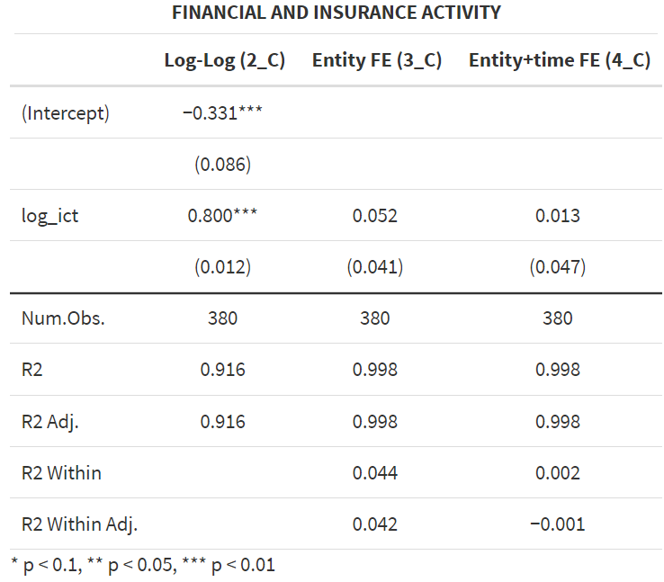
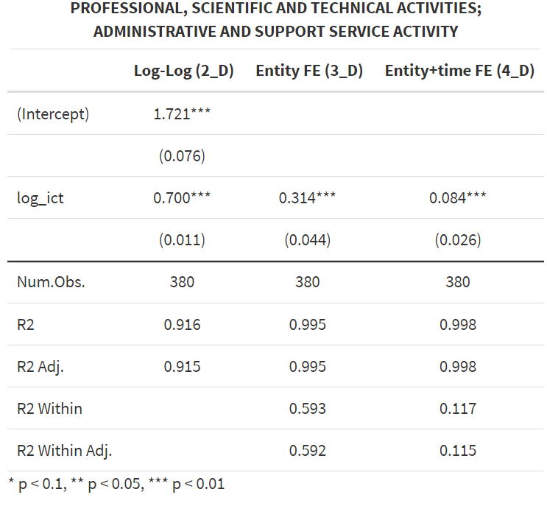
REGRESSION
$$Models 2_A,B,C,D$$
$${\log\left(EMP\right)}_{i,t}=β_{0}+β_{1}∗{\log\left(ICT\right)}_{i,t}+u_{i,t}$$
$$Models 3_A,B,C,D$$
$${\log\left(EMP\right)}_{i,t}=β_{1}∗{\log\left(ICT\right)}_{i,t}+α_{i}+u_{i,t}$$
$$Models 3_A,B,C,D$$
$${\log\left(EMP\right)}_{i,t}=β_{1}∗{\log\left(ICT\right)}_{i,t}+α_{i}+λ_{t}+u_{i,t}$$

Slide 12

CONCLUSION
Summary
Considering all sectors, a 1% increase in ICT investments involve a 0.337% increase in Annual employment for $α=1\%$.
In Manufacturing sector, a 1% increase in ICT investments involve a 0.043% increase in Annual employment for $α=10\%$.
In Information and communication and Financial and insurance activities the coefficients aren’t statistically different from 0.
In Professional, scientific and technical activities; administrative and support service activities, a 1% increase in ICT investments involve a 0.084% increase in Annual employment for $α=1\%$.

Slide 13
CONCLUSION
Model’s limits
Omitted variables
Reverse causality
Data selection
Policy’s implications
Continue to invest in ICT in all sectors with continuous professional developments.
Technological progress must advance alongside human skills advancement.
Prevent situations where hiring new workers is the only way to fully leverage technological innovations.

Slide 14
Bibliography
After reading the articles below, I used ChatGPT to summarise them more efficiently.
“OECD Digital Economy Outlook 2024 (Volume 1)”, OECD (2024)
“Negative impacts of technology in the workplace”, Deloitte Insight (2023)
"The Dangers of Automation", Michael Chui et al. (2017)
"The Human Cost of Digital Transformation in Financial Services", McKinsey & Company (2021)
"The impact of ICT professionals on job demand and employment trends", CEDEFOP (2023)
"ICTs and Jobs: Complements or Substitutes? The Effects of ICT Investment on Labour Demand by Skills and by Industry in Selected OECD Countries", Vincenzo Spiezia, Michael Polder, and Giorgio Presidente (2016)
"Technological Change and Employment in the Manufacturing Sector", World Bank (2022)
"The Impact of Information and Communication Technologies on Employment in Financial Services", Michael G. Kearney and Eoin O’Leary (2015)
"The Impact of ICT on Employment in the Information and Communication Sector", Zainab A. Al-Mahmoud e Mohaisen Al-Marzouqi (2018)
"The Future of the Digital Workforce: Current and Future Challenges for Executive and Administrative Assistants", Anabela Mesquita, Luciana Oliveira, and Arminda Sequeira (2019)
"The influence of information and communication technology on productivity: A systematic review”, Müller and Christmann (2019)
“Information technology and the U.S. productivity Revival: What Do the Industry Data Say?”, Kevin J. Stiroh (2002)

