Slide 1

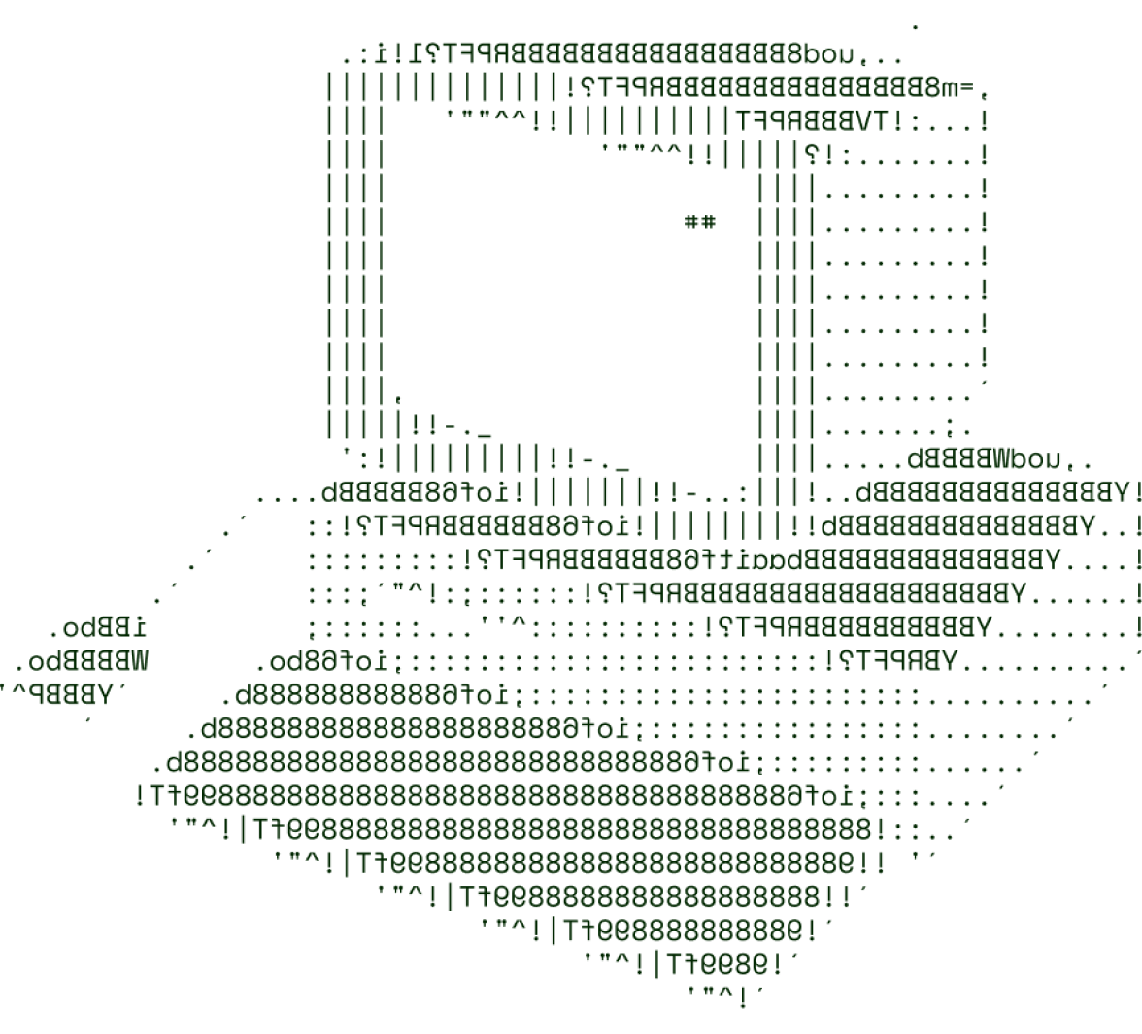

DISASTER PREPAREDNESS WEB PORTAL
(SEDS_AURORA)

Slide 2
SOLUTION OVERVIEW
About the problem or solution
The Disaster Preparedness Web Portal helps centralize disaster-related data and guidance, providing communities with real-time alerts, safety information
How It Addresses the Problem:
The portal tackles the issue of fragmented information during emergencies. It provides a unified platform for alerts, evacuation plans, and emergency resources, allowing users to react quickly and with confidence.
Innovation and Uniqueness:
Real-time data integration from multiple sources - Location-based alerts and offline maps - Crowdsourced reports and user feedback to ensure relevance - Interactive preparedness guides with simulations
Highlighting Key Features:
- Real-time Alerts: Live disaster notifications - Evacuation Routes & Safe Zones: Interactive maps with real-time data - Emergency SOS: One-click emergency assistance

Slide 3

TECHNICAL ARCHITECTURE
Tech stack
Frontend Technologies: (HTML , CSS , Javascript)
Backend Technologies:( Node.js)
Database:(PostgreSQL)
Deployment: using Github

Slide 4
SCALABILITY AND FUTURE SCOPE
Load Management Strategies
The portal will utilize cloud services that enable dynamic scaling, automatically adjusting resources in response to real-time traffic fluctuations during peak emergency situations.
Architecture considerations (e.g., cloud services, load balancing)
Implement a CDN to serve static content (such as images and scripts) from locations closer to users, minimizing latency and improving loading times during emergencies.
Technologies that support scalability
Containerization: Use technologies like Docker to package applications, ensuring consistent environments and enabling rapid scaling in response to load changes.

Slide 5
FEASIBILITY
Potential challenges and risks
. Data Accuracy & Reliability
. User Trust and Adoption . Scalability
. Security and Privacy Risks . Offline Availability
. Integration of APIs and Real-Time Updates
Strategies for overcoming these challenges
Robust Verification Systems: Implement systems to cross-verify data from multiple reliable sources (e.g., government agencies, trusted NGOs) to enhance accuracy.
Collaboration with Trusted Organizations: Partner with credible organizations (e.g., NDRF, government bodies) and media outlets to boost platform credibility.
Cloud Solutions: Use of AWS that automatically adjust resources based on demand.
End-to-End Encryption: Ensure all user communications are encrypted (using SSL/TLS).
Redundant Servers: Set up redundant servers and backup systems to ensure platform functionality even if some components fail.

Slide 6

Team Name:- SEDS_AUORA Team Leader:- SWASTIK SHARMA(23BCE8088)

Slide 7




Name, last name
Name, last name
Job title
Company name
Job title
Company name
Name, last name
Name, last name
Job title
Company name
Job title
Company name

