Slide 1



SPORT UP
TEAM-36
(SportUp)

Slide 2

SOLUTION OVERVIEW
SportUP is a comprehensive web platform designed to bridge the gap between aspiring local athletes and the funding organizations, government agencies, and professional bodies that support athletic development.. By using SportUP, athletes gain an opportunity to highlight their achievements, build a digital portfolio, and connect directly with industry professionals, coaches, and mentors.
The platform facilitates a streamlined, supportive environment where athletes can showcase their credentials, access valuable resources, and seek training opportunities or financial backing to advance their careers. SportUP also enables organizations and governmental entities to discover and support emerging talent, promoting athletic growth and fostering a community dedicated to excellence in sports.

Slide 3
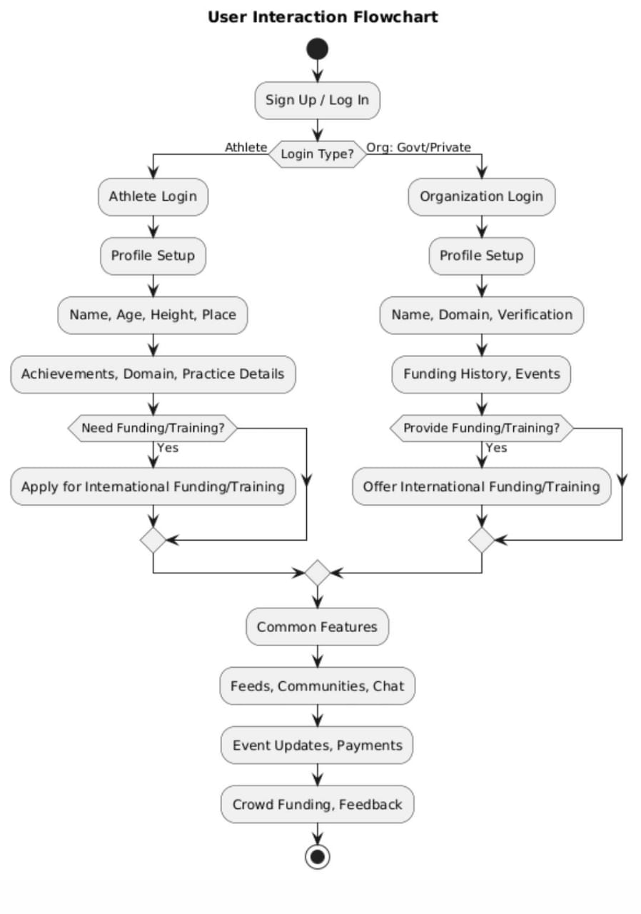
DATA FLOW OF SPORTUP
Key Features:
Athlete Profiles and Portfolios
Mentorship and Coaching Network
Crowdfunding Platform
Event and Competition Listings
Scholarships and Grant Search Tool
Success Stories and Testimonials

Slide 4
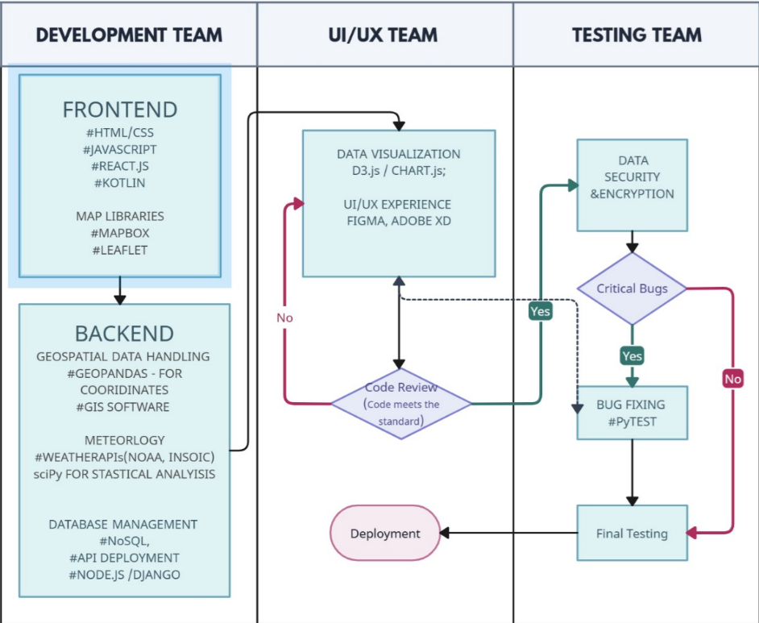

TECHNICAL ARCHITECTURE
UI/UX Design:
React.js
Tailwind CSS
Figma and wireframes
GSAP
Data Integration:
APIs
Node.js with Express
Django (Python) MongoDB.
Security & Database:
Database Management Systems
MySQL
JSON
Data Encryption(Hashing) AWS RDS.
Launch and Deployment :
GitHub or GitLab
Docker
Content Delivery Network
AWS (Amazon Web Services)
AWS CloudFront and containers.
PROTOTYPE VIDEO LINK :-
https://drive.google.com/file/d/1QJmpVIzrCQFZMpEggxHeiEGkt82Ya0yV/view?usp=sharing

Slide 5
SCALABILITY AND FUTURE SCOPE
Scalability
Microservices Architecture: Allows SportUP to manage features independently, enabling smoother updates and efficient resource allocation.
Database Optimization:Using scalable databases, like NoSQL, ensures efficient handling of large athlete profiles and funding data.
Future Scope
AI and Data Analytics: Offers personalized recommendations and insights into funding trends and athlete potential.
Mobile Application: Enhances accessibility for athletes to connect with funders and trainers on the go.
Brand Partnerships: Expands funding sources and sponsorship opportunities through collaborations with sports brands.
Integration with Wearable Tech : Tracks athletic performance in real-time, allowing funders to monitor athletes' progress.

Slide 6

FEASIBILITY
TECHNICAL FEASIBILITY
Scalability: The microservices and scalable databases chosen will ensure that SportUP can grow as its user base expands without performance bottlenecks.
Cross-Platform Compatibility: Mobile app development will require cross-platform support (iOS and Android), adding to accessibility and technological adaptability.
Security and Compliance: With athlete data and financial transactions, robust data protection and compliance with international data regulations (like GDPR) will be essential.
MARKET FEASIBILITY
Growing Athlete Funding Need: More athletes seek funding and sponsorships beyond traditional sources, indicating a solid user base.
Interest in Athlete Analytics: Growing interest from funders in data-driven insights and real-time tracking provides demand for AI analytics and wearable tech.
Globalization of Sports: Expanding to international markets aligns with the rising global interest in athletic sponsorships and fundings.
FINANCIAL FEASIBILITY
Revenue Streams: Multiple revenue streams, including subscriptions, brand partnerships, premium analytics, and advertising, enhance profitability potential.
Initial Investment: High initial costs are required for development, brand partnerships, and compliance, but the return on investment can be substantial through partnerships and global reach.
Risk Management: Diversifying revenue sources and focusing on tech efficiency can mitigate financial risks as the platform scales.

Slide 7




Aditya Mangla
Student – 22BCE7033
Vellore institute of technology
Prerna Jasti
Student- 22BCE7375
Vellore institute of technology
PROTOTYPE VIDEO LINK :-
https://drive.google.com/file/d/1QJmpVIzrCQFZMpEggxHeiEGkt82Ya0yV/view?usp=sharing

Slide 8

SPORT UP TEAM-36

Slide 9

Thanks for Joining

