Slide 1

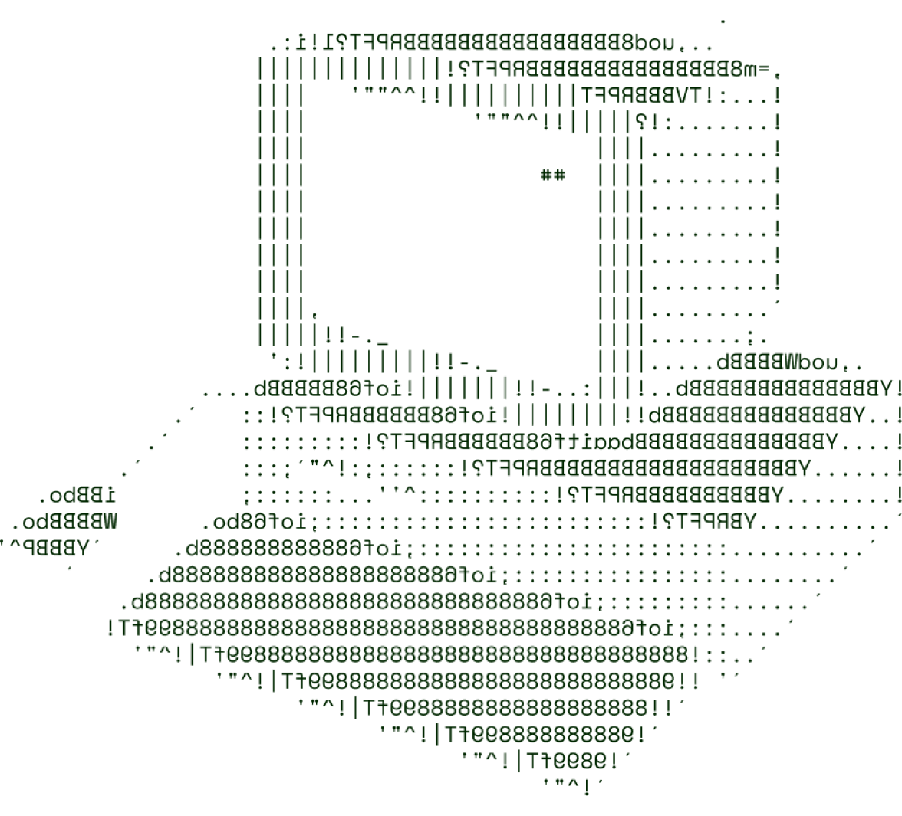

ASTROGATHER
FORTUNE TECHIES

Slide 2

SOLUTION OVERVIEW
Our solution is a crowdsourced astronomy observation platform designed for amateur astronomers.
The main problem is the limited data available from professional observatories due to their limited number and geographic distribution.
This platform is unique because it leverages the power of community and technology to enhance astronomical data collection.
Real-Time Data Sharing
Collaboration Tools
Community Engagement

Slide 3
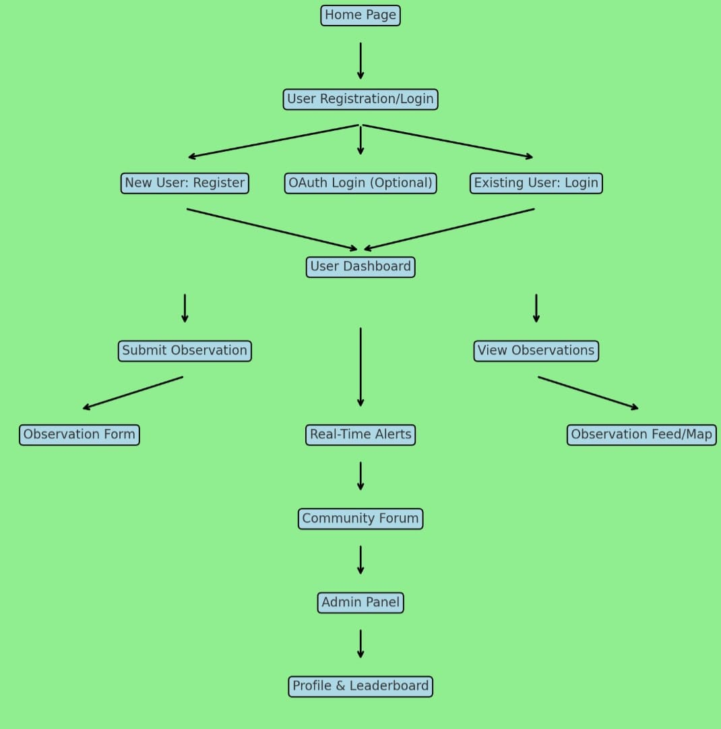
OVERVIEW

Slide 4
TECHNICAL ARCHITECTURE
Flowchart (Not Compulsory)
Tech stack
Frontend Technologies: HTML, JS, CSS
Backend Technologies: Node.js
Database: MySQL
Other Tools/Services: Forums
Note: You are free to customize the template, but make sure to
include all the requested points.

Slide 5
SCALABILITY AND FUTURE SCOPE
Efficient Data Structures: Use simple data structures to store observations to ensure quick access and minimal memory usage. This will help handle the increased load
Cloud Services: Use cloud storage for data, which can easily scale as needed
such as Google cloud and AWS.
Break down your platform into small, manageable services that can be developed, deployed, and scaled independently.
Additional functionalities you plan to implement
FORUMS AND MAPS

Slide 6
FEASIBILITY
POTENTIAL CHALLENGES
Difficult to handle huge amounts of data
Making an interactive interface.
Gathering the huge amount of information.
Assess costs for hosting ,domain registration , and development tools grows.
To be sure of the authenticity of the information.
Strategies for overcoming these challenges
This can be resolved using MySQL.
We will ask the users to add the data they have gathered with proof which will help improve the data base.
Using forums and feedback we can have a regular check for the data

Slide 7

>Team Details

Slide 8




DHRUV DIGUVAPALLI
AKURATI HEMANTH KUMAR
STUDENT
VIT AP
STUDENT
VIT AP
ABHYUDAY SAJLANI
ANURAG
STUDENT
VIT AP
STUDENT
VIT AP

Slide 9

Thanks for Joining

