Slide 1


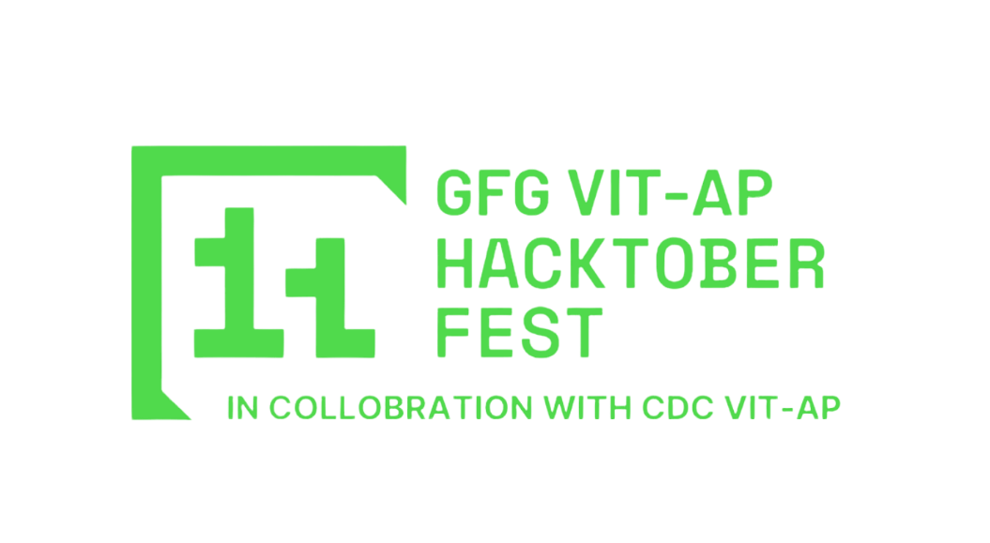
AI-POWERED MEDICAL
ADVISOR BASED
ON SPECIFIC BOOK
(HACKGODS)

Slide 2
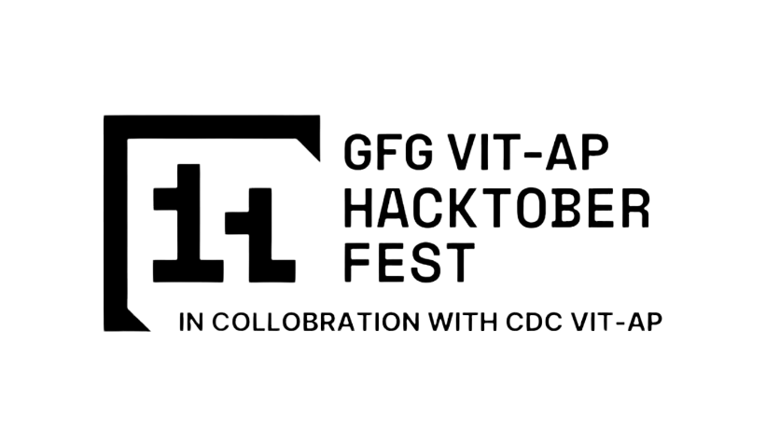
SOLUTION OVERVIEW
KEY OUTCOMES:
Medical Book Digitization –
Text Extraction: Convert the medical book into a machine-readable format using OCR or direct extraction.
Content Structuring: Organize the text into chapters and sections, categorizing with NLP for easy access.
Database Creation: Store the structured content in a searchable database for quick retrieval based on symptoms.
Symptom-Based Input-
User Input Design: Create an intuitive interface for symptom entry, allowing free text and dropdown options.
Symptom Recognition: Use NLP to analyze inputs and accurately extract relevant medical terms.
Symptom Mapping:* Connect symptoms to corresponding sections of the medical book for targeted information retrieval.

Slide 3
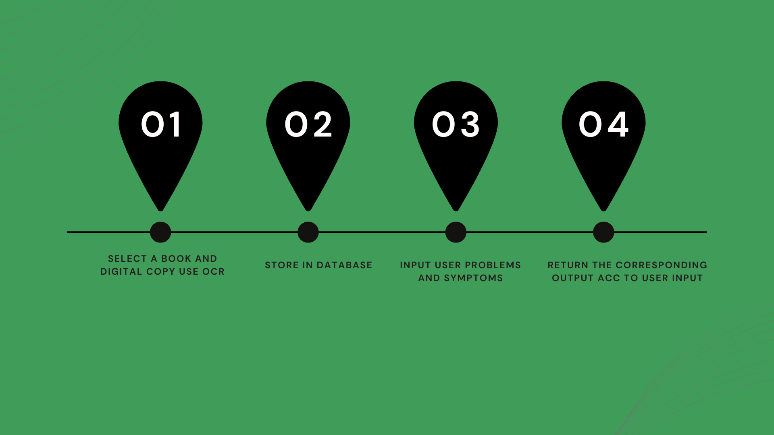
FLOWCHART

Slide 4
Book-Specific Recommendations-
Search Algorithm: Implement a search engine that uses keyword matching and semantic understanding for relevance.
Extracting Key Information: Provide actionable advice from the book based on user-reported symptoms.
Content Validation: Ensure all recommendations are strictly based on the book’s content for reliability.
Contextual Understanding-
Medical Context Recognition: Train the AI to understand medical terminology and context for accurate suggestions.
Knowledge Graph Creation: Build a graph to illustrate relationships between symptoms, conditions, and treatments.
Inference Engine: Use the knowledge graph to infer connections and suggest appropriate content based on user input.
User-Friendly Interface-
UI Design: Develop a clean, intuitive interface for easy symptom input and result display.
Symptom Input: Support both structured and unstructured input methods for user flexibility.
Results Display: Present recommendations clearly, allowing access to detailed content as needed.
Feedback System: Include a mechanism for user feedback to improve the system over time.

Slide 5
Expected Outcome(s):
Delivery of Accurate Medical Advice: The system integrates various components to provide reliable guidance based on the specific content of the medical book.
Contextually Appropriate Guidance: Users receive tailored recommendations that align with their reported symptoms, enhancing understanding of their condition.
Trustworthy Information: The focus on book-specific content ensures that all advice is derived from a recognized medical source, reducing the risk of misinformation.
User Confidence: By providing reliable and contextually relevant advice, users can feel more confident in the recommendations and guidance they receive.

Slide 6

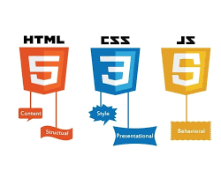

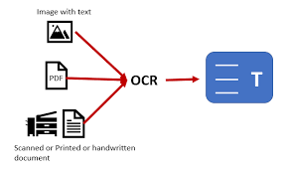
TECHNICAL ARCHITECTURE
> Tech stack:
For Book Digitalization: OCR
Frontend Technologies: HTML, CSS, javascript, react.js, GSAP
Backend Technologies: Flask, node.js,
Database: MySQL, MongoDB
Other Tools/Services: Git

Slide 7
SCALABILITY AND FUTURE SCOPE
Architecture
Considerations: Cloud Services: Use cloud infrastructure (e.g., AWS, Google Cloud, Microsoft Azure) to host your application. Cloud platforms allow for flexible scaling of resources (computing power, storage) based on user demand.
Load Balancing: Implement load balancing to distribute traffic evenly across multiple servers. This ensures that no single server is overwhelmed, which improves system reliability and responsiveness
Database Optimization: Use a highly available, distributed database (e.g., AWS RDS, Google Cloud SQL) with read replicas to handle increased query loads. You can also implement indexing on symptom-related fields for faster search performance.
Content Delivery Network (CDN): Use a CDN to cache static assets (e.g., images, CSS, JavaScript) and offload traffic from your servers, ensuring faster response times for users.

Slide 8
Technologies for Scalability
Microservices Architecture: Break the system into microservices (e.g., user management, symptom analysis,
recommendation engine). Each service can be deployed, scaled, and updated independently, enhancing system
flexibility and fault tolerance.
Containerization: Use Docker containers to package and deploy services consistently across environments. You
can orchestrate them using Kubernetes for automatic scaling, load balancing, and self-healing of services.
Serverless Computing: Use serverless functions (e.g., AWS Lambda, Azure Functions) for specific tasks like
processing user input or querying the medical book. This allows for automatic scaling without needing to manage
the underlying infrastructure.
Caching: Implement caching (e.g., Redis, Memcached) to store frequently accessed data and reduce database
load during peak usage times.

Slide 9
Additional Functionalities:
Multilingual Support: Implement NLP models that support multiple languages to broaden the reach of your medical advisor.
Voice Input: Add a voice-based interface for users to input symptoms using speech recognition, making the system accessible for non-typers or users with disabilities.
AI Explainability: Integrate Explainable AI (XAI) techniques so that users can understand the reasoning behind the AI's recommendations, enhancing trust and transparency.
Telemedicine Integration: Allow users to connect directly with a healthcare professional if further consultation is required, integrating with telemedicine platforms.
These considerations will allow your solution to handle increased load while ensuring the system is scalable, reliable, and user-friendly

Slide 10
FEASIBILITY
OCR can easily handle large volumes of text. Combined with post-processing methods like text-cleaning, the extracted data can be organized into a structured format, making it searchable and easy for the AI to reference
NLP technologies like BERT, GPT-based models, and pre-trained medical models (e.g., BioBERT, MedGPT) are readily available and highly effective in handling medical language. Additionally, symptom recognition models can be fine-tuned with specific medical data, further enhancing accuracy.
Current ML frameworks such as TensorFlow, PyTorch, and scikit-learn offer robust solutions for training models. Pre-trained models in the healthcare domain can also be fine-tuned to match the specific medical context of the book. Additionally, federated learning can allow decentralized training using data from multiple sources without compromising privacy.
Many AI healthcare projects successfully collaborate with medical professionals, and partnerships with hospitals or medical schools can provide access to expertise and real-world testing scenarios. Involving them early in the process will ensure continuous feedback and improvements.
Frontend development frameworks like React, Angular, and Vue.js can be used to create responsive, dynamic interfaces. For mobile users, native app development in Android and iOS ensures broad accessibility. Additionally, incorporating voice-based input for symptom recognition (using tools like Google Dialogflow or Amazon Lex) can further enhance usability.
With the availability of cloud-based AI platforms (e.g., AWS Sagemaker, Google AI Platform), scaling the project’s computational needs is highly feasible. Testing environments can simulate load, stress, and user behavior to validate system performance before full deployment. Continuous integration and delivery (CI/CD) pipelines ensure smooth updates and improvements during development

Slide 11

>Team Details

Slide 12





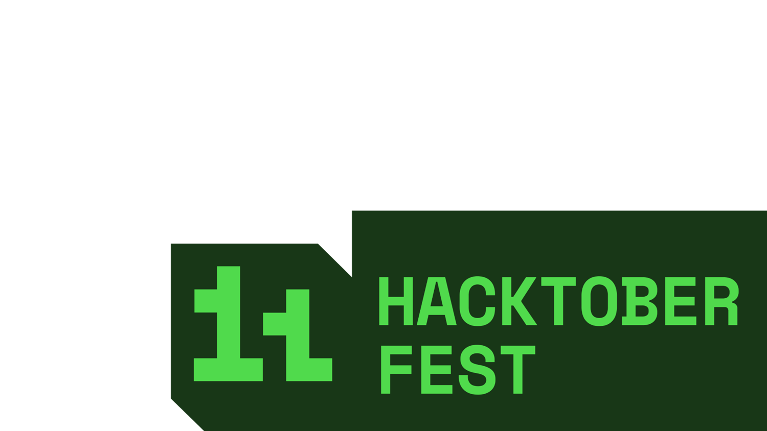


Dheerendra Pratap Singh
AdityaSingh
Leader,Project Manager
HackGods
Database &Backend manager
HackGods
Sushank Singh
RishabhMudgal
Back-End Developer
HackGods
Front-End Developer
HackGods

Slide 13

Thanks for the Opportunity

