Slide 1

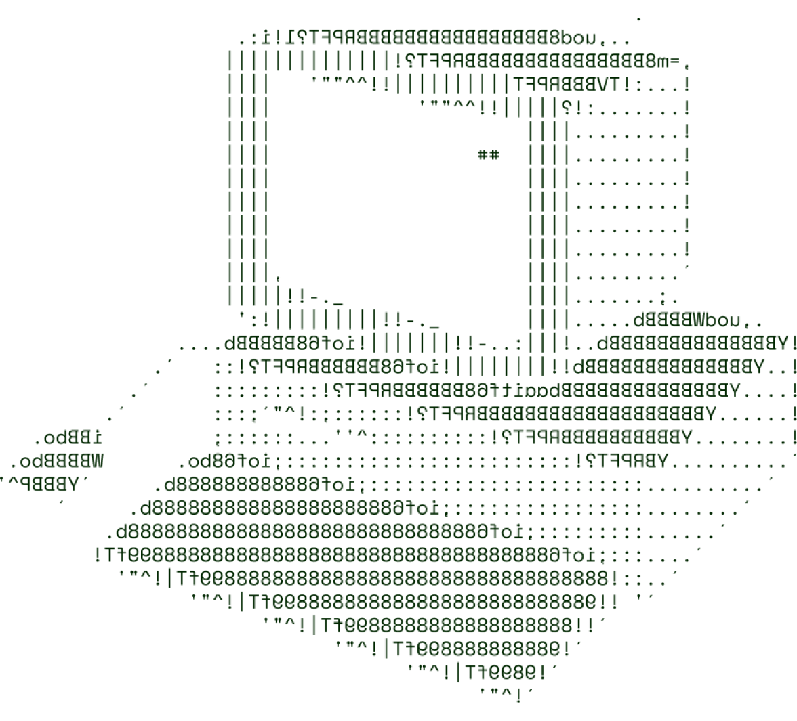

Tech in Agriculture & Rural Development
Surya

Slide 2

SOLUTION OVERVIEW
Lack of information regarding different government subsidies, use of right amount of fertilizers, soil health, proper price of different crops.
Our website, Agro-Mitra solves of these by bringing these information unified into one single website.
The uniqueness of this idea is the simplicity, the ease of access to famers by providing data in their local language and easy to use website
Info on government subsidies relevant to the area, person to reach out to avail the government subsidy
Using and providing soil health kits on their location to help them improve crop yield
Proper pricing of all the crops shown in real time to increase transparency between the farmers and the crop buyers

Slide 3
TECHNICAL ARCHITECTURE
Tech stack
Frontend Technologies:
JQuery
Html
CSS
Tailwind
bootstrap
Backend Technologies:
Python
PHP
flask,
Javascript
Database:
MySQL
Other Tools/Services:
Firebase
Git

Slide 4
SCALABILITY AND FUTURE SCOPE
Real-Time Pricing
Farmers can access up-to-date market prices for their crops, enabling them to make informed sales decisions.
Price Forecasting
Predictive analytics and historical data help farmers anticipate price fluctuations and plan their production and marketing strategies accordingly.
Public Crop
ListingFarmers can showcase their available crops and prices on a public platform, connecting directly with buyers and consumers.

Slide 5
FEASIBILITY
Potential challenges and risks:
1. Digital Literacy: Some farmers, particularly in rural areas, may face difficulties accessing or navigating the website.
2. Content Updation: Agricultural policies, subsidy rates, and other relevant information are subject to change. Keeping the website updated can be challenging.
3. Language Barriers: Content needs to be presented in languages accessible to all target users
Strategies for overcoming these challenges:
User-Friendly Design: Design a simple, mobile-friendly interface with intuitive navigation, using images and icons to help users with low digital literacy.
2. Regular Updates: Create a team or automated system to regularly review and update content, especially on policies and subsidies.
3. Multilingual Support: Provide content in multiple languages spoken by farmers, with options for regional dialects if possible.

Slide 6

>Team Details

Slide 7
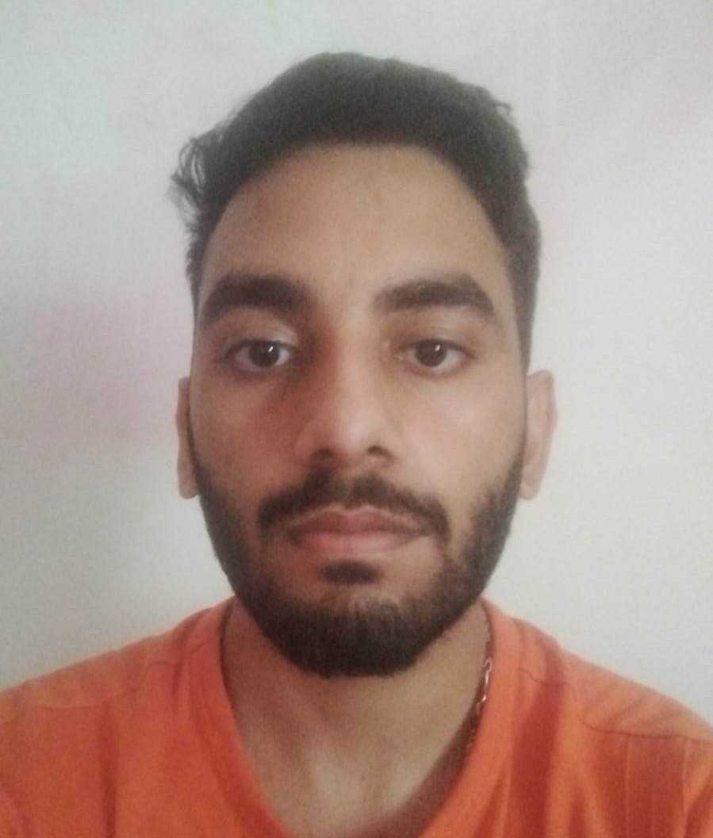

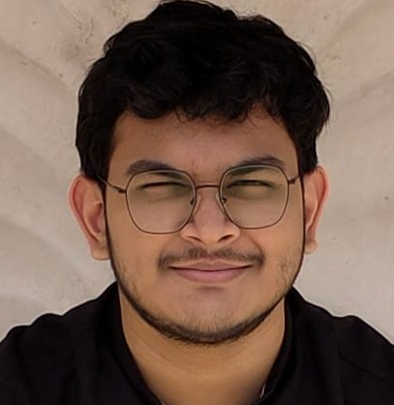


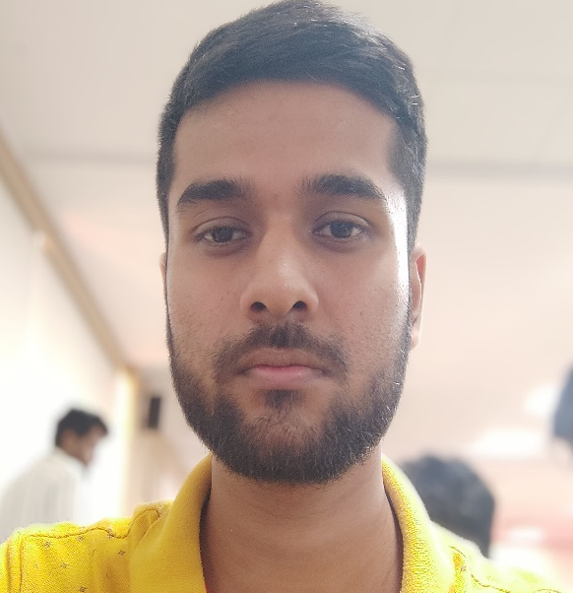
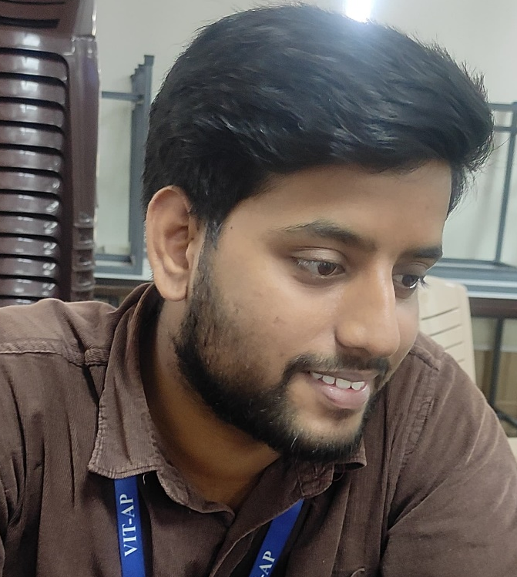
Argha Saha
Vrishank Raina
23BCE8806
23BCE8373
Arnab Das
Raushan Shrivastwa
23BCE7782
23BCE7219

Slide 8

Thanks for Joining

