Slide 1

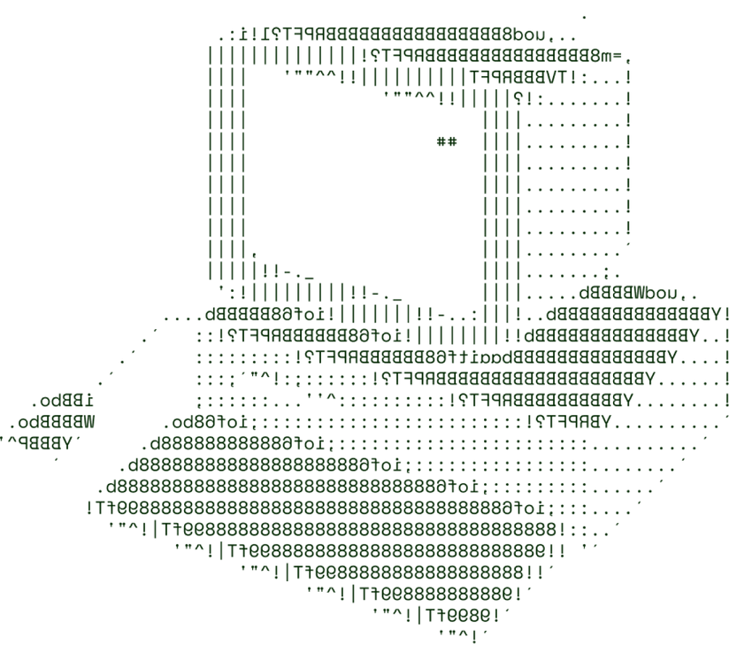


PUBLIC SAFETY AND SECURITY
~STRIKERS

Slide 2


SOLUTION OVERVIEW
Description:
Problem addressed:
Our Crime Prevention and Reporting System is a digital platform designed to empower communities and law enforcement agencies in tackling rising crime rates. It combines real-time reporting, data analytics, and community engagement tools to create a safer environment.
The system directly addresses rising crime rates by facilitating timely reporting of incidents, enhancing communication between citizens and law enforcement, and providing data-driven insights to identify and prevent crime hotspots.
UNIQUENESS:
This solution stands out by integrating advanced technologies such as machine learning and mobile connectivity. It not only enables real-time incident reporting but also uses predictive analytics to foresee potential crime trends, allowing for proactive measures.

Slide 3
Briefly describe your solution or product.
How it addresses the problem
Innovation and uniqueness of the solution
Highlight crime prevention key features and benefits.
SOLUTION OVERVIEW
KEY FEATURES AND BENEFITS:
1. Real-Time Incident Reporting
Feature: Users can quickly report crimes or suspicious activities through a mobile app or web platform.
Benefit: Enables immediate notification to law enforcement, leading to faster response times and potential crime deterrence.
2. Predictive Analytics
Feature: Utilizes data to forecast potential crime hotspots and trends based on historical data.
Benefit: Allows law enforcement to proactively deploy resources and strategies, reducing crime rates before they escalate.
3. Education and Awareness Programs
Feature: Access to safety tips, crime prevention workshops, and informational resources.
Benefit: Empowers citizens with knowledge and skills to recognize and prevent crime in their neighborhoods.

Slide 4
TECHNICAL ARCHITECTURE
FRONT END TECHNOLOGIES
D3.js for Crime Analysis Dashboards
Leaflet.js for Emergency Management
DATA BASE TECHNOLOGIES
WebRTC for Live Surveillance and Incident Reporting
Oracle Database (for High-Security Needs)
Progressive Web Application (PWA) for Emergency Alert Systems
Microsoft SQL Server
Amazon DynamoDB (Managed NoSQL Database)
BACK END TECHNOLOGIES
Firebase (as a Backend-as-a-Service)
Firebase Realtime Database (for Mobile-First Applications
PostgreSQL with PostGIS
Elasticsearch
Redis for Real-Time Caching and Data Processing
Redis for Real-Time Caching and Data Processing

Slide 5
SCALABILITY AND FUTURE SCOPE
Handling Increased Load:
To effectively manage increased load and ensure the system remains responsive during peak usage, several architectural strategies will be employed:
Cloud Services: Utilizing cloud providers like AWS, Azure, or Google Cloud enables automatic scaling based on demand. These services allow for elastic resource allocation, meaning the system can scale up or down based on traffic.
Load Balancing: Implementing load balancers (e.g., AWS Elastic Load Balancing) distributes incoming traffic across multiple servers. This ensures no single server becomes a bottleneck, enhancing performance and reliability.
2. Architecture Design
Microservices Architecture: The system will be designed using microservices, allowing different components (e.g., user authentication, incident reporting, data analytics) to operate independently. This modular approach enables easier scaling and maintenance.
API Gateway: An API gateway will manage requests to various microservices, handling authentication, logging, and routing. This centralizes control and enhances security.
Database Scaling: Using a combination of SQL (e.g., PostgreSQL) and NoSQL (e.g., MongoDB) databases can optimize performance for structured and unstructured data. Databases can be scaled vertically (upgrading server resources) or horizontally (adding more database instances).

Slide 6
3. Technologies Supporting Scalability
Containerization: Utilizing Docker to containerize microservices ensures consistency across development, testing, and production environments. Containers can be easily deployed and scaled based on demand.
Kubernetes: For orchestration, Kubernetes can manage the deployment, scaling, and operation of containers. It automates load balancing and scaling, ensuring optimal resource usage.
Caching Solutions: Implementing caching layers (e.g., Redis, Memcached) to store frequently accessed data reduces load on databases and speeds up response times.
SCALABILITY AND FUTURE SCOPE
4. Additional Functionalities Planned
To further enhance the system and accommodate future growth, the following functionalities are planned:
Real-Time Analytics Dashboard: A dynamic dashboard for law enforcement to visualize crime trends and respond proactively.
Machine Learning Integration: Implement predictive analytics to identify potential crime hotspots based on historical data, allowing for proactive resource deployment.

Slide 7
FEASIBILITY
1.Data Privacy and Security
1.Enhance Data Security and Privacy
2.False Reporting and Misuse of the Platform
2.Implement Verification and Reporting Filters
3.User Adoption and Community Trust
3.Engage with Community and Law Enforcement for Buy-In
4.Ensuring Accurate Data Analytics and Reporting
4.Use Cloud-Based Infrastructure for Scalability
5.System Scalability and Reliability
5.Optimize Data Analytics with Quality Checks

Slide 8

>Team Details

Slide 9



BALINA KRISHNA KARTIK
EERLA SIVA REETHIKA

Slide 10

Thanks for Joining

