Slide 1

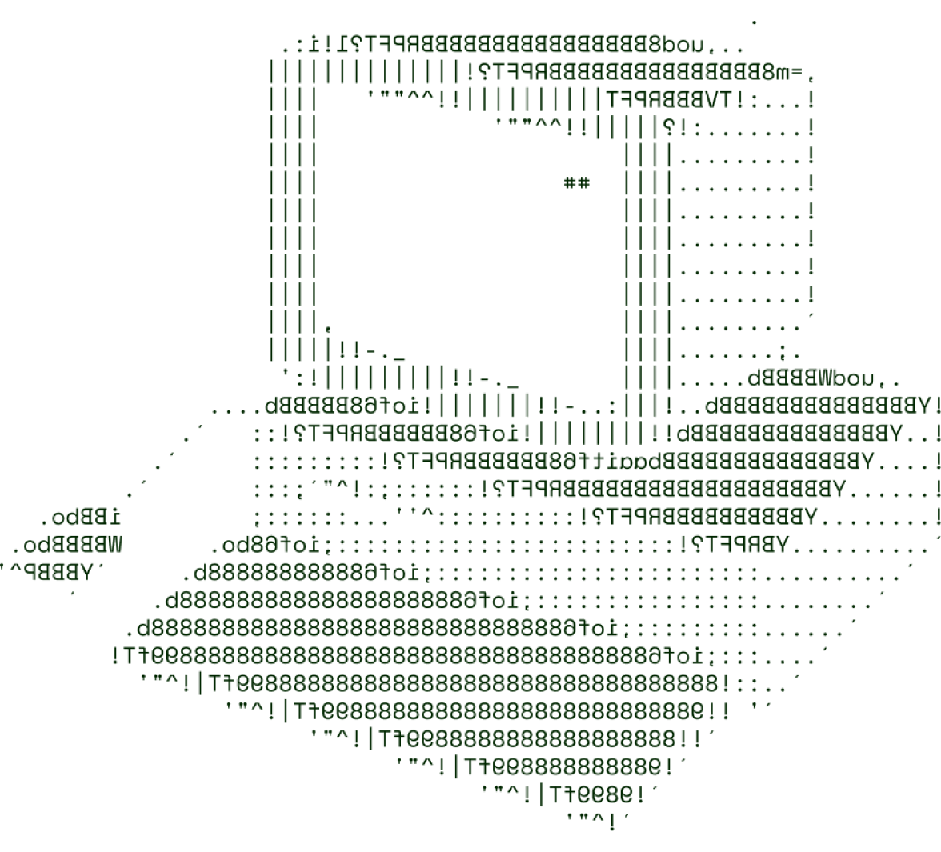

> Sales Sight
CODZ

Slide 2

OVERVIEW OF THE SOLUTION
This Sales Sight will allow users (shop owners) to have a record of their present, past and future sales trends
Users (shop owners) will be able to view their current, historical, and projected sales trends with this Sales Sight.
• In essence, it controls sales and grants you the ability to view site data so that you can make money from them.
• This software is lighter than others and will yield a more precise forecast.
• It enables you to visualize your unique dimensions.
• It lets you access a specific space's data.
• You can use it to visualize the data and forecast future sales.

Slide 3
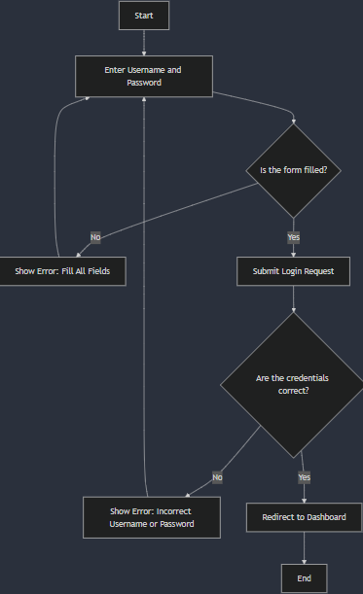
TECHNICAL ARCHITECTURE
Tech stack
Frontend Technologies: React JS
Backend Technologies: Node JS,Expres JS
Database:MongoDB
Other Tools/Services: Github, Python

Slide 4
SCALABILITY AND FUTURE SCOPE
• It processes the data for visualization and organizes it in tabular form
helping you visualize the data.
It works on Cloud Servers being available all over the world and over the clock
The prediction features can help in increase the sales efficiency and help in markey strategies

Slide 5
FEASIBILITY
Seasons such as christmas , dussehra or other festivals can have unpredictable trends in the market due to which the sales can’t be predicted properly
The solution is to analyze data of previous seasons and train on that dat to predict the upcoming sales

Slide 6

>Team Details

Slide 7




Sanyog tripati
Tansheed
Team lead
Member(web dev)
S.T.V Dayanidh
Y. Sushila
Member(webdev front end)
App development

Slide 8

Thanks for Joining

