Slide 1



> Fit and Fierce
Empowering the world with smart solutions.
AthleTech

Slide 2

SOLUTION OVERVIEW
Our website provides real time tracking of fitness and manages your diet plans for you.
There are few plain and not so interactive webpages which are boring.. Right?
Well ,we will be making a page that’s exactly the opposite
AthleTech is a website which is very alluring and uses various technologies to make it as cool as possible and is efficient, not throwing up many pop ups.
How it addresses the problem: This solution tackles two key problems:
It improves fitness outcomes by providing real-time feedback on posture, helping users avoid injury and improve performance.
It streamlines the process of booking fitness slots at VIT AP, offering an efficient way for users to manage their fitness schedules.(gym, tennis and badminton)
Game like environment to increase interest on fitness.

Slide 3
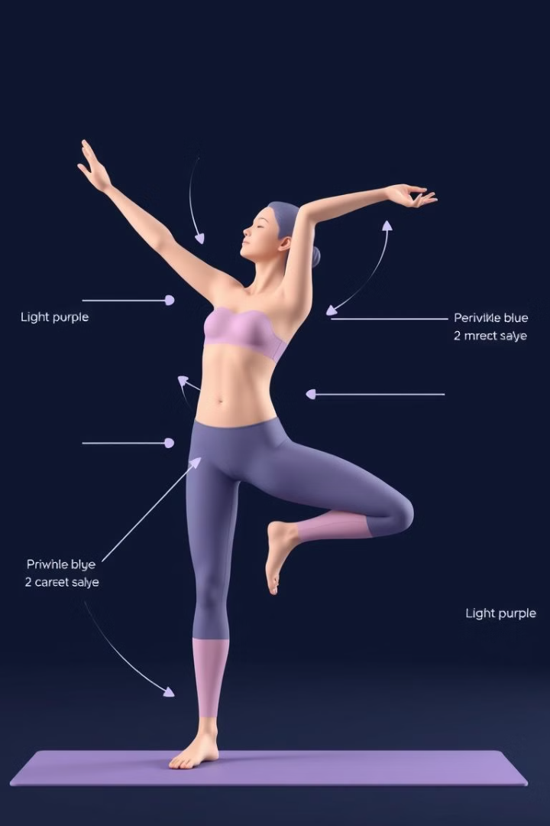
SOLUTION OVERVIEW
Innovation and uniqueness of the solution: The innovation lies in the integration of posture correction using movement-tracking technology and a convenient booking system all within one platform. The use of computer vision to track body movements and provide instant feedback makes it unique, especially when combined with the slot booking feature specifically tailored for VIT AP students.
Key features and benefits:
Real-time posture analysis: Using OpenCV to track and analyze body movement, the system can identify incorrect postures and provide instant feedback to the user.
Slot booking feature: Users can easily reserve time slots for fitness activities at VIT AP, making scheduling simple and efficient.
User-friendly interface: A seamless experience designed to assist students and fitness enthusiasts with both their posture and fitness management.

Slide 4
TECHNICAL ARCHITECTURE
Tech stack
Frontend Technologies: (HTML , VS code,React. )
Backend Technologies:( Node.js, React.js, Django)
Database:( MySQL, MongoDB)
Other Tools/Services:( AWS, Firebase, Git)

Slide 5
SCALABILITY AND FUTURE SCOPE
We can handle load and avoid Ddos by implementing In proper stages and verified frameworks
Architecture Considerations:
1. Cloud Services: Host on Vercel
2. Load Balancing: Use Elastic Load Balancer (ELB) or Google Cloud Load Balancing to distribute traffic across instances.
3. Auto Scaling: Implement auto-scaling policies to dynamically adjust instance count based on traffic demand.
4. Microservices Architecture: Break down the application into smaller, independent services for easier maintenance and scaling.
5. Database: MySQL,MongoDB
We also plan to implement social sharing, gamification, personalized coaching, Wearable integration, using AI and ML to detect wrong movements, Multi-Language Support and Voice Assistant Integration:

Slide 6
FEASIBILITY
Potential challenges and risks:
Logistical Challenges for Slot Booking:
Ensuring accurate real-time updates on slot availability to prevent overbooking and alsoEstablishing fair and clear cancellation and rescheduling policies that work for users and providers.
Technical Challenges
Accurate Posture Detection: Developing algorithms that reliably assess posture across different body types and movements.
Ensuring seamless compatibility with various fitness trackers and devices for movement tracking.
User Experience Risks
Keeping users motivated to consistently use the website and engage with its features and Avoiding overwhelming users with too much information at once.
Health and Safety Risks
Risk of users receiving inaccurate assessments, potentially leading to injury or poor training habits
Privacy and Security Concerns
Data Privacy: Safeguarding sensitive personal data collected from users, especially health-related information.
Consent Management: Clearly communicating data usage policies and obtaining user consent effectively.

Slide 7
Strategies for overcoming these challenges
Logistical Strategies for Slot Booking
Real-time Updates: Implement a robust scheduling system that reflects real-time availability to minimize booking errors.
Clear Cancellation Policies: Develop straightforward cancellation and rescheduling processes, and communicate these clearly to users to manage expectations.
Health and Safety Strategies
Professional Guidance: Incorporate expert advice within the website, such as video tutorials or tips from certified trainers, to supplement automated feedback.
User Education: Provide educational content on posture and movement to help users understand the importance of proper technique.
User Experience Strategies
Gamification: Incorporate gamified elements to enhance user engagement, such as challenges, rewards, or leaderboards.
Simplified Interface: Focus on a clean, intuitive design that guides users through features without overwhelming them with data. Use tooltips or tutorials for new users.

Slide 8

>Team Details

Slide 9




DWARAMPUDI YASHWITA SRI
MOHAMMED ALI KHAN
Student,2nd year
VIT-AP UNIVERSITY
Student,2nd year
VIT-AP UNIVERSITY
YAKKALA BANGARU LAKSHMAN
GUTHA GNAPIKA
Student,2nd year
VIT-AP UNIVERSITY
Student,2nd year
VIT-AP UNIVERSITY

Slide 10

Thank you

