Slide 1

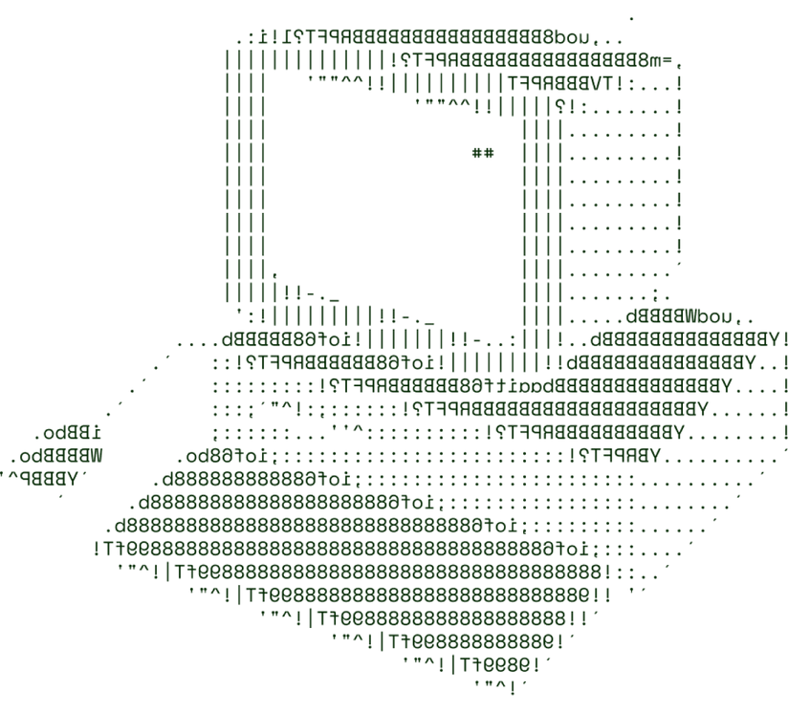
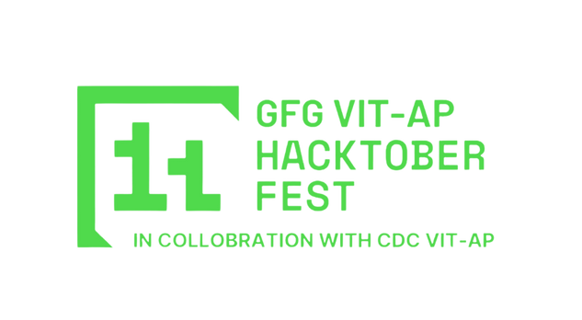

> CLEAN
TEAM BYTE SQUAD

Slide 2
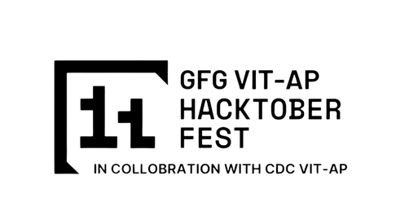
SOLUTION OVERVIEW
Problem
There is a lack of transparency and regulations among Indian food products. Several hazardous preservatives, food colourings and emulsifiers hide under seemingly harmless ingredient names behind the food products. Ingredients are coded in different names to make it even more difficult for the end consumer to quantify the risks they are involving themselves by consuming those products.
Solution
We here at CLEAN ensure that transparency is our top priority. We offer a clean and minimalistic interface to all the information you need inorder to assess your food product.
A barcode or product name is used to fetch the ingredients and details for the food product from openfoodfactsapi - an open source food database
This data is then fed into a LLM (LLAMA 3.1) via the groq sdk to fetch the relevant insights.
A comprehensive and personalised report is generated for the end user which is displayed on our web portal.

Slide 3








TECHNICAL ARCHITECTURE
TECH STACK USED:
NODE.JS : SCALABLE SERVER-SIDE JAVASCRIPT RUNTIME.
TAILWIND CSS: UTILITY-FIRST RESPONSIVE CSS FRAMEWORK.
EXPRESS.JS: WEB FRAMEWORK FOR NODE.JS.
JAVASCRIPT: CLIENT-SIDE SCRIPTING LANGUAGE.
OLLAMA 3.1 BASED GROQ SDK: AI-BASED DATA QUERYING API
OPENFOODFACTS.ORG API: INGREDIENT/PRODUCT INFORMATION API.
MONGODB: NO-SQL BASED DATABASE APPLICATION

Slide 4
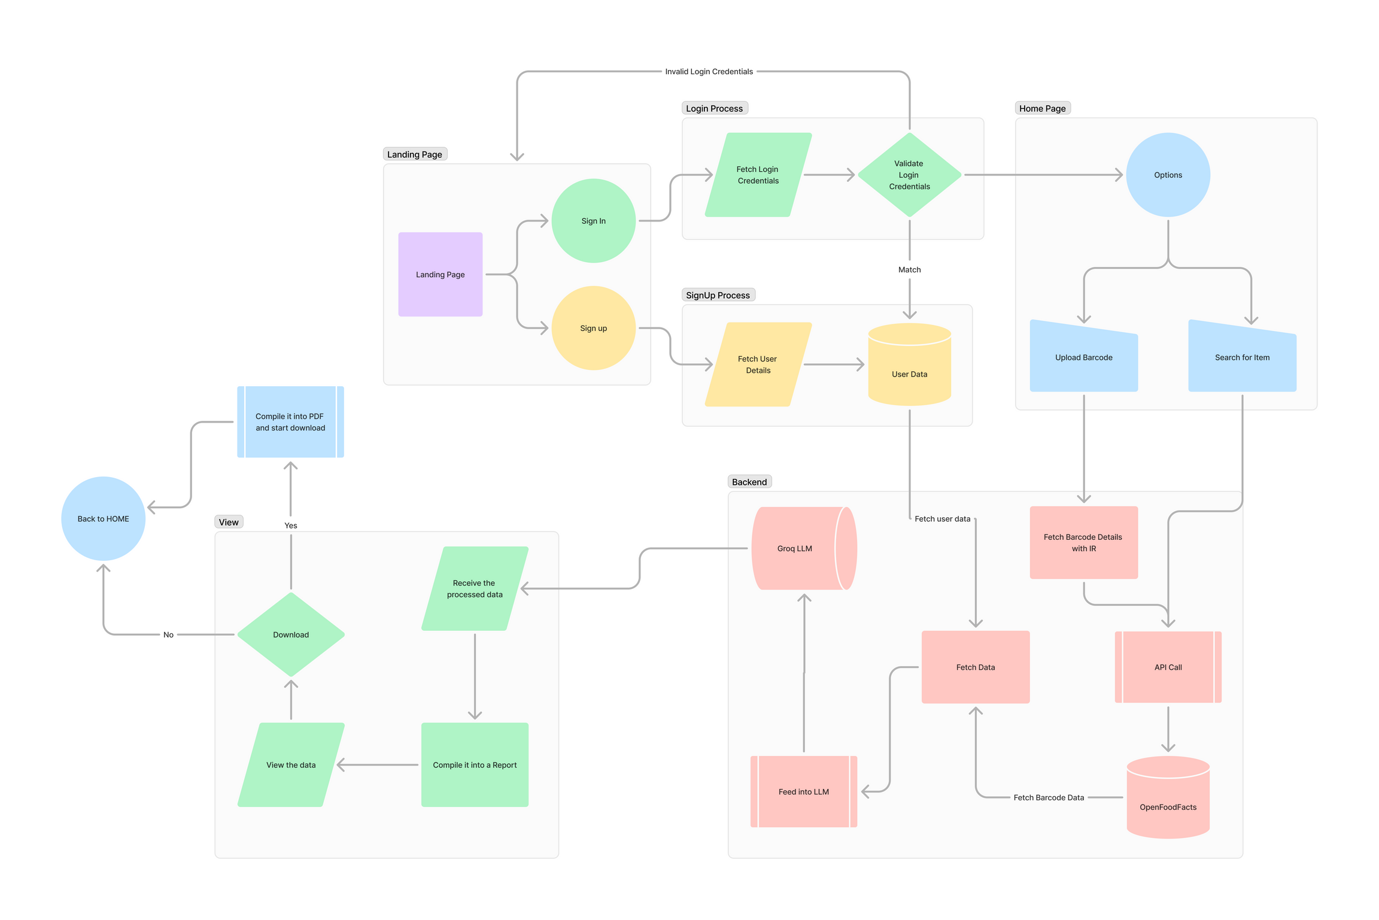
PROTOTYPE FLOWCHART

Slide 5
SCALABILITY AND FUTURE SCOPE
To maintain scalability, the system can leverage cloud services like AWS for horizontal scaling.
Incorporating server-side caching to reduce server load under identical queries.
Fine-tune machine learning models to ensure higher prediction accuracy.
Implement an easy portal to ensure smooth and effortless addition of new products to expand our repository of ingredients.
MOBILE APP
If our product shows promise and public support, we plan to create a fully functional mobile application for our product. The barcode will be scanned natively by the device itself and the result will be displayed seemingly instantaneously. The availability of a mobile interface unlocks a major portion of the Indian population.

Slide 6
FEASIBILITY
The system's technical feasibility is confirmed, with barcode scanning possible via mobile cameras and LLM processing using Groq SDK with LLama 3.1.
Web integration ensures low latency and accessibility across multiple devices on scalable hosting platforms.
Challenges include potential inaccuracies in barcode scanning, a limited ingredient database, and a potentially complex user interface.
Solutions proposed are using enhanced barcode scanning techniques, regularly updating the database, and creating a simplified, user friendly UI.

Slide 7

>Team Details

Slide 8
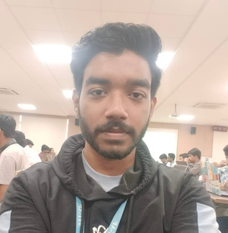



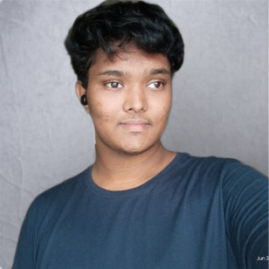



Rakib Mondal
Roshan Laharwani
Student
VIT-AP University
Student
VIT-AP University
Satyajit Panda
Suryabrata Sahoo
Student
VIT-AP University
Student
VIT-AP University

Slide 9

Thanks for Joining

