Slide 1


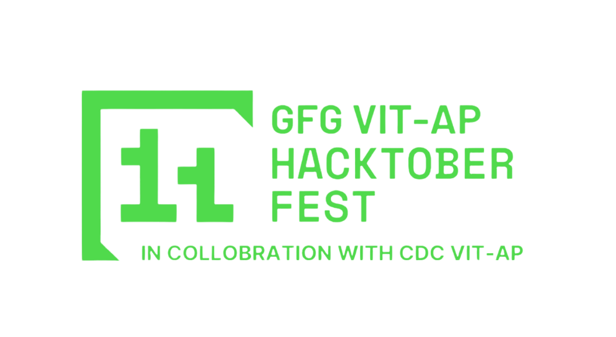
> CardioCare
(Team Name)

Slide 2
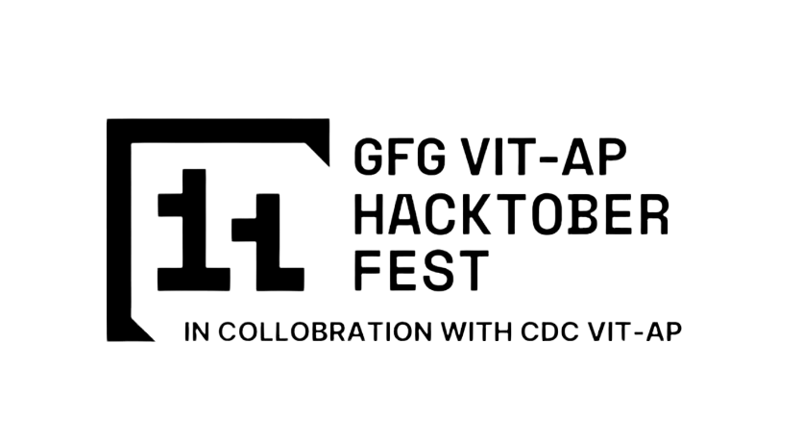
CHALLENGES IN MONITORING HEART PATIENTS REMOTELY
Heart patients, especially in rural or remote areas, often lack regular access to cardiologists or health facilities.
Critical heart conditions require continuous monitoring, which can be costly and challenging due to geographical limitations.
Without real-time monitoring, doctors may miss early warning signs of cardiac issues, potentially leading to delayed interventions.

Slide 3
Proposed Solution:
Real-Time Remote Monitoring for Heart Health
A health tracker designed specifically for heart patients, enabling doctors to monitor critical health metrics in real-time.
Key metrics such as heart rate, ECG, and other vital signs are continuously collected and transmitted to healthcare providers. In a personalized dashboard
Alerts are sent to doctors when abnormal readings are detected, ensuring timely interventions and care adjustments.

Slide 4
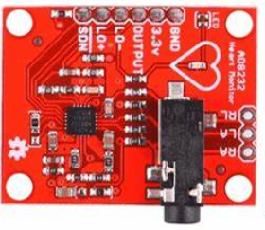
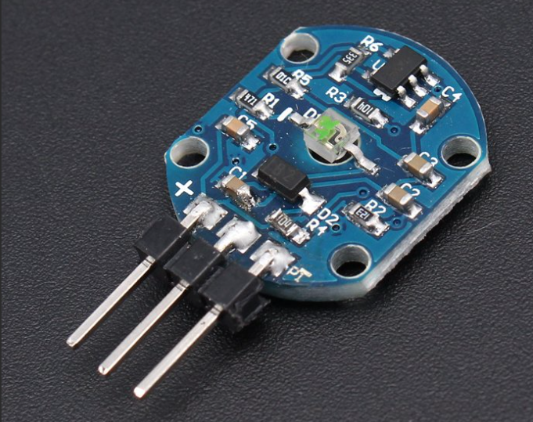
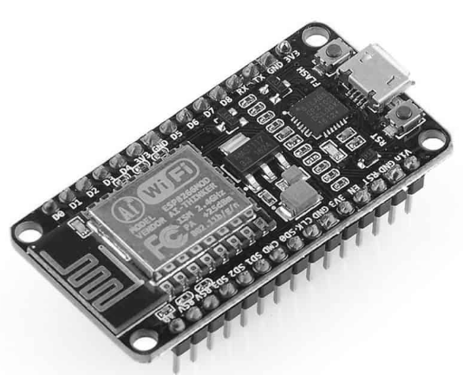
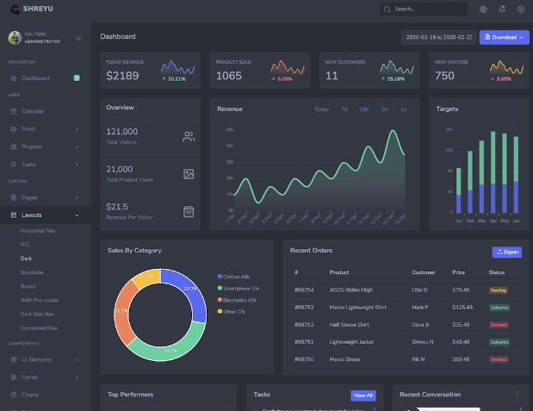
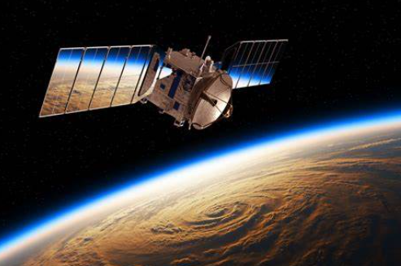
TECHNICAL ARCHITECTURE
Sensors on patient’s wrist band will collect vital information like heart rate and ecg.
Sensors used: ecg module and heartbeat sensors
Data from sensors will be processed by microcontroller and uploaded to a decentralized webserver.
Equipment: ESP32 AI thinker
Viral information in real time will be displayed on patient and doctor dashboard. Which also features one-on-one vc and AI suggestions
Tech Stack: flask, reactjs
In case of an emergency near by medical aids will be notified via satellite SOS.
Tech: apple emergency sos, similar features coming for
android users, or on board satellite positioning module for esp32

Slide 5
SCALABILITY AND FUTURE SCOPE
Handling Increased Load
-Horizontal Scaling: Adding more instances of services to distribute load effectively.
Architecture considerations
-Cloud Services: Leveraging cloud providers (like AWS, Azure, or Google Cloud) offers auto-scaling capabilities and on-demand resources to accommodate varying loads.
Technologies that support scalability
-API Gateways: Implementing API gateways (like Kong or AWS API Gateway) for managing traffic, authentication, and routing requests helps improve performance and scalability.
Additional functionalities
-Enhanced User Interface: Developing mobile and web applications with responsive designs to improve user engagement and accessibility.

Slide 6
FEASIBILITY
Potential Challenges and Risks:
Data Privacy and Security: Sensitive health information could be exposed to breaches or unauthorised access , raising concerns about user privacy.
Technical Issues: Malfunctions, connectivity problems, or software bugs can disrupt data collection and cause irregularities in the data leading to inaccurate analysis.
Integration with Healthcare Systems: Challenges may arise in ensuring that the data is effectively reaching the healthcare systems and is being registered in the database

Slide 7
Strategies for Overcoming these Challenges:
Data Privacy and Security:
-Access Control: Establish strict access controls and authentication measures (e.g., two-factor authentication) to limit who can view and manage health data.
-Decentralisation: The data is stored in a peer 2 peer network, there is no centralised server.
Technical Issues:
-Redundancy System: Use backup systems and fail-safes to ensure continuity of data collection during technical failures.
-Real-time Monitoring: Employ real-time monitoring tools to detect and address technical issues as they arise, minimizing disruptions.
Integration with Healthcare Systems:
-API Development: Develop robust APIs that allow for easy integration with various healthcare platforms and electronic health records (EHRs).
-Pilot Programs: Conduct pilot programs to test integration strategies and gather insights for improvement before wider implementation.

Slide 8

>Team Details

Slide 9





Izhaan Raza
Akshat Abhishek Singh
Hardware Automation
Backend

Slide 10

Thanks for Joining

