Slide 1

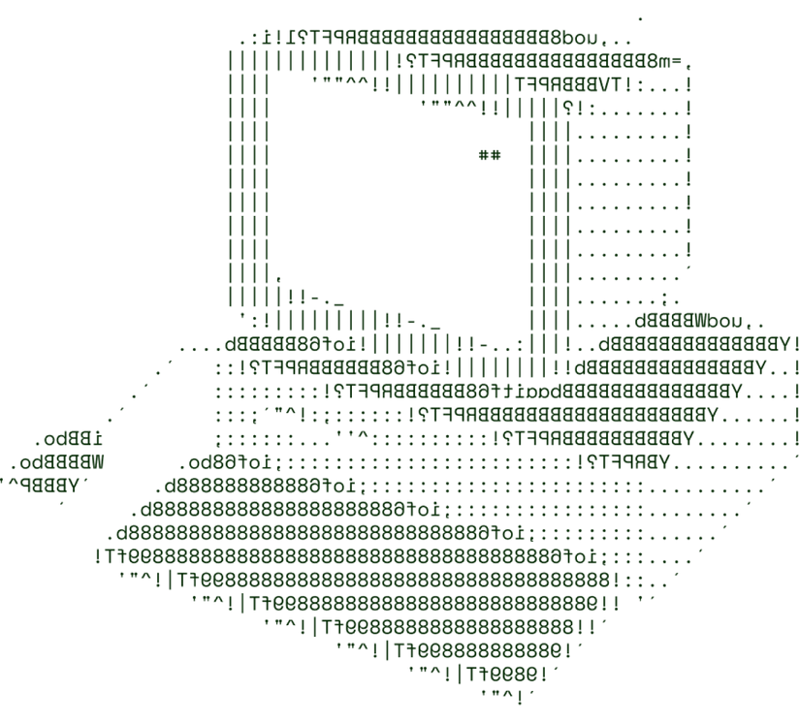


> Agri gen
CODE

Slide 2

SOLUTION OVERVIEW
Briefly describe your solution or product.
Sustainable Food Production & Demand focuses on addressing the environmental impact of conventional farming and food waste. Sustainable farming practices, like organic farming, permaculture, and regenerative agriculture, promote healthier ecosystems by improving soil health, conserving water, and reducing chemical usage. Globally, one-third of all food is wasted, adding to resource depletion and emissions. By improving supply chain management, educating consumers, and implementing innovative solutions, we can reduce food waste.
Collaboration among individuals, businesses, and policymakers is essential. Individuals can support sustainable choices, businesses should adopt eco-friendly practices, and governments must create incentives for sustainable agriculture. Education and awareness are key to driving change.
How it addresses the problem
The platform addresses the issue of food waste and inefficient food distribution by enabling better coordination between producers, suppliers, and consumers. It minimizes food wastage through smart logistics, encourages the adoption of sustainable practices by producers, and educates consumers on responsible consumption.

Slide 3
SOLUTION OVERVIEW
Innovation and uniqueness of the solution
Real-time Surplus Monitoring: Tracks food supply from production to consumption and redirects surplus food to areas of need (NGOs, food banks).
Smart Supply Chain Optimization: Uses AI to optimize food storage, transportation, and distribution, ensuring minimal spoilage.
Consumer Education Portal: Provides tips and resources to help users reduce waste and make sustainable food choices.
Highlight its key features and benefits.
Reduced Food Waste: Minimizes environmental impact by ensuring excess food is used effectively.
Improved Sustainability: Encourages sustainable farming and consumption habits.
Cost Savings: Reduces operational costs for businesses through efficient supply chain management.
Increased Awareness: Empowers consumers with knowledge about reducing waste and supporting sustainable practices.

Slide 4
TECHNICAL ARCHITECTURE
Flowchart (Not Compulsory)
Tech stack
Frontend Technologies:
React.js: For building a responsive and interactive user interface. React's component-based architecture enables efficient UI updates and offers reusable components for consistent user experience. Enabling users to track food availability, make requests for surplus, and access sustainability resources seamlessly.
Backend Technologies:
Flask: A lightweight and flexible Python web framework. Flask handles user requests, executes business logic, and integrates with the database to manage real-time surplus tracking, logistics coordination, and user interactions with the system.
Database:
Mysql: A relational database that stores structured data, such as user accounts, surplus food details, and distribution records. It ensures data integrity and supports complex queries for reporting and analysis on food supply and demand patterns.

Slide 5
SCALABILITY AND FUTURE SCOPE
How your solution can handle increased load
Caching Mechanisms:
Description: Implementing caching solutions (e.g., Redis, Memcached) can significantly reduce
the load on the database by storing frequently accessed data in memory. This allows for faster
data retrieval and reduces the number of direct database queries.
Benefits: Improved response times for users and reduced strain on the database, enhancing overall
application performance
Database Optimization:
Description: Implementing database optimization strategies such as indexing, query optimization, and partitioning can enhance performance. Using read replicas can also distribute the load for read-heavy applications.
Benefits: Faster query response times and reduced load on the primary database, ensuring that the system can handle more concurrent users.

Slide 6
FEASIBILIY
Potential challenges and risks
Technical Complexity: Implementing a microservices architecture and containerization can introduce complexity in development, deployment, and maintenance.
Data Security and Privacy: Handling sensitive user data, such as personal information and food preferences, poses risks related to data breaches and compliance with regulations (e.g., GDPR).
Scalability Issues: As user demand increases, ensuring that the system can scale without performance degradation may require continuous monitoring and adjustment.
User Adoption: Gaining traction among users and encouraging them to adopt the platform can be challenging, especially if they are accustomed to traditional methods.
Supply Chain Disruptions: External factors such as natural disasters, economic shifts, or pandemics can impact food supply chains and affect the platform’s operations.
Strategies for overcoming these challenges

Slide 7
FEASIBILIY
Strategies for overcoming these challenges
Technical Training and Documentation: Invest in training for the development team on microservices, containerization, and cloud services. Comprehensive documentation will help streamline development processes and reduce complexity.
Robust Security Measures: Implement strong encryption for data at rest and in transit, use secure authentication methods, and conduct regular security audits. Compliance with data protection regulations should be prioritized through the implementation of privacy policies and user consent protocols.
Performance Monitoring Tools: Utilize application performance monitoring (APM) tools (e.g., New Relic, Datadog) to continuously monitor system performance and identify bottlenecks early. Establishing automatic scaling policies can ensure resources are dynamically adjusted based on load.
User Engagement and Marketing Strategies: Develop targeted marketing campaigns that highlight the platform's benefits and features. Collaborate with local producers and NGOs to promote the platform within communities. User onboarding processes should include educational resources and support to facilitate adoption.
Flexible Supply Chain Strategies: Build relationships with multiple suppliers to diversify sources and reduce dependency on a single provider. Implementing features that allow for real-time updates on supply conditions can help users adapt to changing circumstances.

Slide 8

>Team Details

Slide 9




Potnuru Manmohan
team name : code

Slide 10

Thanks for Joining

