Slide 1

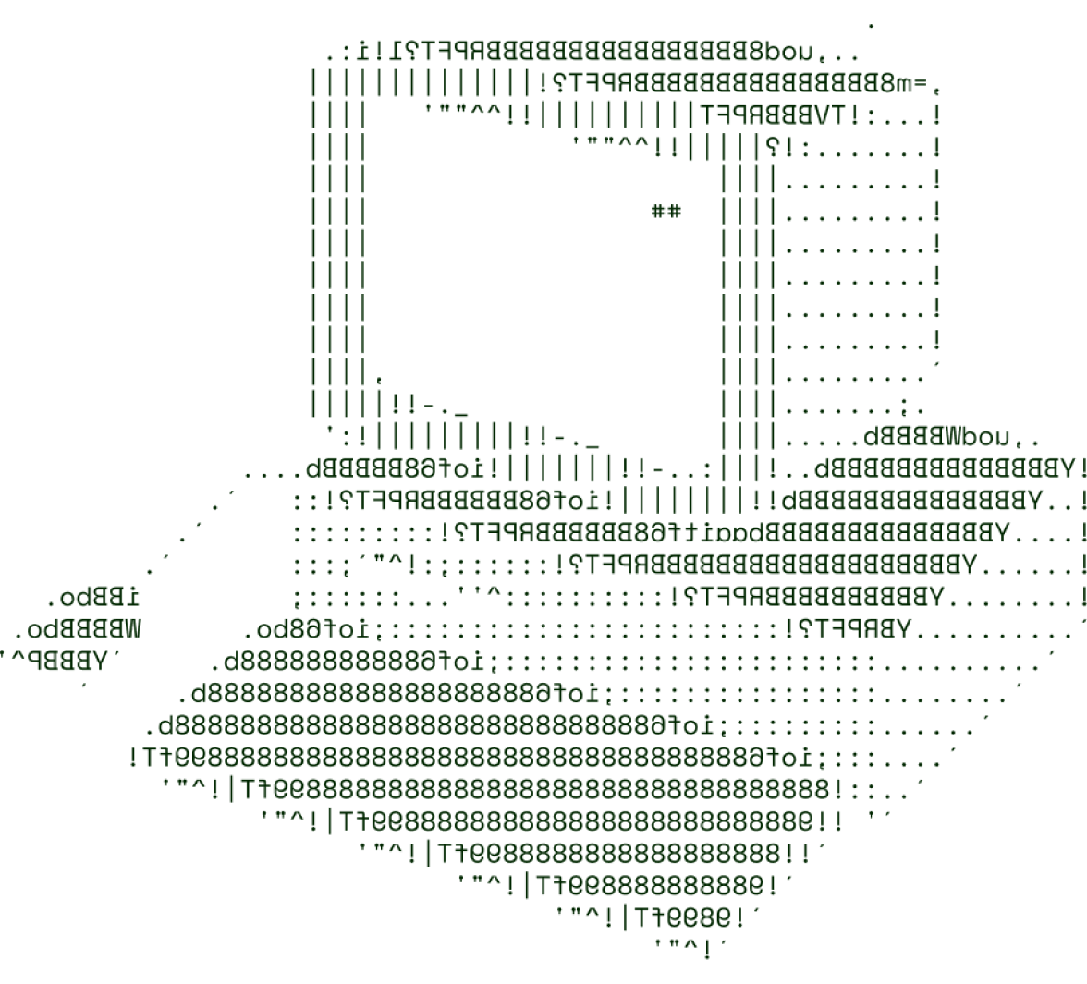
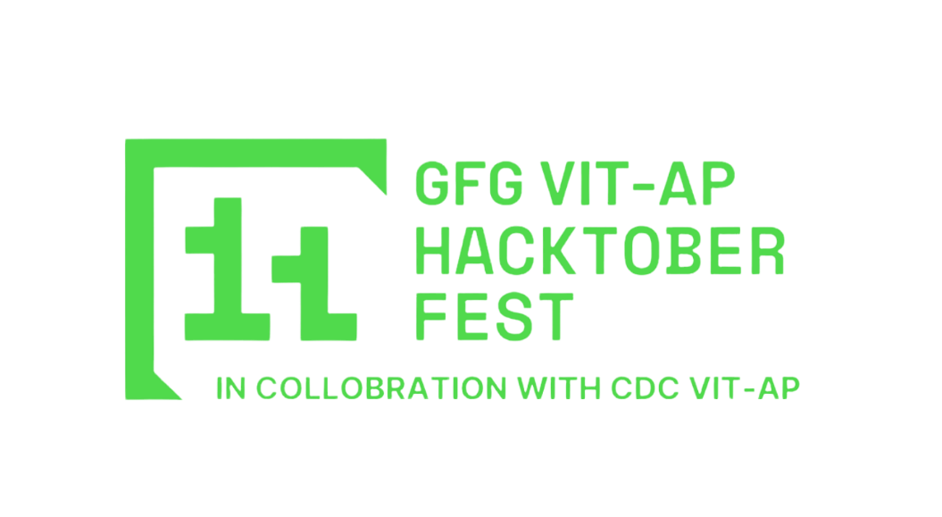
> Reinforced Drug Discovery
R O N I N

Slide 2
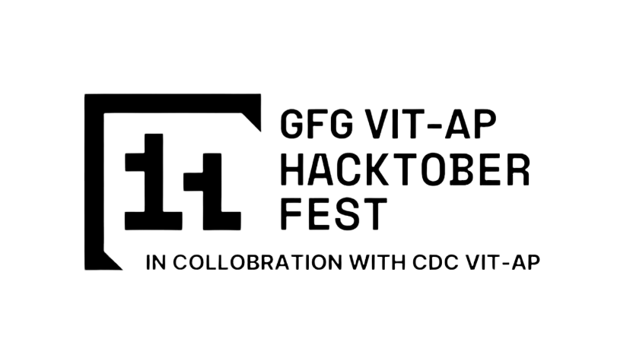
SOLUTION OVERVIEW
Drug Discovery using Reinforcement learning and Visual Transformers is the key component for solving major world health problems and upcoming challenges in the human biology. The Product uses reinforcement learning to make use and analyze the various patterns of DNA and RNA, Makes the designated Drugs for specific Compositions of Molecular chemicals found in the cell composition.
The Product Challenges the major problems of BioChemistry and Human Patternology, With a well equipped models from transfer learning and CNN nets for analyzing the complex patterns. The Model can recognize the patterns found in the specific drug and the human cell and classifies the correct drug and disease
Using Reinforcement Learning in the field of Medics is rare. Showcasing the product’s uniqueness, the models are trained to acquire results faster compared to other complex models.
Well trained CNN Which is attached to Reinforced model via Transfer learning.
Average time for classification is much lower than actual model
Can Even Discover Drugs for newly found Diseases using Previous Data

Slide 3
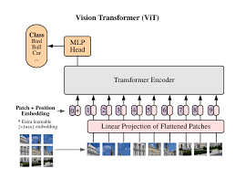
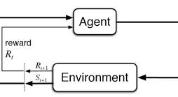
TECHNICAL ARCHITECTURE
Flowchart of Visual transformers
The Above Provided flowcharts interact each other via transfer learning process that associates the particular Agent with batched data. The first shows about the visual transformers while the second one shows about the Reinforcement learning

Slide 4
TECHNICAL ARCHITECTURE
Tech stack
Frameworks Used : Pytorch , tensorflow, scikit-learning
VCS Used : GIT
Transformer Framework used: Hugging face and BERT(Architecture)

Slide 5
SCALABILITY AND FUTURE SCOPE
Drug Discovery with human interaction makes do waste a lot of time. The model can analyze the patterns found in the drug and diseased cells and makes a mathematical model that can solve hidden complexities and instances
Architecture considerations
--- > Microsoft Azure And IBM Watson
Technologies that support scalability (e.g., microservices, containerization)
Additional functionalities you plan to implement:
Making the Model more Complex increase the variance in dataset but it is yet useful for making model strong enough to classify the hidden complexities yet we can make the realtime datacollection to ensure the variance is under control

Slide 6
FEASIBILITY
Potential challenges and risks:
Heavy Data Usage is one of potential threats recorded ever in the field of Ai..
By Acquiring more Data. The model complexity can be increased much that it can make wrong drug for a certain suffering.
Strategies for overcoming these challenges:
Using Mini Batch Graditnt Decent for CNN and using SGD with momentum for Visual transformers. We can leverage the difficulty of potential Threats of Data..

Slide 7
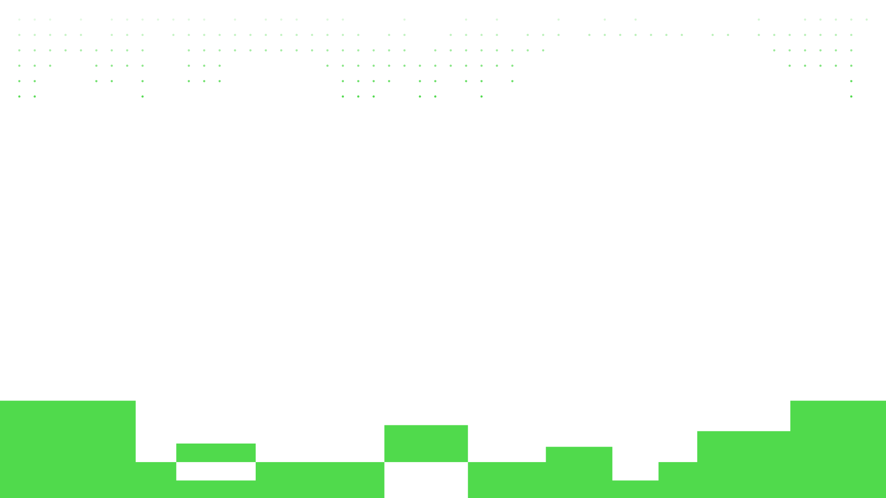
> R O N I N

Slide 8


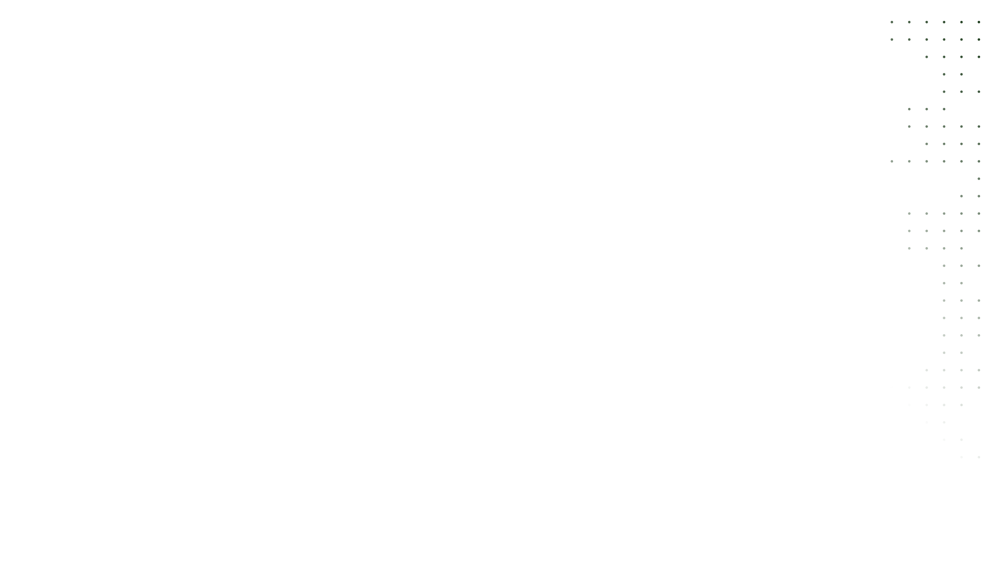
Nandhan Golla
Student

