Slide 1
计算机网络 – Tutorial2 网络抓包工具
授课助教：朱蔚骐
zhwq66@stu.pku.edu.cn
(内容修改自 孙海锋 2023秋 计算机网络 Turorial2)
2024.11.13

Slide 2
内容
Wireshark抓包和过滤
BPF简介
libpcap编程
tcpdump使用

Slide 3
Overview
BPF
libpcap
tcpdump
Wireshark
常用的网络抓包软件
网络报文抓取的 C/C++ 库
高性能的报文过滤机制

Slide 4
内容
Wireshark抓包和过滤
BPF简介
libpcap编程
tcpdump使用

Slide 5

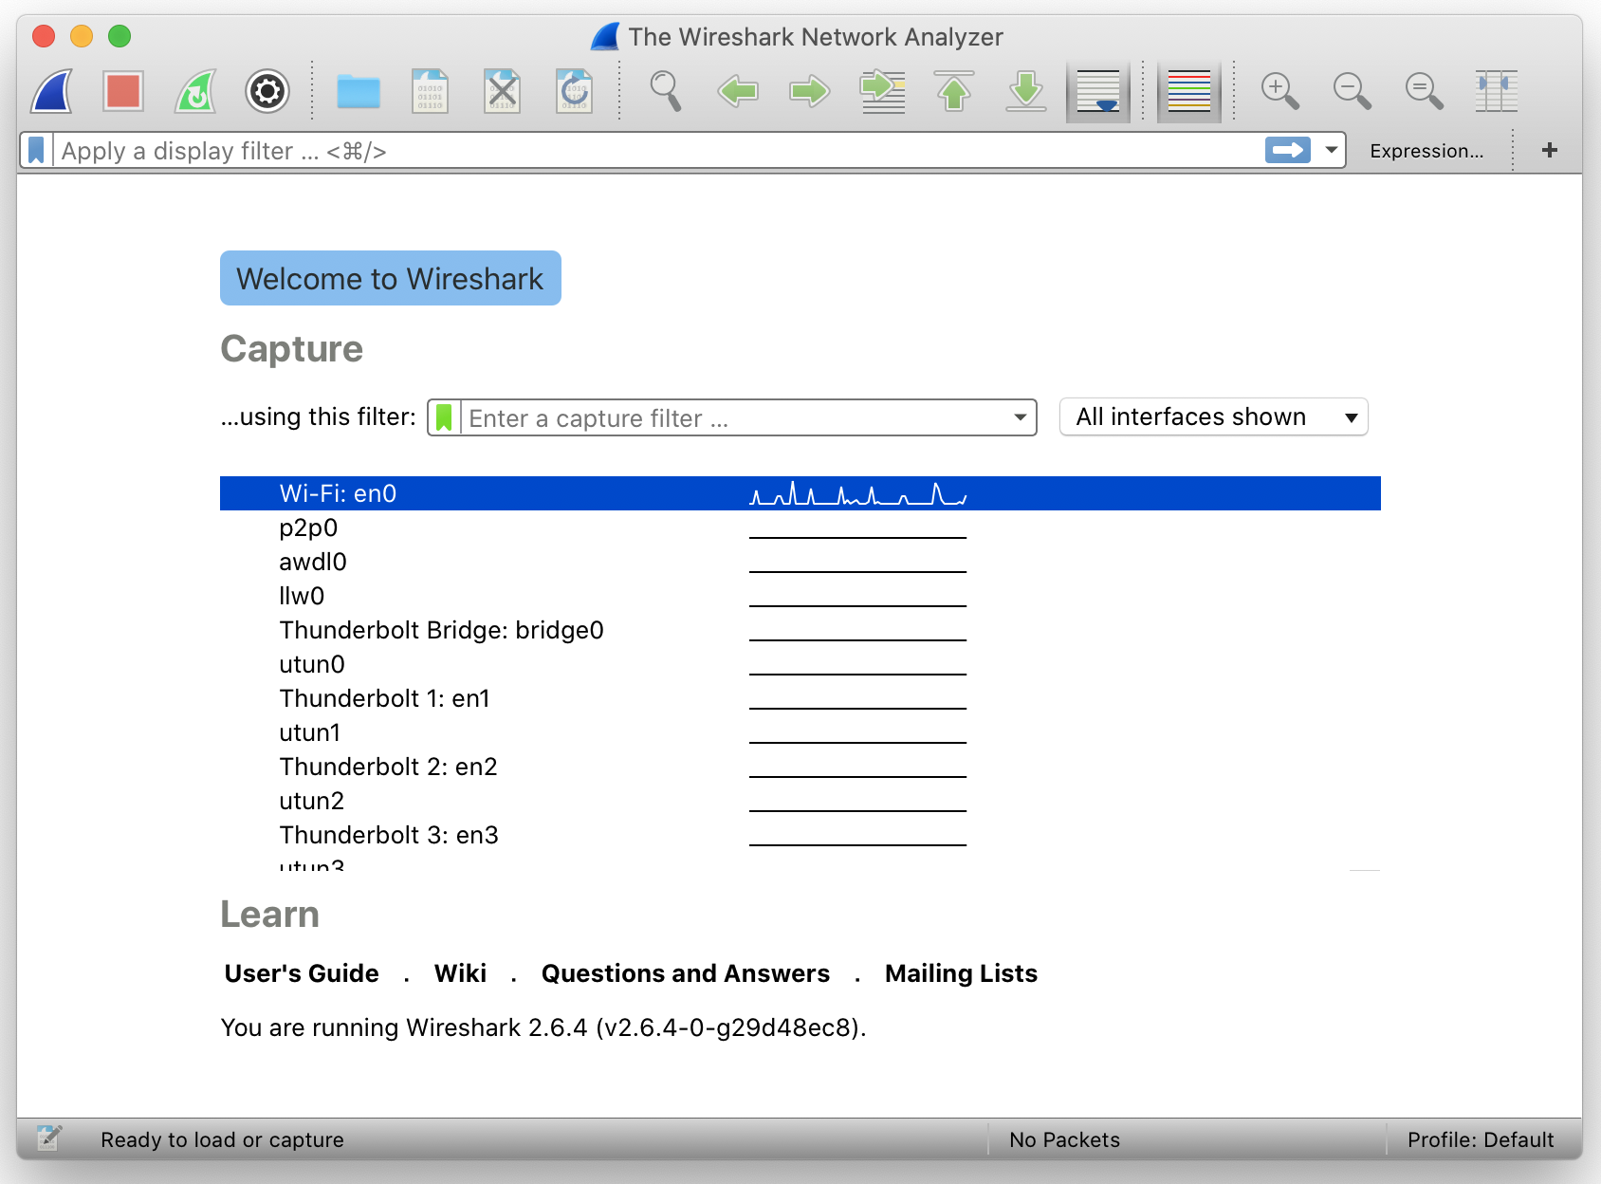
Wireshark
Wireshark: A free and open-source widely-used network protocol analyzer.
Automatically capture, analyze packets and collect statistics.
Demonstration

Slide 6

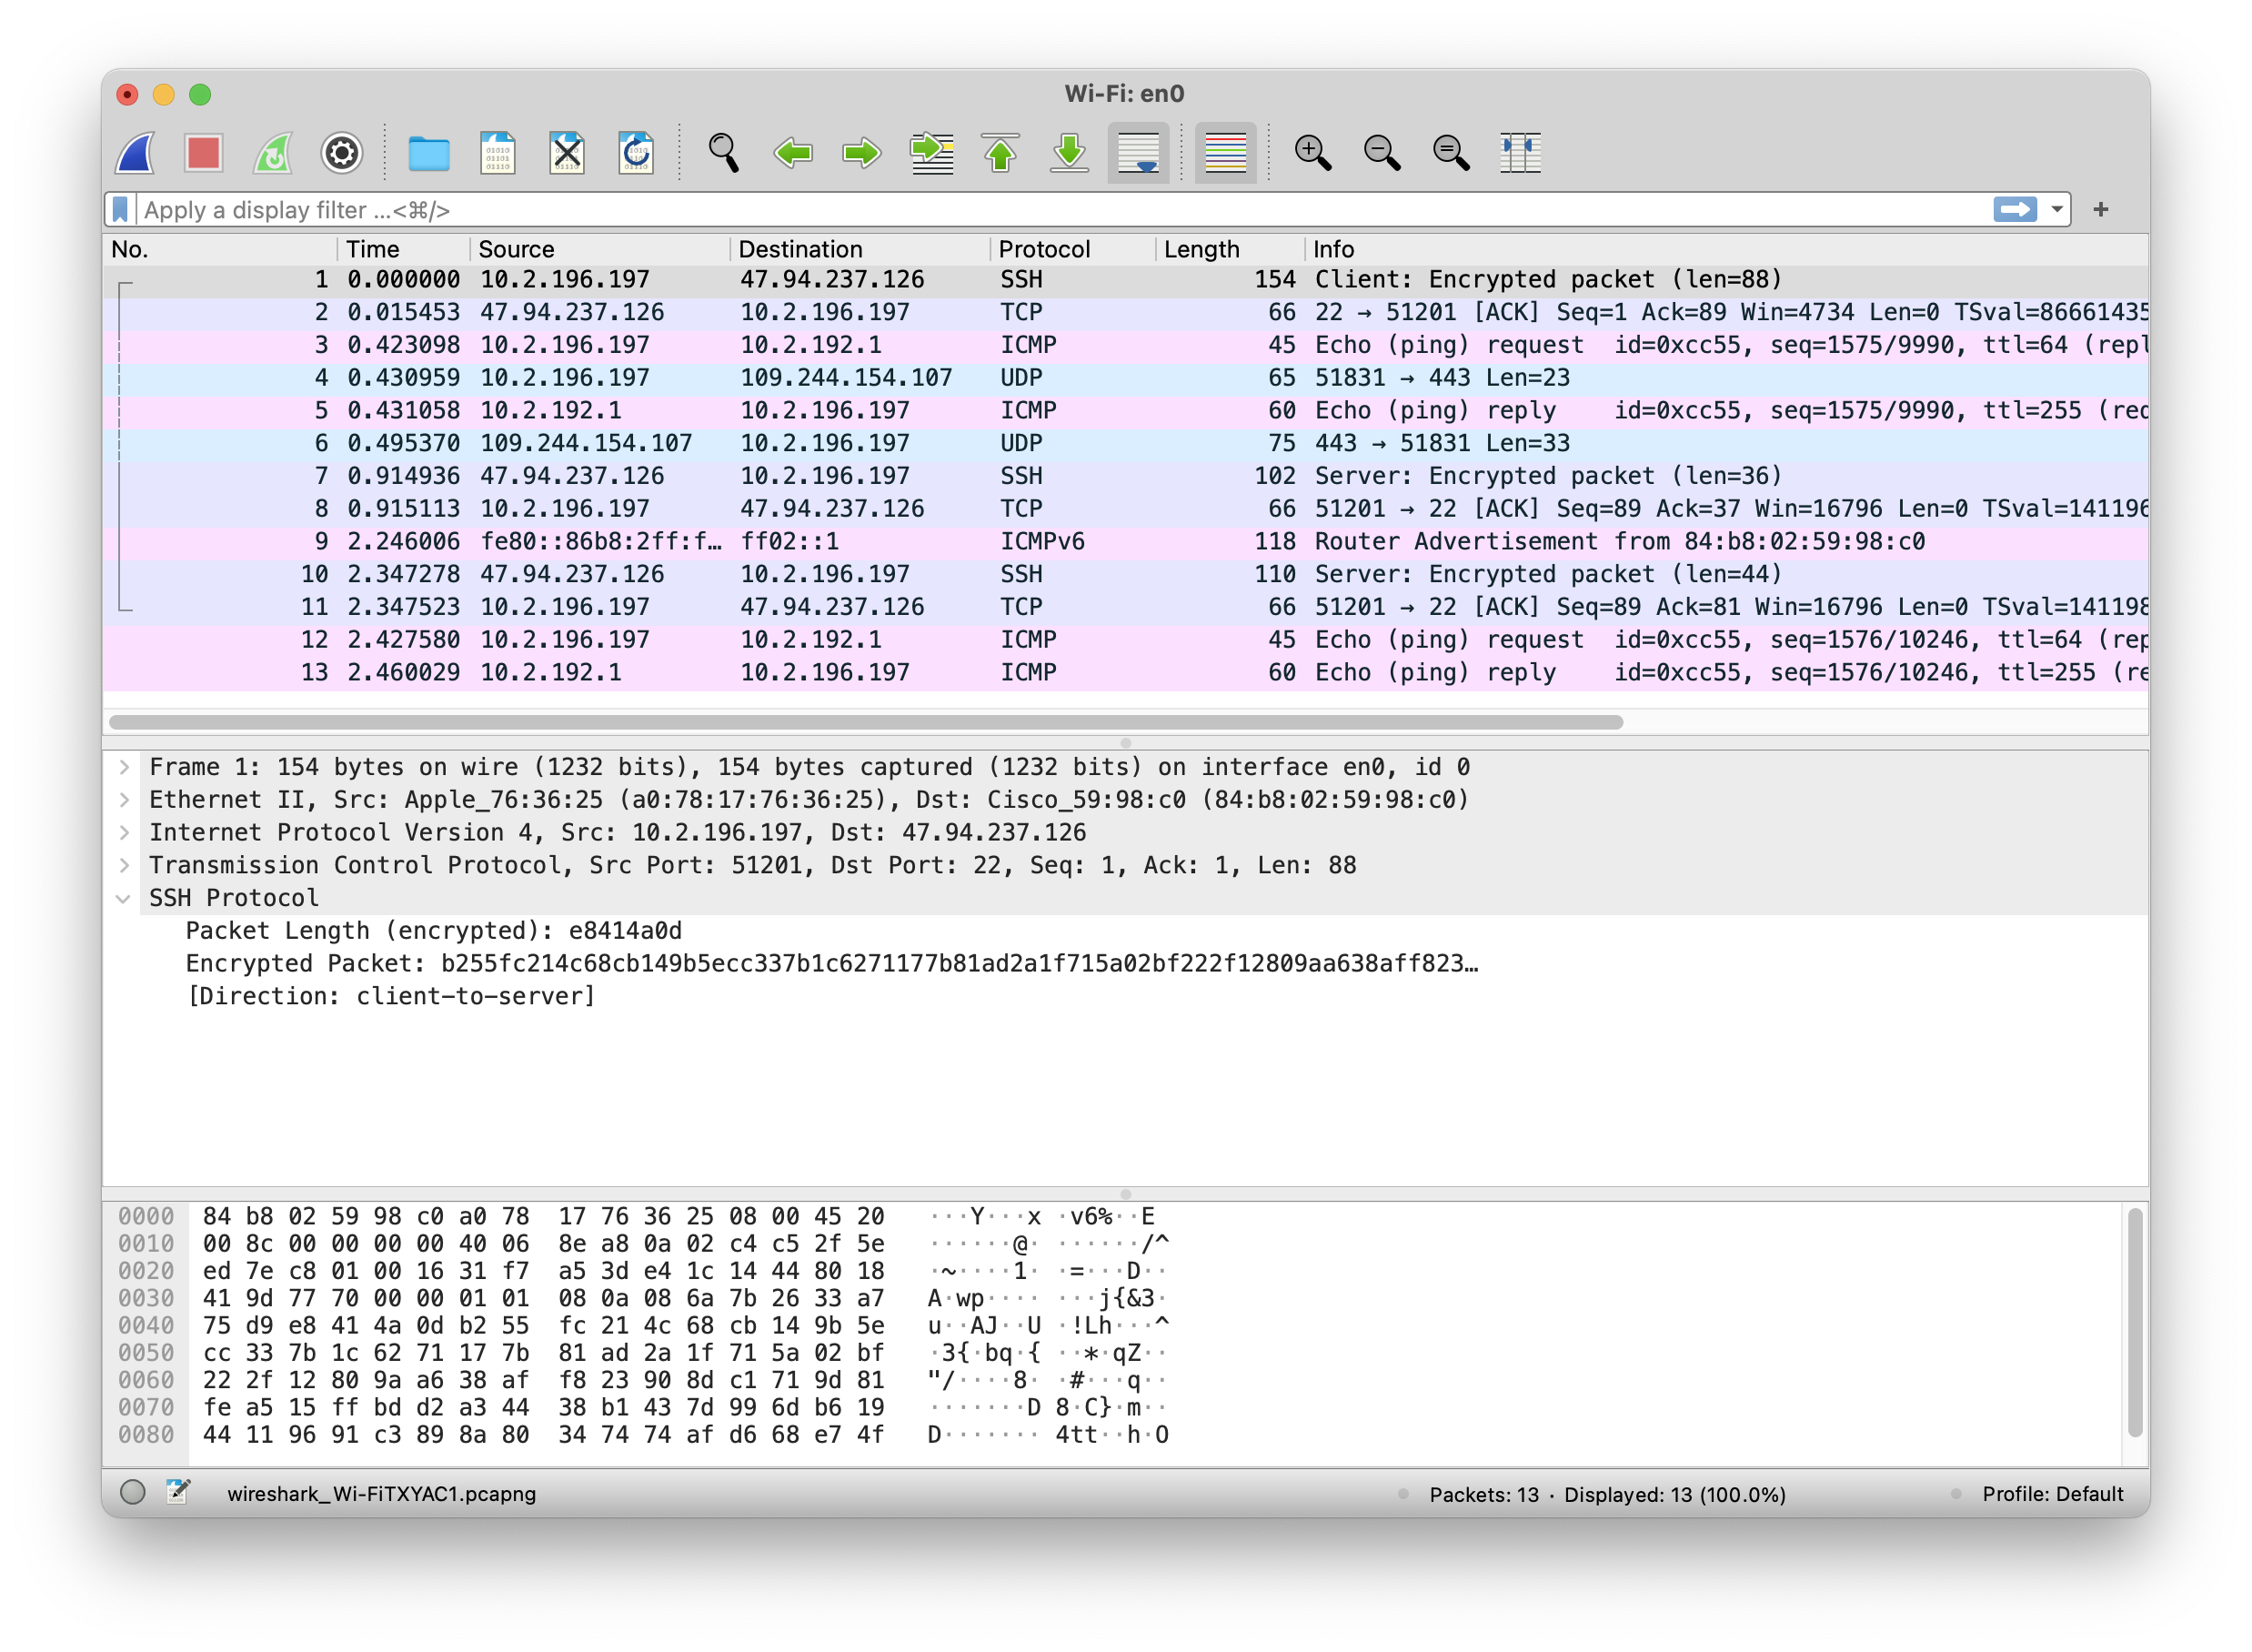
Overview
Capturing Data Packets on Wireshark
Choose interface
Start and stop capturing
Analyzing Data Packets on Wireshark (see the fig here)
Functions of the three panels
Statistics (menu)
File I/O
Save as .pcap files
Read from .pcap files (e.g. CAIDA dataset)

Slide 7
Wireshark filters
Display filter: Detailed search in the captured results
ip.addr == 10.1.1.1
ip.src != 10.1.2.3 or ip.dst != 10.4.5.6
tcp.dstport == 22
udp.port == 8081
Capture filter：Decide what kind of packet to record in the capture result
host 10.4.1.12 or src net 10.6.0.0/16
tcp dst portrange 200-10000 and dst net 10.0.0.0/8
udp port 8081
The filtering syntax supported by the two filters is different
The syntax of capture filter is based on BPF

Slide 8
内容
Wireshark抓包和过滤
BPF简介
libpcap编程
tcpdump使用

Slide 9
BPF简介
The BSD Packet Filter: A New Architecture for User-level Packet Capture “USENIX winter. 1993”
Berkeley Packet Filter : 过滤(filter)网络报文(packet)的架构
核心功能:
过滤(Filter): 根据外界输入的规则过滤报文
复制(Copy): 将符合条件的报文由内核空间复制到用户空间
应用: tcpdump, Wireshark
1997 年首次被引入 Linux ，内核版本 2.1.75

Slide 10
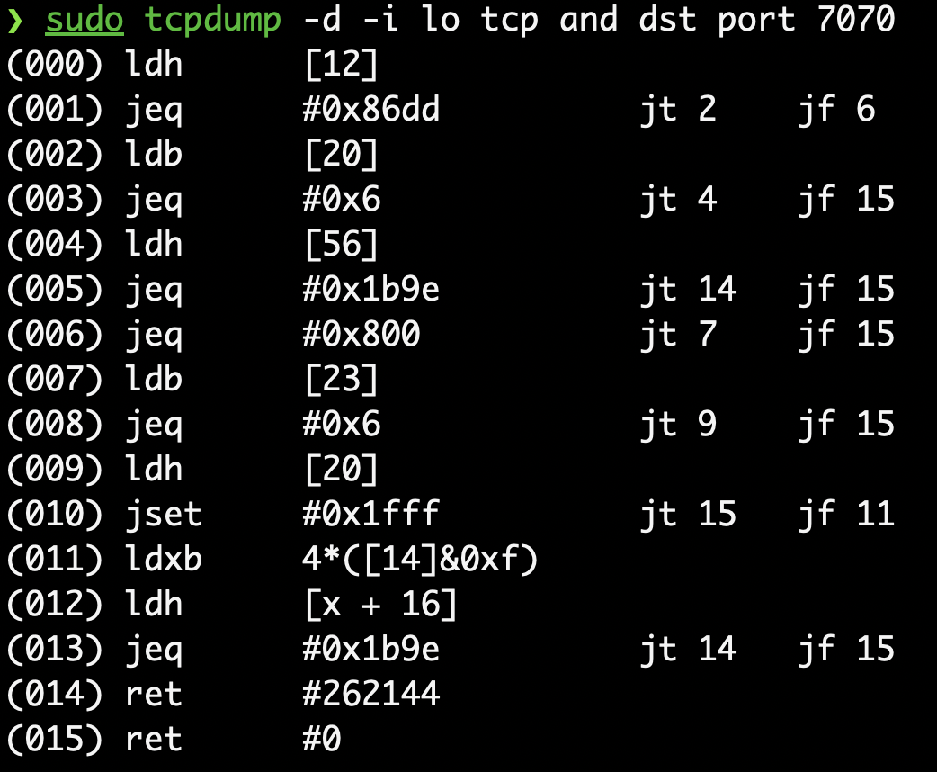
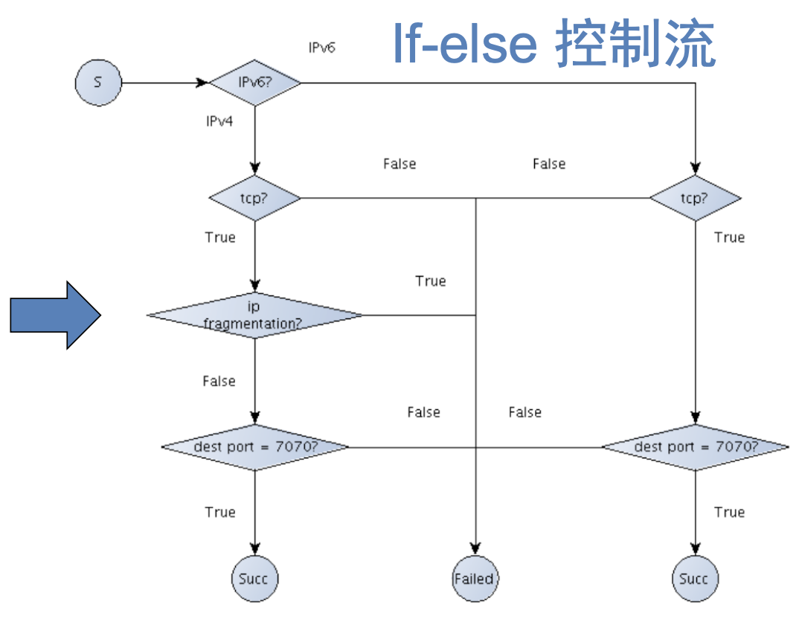
BPF 过滤器实现
BPF的报文过滤基于CFG(Computation Flow Graph)模型
Notes:
可以用wireshark也演示一下

Slide 11
BPF发展史
BPF的报文过滤基于CFG(Computation Flow Graph)模型
虚拟机+指令集(20多条指令+两个4字节的寄存器)
Linux3.0, 引入 JIT 进行加速优化
2014，Linux 3.15开始支持eBPF (extended BPF)，在3.17源码中获得了一个单独的 bpf目录；原先的BPF依然支持，用cBPF指代
现在，Linux内核只运行eBPF，内核会将加载的cBPF字节码透明地转换成eBPF再执行（都什么年代还在用传统BPF）
eBPF全新设计了更丰富的指令集、增加了寄存器，性能大幅提高
The original patch that added support for eBPF in the 3.15 kernel showed that eBPF was up to four times faster on x86-64 than the old classic BPF (cBPF) implementation for some network filter microbenchmarks, and most were 1.5 times faster.
功能全面升级!不再仅仅是进行报文复制和过滤!
It is a way to run mini programs on a variety of kernel and application events.

Slide 12
内容
Wireshark抓包和过滤
BPF简介
libpcap编程
tcpdump使用

Slide 13
Libpcap: 得力抓包助手
PCAP: packet capture, an API for capturing network traffic
Unix-like system: libpcap
Windows: WinPcap, NPcap
Libpcap: a portable C/C++ library for network traffic capture
In simplest scenario, you specify a device to sniff on, set rules of filtration and then wait for the lib to collect the parsed data.
Network analyzers like Wireshark create .pcap files to collect and record packet data from a network.

Slide 14
Libpcap编程：Workflow
Determining which interface we want to sniff on. E.g. eth0 in Linux.
ifconfig will print a list of available interfaces
libpcap can also detect interfaces itself
Initialize pcap. We tell pcap what device to sniff on and how to sniff it. The opening sniffing sessions are abstracted into user-level file handles, so you may eavesdrop on multiple devices at the same time.
Filtration. (Optional) In the event that we only want to sniff specific traffic (e.g. TCP packets / FTP files), we must create a rule set, "compile" it, and apply it.
A three phase process.
BPF program
To be cont. in the next slide

Slide 15
Libpcap编程：Workflow
Sniffing. User can set callback functions, which will be invoked every time a packet satisfying the rules is captured. In this function, virtually everything can be done!
Close the session and release resources.
Let’s walk it through via a concrete example of a RTP (Assignment 2) sniffer.

Slide 16
Libpcap编程：#1 Open the device
pcap_t *: File handler
pcap_t *pcap_open_live(
char *device, int snaplen, int promisc, int to_ms, char *ebuf
);
promiscuous mode: If on, sniffs all traffic on the wire.
Either true or false.
error messages buffer
A common designing trick in libpcap API
The device to sniff
an integer defining the maximum number of bytes to be captured by pcap
read timeout in milliseconds
(a value of 0 sniffs until an error occurs; -1 sniffs indefinitely)

Slide 17
Libpcap编程：#1 Open the device
pcap_t *pcap_open_live(
char *device, int snaplen, int promisc, int to_ms, char *ebuf
);
#include <pcap.h>
#define SNAP_LEN 1518 // maximum bytes per packet to capture
...
pcap_t *handle;
char errbuf[PCAP_ERRBUF_SIZE]; /* error buffer */
char dev[] = ”eth1”;
/* open capture device */
handle = pcap_open_live(dev, SNAP_LEN, 1, 1000, errbuf);
if (handle == NULL) {
fprintf(stderr, “Couldn‘t open device %s: %s\n”, dev, errbuf);
exit(EXIT_FAILURE);
}
...

Slide 18
Libpcap编程：#2 Filtering traffic
Now we have a working sniffing session and we can apply the BPF filter.
Why not boolean formula? Since BPF filter is a lot more efficient and easier to use!
Syntax of BPF filter
Well documented in the man page for tcpdump.
Examples:
host 10.4.1.12 or src net 10.6.0.0/16
tcp dst portrange 200-10000 and dst net 10.0.0.0/8
udp port 8081
To compile the program we call pcap_compile().

Slide 19
Libpcap编程：#2 Filtering traffic
To compile the program we call pcap_compile().
Apply the filter. Enter pcap_setfilter().
int pcap_compile(
pcap_t *p, struct bpf_program *fp, char *str,
int optimize, bpf_u_int32 netmask
);
our session handle
the place we will store the compiled version of our filter
the expression itself
if the expression should be "optimized" or not. 0 for false and 1 for true.
the net mask of the network the filter applies to
int pcap_setfilter(
pcap_t *p, struct bpf_program *fp
);

Slide 20
Libpcap编程：#2 Filtering traffic
...
/* BPF filter expression; Assume RTP receiver listen on port 8081 */
char filter_exp[] = ”udp port 8081“;
struct bpf_program fp; /* compiled filter program (expression) */
/* compile the filter expression */
if (pcap_compile(handle, &fp, filter_exp, 0, PCAP_NETMASK_UNKNOWN)==-1) {
fprintf(stderr, "Couldn't parse filter %s: %s\n", filter_exp,
pcap_geterr(handle));
exit(EXIT_FAILURE);
}
/* apply the compiled filter */
if (pcap_setfilter(handle, &fp) == -1) {
fprintf(stderr, "Couldn't install filter %s: %s\n", filter_exp,
pcap_geterr(handle));
exit(EXIT_FAILURE);
}

Slide 21
Libpcap编程：#3 The actual sniffing
Callback functions: user supplied
The two functions that one can use to define their callback is pcap_loop() and pcap_dispatch()
Both of them call a callback function every time a packet is sniffed that meets our filter requirements
if any filter exists, of course. If not, then all packets that are sniffed are sent to the callback
The difference between the two functions:
pcap_loop(): When the NIC receives no packets, the process is blocked
pcap_dispatch(): When the NIC receives no packets, the function returns, cooperated with the pcap_setnonblock() to set libpcap for non-blocking mode
They can read from a live capture or “savefile”

Slide 22
Libpcap编程：#3 The actual sniffing
int pcap_loop(
pcap_t *p, int cnt, pcap_handler callback, u_char *user
);
our session handle
how many packets it should sniff for before returning (a negative value means it should sniff until an error occurs)
arguments of our own that we wish to send to our callback function, in addition to the arguments that pcap_loop() sends.
void got_packet(
u_char *args, const struct pcap_pkthdr *header, const u_char *packet
);
corresponds to the last argument of pcap_loop(). Whatever value is passed as the last argument to pcap_loop() is passed to the first argument of our callback function every time the function is called.

Slide 23
Libpcap编程：#3 The actual sniffing
void got_packet(
u_char *args, const struct pcap_pkthdr *header, const u_char *packet
);
the pcap header, which contains information about when the packet was sniffed, how large it is, etc.
the entire packet. It is the unmarshalling (or serialization) of the packet.
struct pcap_pkthdr {
struct timeval ts; /* time stamp */
bpf_u_int32 caplen; /* length of portion present */
bpf_u_int32 len; /* length this packet (off wire) */
};

Slide 24
Libpcap编程：Unmarshalling
/* Ethernet header */
struct sniff_ethernet {
u_char ether_dhost[ETHER_ADDR_LEN]; /* Destination host address */
u_char ether_shost[ETHER_ADDR_LEN]; /* Source host address */
u_short ether_type; /* IP? ARP? RARP? etc */
};
/* IP header */
struct sniff_ip {…};
/* UDP header */
struct sniff_udp {…};
/* RTP header */
struct sniff_rtp {…};
const struct sniff_ethernet *ethernet; /* The ethernet header */
const struct sniff_ip *ip; /* The IP header */
const struct sniff_udp *udp; /* The UDP header */
const struct sniff_rtp *rtp; /* The RTP header */
const char *payload; /* Packet payload */

Slide 25
Libpcap编程：Unmarshalling
int size_ethernet = sizeof(struct sniff_ethernet);
int size_ip = sizeof(struct sniff_ip);
int size_udp = sizeof(struct sniff_udp);
int siez_rtp = sizeof(struct sniff_rtp);
ethernet = (struct sniff_ethernet*)(packet);
ip = (struct sniff_ip*)(packet + size_ethernet);
udp = (struct sniff_udp*)(packet + size_ethernet + size_ip);
rtp = (struct sniff_rtp*)(packet + size_ethernet + size_ip + size_udp);
payload = (u_char *)(packet + size_ethernet + size_ip + size_udp + size_rtp);
Head | Head | Head | Head | Data
1. Pay attention to byte order in packet header
2. Pay attention to Ethernet header type
UDP
RTP payload
ethernet
IP
RTP

Slide 26
RTP sniffer example
int main(){
...
/* now set our callback function */
pcap_loop(handle, num_packets,
got_packet, NULL);
/* cleanup */
pcap_freecode(&fp);
pcap_close(handle);
printf("\nCapture complete.\n");
return 0;
}
void got_packet(
u_char *args,
const struct pcap_pkthdr *header,
const u_char *packet
) {
/* packet counter */
static int count = 1;
printf(”\n Packet: %d\n", count++);
/* print src & dst ip */
/* print src & dst port */
/* print RTP type, length & seqnum */
...
}
Notes:
这个地方，需要打开程序，给学生看一下，顺便回答一下 关于网络字节序的问题

Slide 27
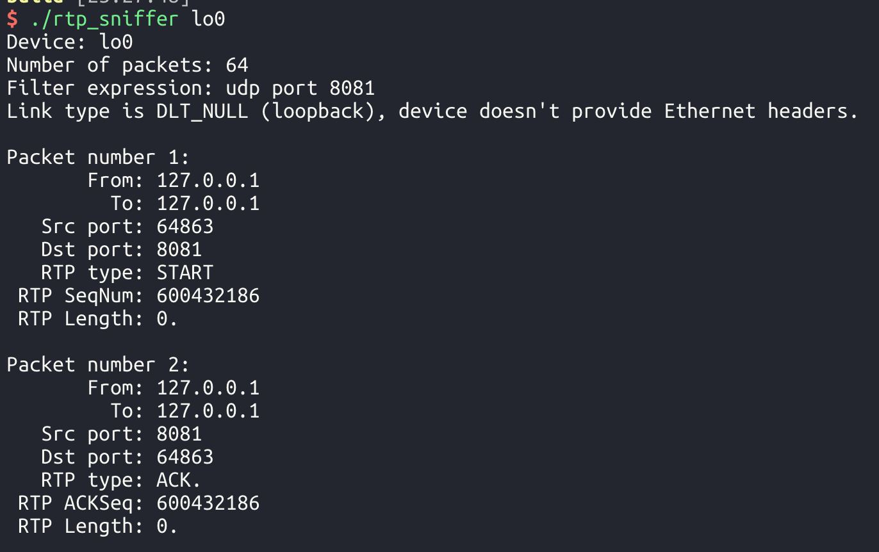
RTP sniffer example
int main(){
...
/* now set our callback function */
pcap_loop(handle, num_packets,
got_packet, NULL);
/* cleanup */
pcap_freecode(&fp);
pcap_close(handle);
printf("\nCapture complete.\n");
return 0;
}
void got_packet(
u_char *args,
const struct pcap_pkthdr *header,
const u_char *packet
) {
/* packet counter */
static int count = 1;
printf(”\n Packet: %d\n", count++);
/* print src & dst ip */
/* print src & dst port */
/* print RTP type, length & seqnum */
...
}

Slide 28
More about libpcap
pcap_t *pcap_open_offline(const char *fname, char *errbuf);
open a pcap_t for a savefile, given a pathname
pcap_dumper_t *pcap_dump_open(pcap_t *p, const char *fname);
Opening a handle for writing captured packets
…
Libpcap tutorial (easy to follow):
https://www.tcpdump.org/pcap.html
Get your hands dirty!

Slide 29
内容
Wireshark抓包和过滤
BPF简介
libpcap编程
tcpdump使用

Slide 30
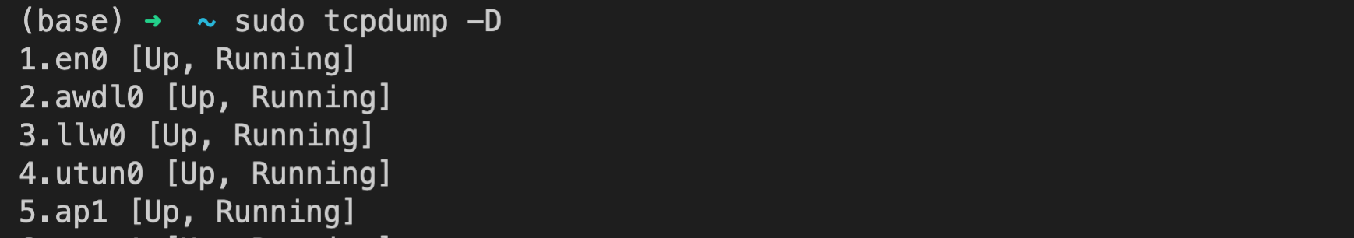
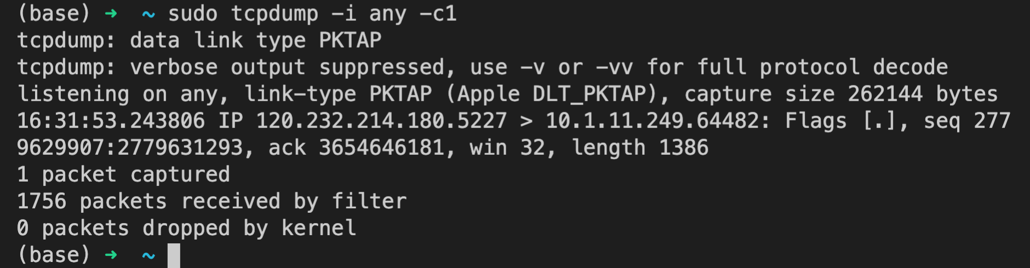
tcpdump： Usage
tcpdump: A cmd line tool built on top of libpcap. It is also a packet analyzer and is used to diagnose and analyze network issues.
To get a list of interfaces, use
To specify an interface, use -i or --interface. If “any” is given, packets from all interfaces will be grabbed. It is running until it gets an interruption from the user (or an error is encountered). To limit the number of packets being sniffed, use -c flag.

Slide 31
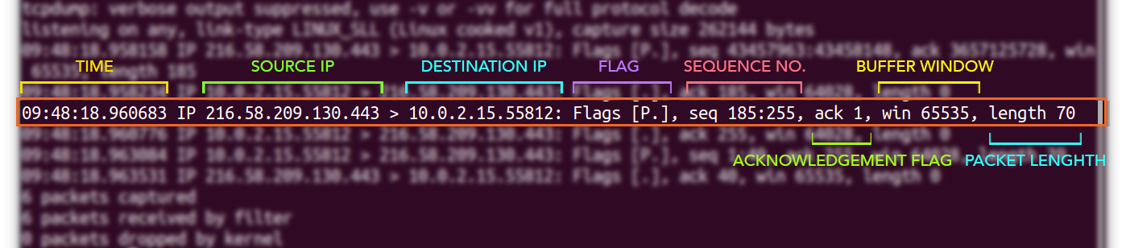
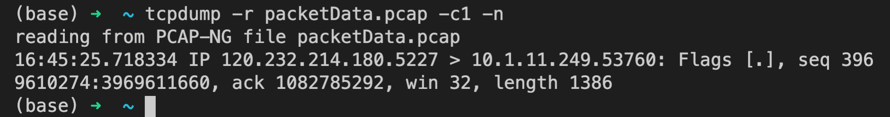
tcpdump：Basic Usage
Understand information about a captured packet:
Store captured data: -w
sudo tcpdump -i any -c5 -w packetData.pcap
Read captured data: -r
tcpdump –r packetData.pcap # append any trailing flags you want

Slide 32
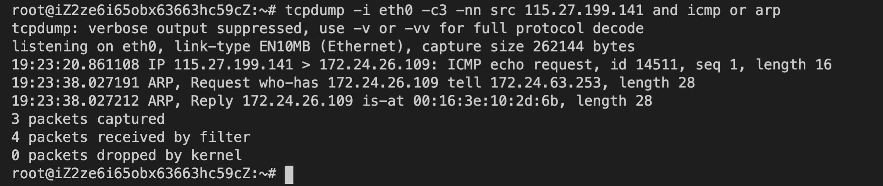
tcpdump：BPF Filter
To get packets from/to a specific host only:
host/src/dst xxx
sudo tcpdump -i eth0 -c4 -nn host 127.0.0.1
A specific port
port xxx
sudo tcpdump –i eth0 –c2 port 80
A specific protocol (directly append its name to the line)
sudo tcpdump -i any -c5 udp
Multiple rules: concatenate them with and/or

