Slide 1
Recitation2
李磊
2023/09/20

Slide 2
Announcements
目前为止, class machine已经可以用了, 但是autolab还不能用, 第一个lab也没有发布, 请大家再耐心等一等
本周开始, 小班人员确定, 请大家之后尽量不要再调整座位了, 方便大家互相认识
请当天回课的同学在回课完成之后把ppt整理一下发到群里供大家复习使用, 谢谢各位同学的付出

Slide 3
Schedule
赵陆森同学, 姚一伦同学做回课
助教讲述关于autolab, class machine等内容
助教回顾课程重点内容, 讲述相关往年题
Bit representation相关有趣问题(如果有时间)

Slide 4
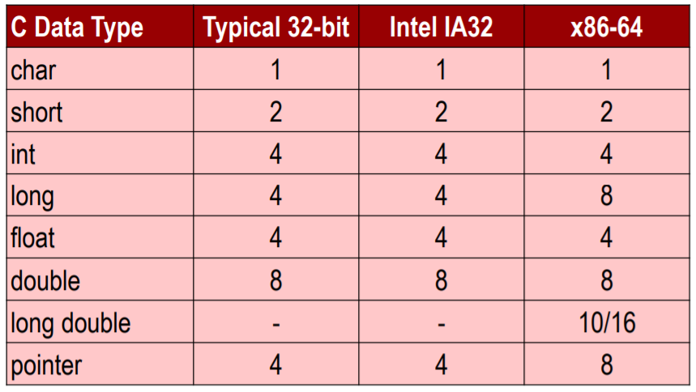
Memorize the number of bytes for types such as char, short, int, long long, float, double, pointer.
The most significant difference between 32-bit and 64-bit machines lies in the size of pointers.
The C/C++ standards do not guarantee that 'char' is signed, and they also do not guarantee that 'long' is always 4 bytes or 8 bytes.

Slide 5
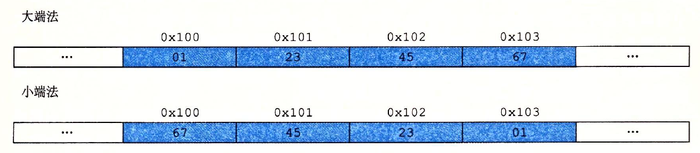
Little Endian & Big Endian
默认小端法, 低位低地址, 高位高地址
看见往地址里填数字的问题要条件反射地考虑大小端
Typical big-endian architectures include Sun, the Internet, most IBM systems, and many Oracle platforms.
Typical little-endian architectures include (Intel) x86, ARM processors running Android, iOS, and Windows.

Slide 6
Examples
已知在x86-64架构下,0x100到0x103的字节存储如下图所示.假设指针p一开始指向地址0x100处,类型为“short *”.则当执行“p++;”的指令后,p所指向的短整型(short)的值变为 ( )
A.0x2021 B.0x2120 C.0x2111 D.0x1121
p
存储
…
0x20
0x21
0x11
0x08
…
地址
高地址
0x103
0x102
0x101
0x100
低地址

Slide 7
Examples
已知在x86-64架构下,0x100到0x103的字节存储如下图所示.假设指针p一开始指向地址0x100处,类型为“short *”.则当执行“p++;”的指令后,p所指向的短整型(short)的值变为 ( A )
A.0x2021 B.0x2120 C.0x2111 D.0x1121
p
存储
…
0x20
0x21
0x11
0x08
…
地址
高地址
0x103
0x102
0x101
0x100
低地址

Slide 8
Examples
( ) 在采用小端法存储机器上运行下面的代码,输出的结果将会是____.(如无特别说明，int,unsigned为32位长,short为16位长,0~9的ASCII码分别是0x30~0x39,之后题目同)
A.0x00002303 B.0x00032303
C.0xffff8313 D.0x00008313
char*s="2018";int* p1=(int*)s;
short s1=(*p1)>>12;
unsigned u1=(unsigned)s1;
printf("0x%x\n",u1);

Slide 9
Examples
(C) 在采用小端法存储机器上运行下面的代码,输出的结果将会是____.(如无特别说明，int,unsigned为32位长,short为16位长,0~9的ASCII码分别是0x30~0x39,之后题目同)
A.0x00002303 B.0x00032303
C.0xffff8313 D.0x00008313
char*s="2018";int* p1=(int*)s;
short s1=(*p1)>>12;
unsigned u1=(unsigned)s1;
printf("0x%x\n",u1);

Slide 10
Bitwise operations
"&”,"|" "~" "^," bitwise operations have lower precedence than addition and subtraction.
For logical operators "&&" and "||," if the result of the first operand determines the outcome, the second operand may not be evaluated.
Please note the difference between arithmetic right shift and logical right shift.
int *p = NULL;
If (p == NULL||*p) {;} //OK

Slide 11
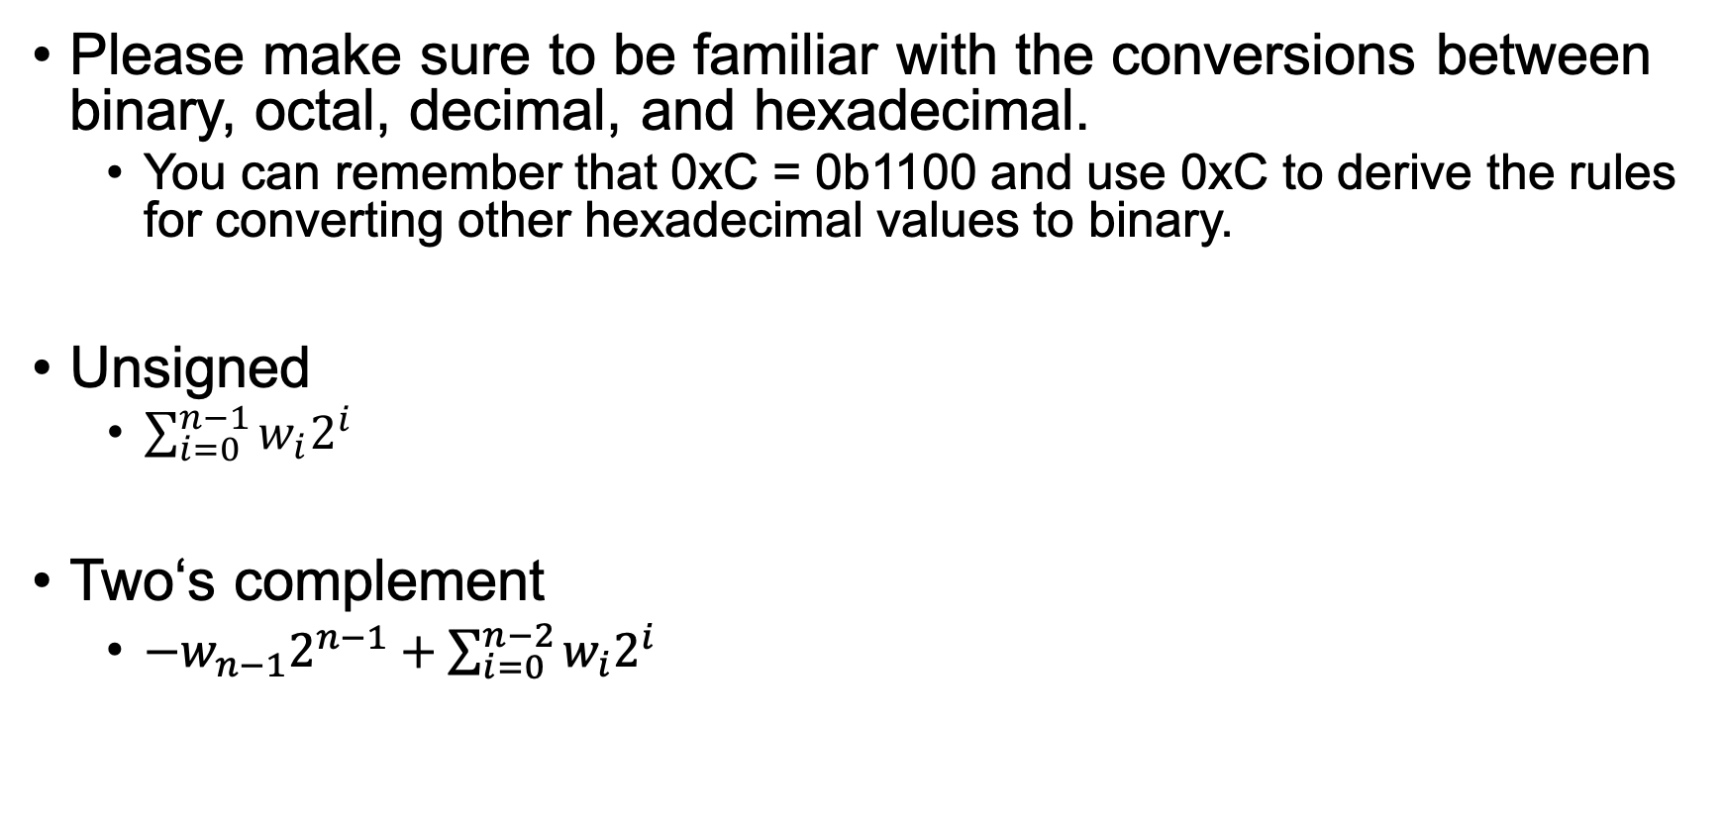
Number representation
Please make sure to be familiar with the conversions between binary, octal, decimal, and hexadecimal.
You can remember that 0xC = 0b1100 and use 0xC to derive the rules for converting other hexadecimal values to binary.
Unsigned
$\sum_{i=0}^{n−1}{w_{i}2^{i}}$
Two‘s complement
${−w}_{n−1}2^{n−1}+\sum_{i=0}^{n−2}{w_{i}2^{i}}$

Slide 12
Examples
考虑下面代码所示的变量,使用">","<","==","!="之一填空,能够填写">"或"<"的请不要填写.
int x, y;
unsigned ux = x;
A.如果x>y,则ux y.
B.如果((x<<31)>>31)<0,则x&1 0.
C.(!!x)-sizeof(short) 0. (考试时默认short为2Bytes).
D.xˆyˆ(˜x)–y yˆxˆ(˜y)–x.
int x,y;
unsigned ux=x;
double d;
int x,y;
unsigned ux=x;
double d;

Slide 13
Examples
考虑下面代码所示的变量,使用">","<","==","!="之一填空,能够填写">"或"<"的请不要填写.
int x, y;
unsigned ux = x;
A.如果x>y,则ux != y.
B.如果((x<<31)>>31)<0,则x&1 0.
C.(!!x)-sizeof(short) 0. (考试时默认short为2Bytes).
D.xˆyˆ(˜x)–y yˆxˆ(˜y)–x.
int x,y;
unsigned ux=x;
double d;
int x,y;
unsigned ux=x;
double d;

Slide 14
Examples
考虑下面代码所示的变量,使用">","<","==","!="之一填空,能够填写">"或"<"的请不要填写.
int x, y;
unsigned ux = x;
A.如果x>y,则ux != y.
B.如果((x<<31)>>31)<0,则x&1 > 0.
C.(!!x)-sizeof(short) 0. (考试时默认short为2Bytes).
D.xˆyˆ(˜x)–y yˆxˆ(˜y)–x.
int x,y;
unsigned ux=x;
double d;
int x,y;
unsigned ux=x;
double d;

Slide 15
Examples
考虑下面代码所示的变量,使用">","<","==","!="之一填空,能够填写">"或"<"的请不要填写.
int x, y;
unsigned ux = x;
A.如果x>y,则ux != y.
B.如果((x<<31)>>31)<0,则x&1 > 0.
C.(!!x)-sizeof(short) > 0. (考试时默认short为2Bytes).
D.xˆyˆ(˜x)–y yˆxˆ(˜y)–x.
int x,y;
unsigned ux=x;
double d;
int x,y;
unsigned ux=x;
double d;

Slide 16
Examples
考虑下面代码所示的变量,使用">","<","==","!="之一填空,能够填写">"或"<"的请不要填写.
int x, y;
unsigned ux = x;
A.如果x>y,则ux != y.
B.如果((x<<31)>>31)<0,则x&1 > 0.
C.(!!x)-sizeof(short) > 0. (考试时默认short为2Bytes).
D.xˆyˆ(˜x)–y == yˆxˆ(˜y)–x.
int x,y;
unsigned ux=x;
double d;
int x,y;
unsigned ux=x;
double d;

Slide 17
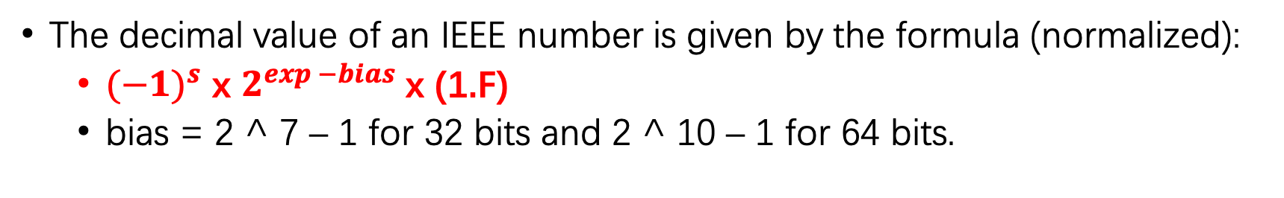
Floating point representation
s | exp | frac
32bits
1 sign bit + 8 exp bits + 23 frac bits
64bits
1 sign bit + 11 exp bits + 52 frac bits
The decimal value of an IEEE number is given by the formula (normalized):
${(−1)}^{s}$ x $2^{exp −bias}$ x (1.F)
bias = 2 ^ 7 – 1 for 32 bits and 2 ^ 10 – 1 for 64 bits.

Slide 18
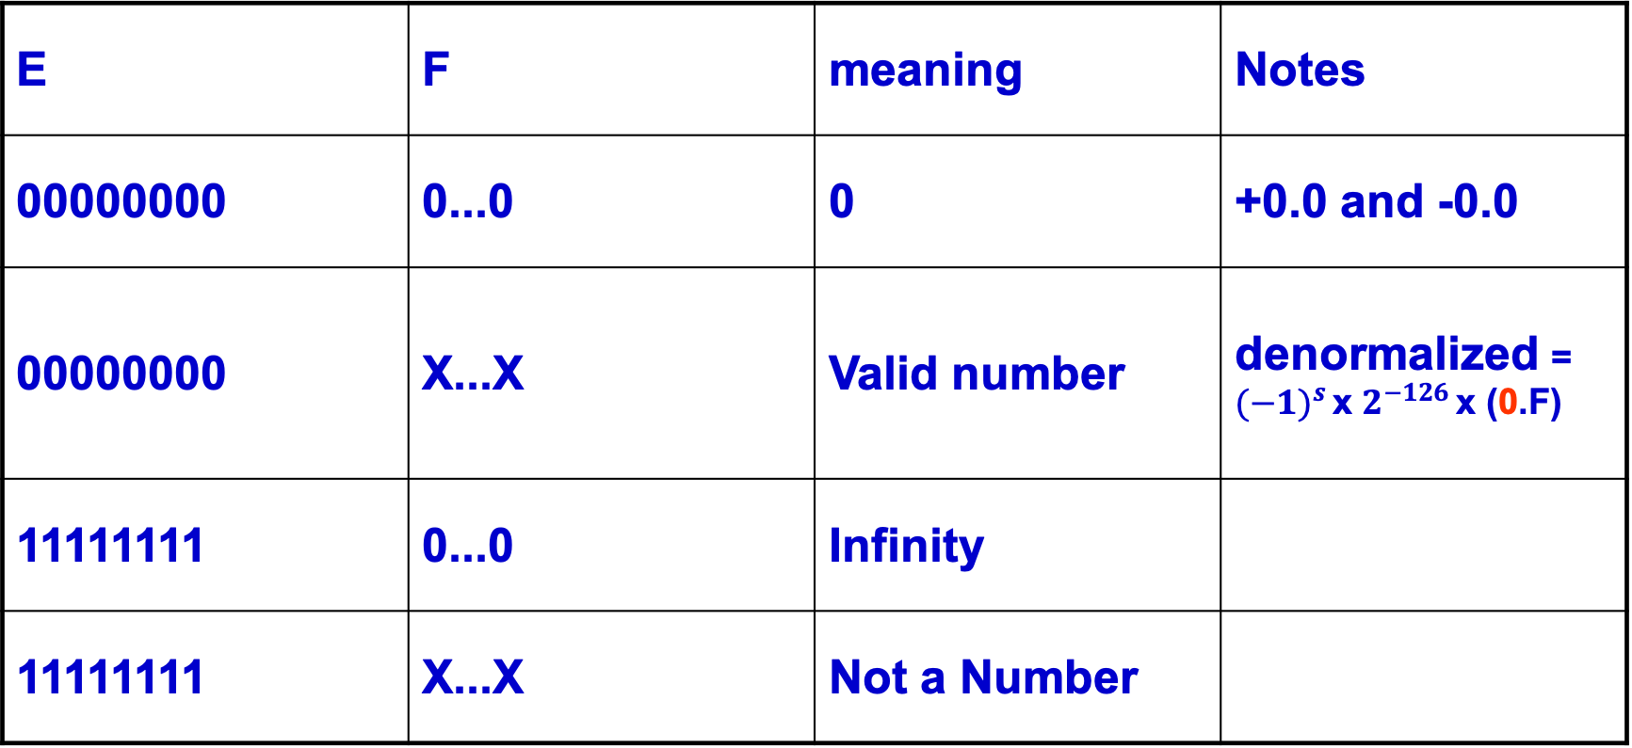
Special Values (single-precision)
E | F | meaning | Notes
00000000 | 0...0 | 0 | +0.0 and -0.0
00000000 | X...X | Valid number | denormalized = ${(−1)}^{s}$ x $2^{−126}$ x (0.F)
11111111 | 0...0 | Infinity
11111111 | X...X | Not a Number

Slide 19
Floating point representation
Floating point is not add associative, why?
FP result approximates real result!
When you add a small number on to a big number, the floating point representation may not change!
Why is the denormalized representation using E = 1 - bias instead of E = -bias?
To represent numbers close to zero.

Slide 20
Examples
下面关于IEEE浮点数标准说法正确的是( ).
考虑一种12-bit长的浮点数(符号位(s)：1-bit;阶码字段(exp)：4-bit;小数字段(frac)：7-bit),此浮点数遵循IEEE浮点数格式,则[1,2)区间中包含( )个用上面规则精确表示的浮点数.
A.在位数一定的情况下,不论怎么分配阶码位和小数部分,所能表示的数的个数不变
B.如果甲类浮点数有10位,乙类浮点数有11位,那么甲所能表示的最大数一定比乙小
C.如果甲类浮点数有10位,乙类浮点数有11位,那么甲所能表示的最小正数一定比乙小
D."0111000"可能是7位浮点数的NAN表示

Slide 21
Examples
下面关于IEEE浮点数标准说法正确的是(D).
考虑一种12-bit长的浮点数(符号位(s)：1-bit;阶码字段(exp)：4-bit;小数字段(frac)：7-bit),此浮点数遵循IEEE浮点数格式,则[1,2)区间中包含( )个用上面规则精确表示的浮点数.
A.在位数一定的情况下,不论怎么分配阶码位和小数部分,所能表示的数的个数不变
B.如果甲类浮点数有10位,乙类浮点数有11位,那么甲所能表示的最大数一定比乙小
C.如果甲类浮点数有10位,乙类浮点数有11位,那么甲所能表示的最小正数一定比乙小
D."0111000"可能是7位浮点数的NAN表示

Slide 22
Examples
下面关于IEEE浮点数标准说法正确的是(D).
考虑一种12-bit长的浮点数(符号位(s)：1-bit;阶码字段(exp)：4-bit;小数字段(frac)：7-bit),此浮点数遵循IEEE浮点数格式,则[1,2)区间中包含( 128 )个用上面规则精确表示的浮点数.
A.在位数一定的情况下,不论怎么分配阶码位和小数部分,所能表示的数的个数不变
B.如果甲类浮点数有10位,乙类浮点数有11位,那么甲所能表示的最大数一定比乙小
C.如果甲类浮点数有10位,乙类浮点数有11位,那么甲所能表示的最小正数一定比乙小
D."0111000"可能是7位浮点数的NAN表示

Slide 23
Several modes of rounding
Round towards + ∞
Round towards - ∞
Truncate (drop the last bits)
Unbiased (default mode). Midway? Round to even.
Round to nearest floating point except if the value is right on the borderline, in which case we round to the nearest EVEN number (zero in this case)
This way, half the time we round up on tie, the other half time we round down. Tends to balance out inaccuracies

Slide 24
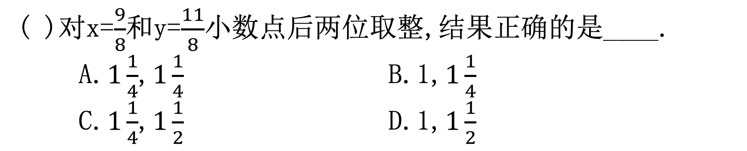
Rounding example
( )对x=$\frac{9}{8}$和y=$\frac{11}{8}$小数点后两位取整,结果正确的是____.
A.$1\frac{1}{4}$,$1\frac{1}{4}$ B.1,$1\frac{1}{4}$
C.$1\frac{1}{4}$,$1\frac{1}{2}$ D.1,$1\frac{1}{2}$

Slide 25
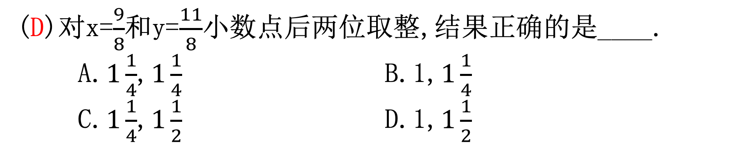
Rounding example
(D)对x=$\frac{9}{8}$和y=$\frac{11}{8}$小数点后两位取整,结果正确的是____.
A.$1\frac{1}{4}$,$1\frac{1}{4}$ B.1,$1\frac{1}{4}$
C.$1\frac{1}{4}$,$1\frac{1}{2}$ D.1,$1\frac{1}{2}$

Slide 26
Precision and accuracy (精度, 精确)
Precision is a count of the number bits in used to represent a value.
Accuracy is the difference between the actual value of a # and its computer representation.

Slide 27
Tricky questions
4. 关于浮点数，以下说法正确的是:
A. 给定任意浮点数a，b和x，如果a>b成立（求值为1），则一定a+x>b+x成立
B. 不考虑结果为NaN、Inf或运算过程发生溢出的情况，高精度浮点数一定得到比低精度浮点数更精确或相同的结果
C. 不考虑输入为NaN、Inf的情况，高精度浮点数一定得到比低精度浮点数更精确或相同的结果
D. 给定任意浮点数a, b和x，如果a>b不成立（求值为0），则一定a+x>b+x不成立。
答案：d。如果不出现NaN和Inf，浮点数是满足单调性的，这时a和d都成立。如果出现NaN和Inf，那么任何时候比较运算的操作数有NaN和Inf就为0，就只有d成立。关于b和c，由于运算的偶然性，高精度不一定比低精度精确。
Try this: printf(“%d %d\n”, (float)0.1 + (float)0.2 == (float)0.3,
(double)0.1 + (double)0.2 == (double)0.3);

Slide 28
discussion
uint32_t i;
if (i == (int)((float) i)) {
printf(“true”);
}
Will not always print “true”!
Most large values of integers don’t have exact floating point representations!
What is the smallest value of i for which printf cannot print “true”?
16777217 (= 2 ^ 24 + 1)
What about double?

Slide 29
discussion
float f;
if (f == (float)((int)f)){
printf(“true”);
}
Will not always print “true”!
Small floating point numbers (<1) don’t have integer representations!
For other numbers, rounding errors!

Slide 30
discussion
有符号数和无符号数的比较, 转换规则?
如何判断有符号数加法溢出？
浮点数的加法与乘法如何实现?
函数show_bytes里面的char必须是unsigned char, 不能是char, 为什么?

Slide 31
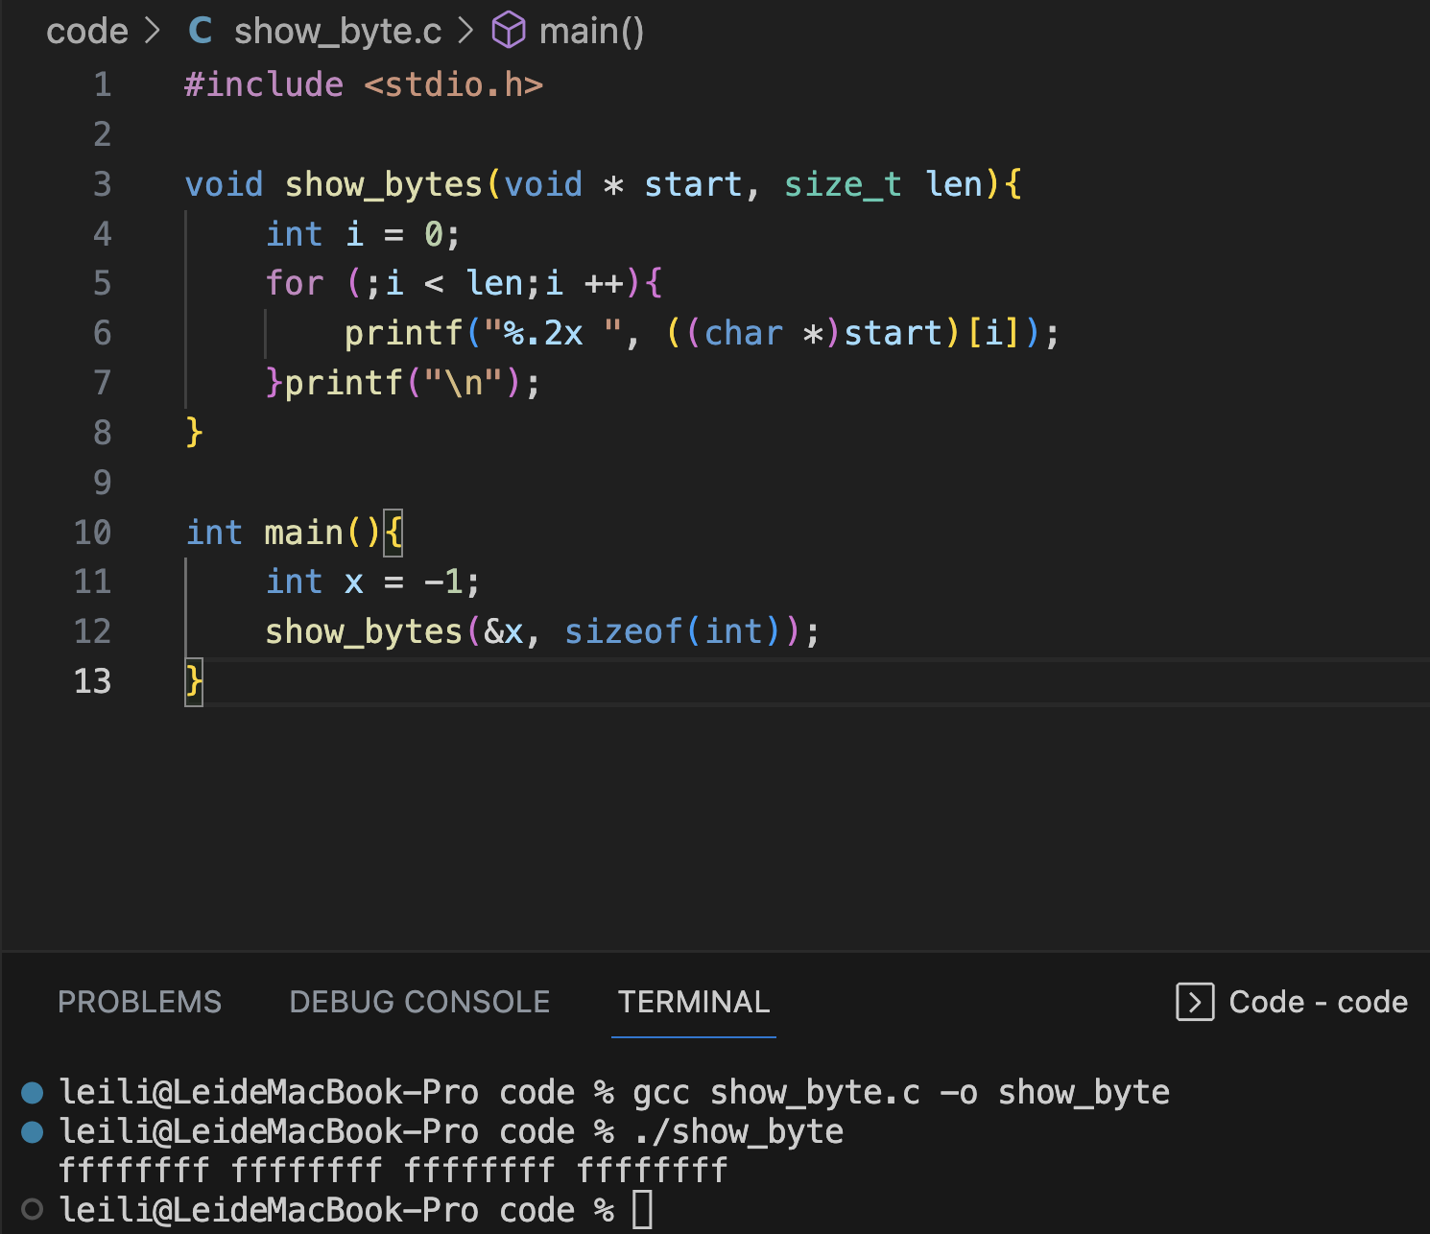

Slide 32
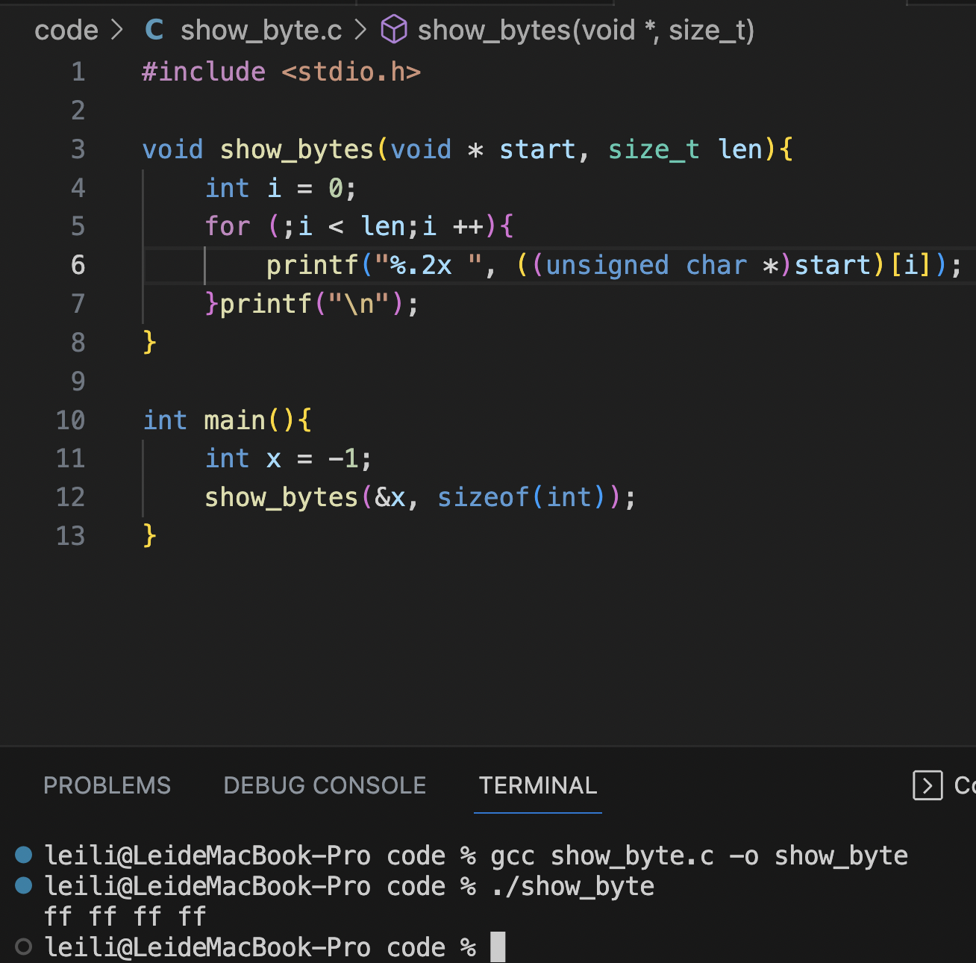

Slide 33
About datalab
Datalab is all about manipulating bits.
You may only use the following operators. (! ˜ & ˆ | + << >> ) (in the interger part.)
You may not use if, for loop, while loop. (In the integer part.)
In floating-point part, feel free to use standard control structures, but there are also some limits. Read the handout carefully.

Slide 34
Count the number of 1s in a number (1)
int bitcount(unsigned int n)
{
int count=0;
while(n != 0)
{
count += n&1;
n >>= 1;
}
return count;
}
Can you think of a solution that doesn’t use a for or a while?

Slide 35
Count the number of 1s in a number (2)(*)
int bitcount(unsigned int n)
{
n = (n & 0x55555555) + ((n >> 1) & 0x55555555);
n = (n & 0x33333333) + ((n >> 2) & 0x33333333);
n = (n & 0x0f0f0f0f) + ((n >> 4) & 0x0f0f0f0f);
n = (n & 0x00ff00ff) + ((n >> 8) & 0x00ff00ff);
n = (n & 0x0000ffff) + ((n >> 16) & 0x0000ffff);
return (n & 0x0000003f);
}
Is there a better (or, more efficient) solution?

Slide 36
Count the number of 1s in a number (3)(*)
int bitcount(unsigned int n)
{
unsigned int tmp;
tmp = n - ((n >> 1) & 033333333333)
- ((n >> 2) & 011111111111);
return ((tmp + (tmp >> 3)) &
030707070707)%63;
}
In the C programming language, numbers that start with 0 are typically in octal notation.
看一眼就行, 反正也看不明白

Slide 37
Other Floating-points representation(*)
Quad-Precision? “binary128”
1 + 15 + 112
Oct-Precision? “binary256”
1 + 19 + 236
Half-Precision? “binary16” or “fp16”
1 + 5 + 10
Half-Precision? “bfloat16”
1 + 8 + 7
Competing with fp16
Same range as fp32!
Used for faster ML
en.wikipedia.org/wiki/Floating_point

Slide 38
Other Floating-points representation(*)
Everything so far has had a fixed set of bits for Exponent and Significant
What if they were variable?
You can choose between range and precision.
Add a “u-bit” to tell whether number is exact or range
https://en.wikipedia.org/wiki/Unum_(number_format)

Slide 39
Thanks for listening!

